Slide 1
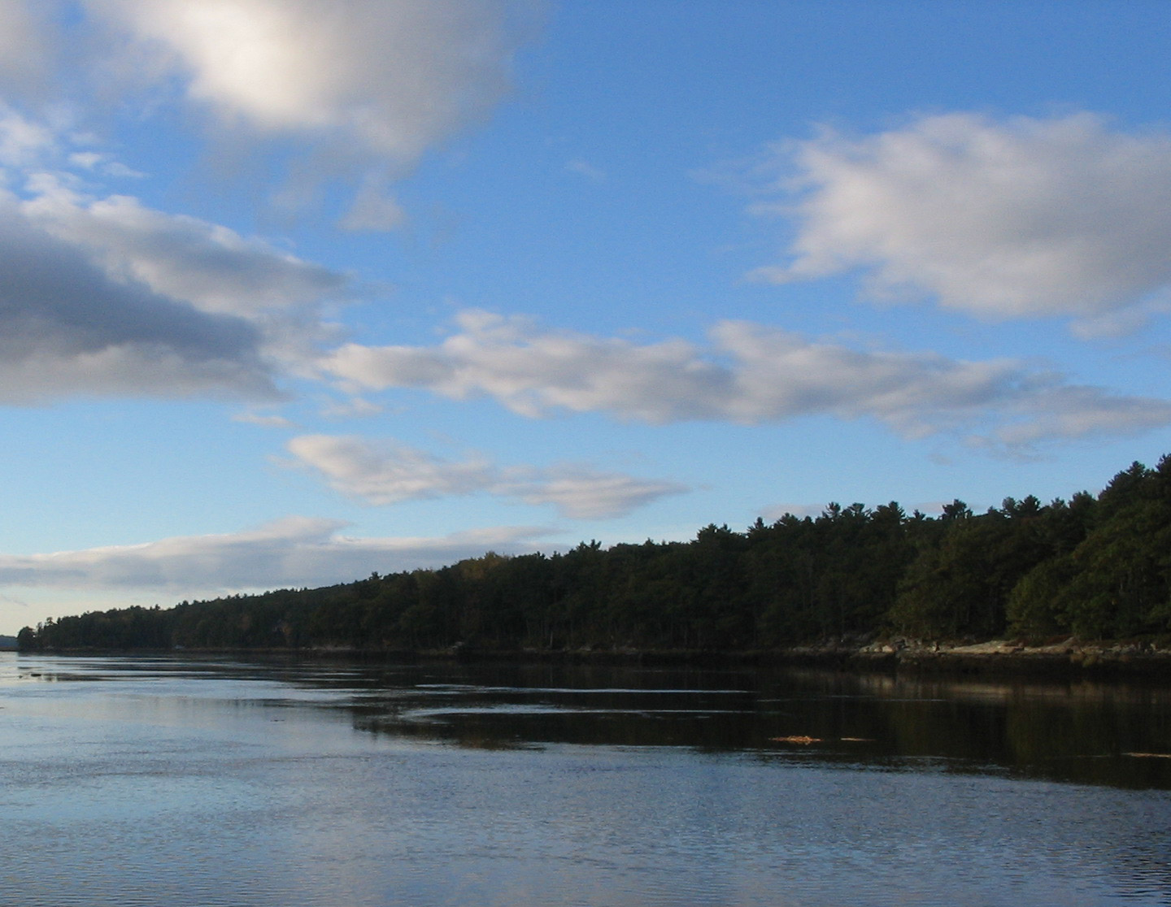


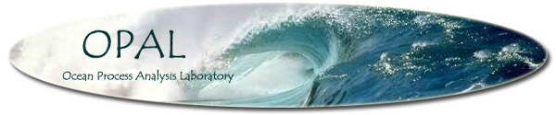
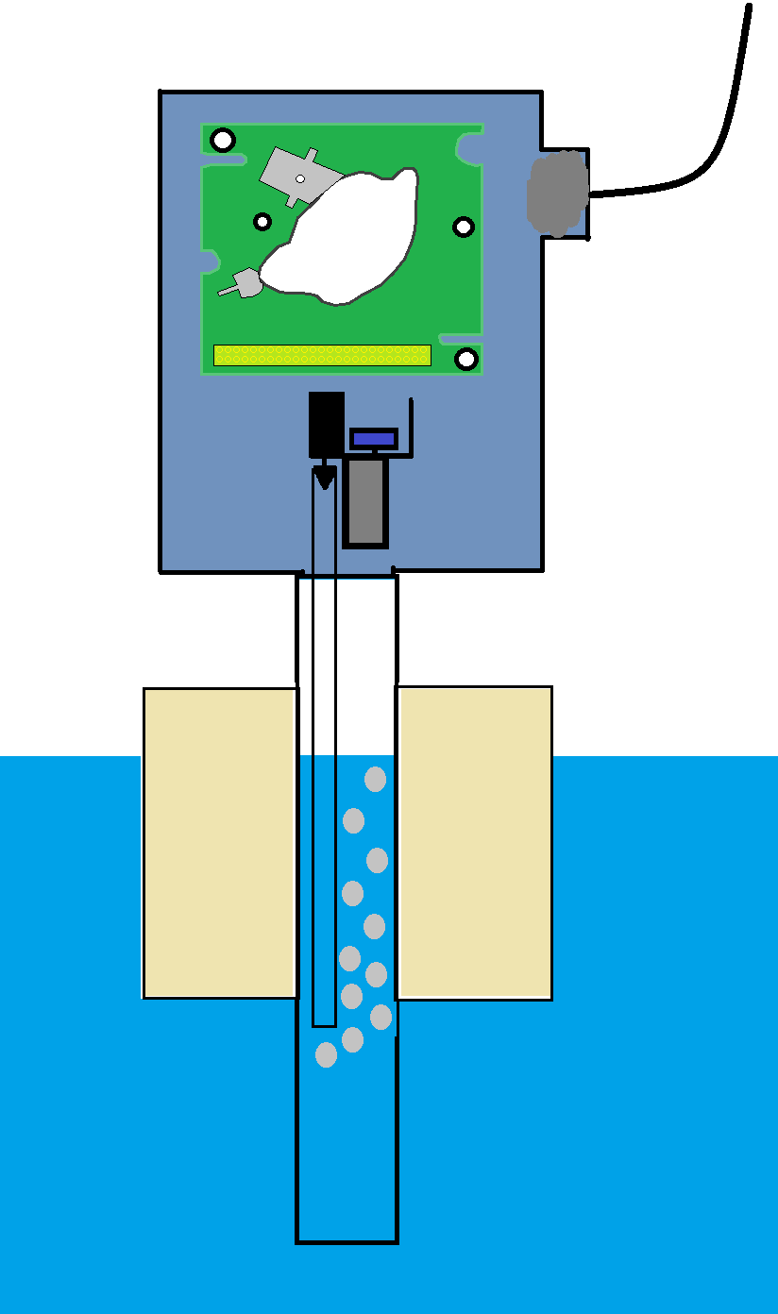
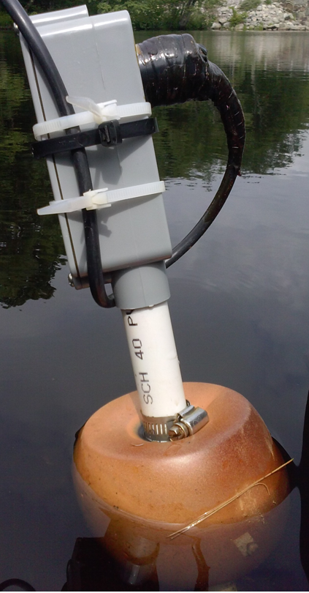
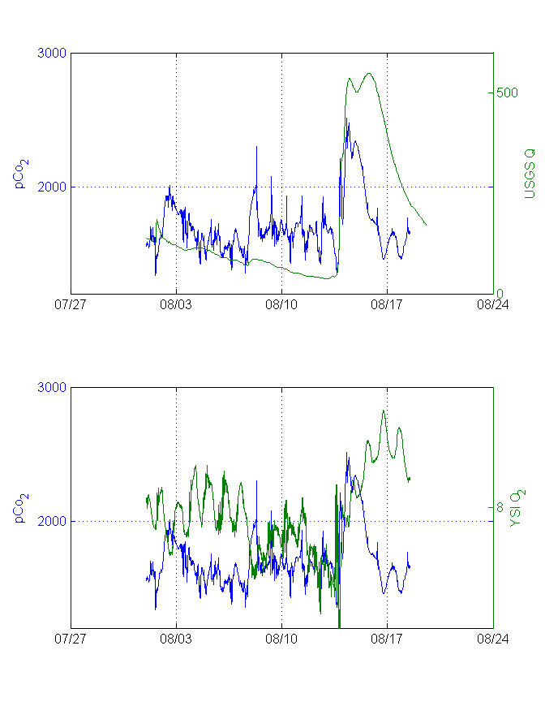
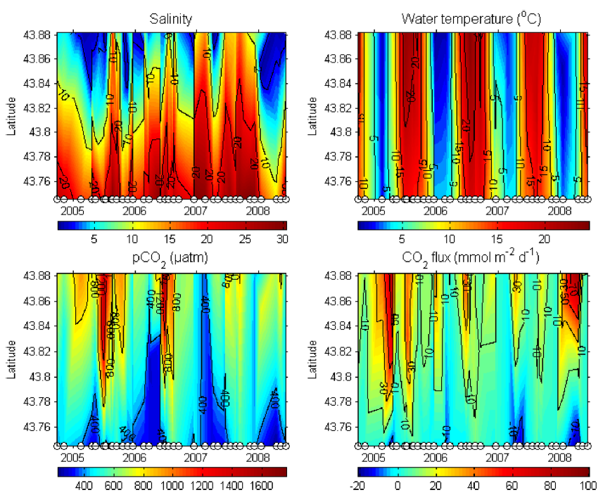
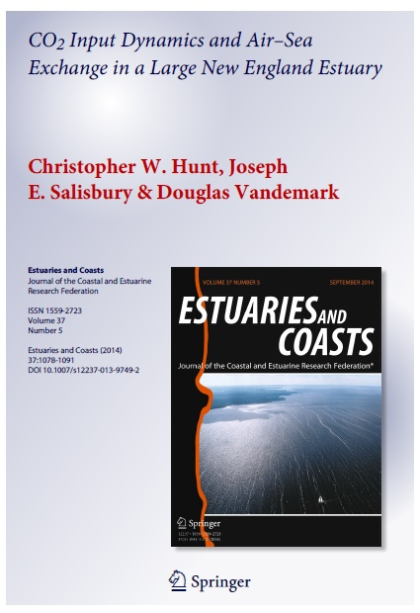
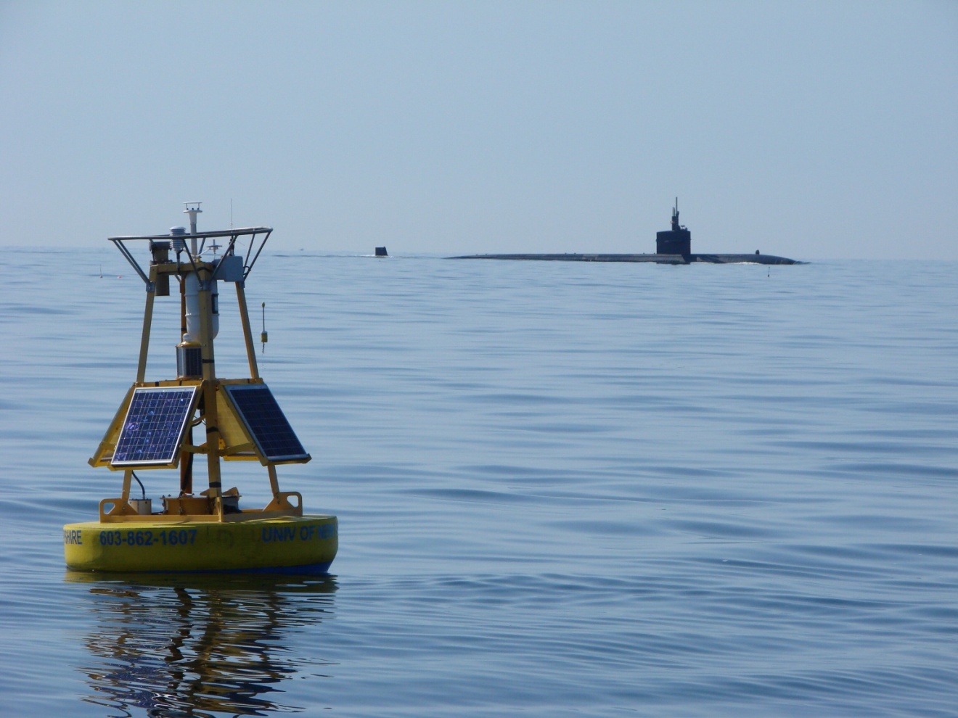
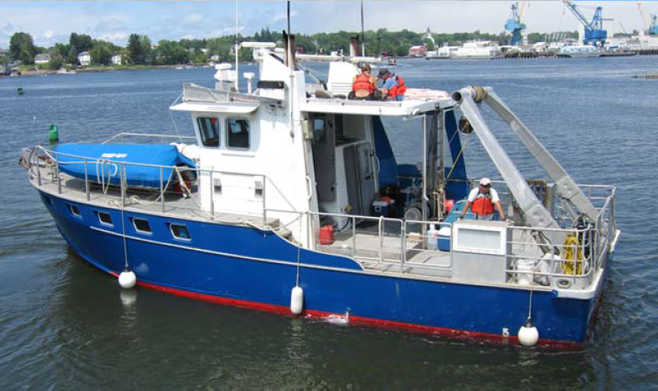
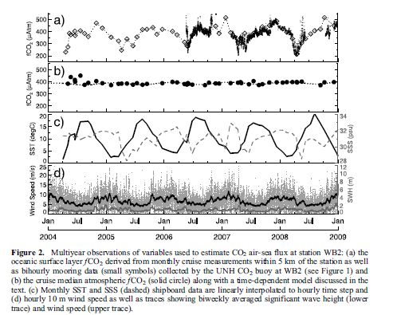
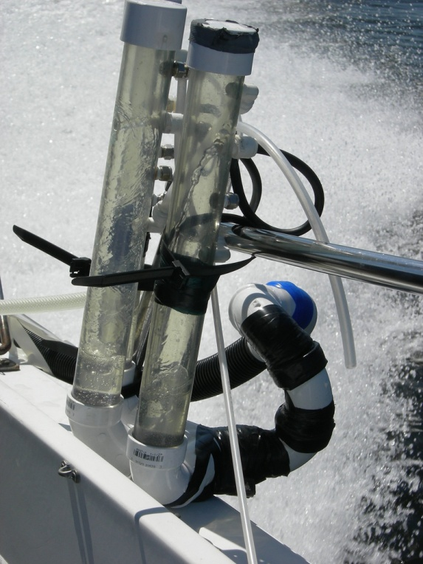
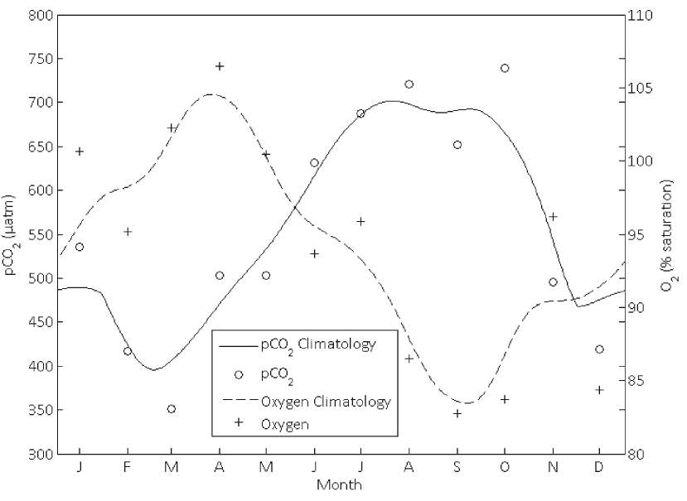
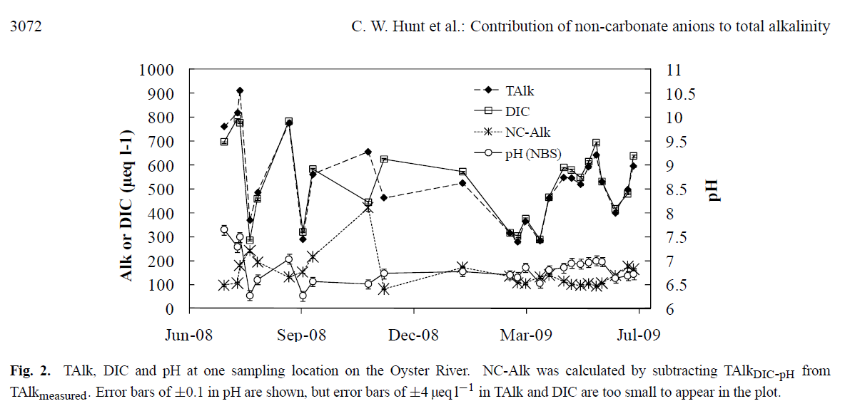
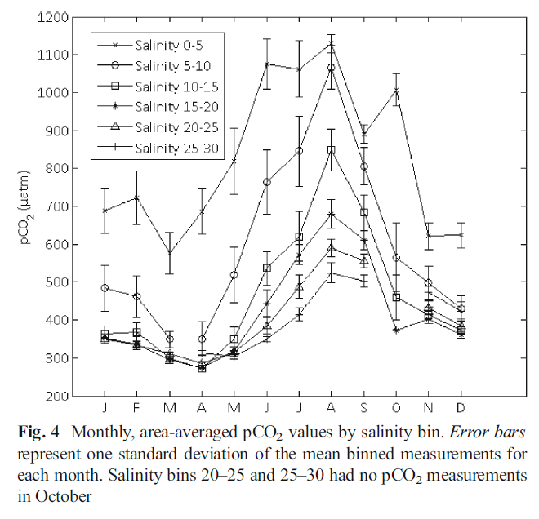
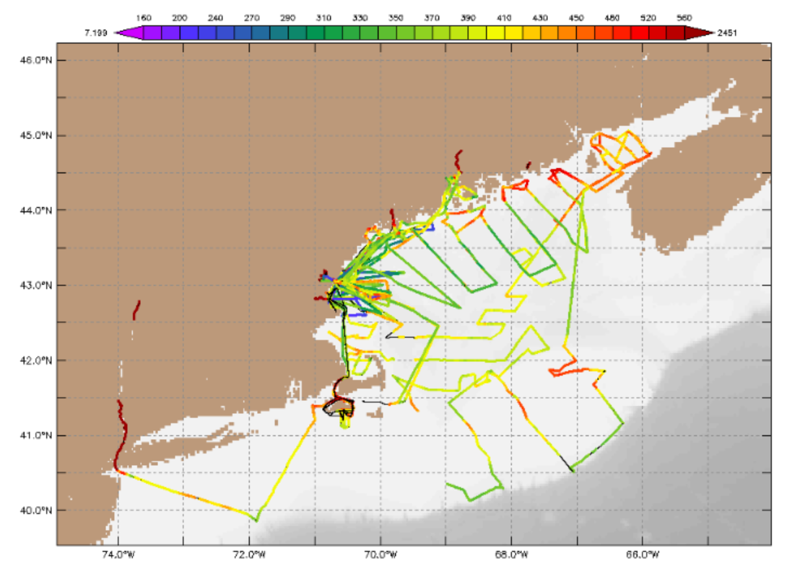
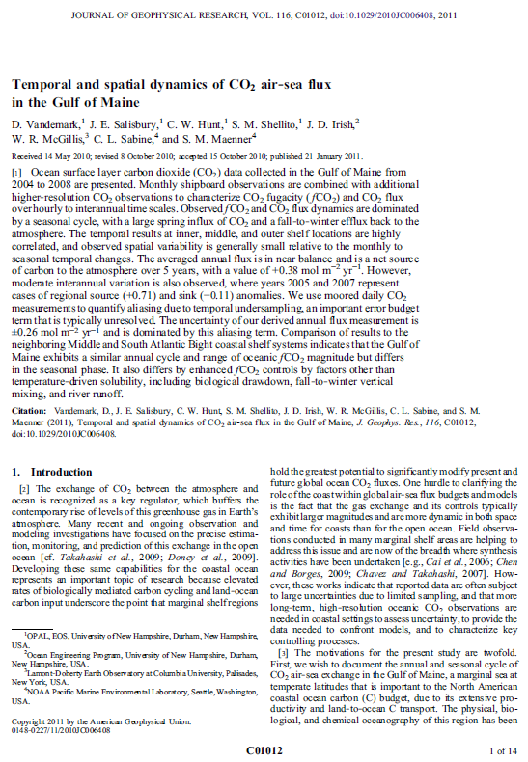
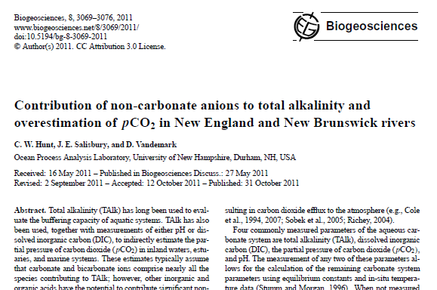
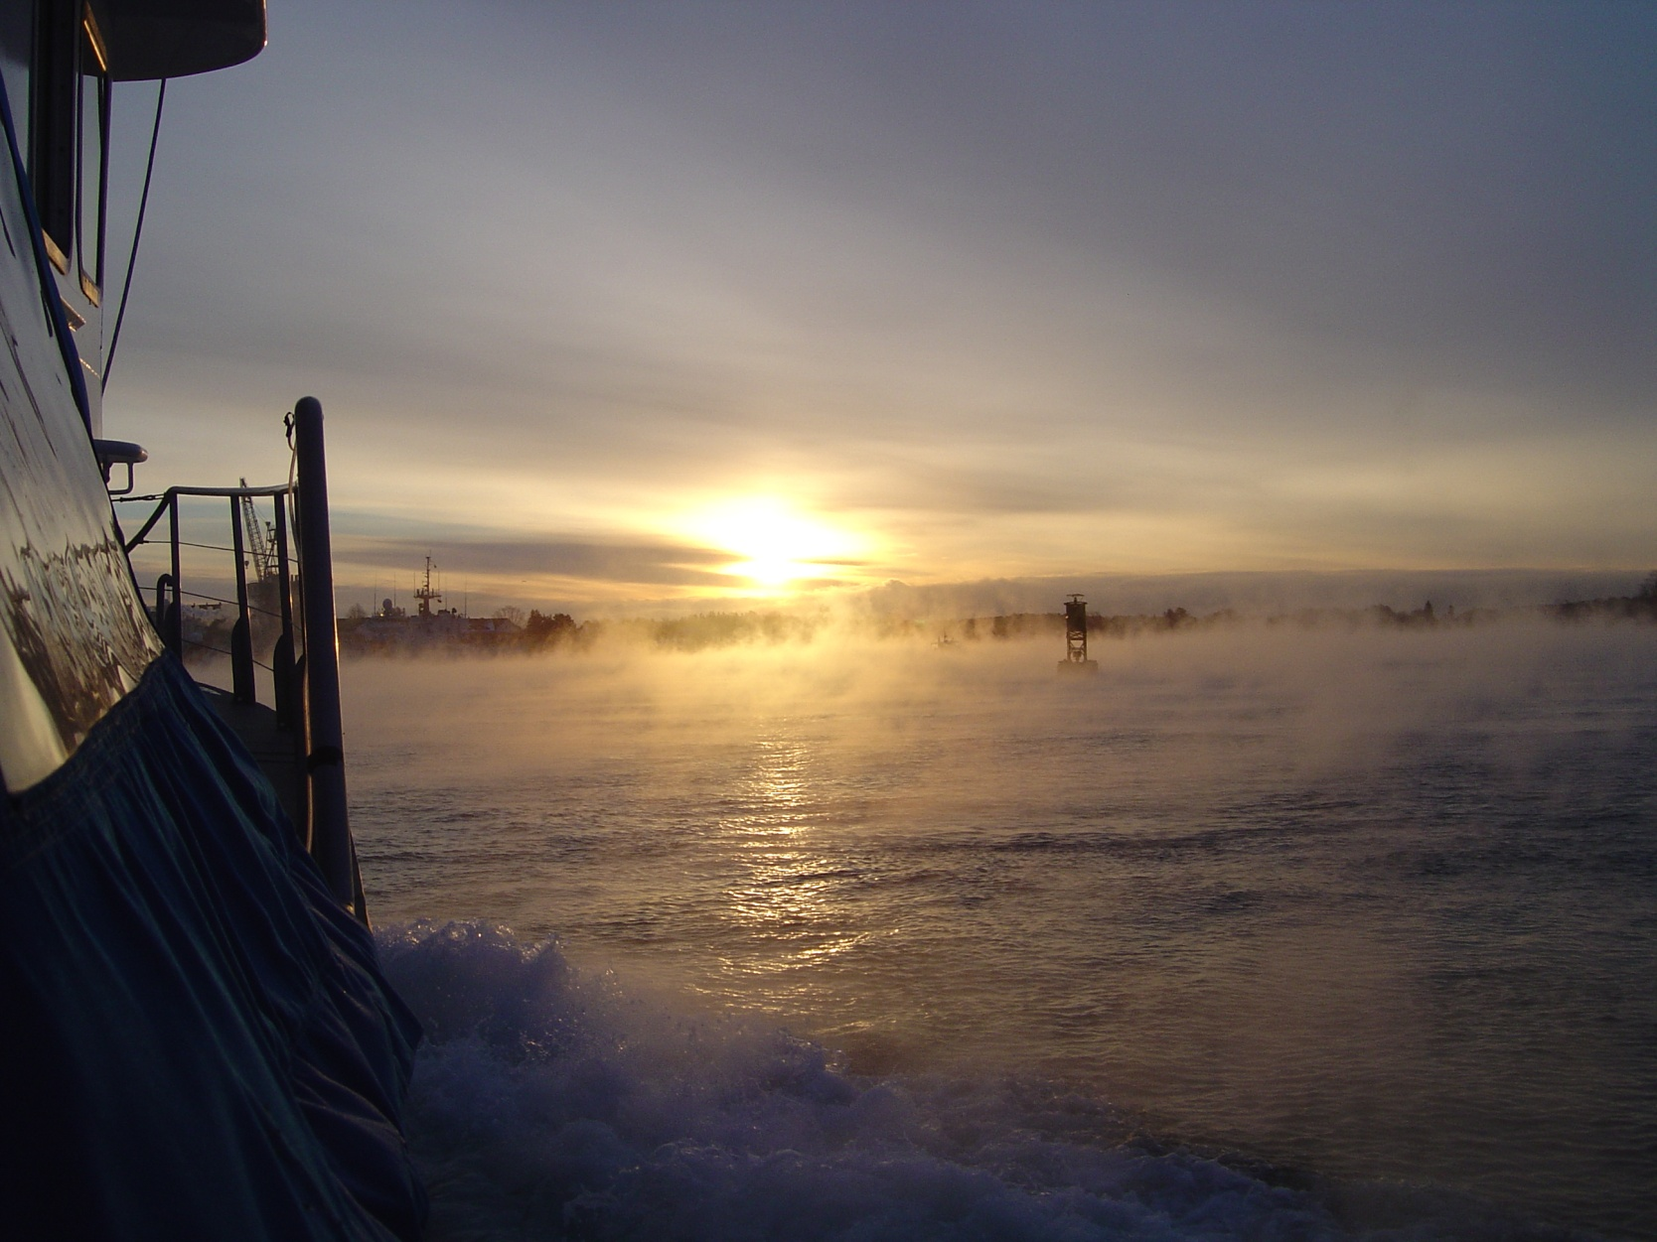
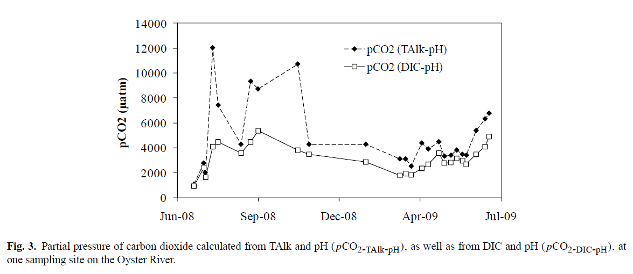
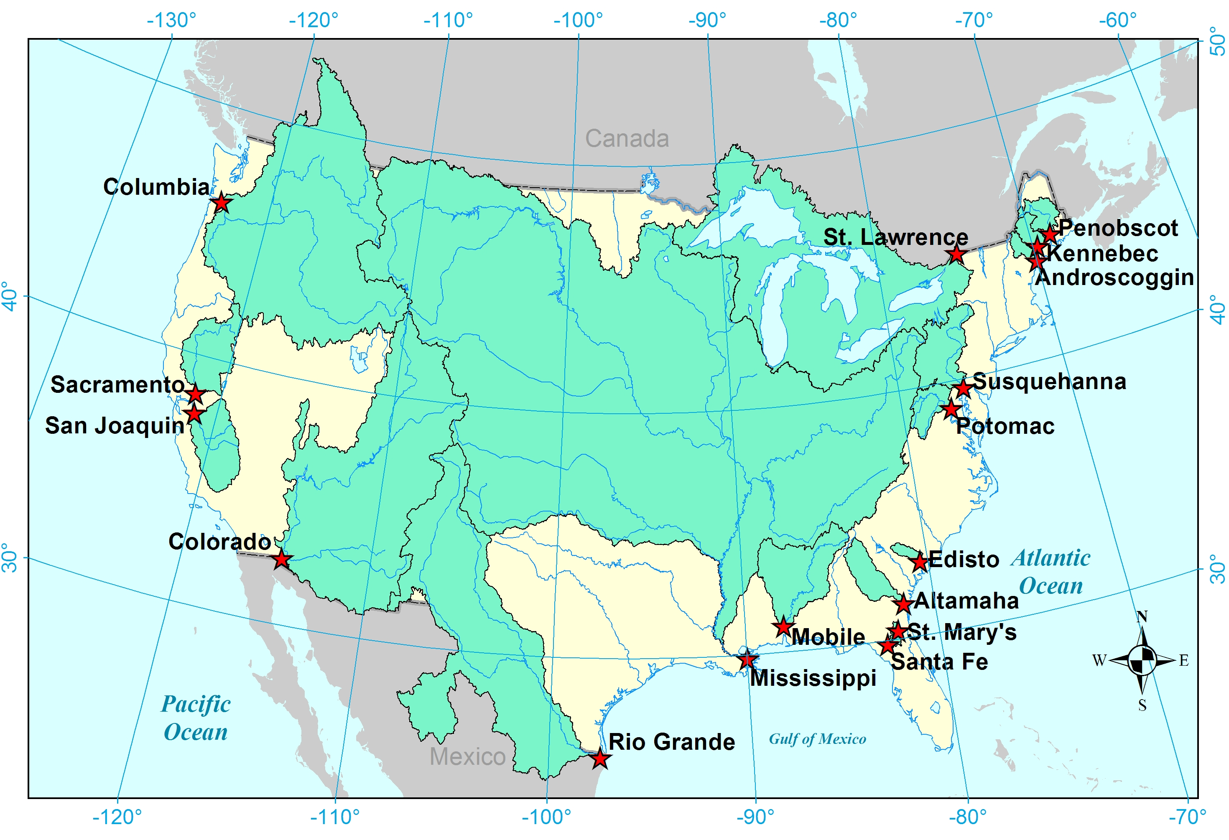
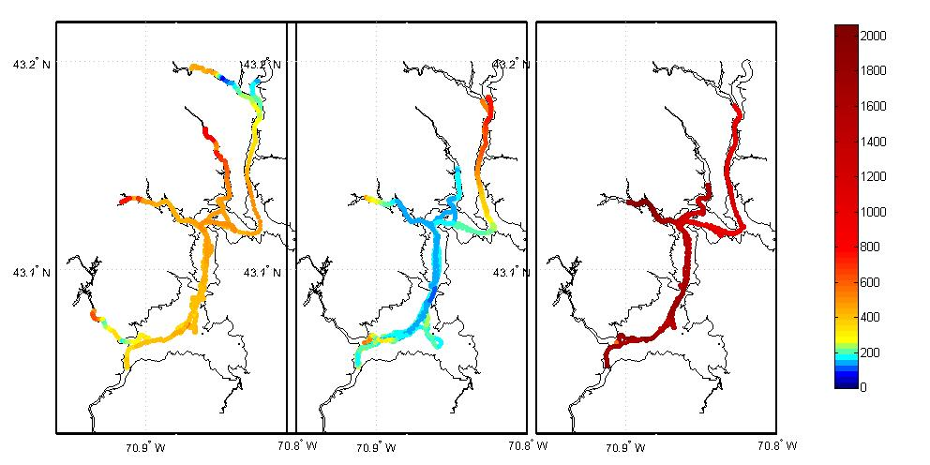
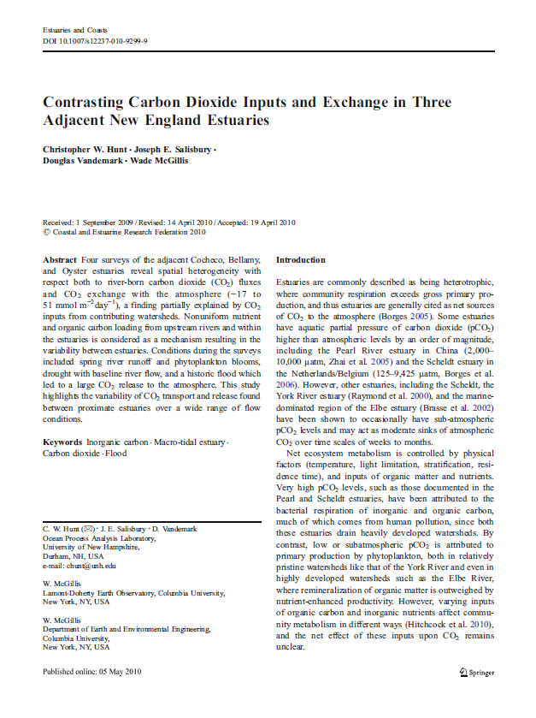
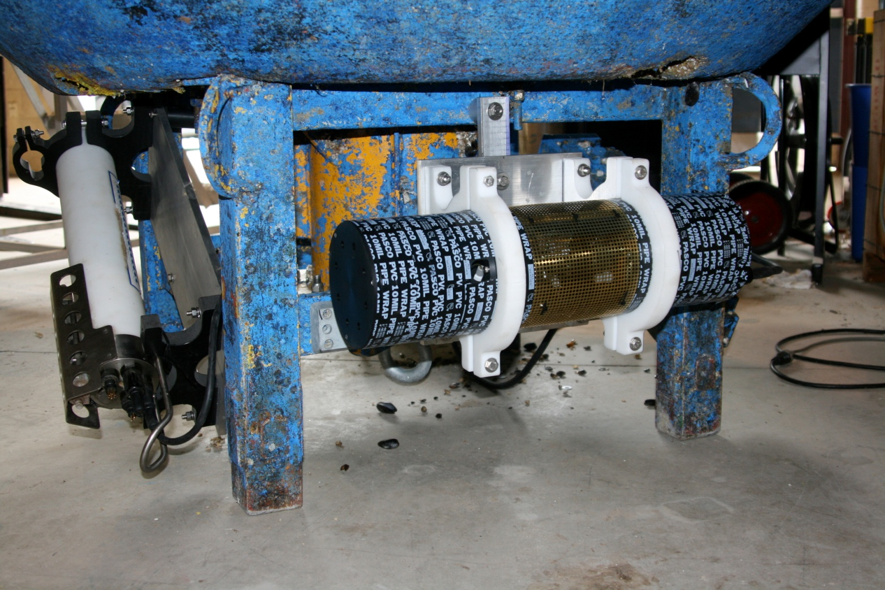
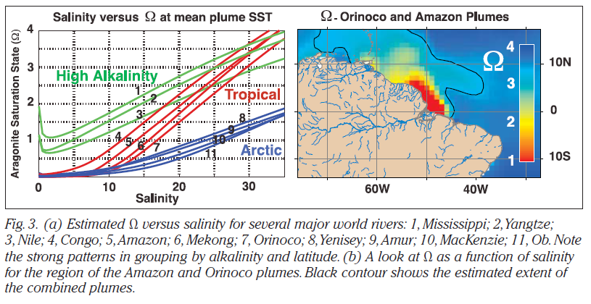
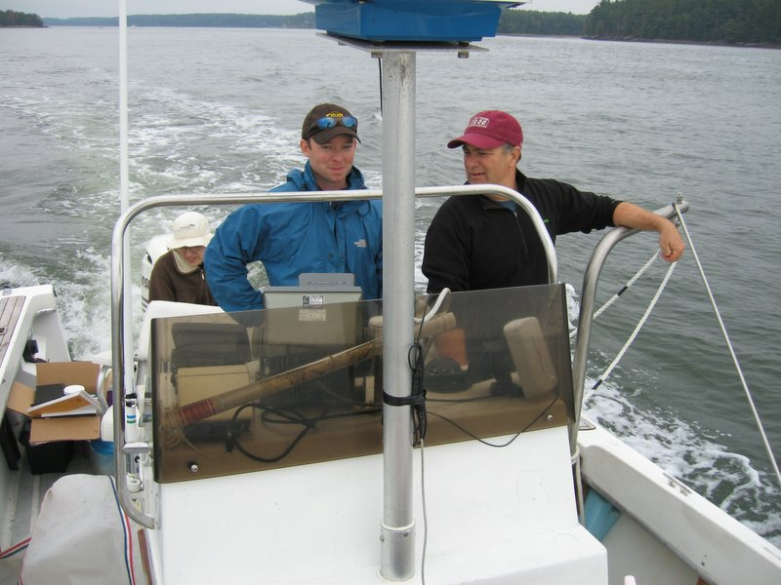
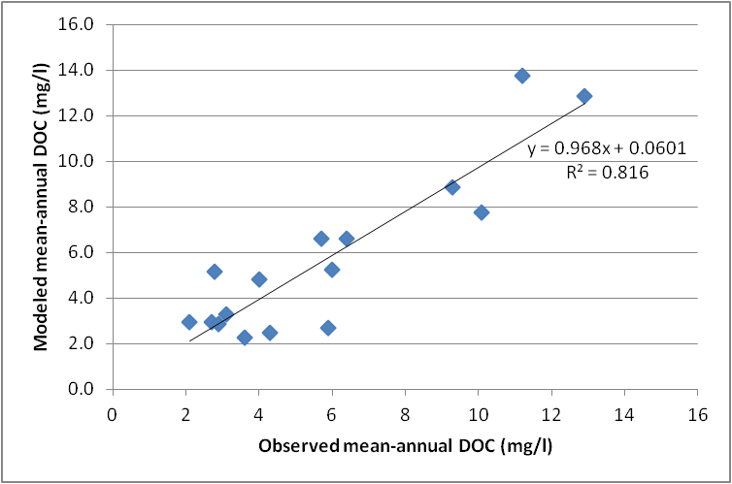
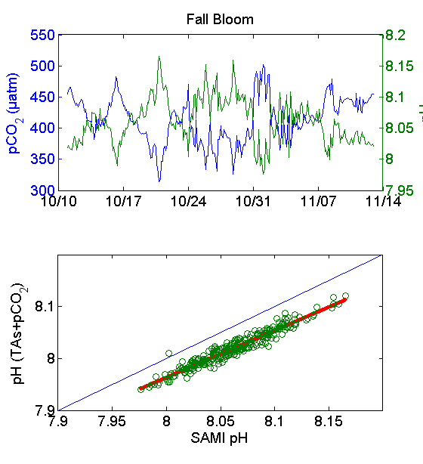
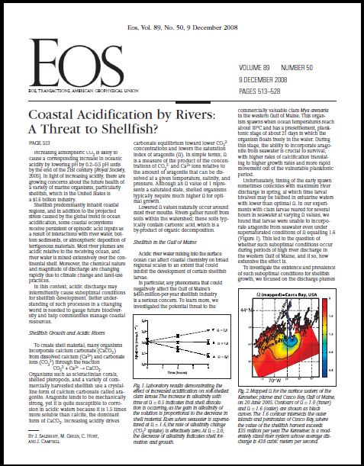
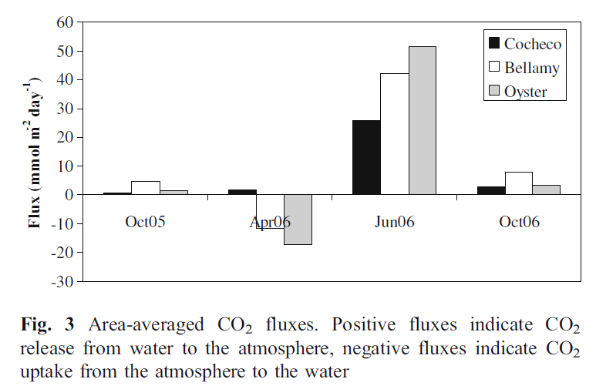
Stream-to-Sea Examinations of Carbon: New Tools and Insights
Christopher W. Hunt, Doug Vandemark, Joseph Salisbury, Shawn Shellito
Ocean Process Analysis Laboratory, University of New Hampshire *contact: chunt@unh.edu
Measuring CO₂ in Streams and Rivers
CO₂ in the Kennebec Estuary
CO₂ in the Coastal Ocean
K-30 CO₂ Sensor
Cable
Our surveys of the Kennebec estuary between 2004 and 2008 found spatial and temporal variability both in sources of carbon dioxide (CO₂) to the estuary and the air–sea flux of estuary CO₂. The estuary had an area-weighted average partial pressure of CO₂ (pCO₂) of 559 μatm. The area-weighted average CO₂ flux to the atmosphere was 3.54 mol C m⁻² year⁻¹.
We have collected hundreds of spatial surveys of CO₂ in the Gulf of Maine. We have also surveyed the Gulf of Mexico, Caribbean Sea, and Bay of Bengal. Our data have been integrated with the world’s highest-quality ocean CO₂ measurements into global data repositories (CDIAC, SOCAT).
Buoy measurements in Great Bay and the Gulf of Maine are integrated with the Northeast Regional Ocean Observing System
Silicone
Sealant
Air
Pump
Air Flow
PVC pipe
Float
Float
A
B
Overall, the Kennebec estuary was an annual source of 7.2× 10⁷ mol CO₂ to the atmosphere. Fluxes of CO₂ from the estuary were elevated following two summertime storms, and inputs of riverine CO₂ outweighed internal estuarine CO₂ inputs in nearly all months. River and estuarine inputs of CO₂ represented 68 and 32 % of the total CO₂ contributions to the estuary, respectively.
I have developed a novel, low-cost sensor for the automated measurement of CO₂ in stream and estuaries. The results shown at right indicate a flushing of CO2 with storm events, along with a strong covariance with dissolved oxygen.
Our 2011 paper examined the influence of organic acids on the calculation of CO₂ from other measurements (total alkalinity and pH). We documented large errors due to these large acids, potentially impacting large-scale estimates of continental or global CO₂ release from lakes and rivers.
Modeling Dissolved Organic Carbon in Rivers
CO₂ in the Great Bay Estuary
Ocean Acidification and Shellfish
A new component of the FrAMES model was developed to estimate the loading of bulk dissolved organic carbon (DOC) to and through river networks on a regional and national 6-minute scale. Additionally, the DOC model apportioned DOC into labile and non-labile fractions, which should be retrievable by remote-sensing techniques in the infrared. The loading of bulk DOC to each grid cell was determined primarily by the fraction of wetlands found in the National Land Cover Database.
Oct 2005
April 2006
July 2006
Anthropogenically-driven ocean acidification is a growing concern, especially in coastal regions. We have expanded our timeseries data collection to include highly precise pH measurements, and are examining the potential effects of increased acidification on commercial species such as oysters and other shellfish.
Relatively good agreement (RMSE=1.4 mg/l DOC, r²=0.81) was found between modeled and observed mean annual bulk DOC export at the large watershed scale (1,000-3,000,000 km²). The RMSE between monthly modeled DOC and measured monthly concentrations ranged from 0.5-15 mg/l (mean monthly RMSE=2.8 mg/l), and we found seasonal discrepancies in a number of studied watersheds. Our results suggest that in-stream processing may play a large role in determining DOC quality and the ratio of labile to non-labile carbon exported to the coastal zone.
pCO2
(uatm)
Four surveys of the Cocheco, Bellamy, and Oyster estuaries revealed spatial heterogeneity in both river-born CO₂ fluxes and CO₂ exchange with the atmosphere (−17 to 51 mmol m⁻² day⁻¹), a finding partially explained by CO₂ inputs from contributing watersheds. Nonuniform nutrient and organic carbon loading from upstream rivers and within the estuaries is considered as a mechanism resulting in the variability between estuaries. Conditions during the surveys included spring river runoff and phytoplankton blooms, drought with baseline river flow, and a historic flood which led to a large CO₂ release to the atmosphere.
Acknowledgments
This work was funded by National Aeronautics and Space Administration grants NNX09AU89G and NNH04AA62I. This work was supported in part by the NOAA Coastal Services Center through an award to the UNH Center for Coastal Ocean Observation and Analysis (COOA); NOAA award NA16OC2740, and the UNH Graduate School.

