Slide 1
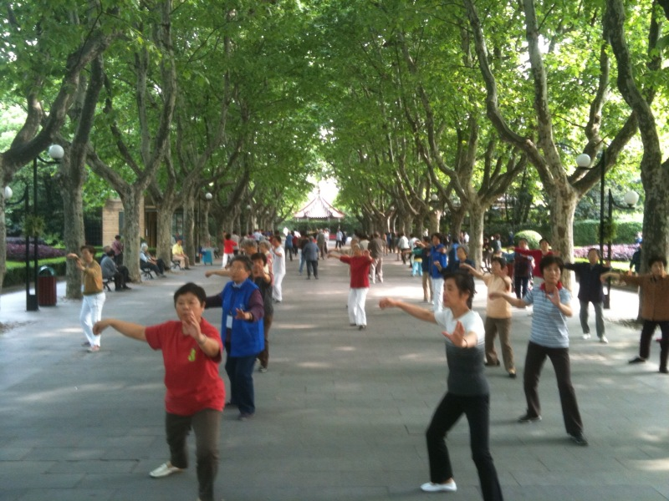




CREATIVE LEISURE OF OLDER ADULTS AT A COMMUNITY SCHOOL IN PUDONG NEW AREA SHANGHAI CHINA
Boyd Hegarty, University of New Hampshire
Chao Yang, University of New Hampshire
Patricia Craig, University of New Hampshire
Jonathan Plucker, University of Connecticut
INTRODUCTION
RESULTS
China has an aging society. There are currently 185 million Chinese people over the age of 60, and that number is projected to reach 370 million by 2050 (Zhang, 2014). Further, due to financial improvement of China, the number of Chinese people participating in new leisure activities is likely to increase (Borzykowsi, 2014). Normally younger generation will take care of older adults because of the value of filial piety, however, the Single Child Policy made it harder for this tradition and older adults have to rely on social support programs. Community schools is one of the support programs. Community schools are schools built for older adults in China to improve their leisure life by providing different classes and leisure activities with an affordable tuition. The participants in community schools are 50 years old or older because of the early retirement policy in China. And this study was conducted at a community school in Pudong New Area, Shanghai. Since research about leisure, creativity, and creative leisure about Chinese older adults is very rare, this study will fill in this vacancy by answering the following two questions: (a) Does creative experience happen within the leisure experience among Chinese older adults? If so, how does this manifest? (b) Do Chinese older adults seek creative expression in their leisure?
Common themes from interviews:
Happiness: -“I feel happy, care-free, unrestrained, and completely liberal (after I achieved the summit state of practicing Tai Chi).”
-“I write for fun”
-“Singing can bring me some happy emotions.”
-“When you find some good but cheap collections, you would be happy for a long time.”
Intrinsic Feelings: -“When wake up in the morning, I’d tell myself ‘Get up, go to classes, relax a little bit even though it is only a short period of time.’”
-“I would not think too much when physically being there, the music was on and everybody was dancing.”
Health Motivation: -“Tai Chi is integration of movements and mind. How well one can play Tai Chi really depends on one’s level of aptness.”
-“Singing to vent emotions is very useful to help you balance your life.”
Flow: -“I was making clothes in the evening and I forgot to eat dinner.”
-“When I was writing happily, I could write for several hours.”
Participants also expressed themes such as life theories in leisure activities, face concern, spare time for leisure activities, self-learning experience and more in interviews.
METHODS
This research utilized a phenomenological design. Phenomenological research design is an inductive process used to search the underlying meaning of the experience of the participants (Creswell, 2007). A purposeful sampling method was employed in this current study. The community school involved in this study locates at Pudong New Area, Shanghai. There were 19 participants from five different classes participating the initial round of open-ended essay surveys which is about “Sharing the most creative experience they have ever had in their leisure life as much detailed as possible”. Out of the 19 participants, 13 of them agreed to have a followed up interview. The core interview questions included “What is your purpose of doing this leisure activity?” “Have you ever created your own…from the leisure activity that you described?” “Is doing this leisure activity a type of self-expression?” “Will you still do the same thing when you are alone or with other people?” All of the interviews were recorded and then transcribed and translated. Next, the first and second researcher did open coding by utilizing Nvivo separately. Lastly, both researchers negotiate the codes together before recode the data again (Cont. data negotiation and recoding)
IMPLICATIONS
This study can be generalized to the developed areas in China such as the east coast areas:
-Creativity exists in leisure among Chinese older adults;
-Older adults in China put emphasis on happiness when they do leisure activities;
-Chinese older adults express themselves in leisure activities, but most of them express themselves for others since they are concerned about losing face;
-Since Chinese older adults have more spare time when they retire, they have opportunities to join more leisure activities;
-Many life theories generated by participating in leisure activities from Chinese older adults.
Department of Recreation Management & Policy
2015 Graduate Research Conference, University of New Hampshire

