Slide 1


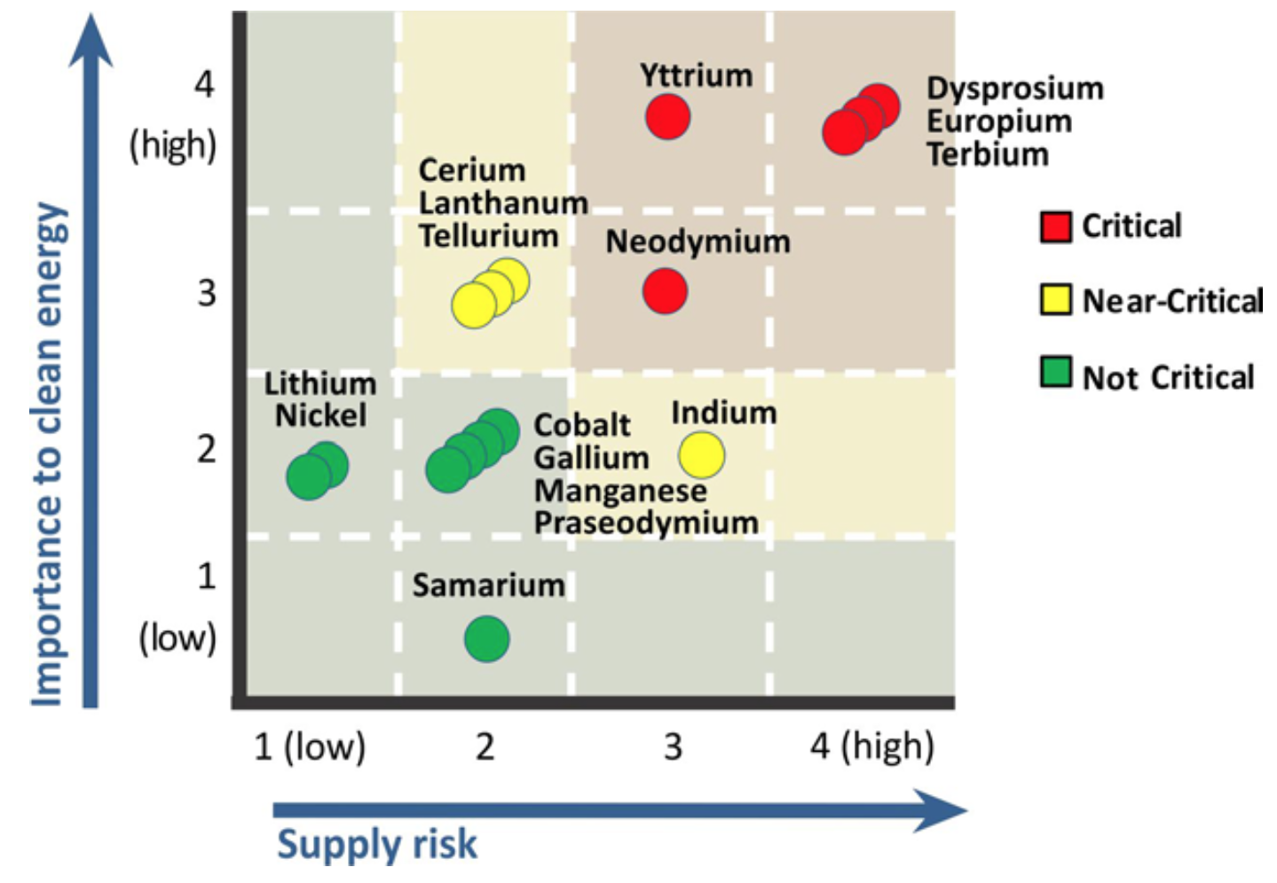
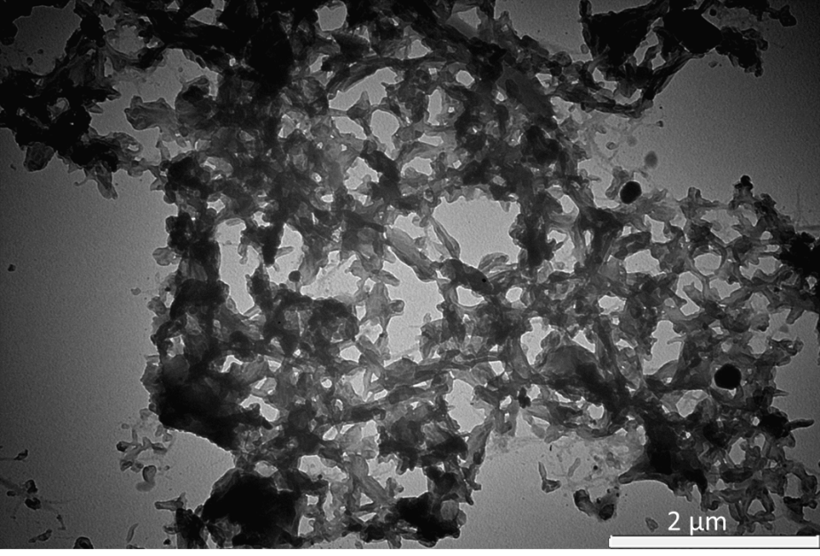
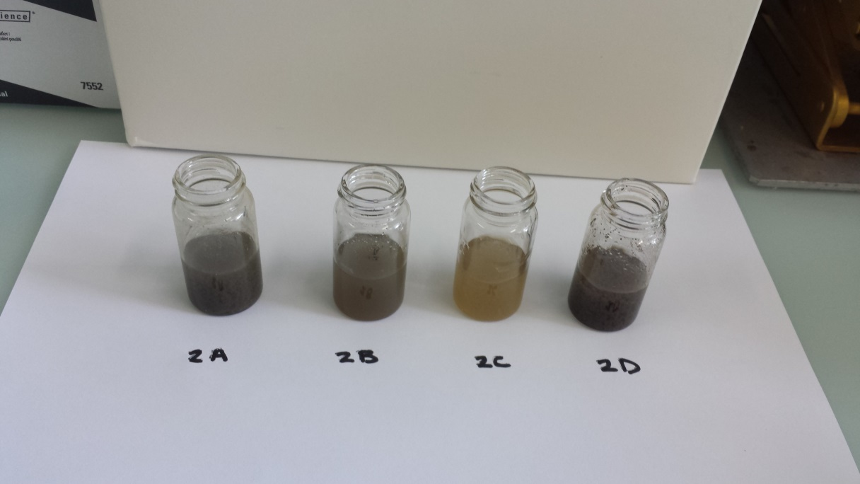
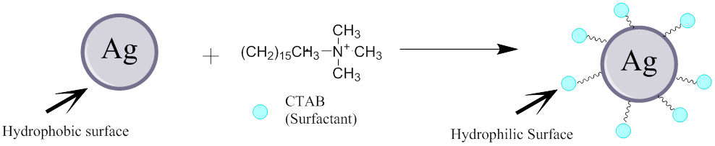
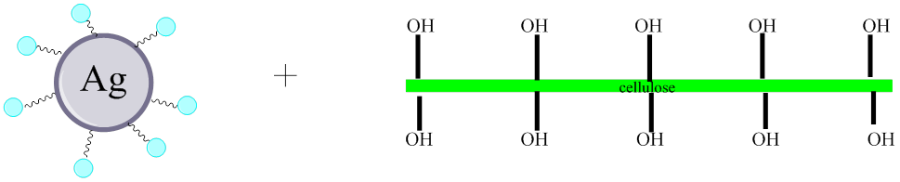
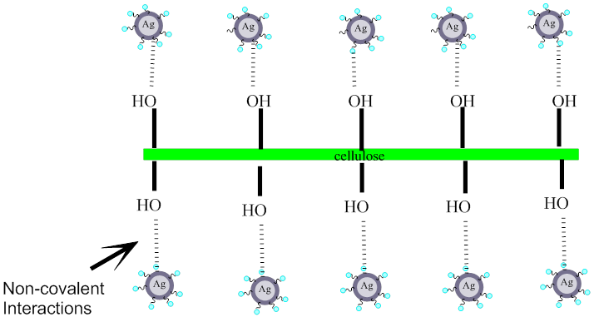
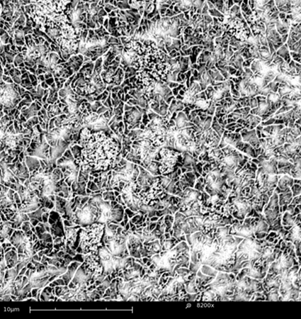
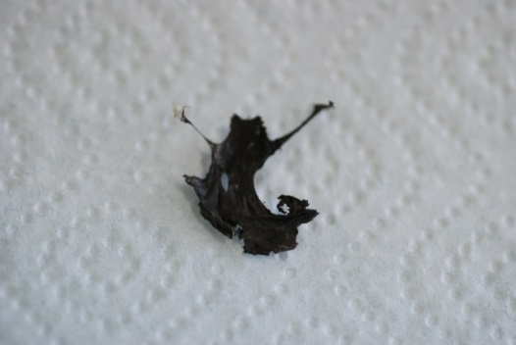
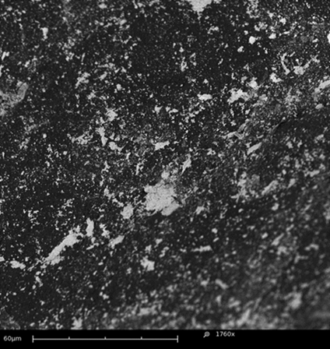

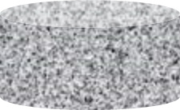



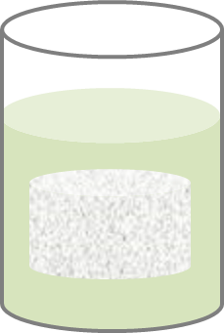



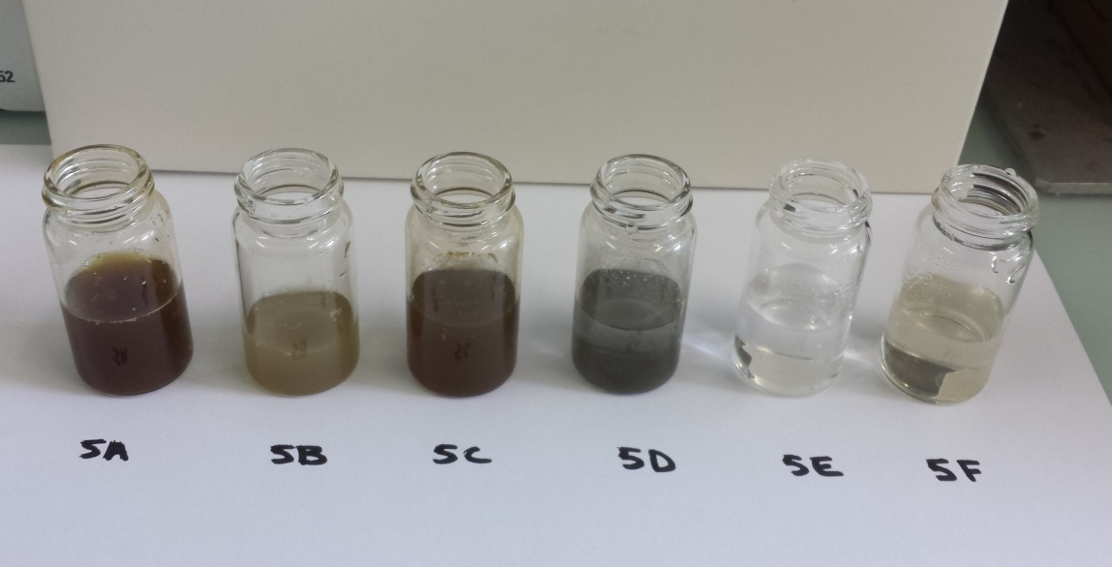

Conductive Cellulose Materials Coated in Silver Particles
University of
New Hampshire
Karen Richards, Mehdi Jorfi, Sandra C. Espinosa, Jens Natterodt, Christoph Weder and E. Johan Foster
Adolphe Merkle
Institute
Adolphe Merkle Institute, Fribourg, Switzerland
Motivation and inspiration
Sulfonated CNC vs. carboxylated CNC
Results continued
Indium tin oxide is a translucent and conduction material used as the conductive layer on liquid crystal displays (LCD), solar cells, smart phones.
Reasons for finding a replacement:
  Indium is a considered a ‘
  Price is steadily increasing
Proposed ITO replacement :
  Percolating network of silver supported
  on a network of cellulose nanocrystals
  Backfill with polymer
  Press into film
Both sulfonated and carboxylated CNCs where tested and analyzed.
Sulfonated tunicate dispersion:
TEM image of sample 2A with 1.0 M AgNO₃
and 1.0 mg/ml sulfonated CNC’s
Binding with sulfonated CNC
Plot of supply risk versus importance to energy of metals currently employed in the USA. (DOE Critical Materials Strategy 2011)
Binding with carboxylated CNC
Mechanical properties of proposed material
Percolation model
Function of reducing agent and surfactant
Results, shown in the chart and image above, indicate a correlation between the amount of AgNO₃ added to the dispersion with both the color and pH of that dispersion.
“percolation on”
Both a reducing agent and surfactant were critical in this reaction.
Cost projections
ITO (indium-tin oxide) | Coating Cellulose with Silver
Roughly $0.25-$0.69 to cover the LDC screen on an iPhone 5 | Roughly $0.02 to cover the LDC screen on an iPhone 5
Reducing agent: Sodium borohydride reduces silver nitrate to create a silver particle in situ.
Conclusion
Sulfonated CNC dispersion
  The best method to create a percolating network of silver on CNC’s
  TEM images
Carboxylated CNC dispersion
  TEM images were inconclusive
Tunicate cellulose aerogel
  The aerogel did not have an even coating of silver
  Cause:
  light-weight porous aerogel floats in solution and is not fully immersed
    The pores caused solution to be trapped and did not circulate throughout the aerogel
Approach
Multiple Potential Methods
Surfactant (CTAB) changes the characteristics of the surface of the silver particle. This forms an attraction between the particle and the alcohol groups of the cellulose fiber.
Approach
Future work
Coating sulfonated tunicate cellulose aerogel with silver
Coating cellulose dispersion with silver
Find a polymer that is both conductive and translucent when condensed into film with dispersion
  Possible polymers: LiClO₄-doped ethylene oxide-epichlorohydrin (EO-EPI)
Results
Carboxylated cellulose dispersion
Sulfonated cellulose dispersion
Sulfonated tunicate aerogel:
Coat polymer with silver sulfonated CNC dispersion, condense material into thin film, and characterize material
All three methods above were tested to find the best for the desired application.
References
Tunicate cellulose aerogel
AgNO₃
+
Two approaches
Solving the ultra-high dilution problem
Kalowkamo J., Baker E. Estimating the manufacturing cost of purely organic solar cells. Elsevier. 2009. 83(8): 1224-1231.
Olsson R.T., Samir A.M.A.S., et.al. Making flexible magnetic aerogels and stiff magnetic nanopaper using cellulose nanofibrils as templates. Nature Nanotechnology. 2010.(5):584-588.
Hebb, H. Malcolm. Electrical Conductivity of Silver Sulfide. The Journal of Chemical Physics. 2004. 20 (1): 185.
Padalkar S., Capadona J.R., et. al. Natural Biopolymers: Novel Templates for the
Synthesis of Nanostructures. Langmuir Article. 2010. 26(11): 8497–8502.
Galland S., Anderson R.L., et. al. Cellulose nanofibers decorated with magnetic
nanoparticles – synthesis, structure and use in magnetized high toughness membranes for a prototype loudspeaker. Journal of Materials Chemistry C. 2013.13 (1): 7963-7972.
Schroers, M., Kokil, A. and Weder, C. (2004), Solid polymer electrolytes based on
nanocomposites of ethylene oxide–epichlorohydrin copolymers and cellulose whiskers. J. Appl. Polym. Sci., 93: 2883–2888o. di: 10.1002/app.20870
Silver covered tunicate cellulose aerogel
Silver covered tunicate cellulose film
a
b.
c.
Reducing agent + surfactant
NaHBH4 (Reducing agent)
CTAB (Surfactant)
Reducing agent + surfactant + tunicate cellulose aerogel
SEM images of tunicate cellulose aerogels coated in 1.0 M AgNO₃: (a) coated in gold in preparation for the SEM so the interaction between the silver and the cellulose fibers is visible (b) picture of the silver coated aerogel (c) was not covered in gold so the silver coating could be easily identified
Coating sulfonated tunicate cellulose aerogel with silver
Coating cellulose dispersion with silver
The method above describes the process of coating a sulfonated tunicate aerogel with silver.
Carboxylated tunicate dispersion:
Carboxylated cellulose dispersion
Sulfonated cellulose dispersion
Water, CTAB (surfactant), NaBH₄
References
Acknowledgements
Sulfonated/ carboxylated
c-CNC dispersion
c-CNC dispersion coated
in Silver particle
Acknowledgments
AgNO₃
A special thanks to:
Adolphe Merkle Institute:
Christoph Weder, E. Johan Foster, Mehdi Jorfi, Sandra C. Espinosa, Jens Natterodt, Silvana Muller, Carola Endes, Janak Sapkota, Apiradee Nicharat, Sara Turner, and everyone at AMI.
University of New Hampshire:
Erik Berda and the Berda group for their continued support for the past four years.
The method above describes the process of coating a carboxylated/ sulfonated cellulose dispersion with silver. All materials were analyzed via scanning electron microscopy(SEM), and transmission electron microscopy (TEM).
The picture above shows dispersions with varying concentrations of AgNO₃. TEM images were inconclusive due to difficulty in differentiating the silver particles.

