Slide 1
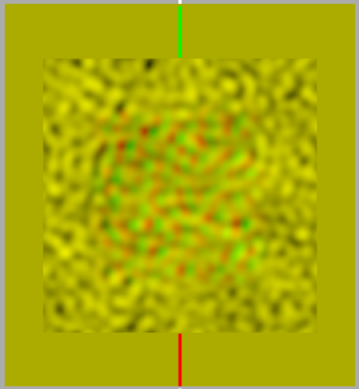
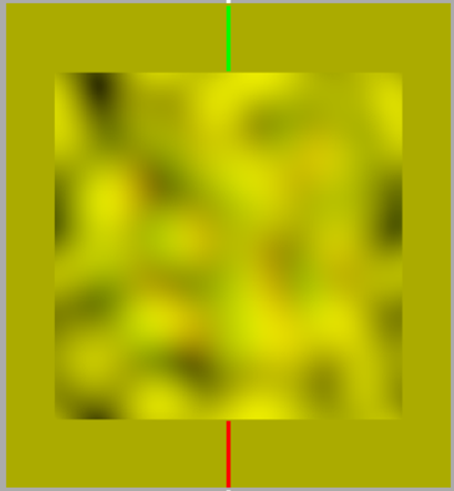
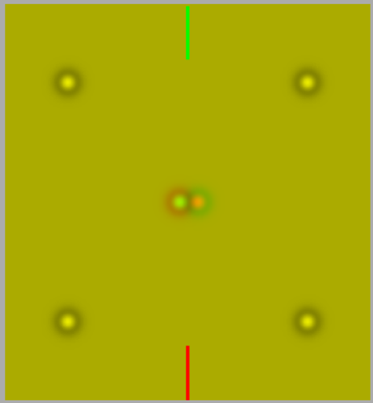
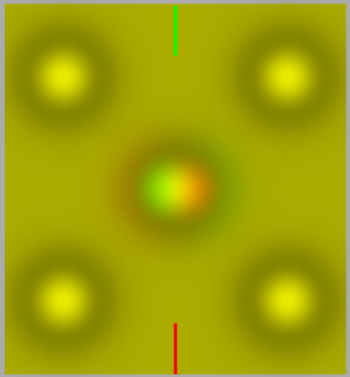
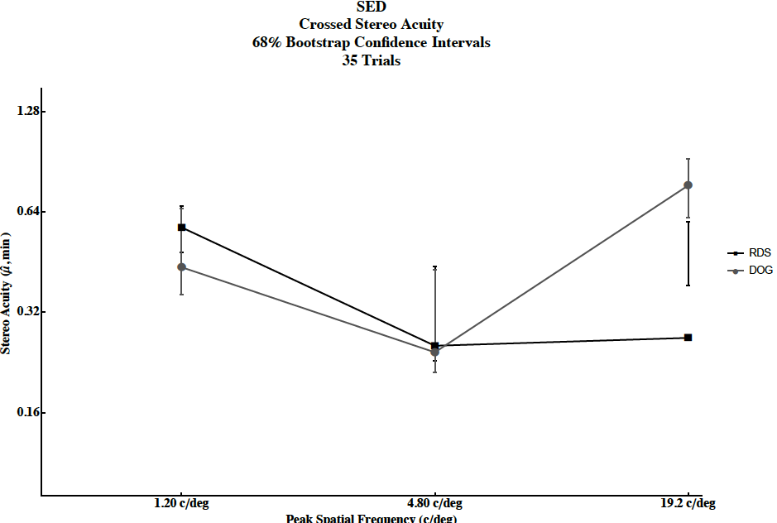
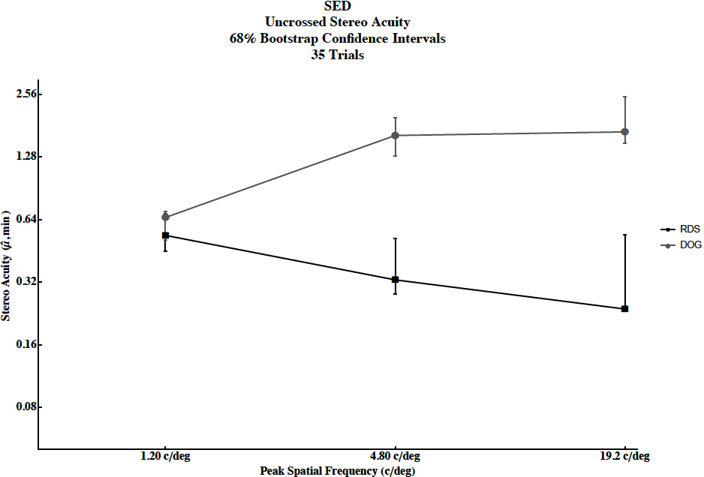
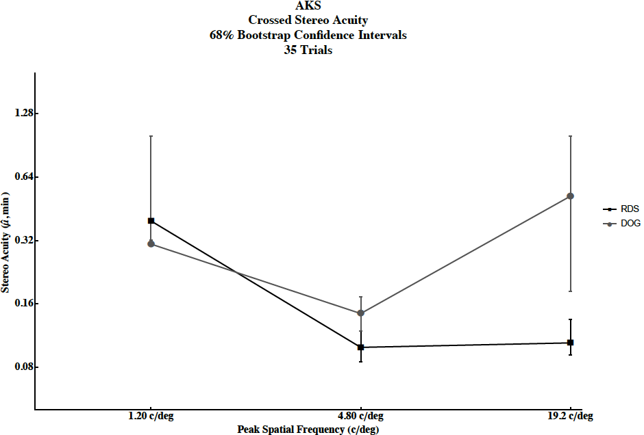
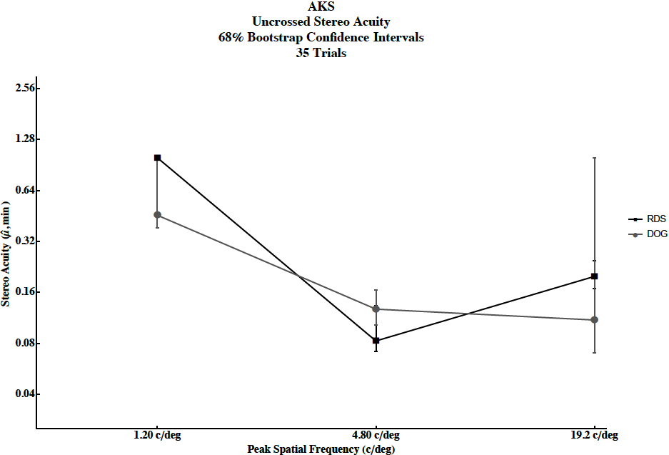
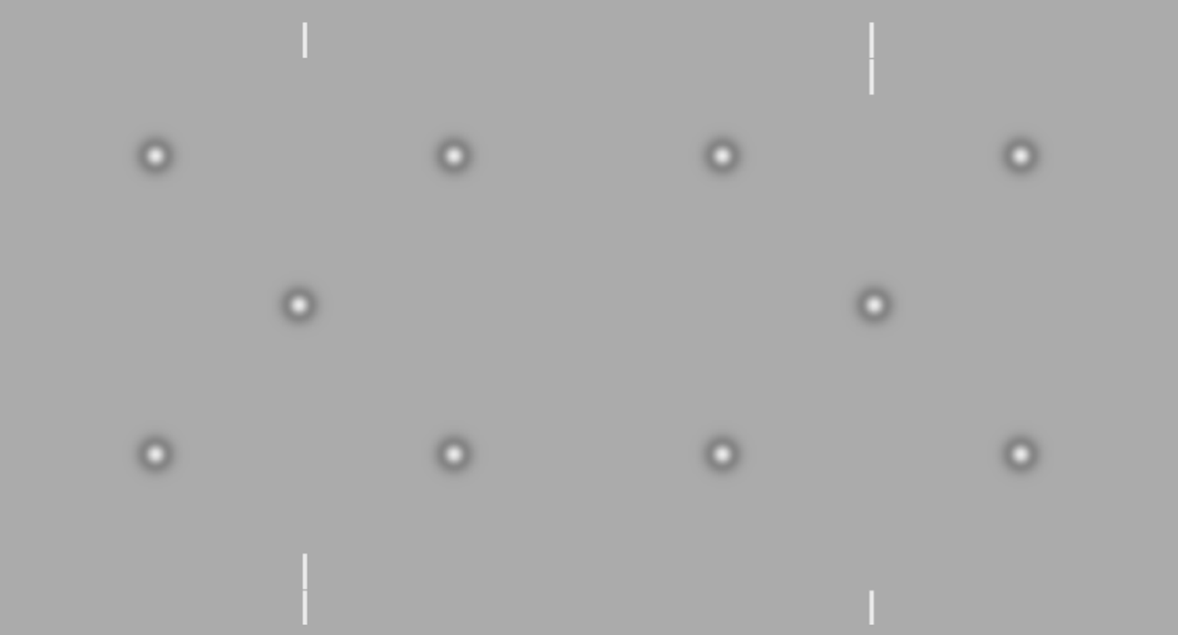
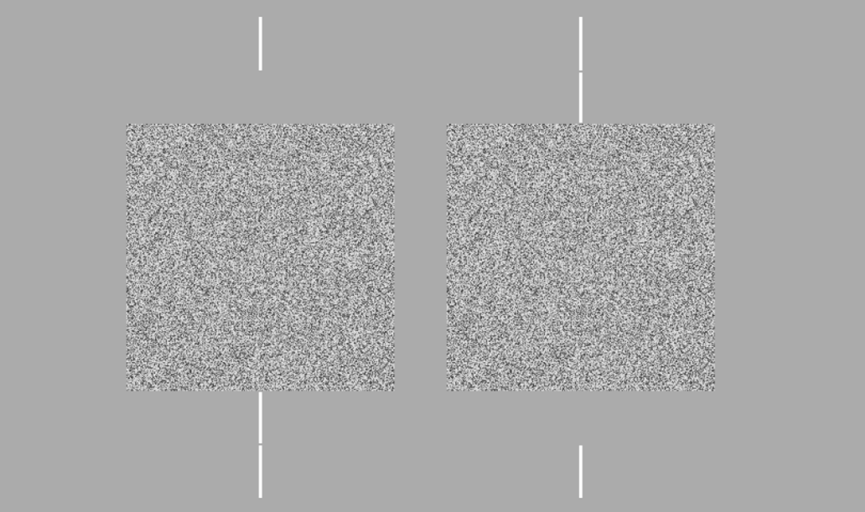
The Effects of Spatial Frequency
on Local and Global Stereo Acuity
Sarah E. DiIanni, Hanne K. Hansen, Patricia A. Levesque, Hayley D. Robertson, Ahlia K. Slone, Nicholas C. Duggan, Jaclyn H. Johnston, Amanda I. LeBel, Megan E. Lusignan, Andrew J. Kitt, and Wm Wren Stine
University of New Hampshire, Psychology Department, Durham, NH
Definitions
Stereopsis: Depth perception that arises from a disparity between the images presented to the two eyes.
Local stereopsis: Depth perception of targets that contain monocular shape cues.
Global stereopsis: Depth perception of targets that do not contain monocularly visible shape cues (Julesz, 1960).
Difference of Gaussians: Combining two different normal (Gaussian) distributions generates patterns of specific spatial frequencies (Schor and Wood, 1983).
Random dot stereogram: Pair of images composed of an array of random dots in which part of one is shifted relative to the other, resulting in the perception of depth in that area when the images are presented to the two eyes.
Anaglyphs
Introduction
There are several competing theories on the underlying mechanisms of local and global stereopsis. Although separating local and global stereopsis has proven to be difficult, if each operate through different channels, it’s reasonable to assume each would each have its own set of spatial frequency threshold curves. If the resulting curves are parallel, a one-mechanism theory is supported. If the curves are not parallel, local and global stereopsis operate through separate channels.
Results
1
3
Methods
Random dot stereograms were used to generate global thresholds across a range of spatial frequencies using the method of constant stimuli, which were compared to difference of Gaussian-based local thresholds.
Images were presented on an Apple Macintosh desktop computer through a Maxwellian view system. A three-way forced choice method was utilized, with choices near, far, and no difference.
2
4
Fig 1 & 2- Crossed stereo acuity for RDS and DOG (2 subjects)
Fig 3 & 4- Uncrossed stereo acuity for RDS and DOG (2 subjects)
Discussion
The results suggest some differences in the spatial frequency curves of local and global stereo acuity. Further research may lead to more concise findings between the two. Patterns and variability between the subjects, as well as differences in uncrossed and crossed disparities can also be explored with additional investigation.
References
Dichoptic stimulus
for local stereopsis
Dichoptic stimulus
for global stereopsis
Julesz, Bela. "Binocular Depth Perception of Computer-Generated Patterns.” Bell System Technical Journal 39.5 (1960): 1125-162.
Schor, Clifton M., and Ivan Wood. "Disparity Range for Local Stereopsis as a Function of Luminance Spatial Frequency." Vision Research 23.12 (1983): 1649-654
Notes:
E15JCY15- Psychology Department
-Stereoacuity: how good you are at stereopsis
-local stereopsis: DOG
-global stereopsis: RDS
-spatial frequency: light across spatial dimension, graphing amount of light across space
-creates black and white bars
-Maxwellian view system: controls amount of light entering the pupil and also aligns the subject (using bite bar)
-Method of constant stimuli: all possible permutations are presented randomly and data is statistically analyzed after
-Define crossed and uncrossed disparity
<number>

