Slide 1
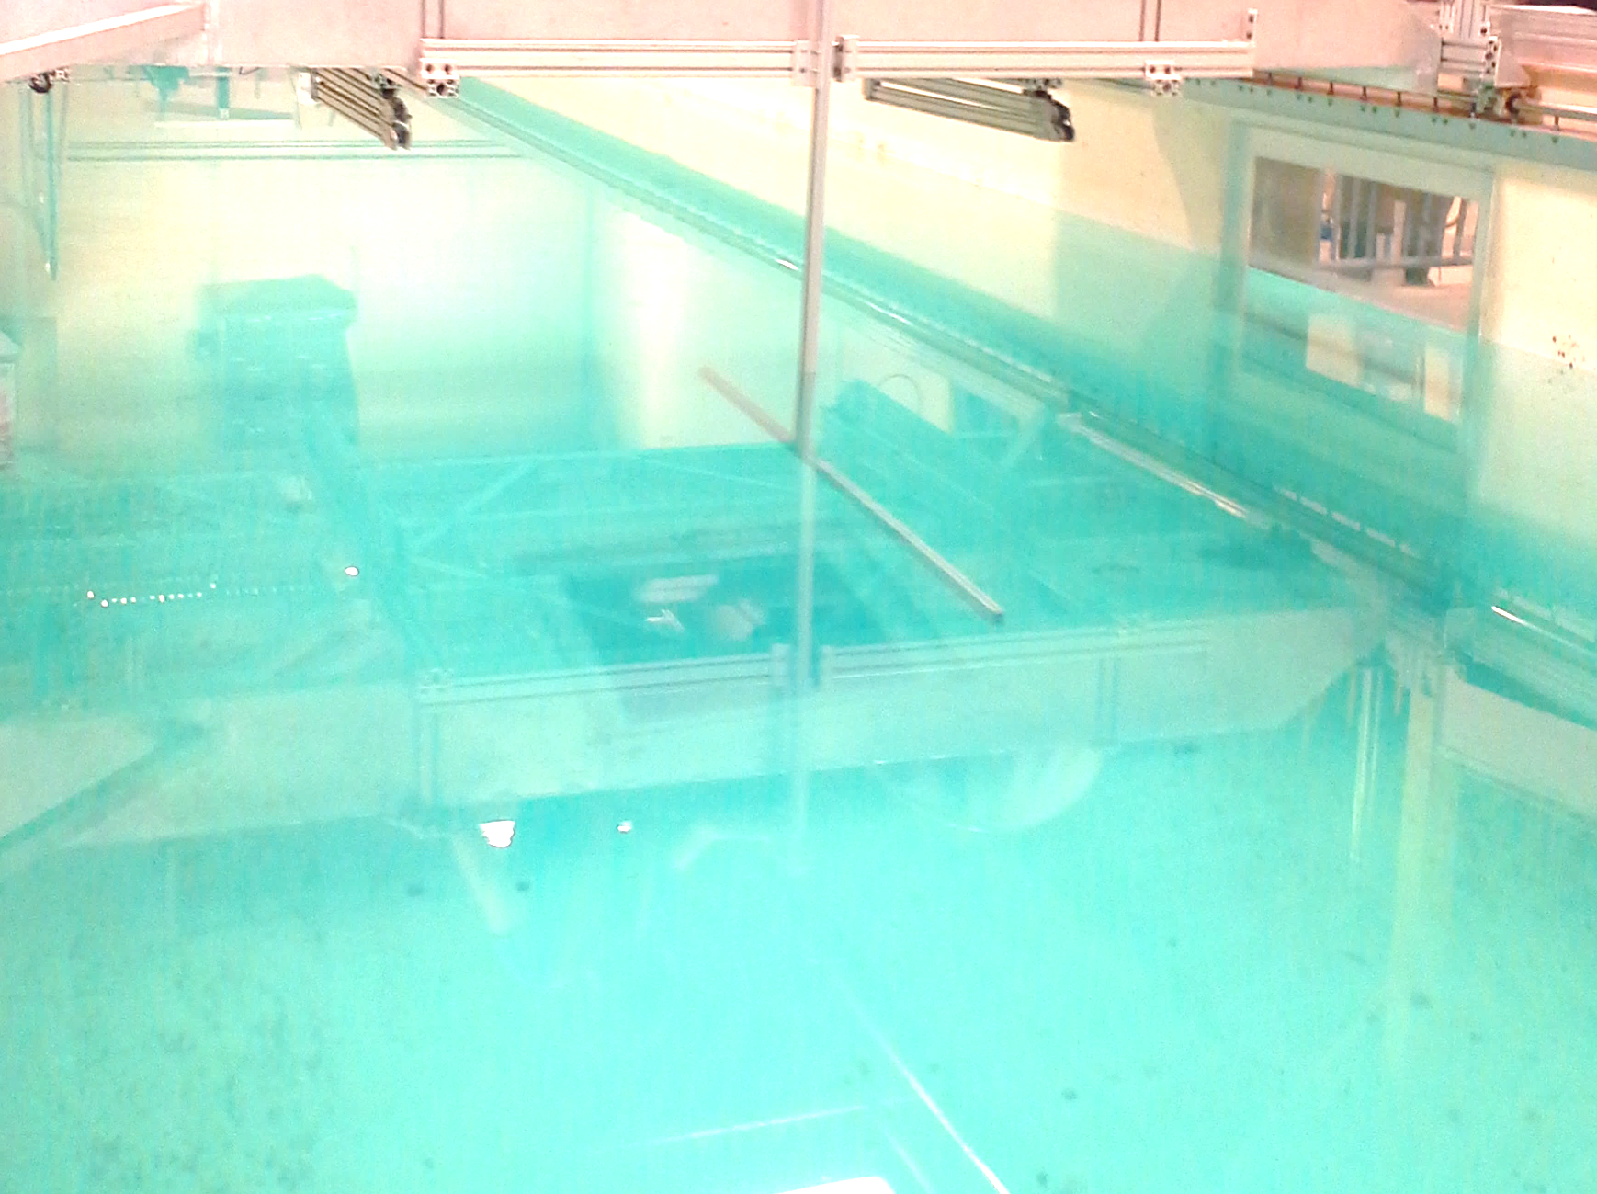


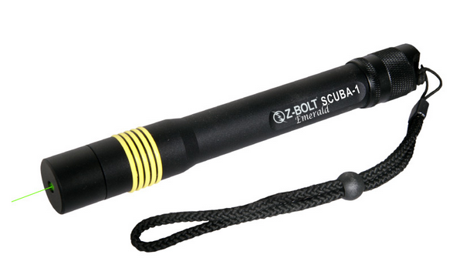
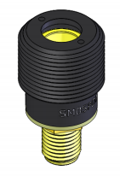
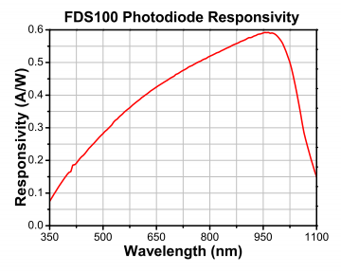
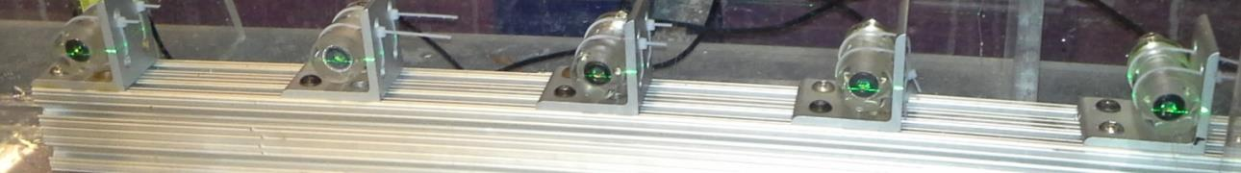
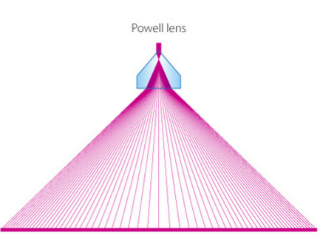
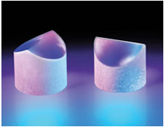
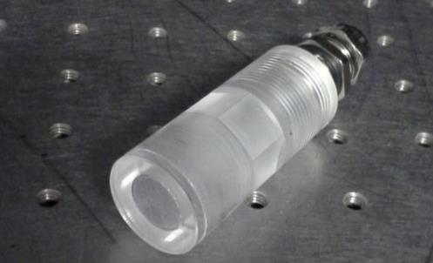
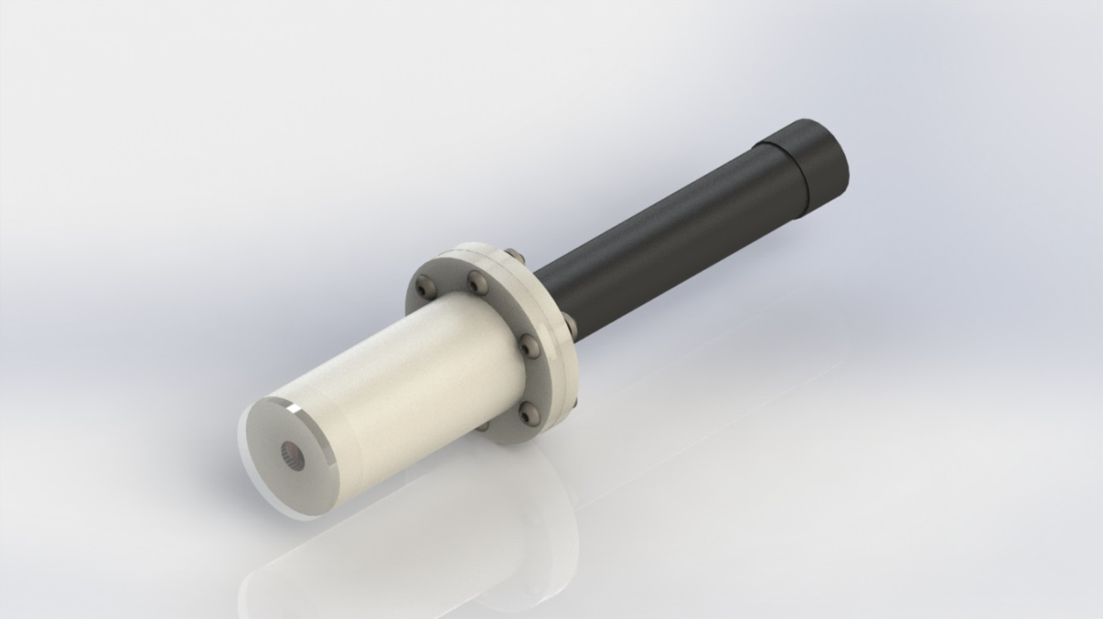
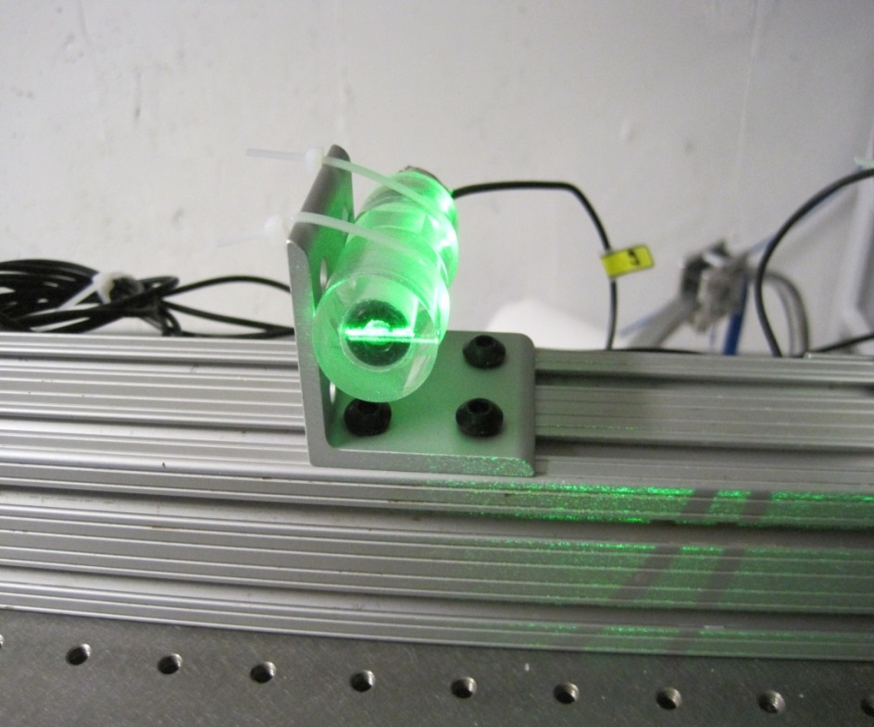
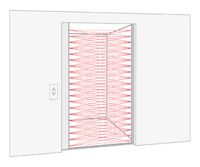
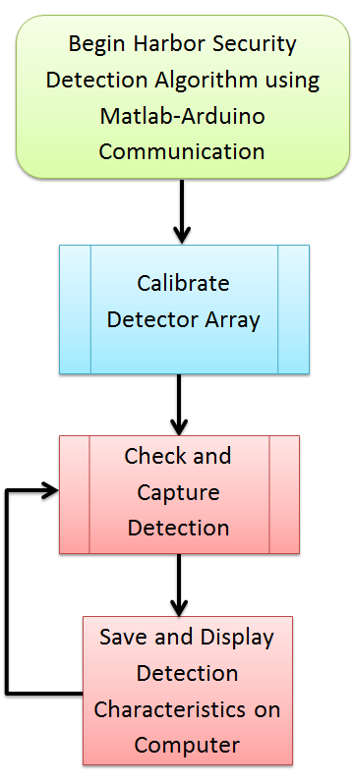
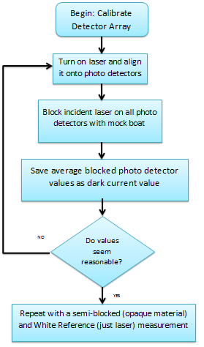
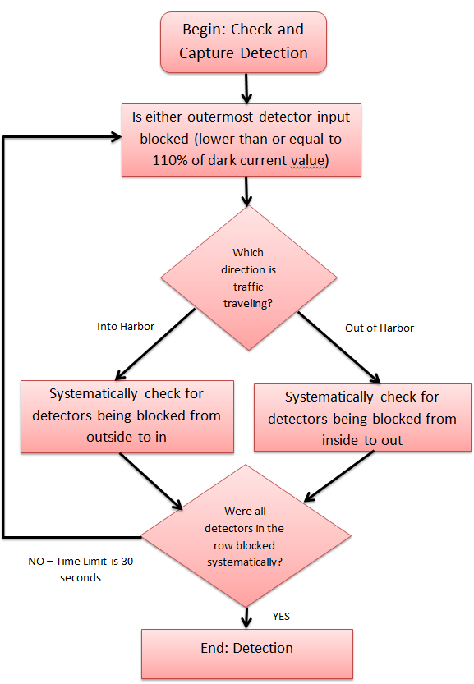
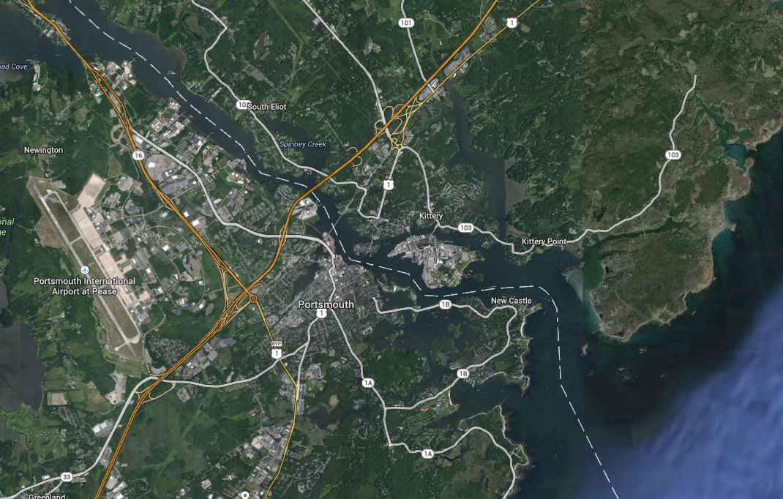
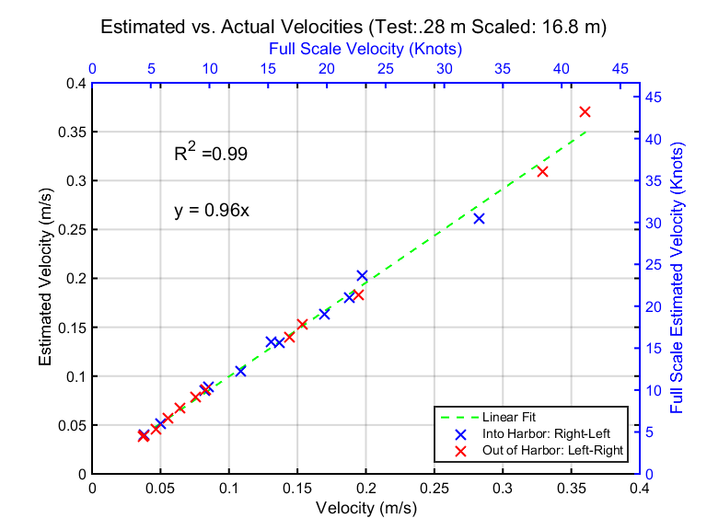
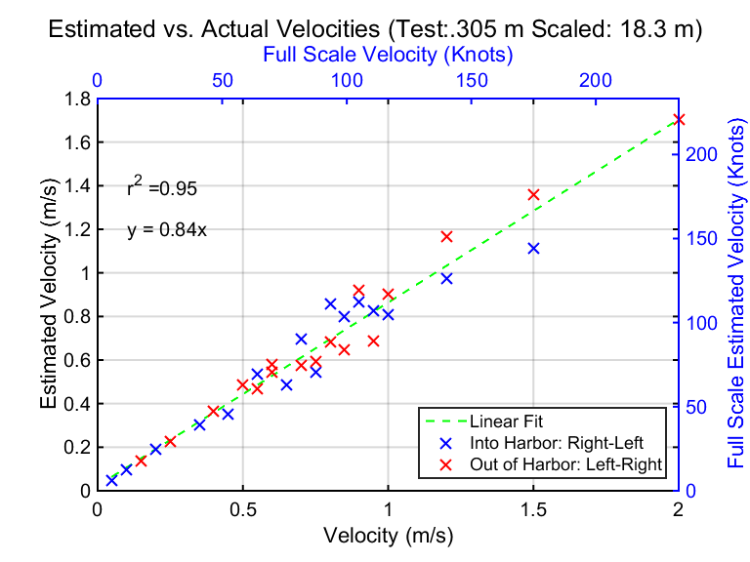
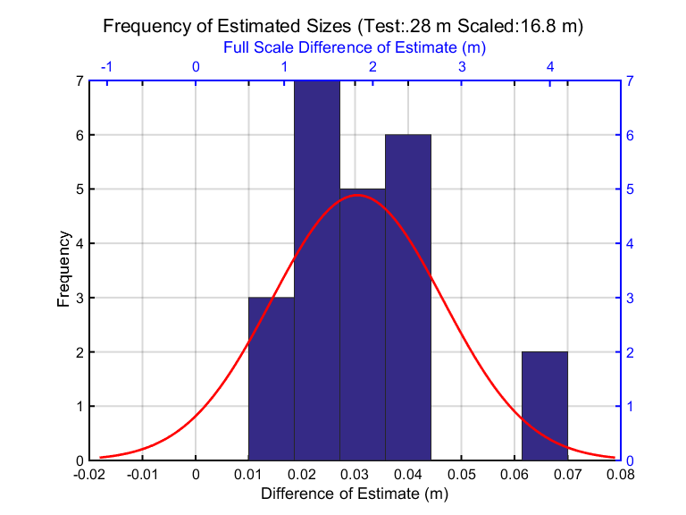
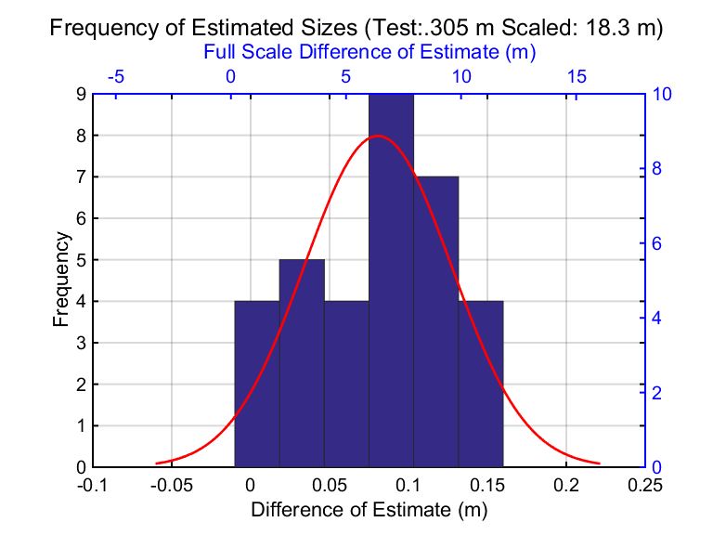
Harbor Security System
Matthew Birkebak (mts54@wildcats.unh.edu) Timothy Brown (tjz63@wildcats.unh.edu)
Abstract
Design and Construction
Detection Algorithm
Harbors and ports provide the infrastructure for commercial trade and naval facilities. It is vital to ensure the safety of these locations. The Harbor Security System provides an optical ‘gate’ using underwater lasers and photodetectors. This system allows monitoring of both surface and submarine vessels traveling into and out of the harbor. Also, the system provides real time alerts when unauthorized vessels enter the harbor. This project provides a proof of concept for a Harbor Security System to be implemented in Portsmouth Harbor. A scaled model of the detection system was constructed and tested. This detection system is capable of detecting surface and submarine vessels along with their velocity and length. Results of the study showed that the average error of the size estimate was 15% and the average error of the velocity estimation ratio(slope) was 9%.
Transmitter Unit
Detector Unit
Components
Underwater 532nm laser- light source (Figure 3)
Laser Line Generator or Powell Lens (Figure 4)- alters laser beam into a fan shape of nearly uniform light with 80% power of single beam.
Laser Line Generator Housing (Figure 5) – Composed of 3-D printed housing made of PTFE with optically clear acrylic lens fixed to front of housing
Components
SM05PD1A Thor Labs Photo detector – measures incident light and outputs voltage. Are the most responsive in visible wavelengths.
Waterproof housing – acrylic optically clear cylinder machined out and mounted with a stainless steel cord grip
Figure 3 : Z-Bolt Underwater Dive Laser (Z-Bolt)
Figure 6: Photodetector and Responsivity (Thor Labs)
Figure 10: Detector Array
Detector Hardware:
Photo Detector Assembly
Arduino
Breadboard
  Capacitors
  Resistors
Detector Software:
MATLAB R2014a
  Arduino® Support Package
Arduino Coding Program
* Linux command module can be used in place of MATLAB
Implementation
Figure 4 : Powell lens (laser line optics)
Figure 7: Waterproof Housing (Paul Lavoie)
Housing
A 1/60th scale model of the Harbor Security system was used for experimentation.
Using a 2-D array of 5 photo detectors information of size and relative velocity of the object passing through can be determined.
Detection Algorithm Flow Chart
The design will mimic an elevator door detector.
Lasers will be aimed directly at photo detectors, if the connection is broken it indicates an object is passing.
Significant acoustic noise in harbors makes a sonar security gate difficult to conceive.
Photodiode
Figure 5 : Solidworks photorealistic rendering of Underwater laser and housing for Powell Lens
Figure 7: Detector Array Setup
Figure 1 : Elevator Door Detector (Telcosensors.com)
Experimental Setup
.5m depth
Proposed location for laser security gate in Portsmouth harbor , NH
Figure 8 : Experimental Diagram
Commercial Ports
Figure 11: Algorithm Block Diagram
Naval Ship
Yard
Discussion
R²=.98
y=.96X
R²=.95
y=.84X
The Harbor Security System implemented in this project can detect a passing vessel and extract velocity and size information. The results showed that the average error of the size estimate was 15% and the average error of the velocity estimation ratio(slope) was 9%.
The shortest width of a full scale detector unit in Portsmouth harbor can be 1.9 m (6.3 ft), based on the systems speed of response for a vessel traveling a scaled velocity of 25kts. (max velocity of a cargo ship)
Figure 10a: Results from Tow Tank Test
Figure 9a: Results from Flume Tank Test
Proposed Location of security system: Between Salamander Point, New Castle, NH and Kittery Point, Kittery, ME
Future Endeavors
Figure 2 : Security System in Portsmouth Harbor
  Develop detection system that uses motorized lasers (larger scanning range, fewer lasers).
  Evaluate Harbor Security System in terms of security threats
    Explore possible regulations to be imposed around laser (no loitering in laser detection area).
    Sound alarm if boat is stopped in detection zone.
    Add Light Detection and Ranging (LIDAR) system to detect distance of ship from detection system.
  Continue full scale implementation in Portsmouth Harbor.
  Develop intertidal detection system, possibly using different wavelength lasers and motorized assemblies to work with the tides.
Environmental Factors Considered
Reasons for Choosing Location of Security System
Mean high Tide at Seavey Island in Portsmouth Harbor (3.7 m) (datum: MLLW)
Turbidity based on season and type of tide (ebb tide vs. flood tide)
Physical distance the laser must cross(610m)
Physical location in reference to the inlet of the ocean
All commercial and submarine traffic entering harbor must pass this location.
There is less turbidity near the mouth of the harbor.
The gap size is small enough that a 20 mW pulsed ND-YAG laser is eye safe under National Environmental Protection Act (NEPA) regulations.
Figure 9b: Results from Flume Tank Test
Figure 10b: Results from Tow Tank Test
Acknowledgements
Shachak Pe’eri, May-Win Thein, Firat Eren, Paul Lavoie, Martin Renken

