Slide 1


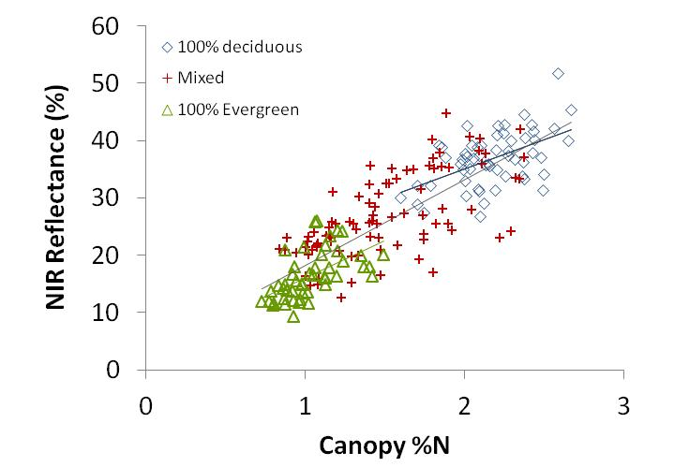
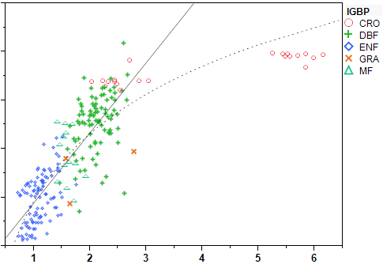
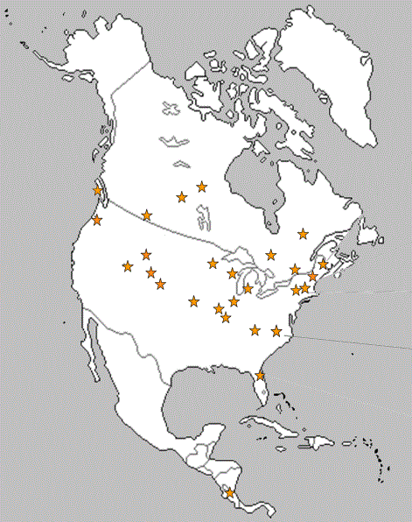
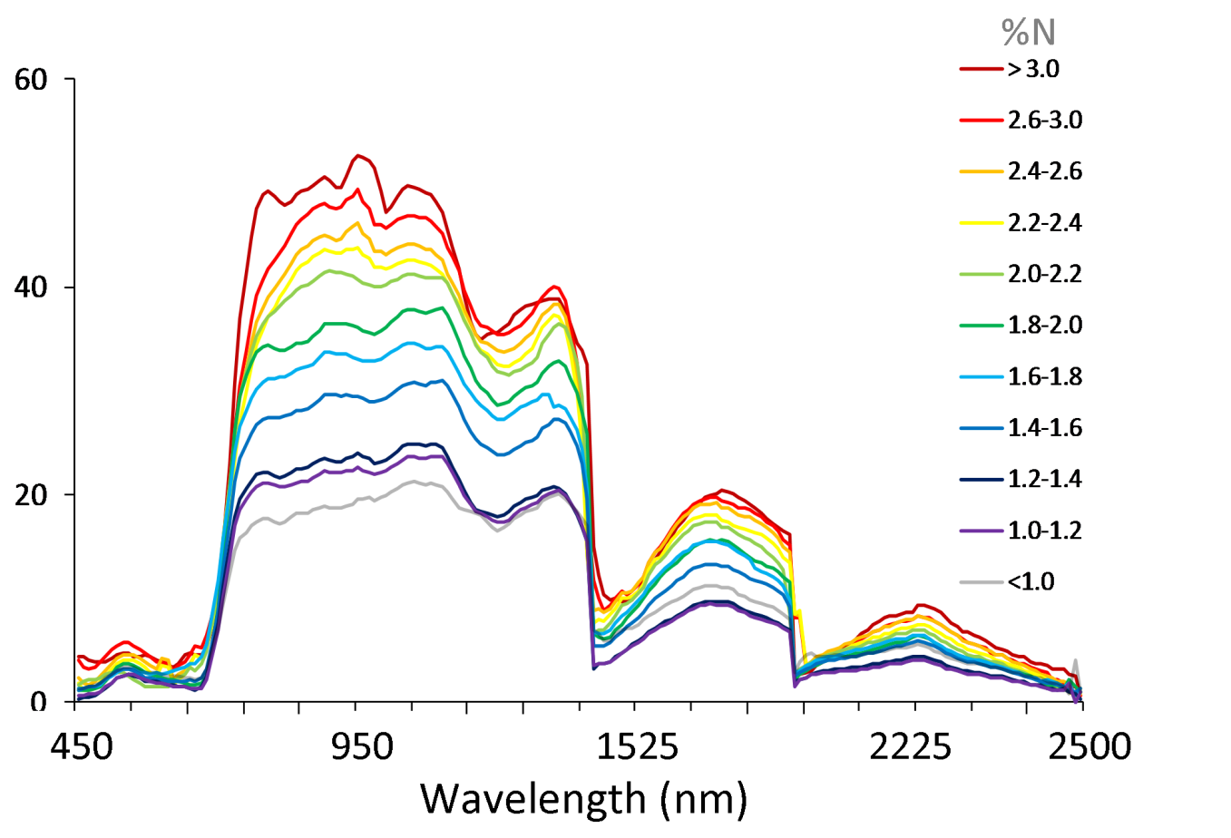
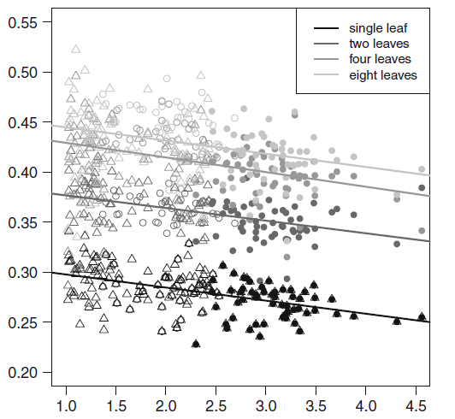
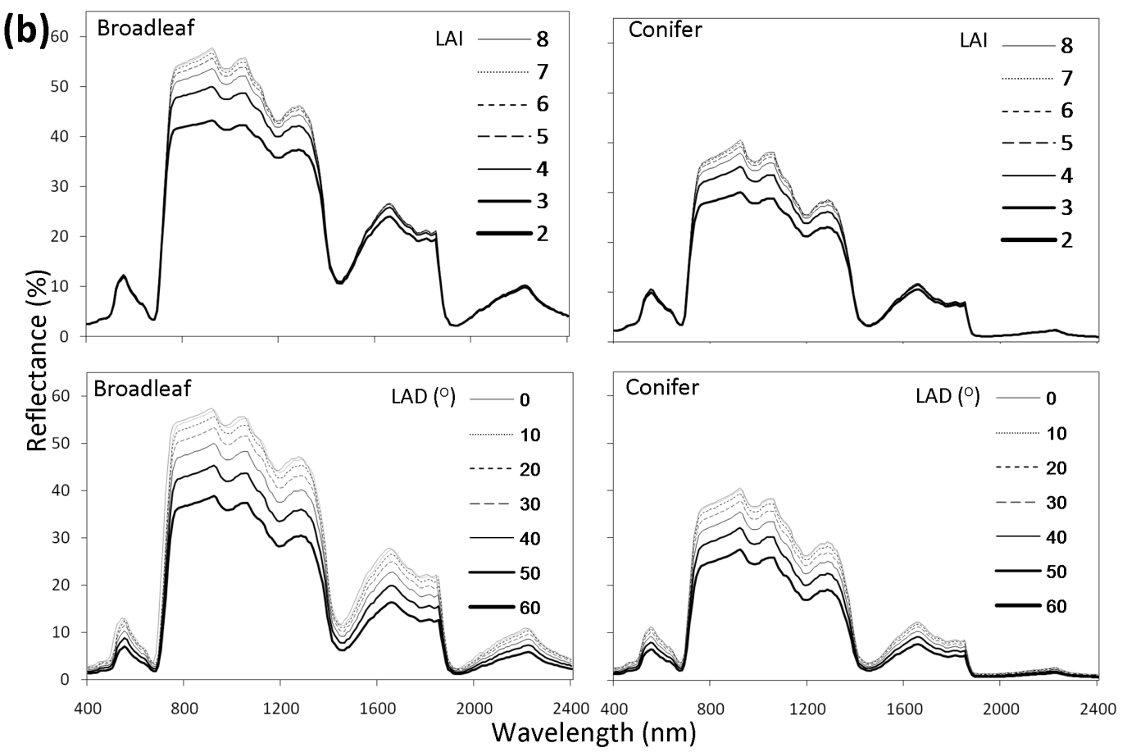
Spectral Reflectance Features Related to Foliar Nitrogen in Forests and their Implications for Broad-Scale Nitrogen Mapping
Lucie C. Lepine, Scott V. Ollinger, Andrew P. Ouimette, Mary E. Martin
scott.ollinger@unh.edu, lucie.lepine@unh.edu, andrew.ouimette@unh.edu, mary.martin@unh.edu
Earth Systems Research Center, University of New Hampshire, Durham, NH 03824, USA
Abstract
The N – NIR relationship is not spurious
The ability to estimate foliar nitrogen concentration (%N) over a range of scales would substantially improve our understanding of terrestrial carbon and nitrogen cycles. At fine scales, %N estimation has been achieved using data from high spectral resolution remote sensing instruments, or imaging spectrometers. Recently, observations of strong correlations between field-measured %N in closed-canopy forests and reflectance across broad portions of the near infrared (NIR) region have raised the possibility that some level of N estimation may be possible with broad-band data.
Concern that the relationship is spurious and is explained solely by the relative abundance of deciduous and evergreen functional groups is not supported by measurements, which show that the trend is highly significant within pure as well as mixed stands.
Moreover, the relationship has now been observed in forest, grass and cropland biomes over a large number of sites.
Fig. 5. Whole-canopy %N relative to NIR reflectance for pure deciduous, pure evergreen and mixed stands. The relationship is significant within each group at p<.0001, as well as across the entire data set. Within mixed stands, NIR reflectance is significantly related to %N values of their deciduous and evergreen subgroups as well as the proportional abundance of the two (r² = 0.71 for the combined model).
r² = 0.27 p<0.0001
r² = 0.42, p<0.0001
All data: r² = 0.71, p<0.0001
r² = 0.35, p<0.0001
60
50
40
30
20
10
Fig. 6. Whole canopy, plot-level %N and NIR reflectance across 215 sites representing a broad range of biomes. Data points include the 102 sites as in Ollinger et al. 2008, as well as additional forest, grassland and cropland sites where %N was measured as part of other studies since the 2008 publication. NIR reflectance represents mean reflectance between 800 and 850nm as measured by AVIRIS or Hyperion sensors. NIR reflectance increases linearly with canopy %N up to about N=3%, and appears to saturate at high %N (e.g. soy), resulting in a nonlinear relationship between %N and NIR reflectance when all plots are included in the regression.
Highlights
We explored the effects of spectral resolution, spatial resolution and sensor fidelity on relationships between forest %N and reflectance.
We compared forest canopy %N and reflectance data from AVIRIS, Landsat and MODIS.
Observed relationships between %N and reflectance were driven primarily by reflectance in the NIR region.
The strength of the relationship between NIR reflectance and %N was influenced more by sensor fidelity than spatial or spectral resolution.
Our results suggest promise for broad-scale canopy %N estimation with a variety of sensors.
NIR reflectance
%N-NIR relationship is significant within pure deciduous and pure evergreen, as well as mixed stands.
solid line r² = 0.71, rmse = 5, p<0.0001
dashed line r² = 0.74, rmse = 5, p<0.0001
Multi-site, generalized %N calibration
Canopy %N
A single PLS regression equation developed from AVIRIS spectra and whole-canopy %N from 155 plots across North America
Underlying causes of the N-NIR relationship
r² = 0.86
Initial speculation that the relationship resulted from leaf-level anatomical structures that influence scattering and reflectance was not supported by leaf level measurements (e.g. Fig. 8, right). This suggests that the trend results from as-yet unidentified functional associations between %N and plant traits at the stem and/or canopy scale.
%N-NIR relationship is not driven by differences in leaf-level reflectance
NIR reflectance
VIP Score
(a)
(b)
Predicted canopy %N
Reflectance (%)
Wavelength
Leaf %N
(a)
(b)
Measured canopy %N
Fig. 2. Variable Importance of Projection (VIP) plot for the PLS regression equation used to predict %N in Fig. 1b. The VIP score on the y-axis describes the importance of each wavelength in the projection of the latent variables that underlie the PLS model. Predictors with a VIP score of one or higher are typically important in the regression model, with those less than 0.8 tending to add very little.
Fig. 7. PLSR factor loadings (e.g. Fig. 2 in panel to the left) were most influenced by NIR bands. This likely reflects the pattern of increasing NIR reflectance with increasing %N observed here, where average AVIRIS spectra were plotted for our study sites and grouped into 11 classes of %N (Ollinger 2011).
Leaf %N
Fig. 1. (a) Location of study sites incorporated in previous studies that have examined CO₂ uptake, canopy N and albedo at local, landscape and regional scales, and for which AVIRIS data have been collected and coordinated field measurements have been made. Data for forested sites here have been integrated into a single PLS regression equation toward developing a generalized method for N mapping at landscape scales (e.g. Martin et al. 2008). An example of a generalized PLS regression model is shown in (b). The regression model is significant at p<0.0001 with a low standard error of calibration (0.19).
Fig. 8. Regression between foliar %N and NIR reflectance for single leaves (a) and stacks of leaves (b). %N was negatively correlated with NIR reflectance, with p<0.0001 in all cases (From Wicklein et al. 2012). A significant, but negative, relationship is observed between foliar nitrogen and leaf reflectance (both full spectrum leaf albedo as well as leaf albedo in the NIR region) (e.g. Bartlett et al. 2011, Wicklein et al. 2012, Sullivan et al. 2013).
The PLS regression model is driven primarily by wavelengths in the NIR region.
Canopy %N in relation to simple measures of canopy reflectance
Multiple lines of evidence suggest that a series of interrelated plant traits (e.g. Fig 9-10 below) that are known to affect radiation scattering over scales ranging from cells to canopies are functionally associated with the nitrogen status of plants. These associations reflect optimization of resource acquisition and carbon allocation and have deep evolutionary origins.
(a)
Vegetation indices that represent some combination of NIR bands and visible bands do not tend to explain more variability in %N than NIR alone.
Here’s why:
(a)
2.5
2.0
1.5
1.0
0.5
r² = 0.81
RMSE = 0.24
4.5
(a)
blue
9
(b)
green
Canopy %N
3.0
6
% Reflectance
3
Fig. 10. Examples of known associations that illustrate convergence of spectrally important plant traits (a); idealized relationships among other variables that exhibit some degree of convergence and that are known to be related to NIR reflectance (b) (Ollinger 2011).
Table 1. Regression statistics from analyses of canopy %N with reflectance at (a) Landsat spectral bands simulated with AVIRIS and obtained directly from Landsat; and (b) MODIS spectral bands simulated with AVIRIS and obtained directly from MODIS.
1.5
0
0
10 20 30 40 50 60
4.5
(c)
red
60
(d)
NIR
(b)
% NIR Reflectance (889 nm)
3.0
40
2.5
2.0
1.5
1.0
0.5
r² = 0.53
RMSE = 0.35
% Reflectance
20
1.5
0
Canopy %N
0
(e)
mid-IR
15
(f)
mid-IR
24
10
16
10 20 30 40 50 60
% Reflectance
5
(c)
% NIR Reflectance (band 4)
8
0
(b)
0
2.5
2.0
1.5
1.0
0.5
r² = 0.77
RMSE = 0.25
0
1.0
2.0
3.0
0
1.0
2.0
3.0
Fig. 9. Canopy reflectance spectra predicted by the PROSPECT/SAIL models, generated using a range of values for LAI and leaf angle distribution (LAD) for whole-canopy reflectance (Ollinger 2011).
Canopy %N
Canopy %N
AVIRIS-simulated Landsat
AVIRIS-simulated MODIS
AVIRIS-simulated Landsat
AVIRIS-simulated MODIS
Landsat
MODIS
Landsat
MODIS
Canopy %N
Fig. 4. Observed relationships between canopy %N and reflectance at Landsat and MODIS bands. No significant relationships were observed between %N and visible reflectance (a–c). A weak negative relationship was observed between %N and actual MODIS red reflectance (r² = 0.25, RMSE = 0.45, p = 0.0085) (c). Highly significant relationships (p<0.0001) were observed between %N and reflectance at the NIR band (d) for all data (simulated and actual), and weak correlations with the mid-IR bands (e-f).
Conclusions
10 20 30 40 50 60
Our results suggest potential for new interpretations of NIR reflectance from broad-band sensors, but our ability to predict conditions under future change scenarios is limited to contemporary conditions because the mechanistic driver in N-NIR link remains unclear
Results reported here nevertheless indicate promise for the possibility of broad-scale N mapping.
Future research in this area should involve refinement of N-mapping methods to include a broad range of ecosystems and land cover types, and further experimentation to better understand the extent to which changes in plant N status, N availability, or increases in N or other atmospheric inputs, will also change NIR reflectance.
% NIR Reflectance (band 2)
Fig. 3. Simple linear regressions of measured canopy %N and NIR reflectance at one NIR band from (a) AVIRIS, (b) Landsat and (c) MODIS using data from sites shown in Fig. 1. All relationships are significant at p<0.0001.
Relationships between measured %N and NIR reflectance from Landsat and MODIS were weaker than those using AVIRIS data aggregated to Landsat and MODIS spectral resolutions. Collectively, our results indicate that the potential to estimate canopy %N for pixels as coarse as 500m with a simple regression model may be most limited not by sensor fidelity, but by lack of field measurements for an area this size, and by insufficient understanding of mechanisms underlying the %N-NIR relationship.
Notes:
1

