Slide 1
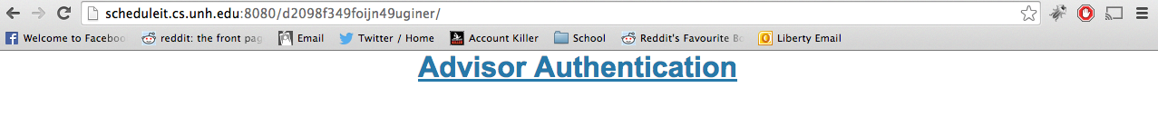
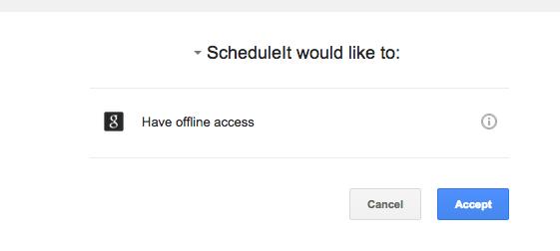
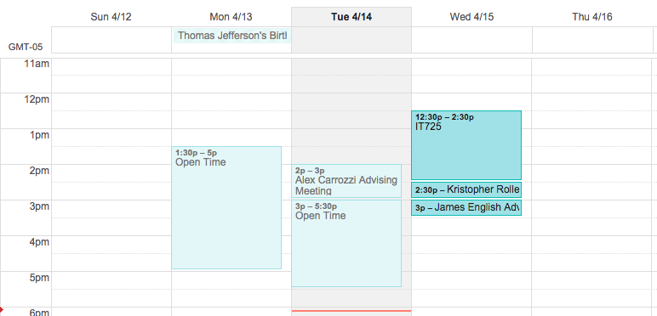
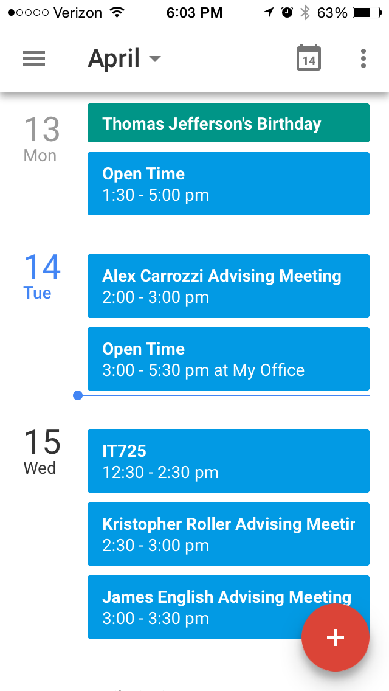

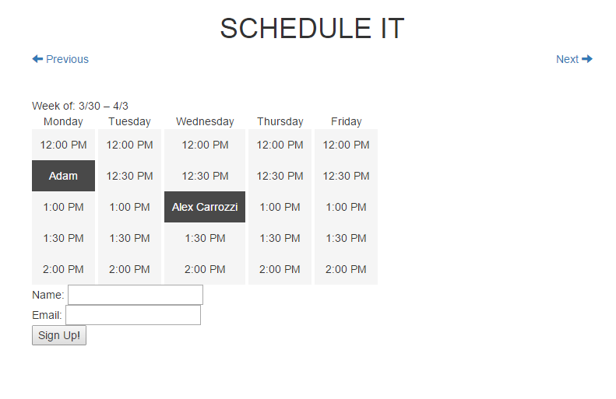
z
ScheduleIT
Streamlining the Student - Advisor Scheduling Process
Alex Carrozzi, James English, and Arturo Hernandez.
Advisor: Radim Bartos, Department of Computer Science
CS & IT students meet with their faculty advisor every semester to discuss progress in their academic program, as well as to select classes for the next semester. Advisors can have many students to meet with, and without a formal scheduling process, advisors must spend valuable time every semester scheduling meetings with an increasing number of students
How it works:
Advisors authorize ScheduleIT to access the specific calendar they choose
Advisors create blocks of time in his / her calendar
Advisor distributes link to students
Students follow link to a page with available times shown and can select their preferred meeting time
Automated email sent if students need to reschedule
Calendar entry on Advisors calendar changed to show students name
ScheduleIT improves administrative control over the scheduling process with time-block listing, and calendar synchronization
Current System:
Advisors forced to handle all scheduling
Students cannot easily reschedule
No established process, faculty have various techniques
Our System:
Quick and easy for both students and advisors
Integration with existing calendar tools
Streamlined user experience for faculty and students
Potential for deployment beyond original scope
Benefits
No registration
No information held outside of Google
Integration with existing solutions
Improving user experience for both Student and Faculty
Technologies Used:
PHP, HTML 5, CSS (Bootstrap)
JavaScript, jQuery and Date.js Libraries, Angular.js MVC
Google API Calendar API 3.0 Oauth 2.0 Google
Advisor
Mobile View (IOS)
Advisor
Desktop View
Link Generation:
(Advisor to emails to students)
Student view from link sent by their Advisor

