Slide 1

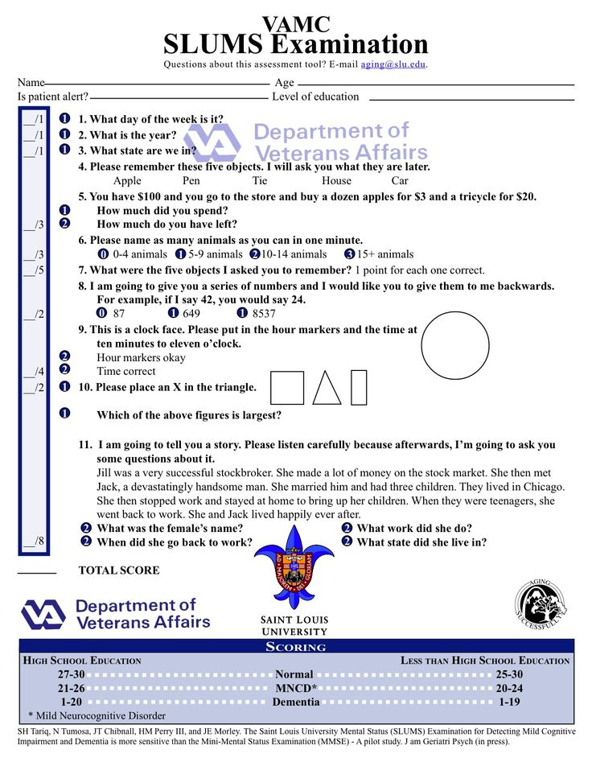
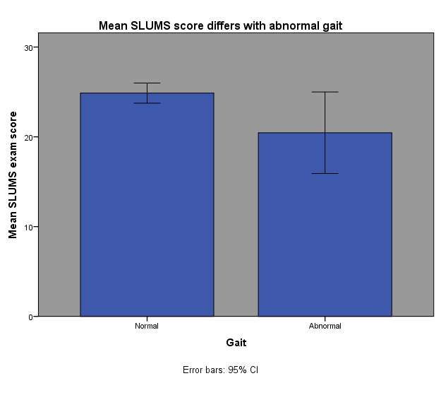

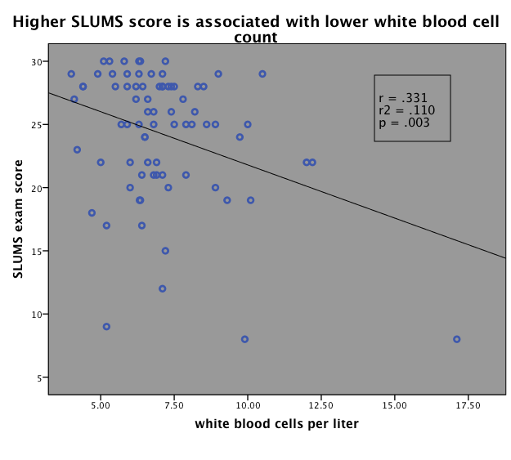
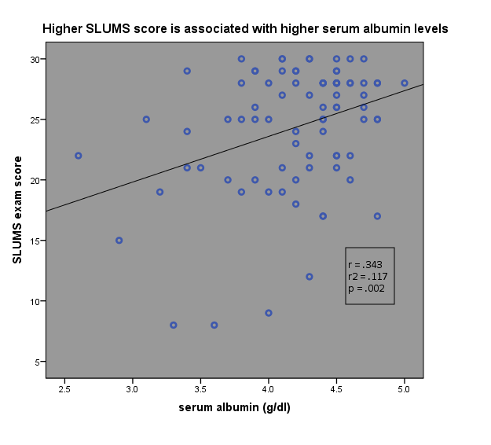
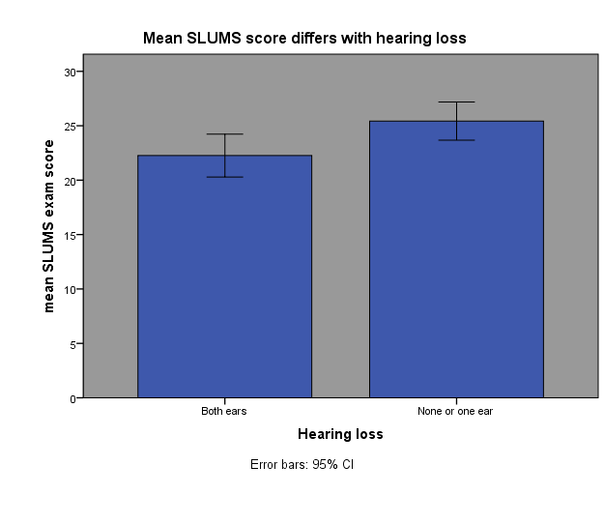
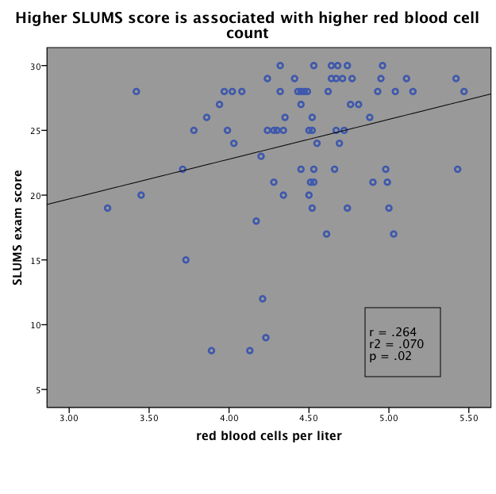
Dementia and primary-care health measures:
Hearing, gait, and markers of inflammation
Elsa Lindgren, Robert C. Drugan, & Rebecca M. Warner
Psychology Department, University of New Hampshire, Durham, NH 03824, USA
Introduction
Measures:
The six
variables analyzed were SLUMS exam score, hearing, gait, white blood cell count, serum albumin level and red blood cell count. The SLUMS exam has a score from 0-30, with scores from 1-20 indicating dementia (N=17), 21-26 indicating mild neurocognitive impairment (N=32), and 27-30 indicating normal cognitive function (N=37). Scoring assumed that all patients had a high school education. The mean SLUMS was 24.35, SD=5.09.
Figure 2: The group with abnormal gait had a significantly lower SLUMS score (M=20.45, SD=6.76) than the group normal gait(M=24.87, SD=4.34).
t(69)=2.82, p=.006, two-tailed. Eta-squared=0.1.
Conclusions
Dementia is estimated to affect 14.7% of the US population aged 70 years and older, and to cost an estimated $159 billion to $215 billion nationwide (1). Primary care visits frequently use screening tools such as the Mini-Mental Status Exam (MMSE) or St. Louis University Mental Status (SLUMS) exam to assess cognitive impairment and dementia. An advantage of the SLUMS exam is that it differentiates dementia from mild neurocognitive impairment (MNCI) which may precede dementia in younger patients (2).
Loss of hearing in both ears was associated with a lower SLUMS score. This supports previous research that found hearing loss associated with a lower MMSE score.
Abnormal gait was associated with a lower SLUMS score.
White blood cell count is negatively correlated to SLUMS score. High white blood cell count indicates a possible immune response.
Serum albumin is positively correlated to SLUMS score. Serum albumin is predictive of systemic inflammation usually measured by C-reactive protein or inflammatory cytokines. This may be possibly associated with nutritional status.
Red blood cell count is positively correlated to SLUMS score. This may be associated with nutritional stratus.
Results are consistent with past research.
Hypertension, dyslipidemia and diabetes have been shown to increase risk for both vascular dementia and Alzheimer's disease (3). Two other directions for research are studying related physical disturbances and related systemic inflammation.
Figures 3-5: Correlation plots for SLUMS score with white blood cell count, serum albumin and red blood cell count.
iStockphoto
Hearing loss was measured by a hearing test of each ear. Data from patients with a hearing aid were not included. Hearing data was available for 45 patients. If a patient passed the test in one or both ears, the patient was placed into the some hearing group (N=14).
Gait was determined by the patient's provider and commented on in the chart. Gait data was available for 71 patients. Any gait that was not described as normal was placed in the abnormal gait group (N=11).
White blood cell count (M=7.09, SD=2.03), serum albumin level (M=4.19, SD=0.47), and red blood cell count (M=4.47, SD=0.45) were all measured by routine blood tests. Statistical analysis was performed using SPSS.
Hearing loss has been shown to correlate with the severity of cognitive impairment according to the MMSE (4), and abnormal gait has been shown to be a predictor of non-Alzheimer's dementia (5). This study examined correlations between these two variables, gait and hearing, and dementia to determine if these previous studies could be supported.
References
Hurd, M. D., Martorell, P., Delavande, A., Mullen, K. J., & Langa, K. M. (2013). Monetary costs of dementia in the United States. New England Journal of Medicine, 368(14), 1326-1334.
Tariq, S. H., Tumosa, N., Chibnall, J. T., Perry, M. H., & Morley, J. E. (2006). Comparison of the Saint Louis University mental status examination and the Mini-Mental State Examination for detecting dementia and mild neurocognitive disorder—a pilot study. The American Journal of Geriatric Psychiatry, 14(11), 900-910.
Kloppenborg, R. P., van den Berg, E., Kappelle, L. J., & Biessels, G. J. (2008). Diabetes and other vascular risk factors for dementia: which factor matters most? A systematic review. European Journal of Pharmacology, 585(1), 97-108.
Uhlmann, R. F., Larson, E. B., Rees, T. S., Koepsell, T. D., & Duckert, L. G. (1989). Relationship of hearing impairment to dementia and cognitive dysfunction in older adults. Journal of the American Medical Association, 261(13), 1916-1919.
Verghese, J., Lipton, R. B., Hall, C. B., Kuslansky, G., Katz, M. J., & Buschke, H. (2002). Abnormality of gait as a predictor of non-Alzheimer's dementia. New England Journal of Medicine, 347(22), 1761-1768
Dik, M. G., Jonker, C., Hack, C. E., Smit, J. H., Comijs, H. C., & Eikelenboom, P. (2005). Serum inflammatory proteins and cognitive decline in older persons. Neurology, 64(8), 1371-1377.
Taniguchi, Y., Shinkai, S., Nishi, M., Murayama, H., Nofuji, Y., Yoshida, H., & Fujiwara, Y. (2014). Nutritional biomarkers and subsequent cognitive decline among community-dwelling older Japanese: a prospective study. The Journals of Gerontology Series A: Biological Sciences and Medical Sciences, 69(10), 1276-1283.
Inflammation is commonly studied by measuring levels of inflammatory proteins in blood plasma such as c-reactive protein (CRP) and interleukin-6 (IL-6). High levels of IL-6 are associated with an increased risk of non-Alzheimer's dementia. As these tests are relatively new and not widely performed in primary care visits, this study looked at other measures of inflammation from the complete blood count panel, including white blood cell count, and serum albumin. In a previous study, serum albumin level was shown to correlate with scores on the MMSE (6). In addition, this study considered red blood cell count for correlations to the SLUMS scores as a recent study found this to also relate to cognitive decline in addition to albumin levels as an association to nutritional levels (7).
Results
Figure 1: The group with hearing loss in both ears had a significantly lower SLUMS score (M=22.26, SD=5.38) than the group with no hearing loss or hearing loss in one ear (M=25.43, SD=3.03).
t(43)=2.055, p=.046, two-tailed. Eta-squared=0.09.
Method
Participants:
Archival data were collected from electronic medical records at Goodwin Community Health, Somersworth, NH. A report was generated for all patients 65 and older with a score on the SLUMS exam, N=86. Data for SLUMS scores and other measures were transferred to a de-identified data file. Approval was given from the University of New Hampshire Institutional Review Board for the Protection of Human Subjects in Research (IRB) and the Chief Information Officer at Goodwin Community Health. A HIPAA privacy regulation waiver was obtained.
Acknowledgements
All data collection methods were reviewed and approved by the University of New Hampshire Internal Review Board and the Chief Information Officer at Goodwin Community Health. Funding for the project was provided by the Hamel Center for Undergraduate Research.

