Slide 1

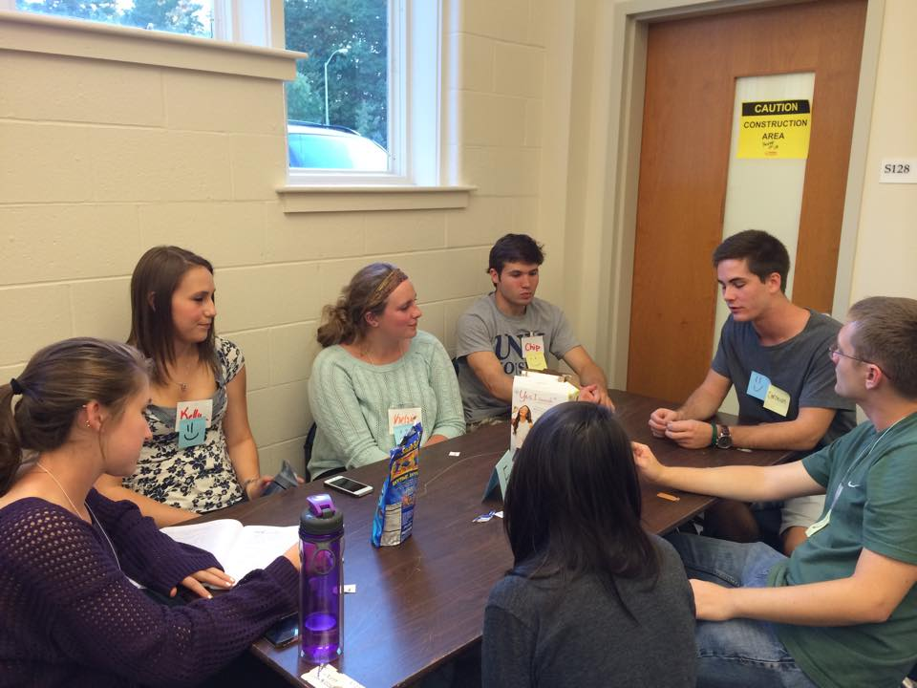
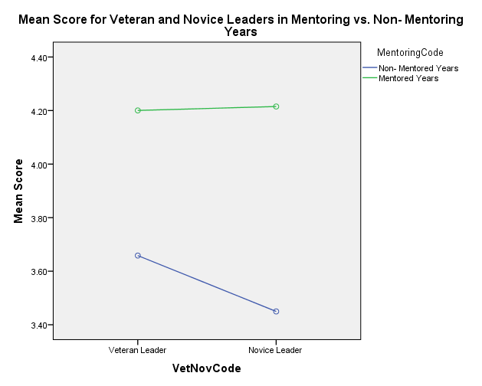
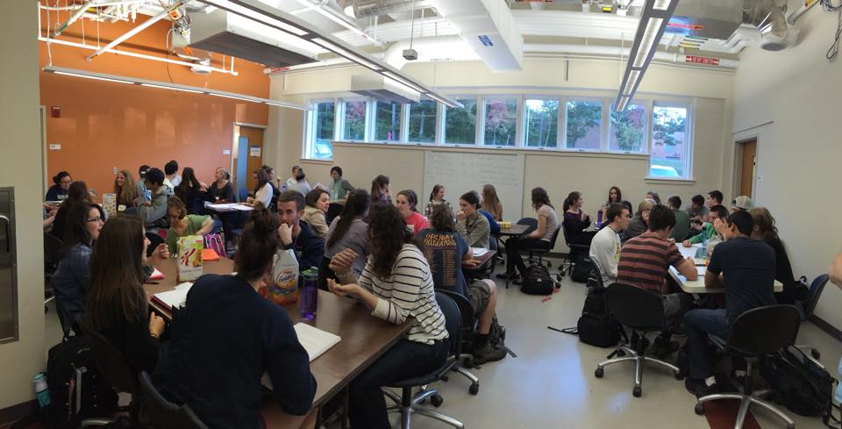
Effectiveness of Peer-Led Team Learning with Different Leader Training in College General Chemistry
Brittney Hutchinson, Dr. Christopher Bauer and Dr. Julia Chan
bsl28@wildcats.unh.edu; Parsons Hall, 23 Academic Way, Durham NH 03824
Peer-Led Team Learning Program
Peer-Led Team Learning (PLTL) was introduced to the University of New Hampshire in 2000 by Dr. Christopher Bauer. The first class that this program was implemented to was college general chemistry. Students that have taken general chemistry were recruited to lead a group of 3-10 students currently taking the course. In 2010 a leader mentoring program was implemented. This mentoring program paired a veteran leader with a novice leader for their first semester running a PLTL group. The PLTL program has grown exponentially since its first implementation. There are currently 42 leaders providing facilitation of a group to students in general chemistry and organic chemistry.
Results and Discussion
No significant differences were found between veteran and novice leaders in all four years
Over time veteran leaders showed higher scores on end of semester surveys than novice leaders (Figure 2)
Students reported higher mean scores on surveys for leaders who received mentoring (4.21) vs. those who did not (3.55) (Figure 1)
  This suggests mentoring may be an effective way to training novice leaders
End of the semester survey questions
Students answered based on a 5 point Likert scale.
SD D N A SA
Strongly Disagree Disagree Neutral Agree Strongly Agree
Participating in PLTL helped to improve my grade.
I would like other chemistry courses to have PLTL associated with them.
Chemistry ideas made more sense to me when people in my PLTL group explained them to me.
I would recommend PLTL to other students.
I would like courses in other departments to have PLTL associated with them.
Time spent in PLTL was more valuable for my learning than if I had spent that time studying alone.
Participating in PLTL has helped me do better on tests.
Figure 1: Profile plot of average means for veteran and novice leaders
Figure 2: Graph showing same leader growth from novice to veteran leader
Future Work
The next step of this research is to further analyze the data pertaining to a specific leader. Each student is given the opportunity to write specific comments about the PLTL program in order for us to gain deeper knowledge of the program. These written comments provide additional data to triangulate our statistical results.
Conclusions
Mentoring program makes a significant difference in a students experience in PLTL. However, it was also concluded that there is not a significant difference between veterans and novices when leading groups. When specific leaders were analyzed over time, the students generally gave them a higher score as a veteran than a novice.
Method
The statistics program SPSS 22 was used. At the end of every semester, students in a PLTL group are asked to take a survey with seven questions (see above) based on a five-point Likert scale (SD- strongly disagree, SA- strongly agree). Data from four fall semesters were analyzed. Two of the fall semesters (2011, 2012) had a mentoring leader system and the other two fall semesters didn’t (2007, 2009).
Acknowledgments
This work would not have been possible without the aid and encouragement of Dr. Christopher Bauer and Dr. Julia Chan. I would also like to thank UNH, and the Department of Chemistry for funding.
References
1. Gafney, L., Varma-Nelson, P. Innovations in Science and Technology. Peer-Led Team Learning; Springer: Illinois, 2008; Vol. 16.
2. Pallant, J. SPSS Survival Manual, 4th ed.; McGraw-Hill: New York, 2010.

