Slide 1

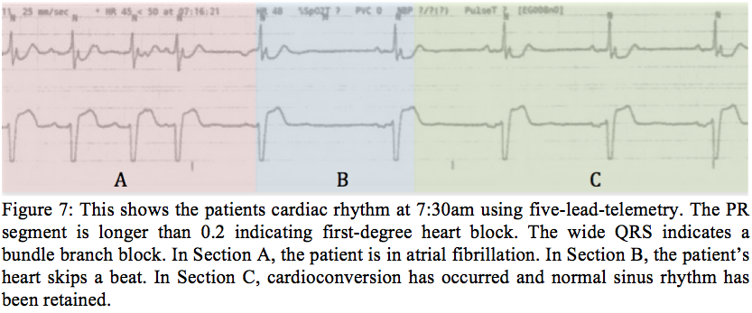
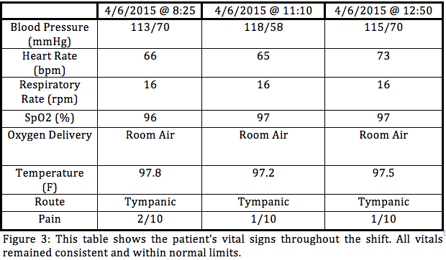
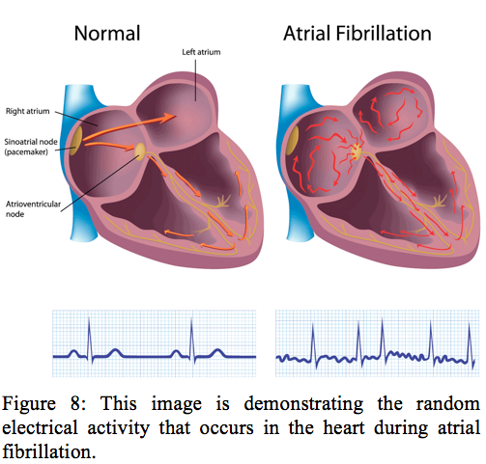
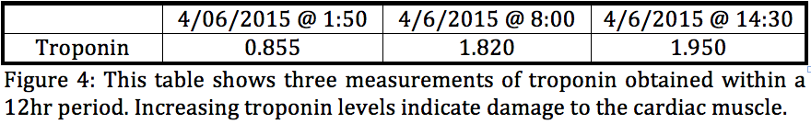
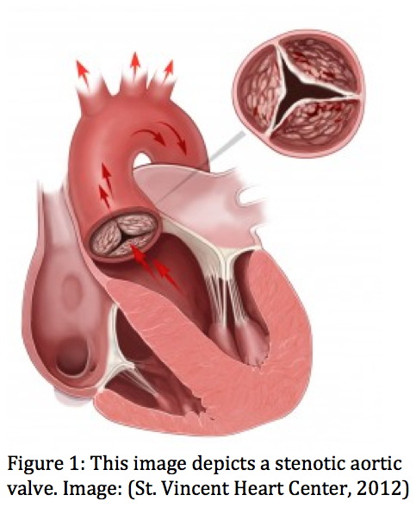
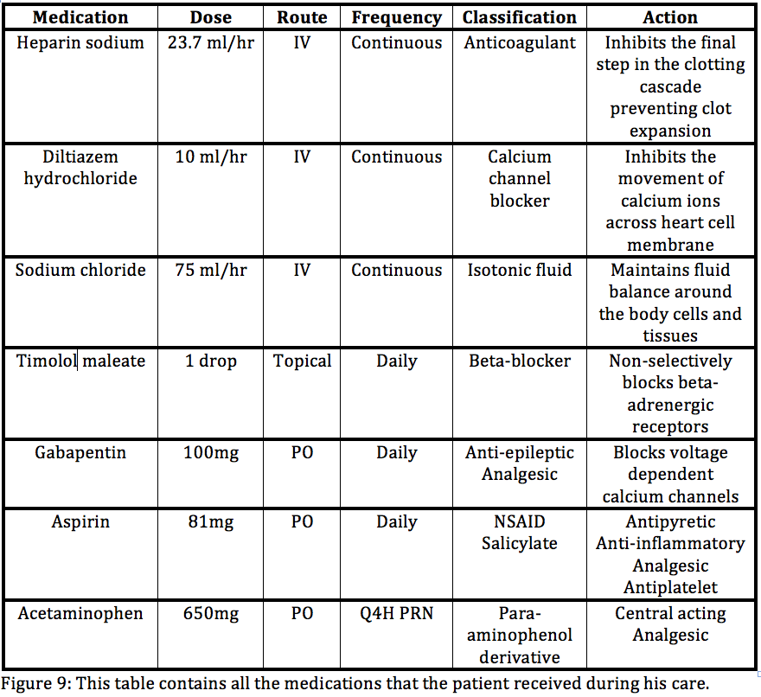
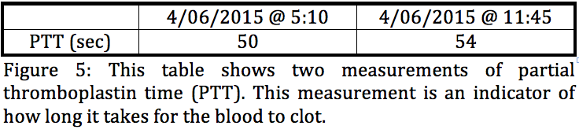
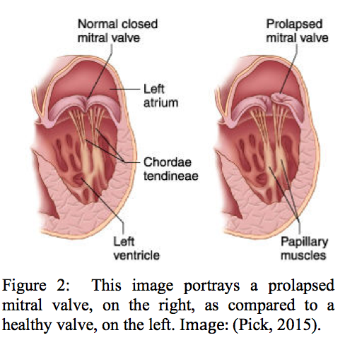
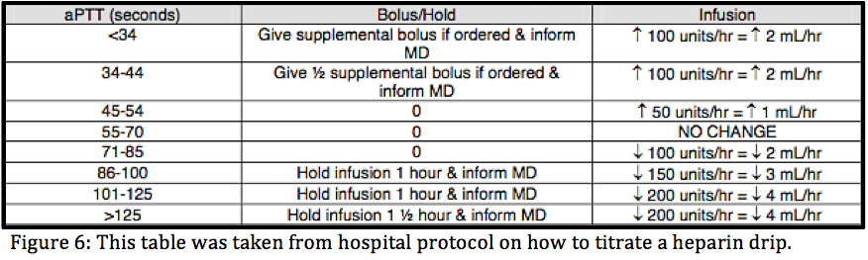
Case Study: Elderly Male With Chest Pain and Palpitations
Rachel Lynch
DEMN Nursing Department, University of New Hampshire
Introduction
Vitals, Lab Tests, Diagnostics
Pathophysiology
Patient Illness Trajectory
An 81-year old male brought to the emergency department complaining of chest pain and generally ‘not feeling right.’ Patient was found to be in atrial fibrillation with a heart rate of 130.
Patients vitals were consistent and remained within normal limits. In addition the patient’s basic blood panel and basic metabolic panel showed no values outside of normal limits.
In the emergency department the patient was found to be in atrial fibrillation. This is evidenced by the patient’s heart rate, rhythm, and telemetry rhythm.
The patient’s atrial fibrillation has been resolved but the underlying heart conditions have not. The patient’s aortic stenosis, mitral valve regurgitation, first-degree heart block and a bundle branch block have not been treated. The patient is at risk for relapsing into atrial fibrillation and other adverse events due to the stress that is on his heart.
The next step in this patient’s treatment is cardiac catheterization.. Catheterization will identify any blockages, or potential blockages, in the vessels. If necessary, a stint will be placed to open the vessel.
Eventually, the patient will need heart surgery to replace his stenotic aortic valve. The stenosis of the aortic valve causes the heart to work harder to circulate blood. Without surgery, his heart problems will continue to get worse.
Past Medical History
The patient has a history of L4-L5 radiculopathy, hypertension, glaucoma, mitral valve disorder and severe aortic stenosis.
L4-L5 Radiculopathy
The compression of nerves in his lumbar spine sends pain down his left leg. The pain has been lessened by gabapentin The injury no longer interferes with his daily activities.
Hypertension
The patient’s hypertension is well managed through lifestyle changes and hydrochlorothiazide PO at home.
Glaucoma
The patient’s glaucoma has been well managed with timolol (Figure 9).
Severe Aortic Stenosis
Mitral Valve Disorder
The erratic contractions of the atria mean that blood isn’t effectively ejected into the ventricles. The patient was started on a Diltiazem drip in order to correct this irregular rhythm. Diltiazem is a calcium channel blocker that is a class IV antiarrhythmic. Figure 7 shows the rhythm of the heart as Diltiazem reverts the heart to sinus rhythm.
Elevated troponin levels indicate damage to the heart muscle.
Acknowledgements
The initial drip rate of heparin was determined to be 22.7 mL/hr according to hospital protocol. At 5:10 am the patient’s PTT was found to be 50 sec. According to hospital protocol, show in figure 6, the drip rate was increased by 1mL/hr. Approximately six hours later, the PTT was re-measured and found to be 54 sec. The drip was increased another mL/hr.
I would like to acknowledge my pathophysiology and pharmacology professor Pamela Kallmerten and the rest of the UNH nursing teaching staff.
I would like to send a special thank you to Eileen Hollis, my clinical nurse preceptor, for patiently teaching about telemetry and the ins and outs of the cardiac floor.
The aortic valve has hardened and doesn’t open or close fully.
He was evaluated in 2012, and was found to have an ejection fraction of 65-70%. This value is within normal ranges.
Medications
References
Aschenbrenner, D., & Venable, S. (2012). Drug Therapy in Nursing
(4th ed.). Philadelphia: Wolters Kluwer Lippincott Williams & Wilkins.
Images from:
Beth Israel Deaconess Medical Center. (2015). Good news for atrial fibrillation patients with sleep apnea. Retrieved from http://www.bidmc.org/Centers-and-Departments/Departments/Cardiovascular-Institute/CVI-Newsletter/Archives/June13/AfibSleepApnea.aspx
Pick, A. (2015). Mitral valve disorders. Retrieved from http://www.heart-valve-surgery.com/mitral-valve-disorders-symptoms.php
St. Vincent Heart Center. (2012). Aortic valve stenosis. Retrieved April 4, 2015, from http://bestheartcare.com/programs-services/valve-center-of-excellence/aortic-valve-stenosis/
A prolapsed mitral valve means that the valve does not close completely. This allows blood to flow backwards into the atria from the ventricle. It decreases the efficiency of the heart.

