Slide 1






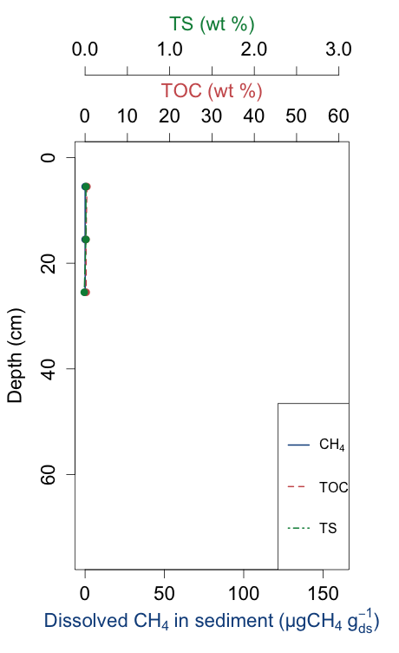
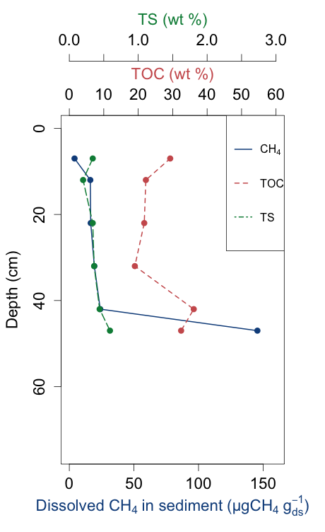
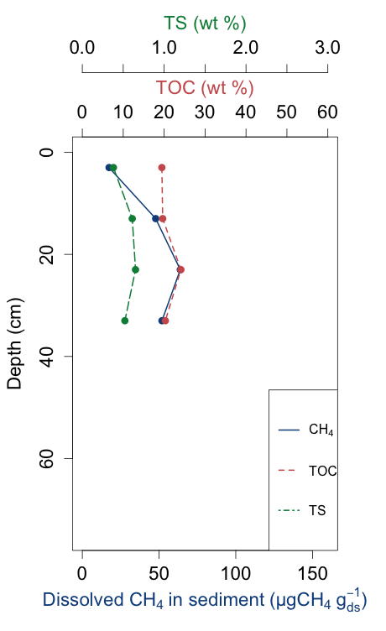
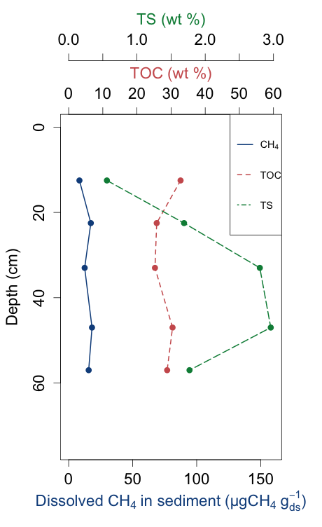
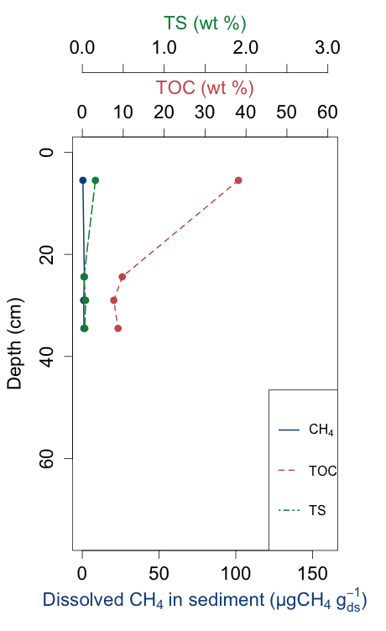
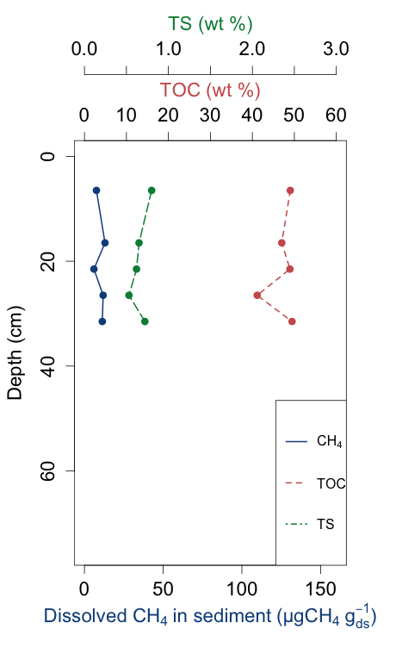
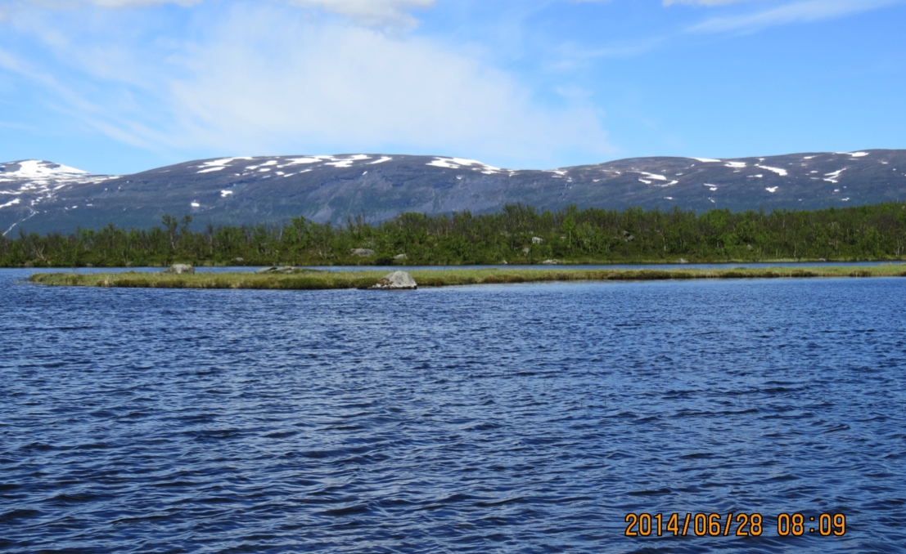
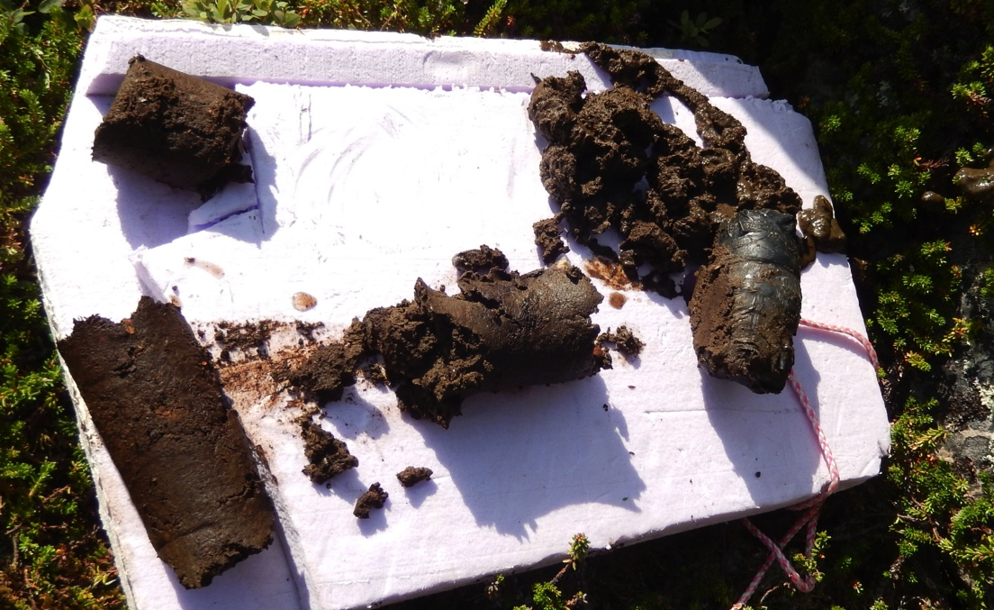
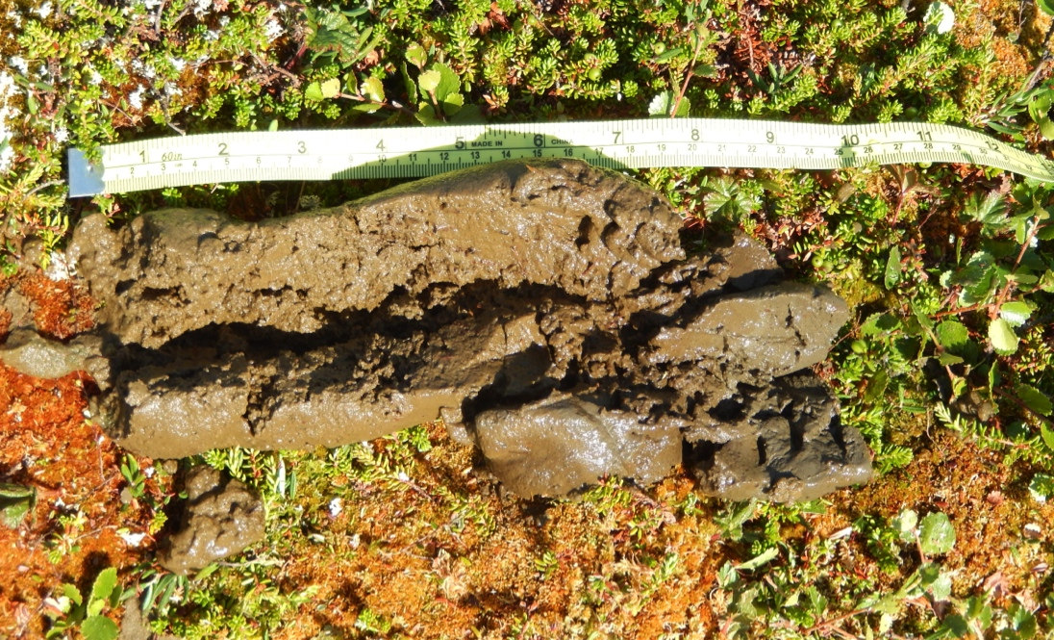
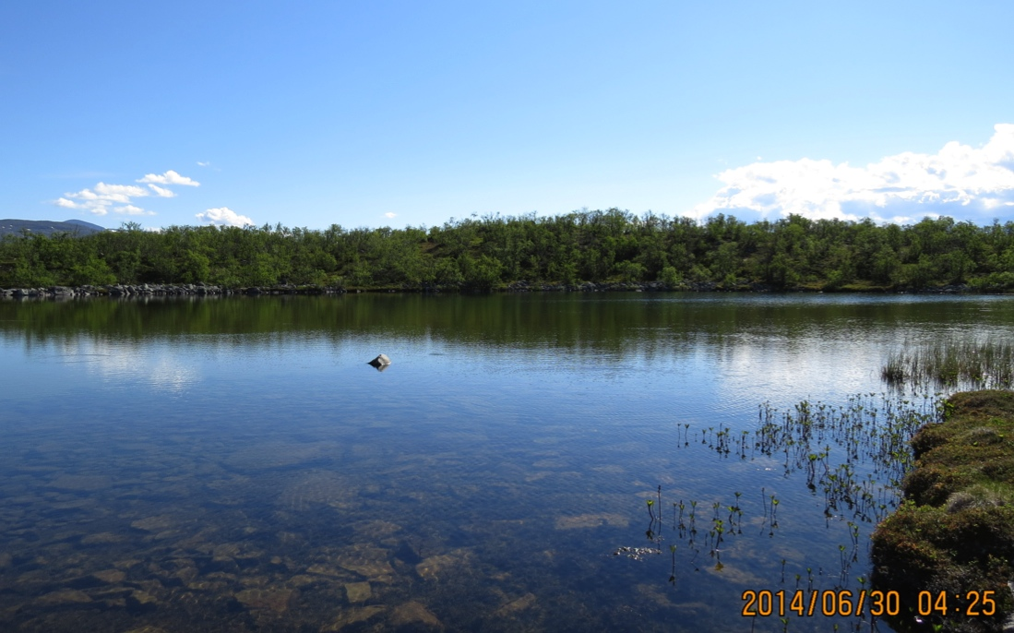
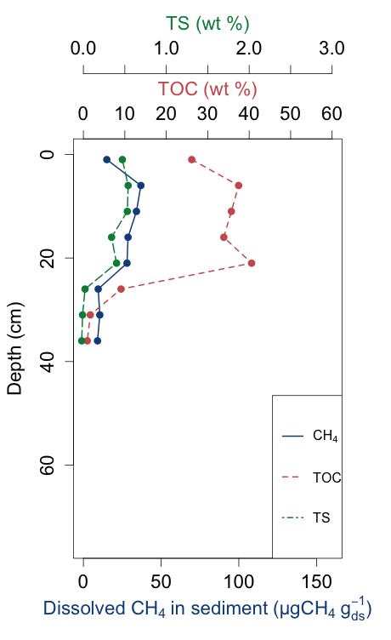
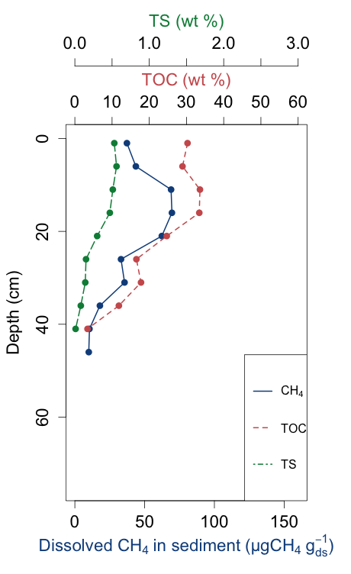
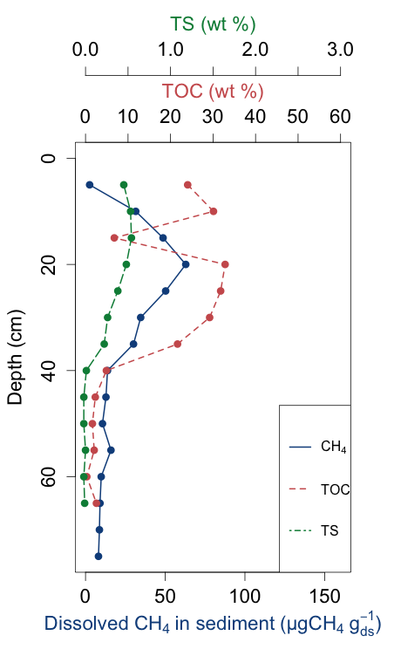
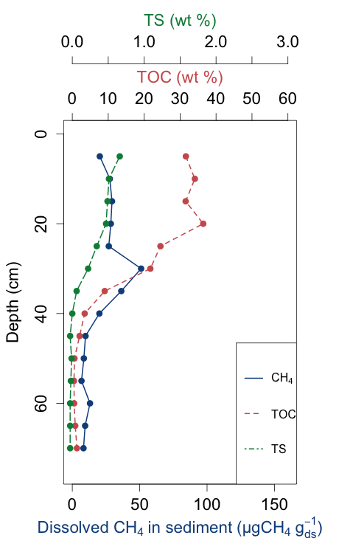
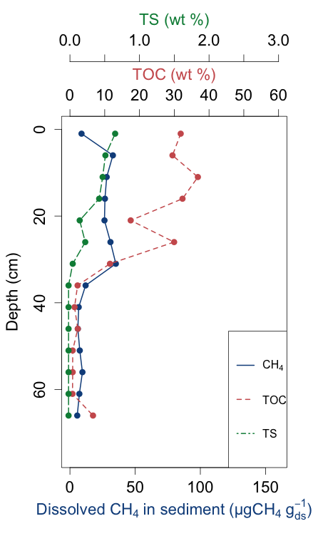
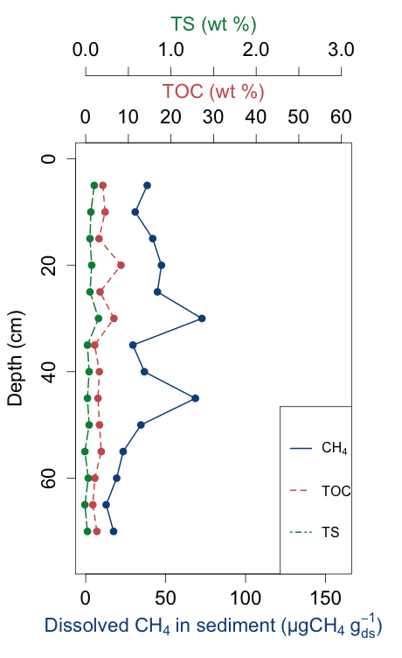
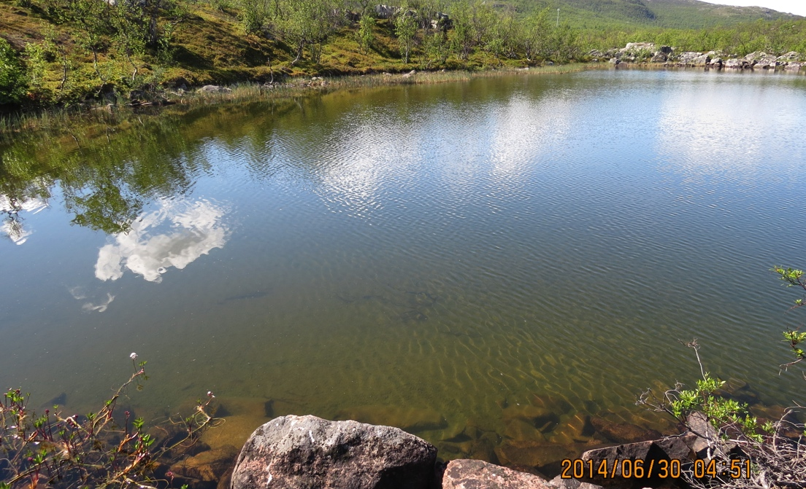
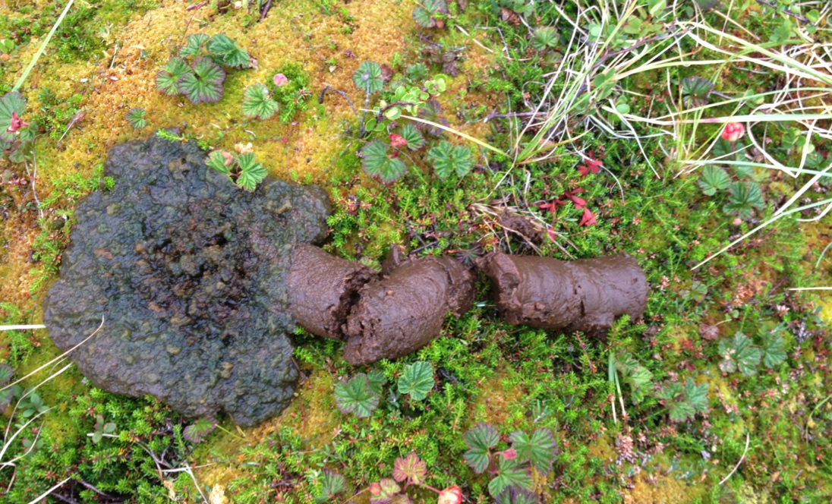
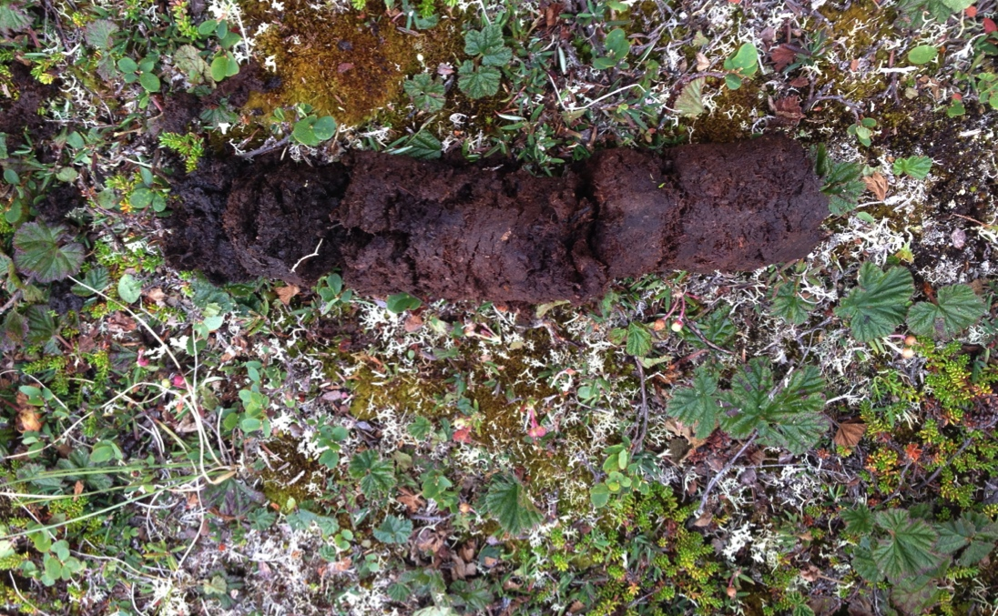
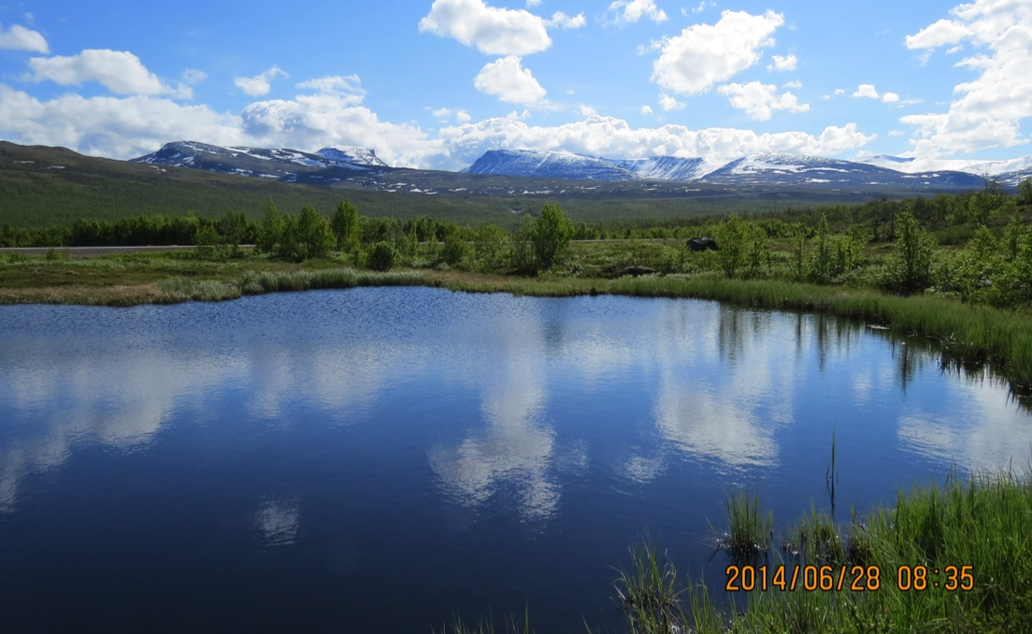
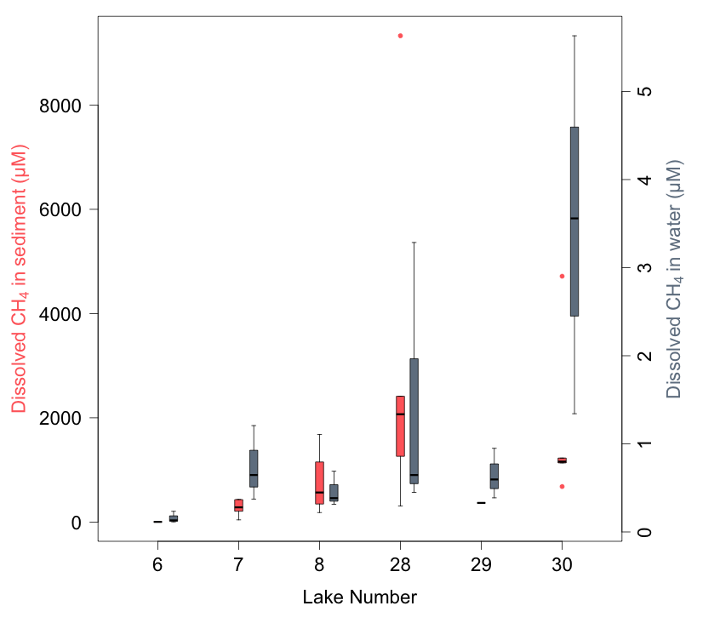
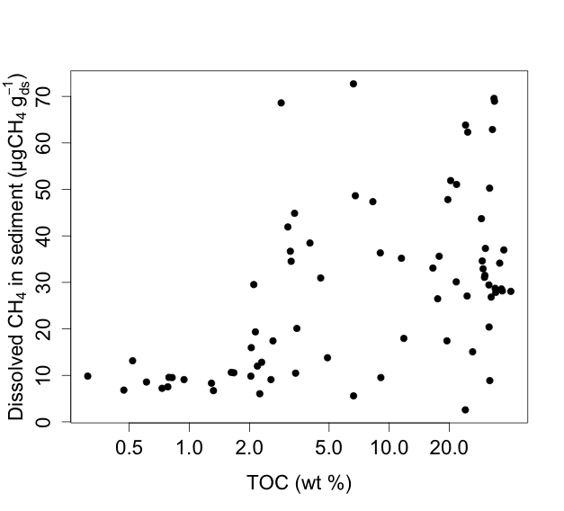
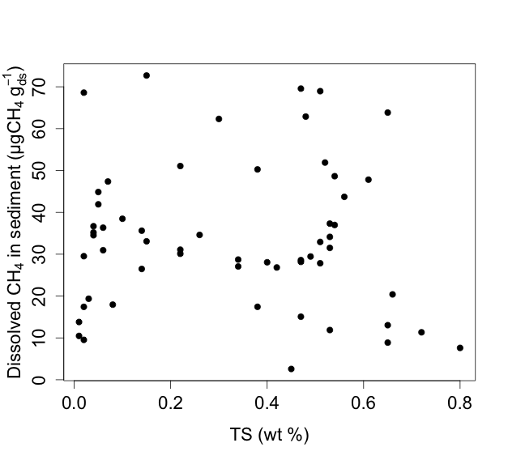
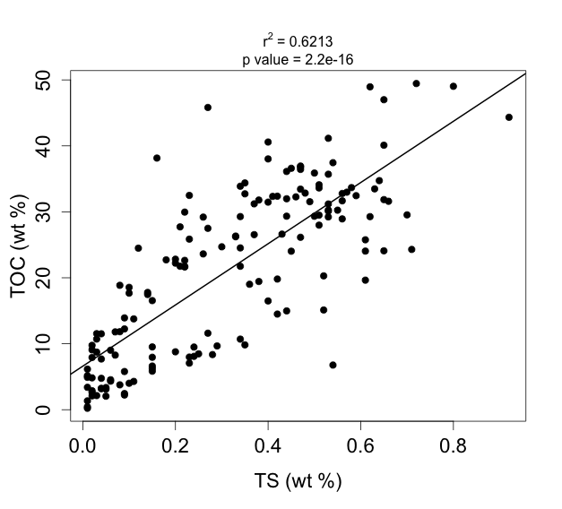
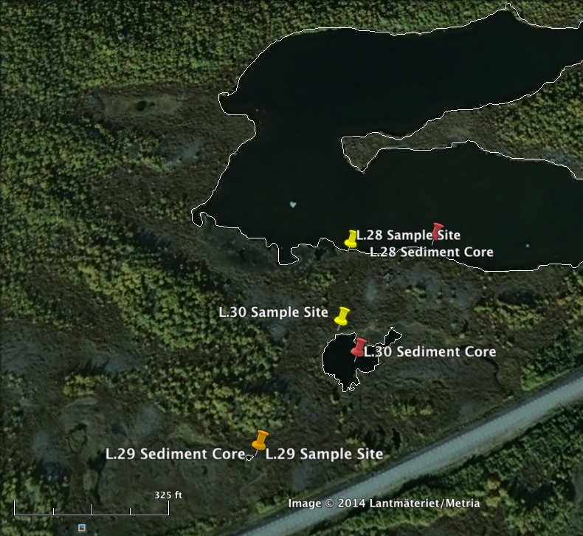
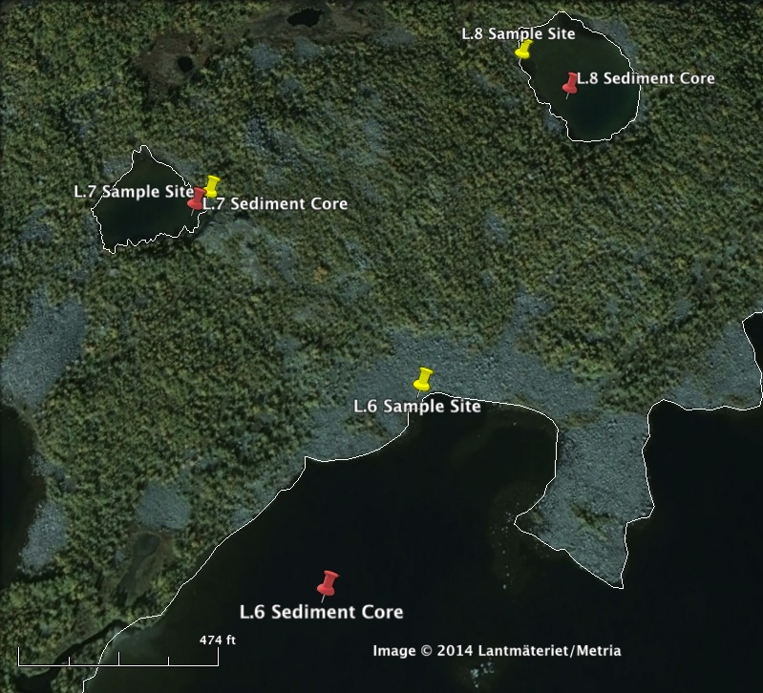
Linking sediment characteristics to methane emission potential in subarctic lakes
Laura Logozzo^{[1]}, Apryl Perry^{[2]}, Martin Wik^{[3]}, Brett Thornton^{[3]}, Patrick Crill^{[3]}, Joel Johnson^{[4]}, Ruth Varner^{[4,5]}
[1] Earth and Atmospheric Sciences, CUNY City College of New York, New York, NY, United States; [2] Departments of Natural Resources and the Environment and Earth Sciences, University of New Hampshire, Durham, NH; [3] Department of Geological Studies, Stockholm University, Stockholm, Sweden; [4] Department of Earth Sciences, University of New Hampshire, Durham, NH, United States; [5] Institute for the Study of Earth, Oceans, and Space, University of New Hampshire, Durham, NH, United States
INTRODUCTION
RESULTS
Fig. 5 – Lake 7; core is mostly peat and organic matter with large pieces of preserved plant material; smell of hydrogen sulfide after core extraction.
Subarctic Sweden is experiencing warmer average annual temperatures, resulting in the thawing of permafrost.¹
CH₄ storage and production in lakes can be understood by understanding organic carbon (TOC), total sulfur (TS), and grain size.
Dissolved CH₄ concentrations in water can indicate whether lakes are sources of CH₄ to the atmosphere.
TOP BOTTOM
Fig. 6 – Lake 8; core had a thick consistency; algae at the top of core. Transition from light-brown to gray coloration towards the bottom of the core.
Fig. 1 – Sources and transport pathways of CH₄ in lakes.
(A) Lake 6
(B) Lake 7
(C) Lake 8
(D) Lake 28
(E) Lake 29
(F) Lake 30
TOP BOTTOM
Fig. 7 – Lake 28; top of core was multi-colored, loosely packed algae. Top of core transitioned into red-brown thick, pudding-like consistency.
TOP BOTTOM
HYPOTHESES
Fig. 8 – Lake 30; Core makeup is peat-like and rich in organic matter. Center of core was a lighter brown than the top and bottom of core.
Lakes with in situ production of CH₄ in sediment will show a positive correlation between CH₄ and TOC, CH₄ and TS, and TOC and TS.
Dissolved CH₄ in the water column will be positively correlated to dissolved CH₄ in sediment.
(G) Villa – M6
(H) Villa – P1
(I) Villa – P2
(J) Villa – P3
(K) Villa – P4
(L) Mellan – D1
TOP BOTTOM
Fig. 3 – Dissolved CH₄ concentrations, TOC, and TS by depth for 12 sediment cores (from 8 lakes).
Fig. 9 –
Dissolved CH₄ concentrations in lake sediment and dissolved CH₄ concentrations in lake water, for Lakes 6-8 and 28-30.
METHODS
One sediment core was taken for each lake (Lakes 6, 7, 8, 28, 29, and 30) (Fig. 2, A&B). We also present data from sediment core sampling at 16 sites from three lakes from 2013.
Cores were sampled for dissolved CH₄ concentrations, grain size distribution, and composition at various depths.
A total of six replicate water samples were taken from the surface of each of the lakes over 3 weeks (Fig. 2, A&B).
(A)
(B)
(C)
(A)
(B)
Fig. 4 – (A) CH₄ concentrations vs. TOC, (B) CH₄ concentrations vs. TS for sediment cores from Lakes 8, VM6, VP1-4, and MD1, and (C) TOC vs. TS for all sediment cores.
CONCLUSIONS AND FUTURE WORK
ACKNOWLEDGEMENTS
REFERENCE
Methanogenesis occurs in situ by the breakdown of TOC in L.8, VM6, VP1-4, and MD1 (Fig. 3 and Fig 4 - A).
Ponds or lakes with peat-dominated shorelines have a higher CH₄ emission potential (Lakes 7, 28, and 30) (Fig. 9).
To understand variability in methane emission potential, lakes should be sampled for water CH₄ concentrations and sediment CH₄ profiles, in several locations over multiple seasons.
Special thanks to Jake Setera, Madison Halloran, Lance Erickson, Joel DeStasio, ANS, the University of New Hampshire and the National Science Foundation Northern Ecosystems Research for Undergraduates program (NSF REU site EAR#1063037) for making this project possible.
1. Callaghan T.V., et al. (2010), A new climate era in the sub-Arctic: Accelerating climate changes and multiple impacts, Geophys. Res. Letts., 37.
Fig. 2 – Water sampling sites (yellow pins) and sediment core sites (red pins) for Lakes 28 – 30 (A), and for Lakes 6 – 8 (B).

