Slide 1

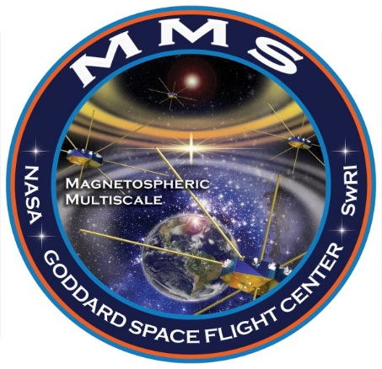

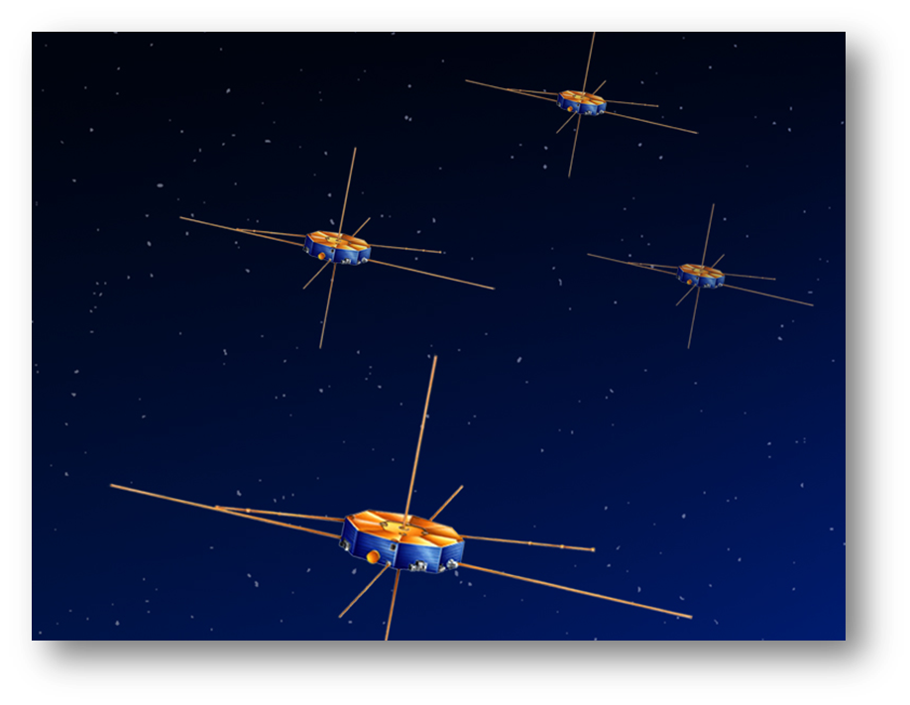
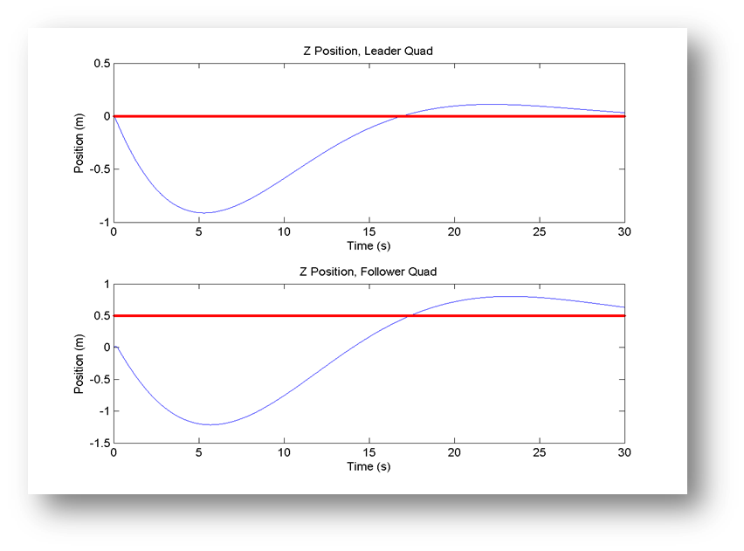
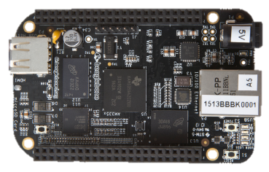
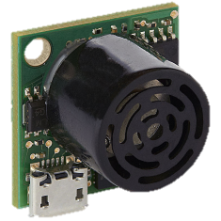
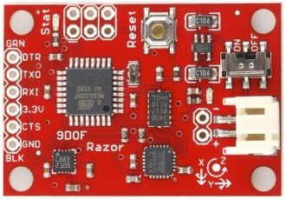
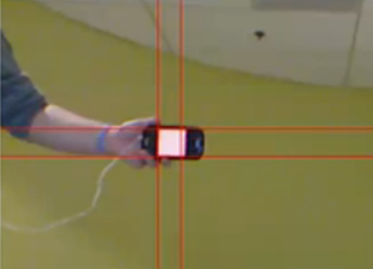

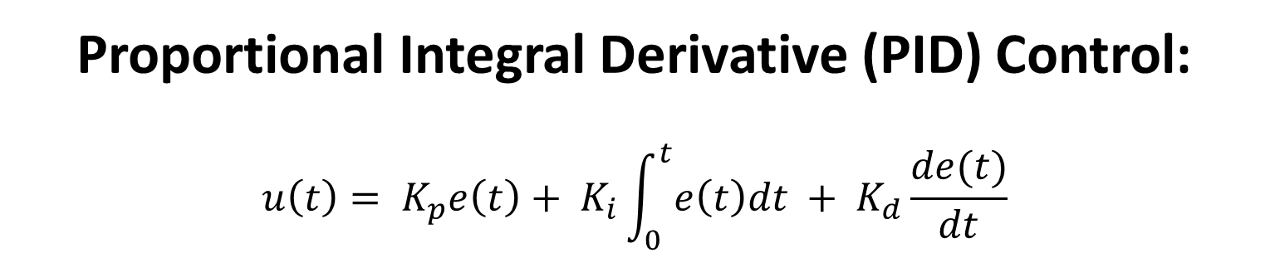
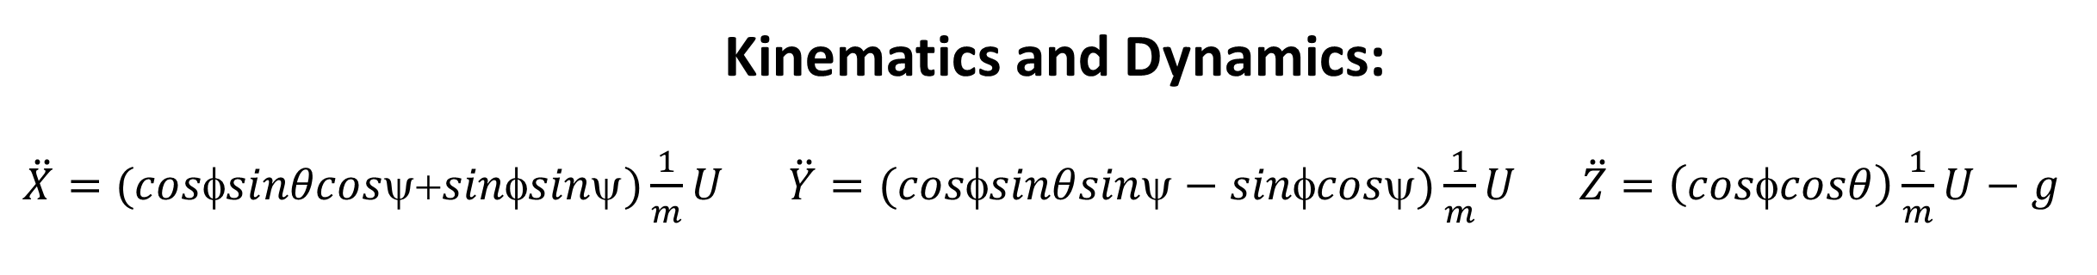
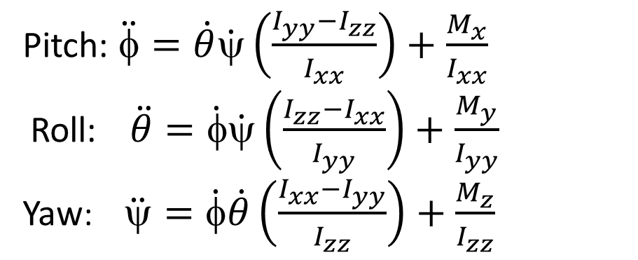
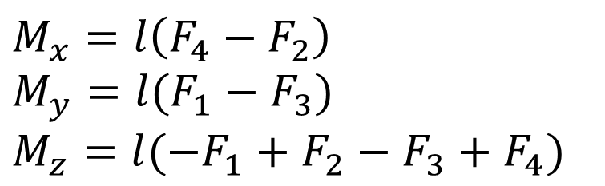
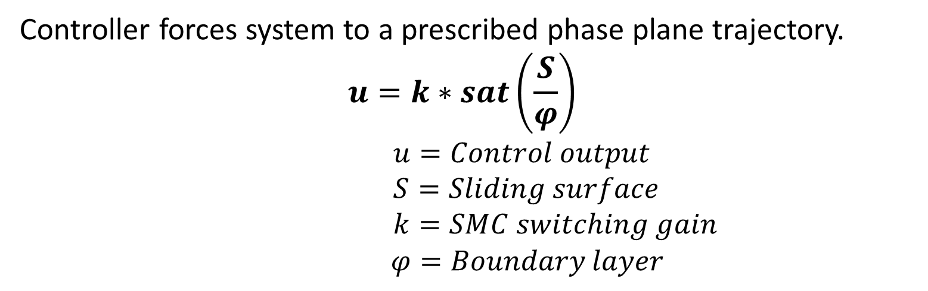
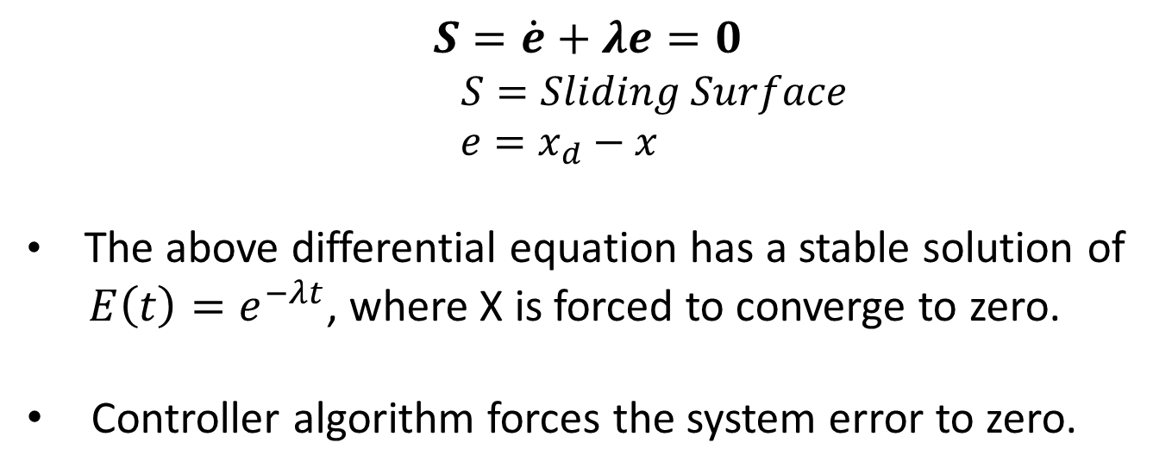
NASA Magnetospheric Multiscale (MMS) Mission QuadSat Generation D
Objective
Attitude Control
Quadsat D aims to stabilize four quadcopters with controlled flight formation. The purpose of this is to create a test bed for spacecraft control algorithm development in support of the NASA MMS mission.
Kinematics and Dynamics:
Pitch: $\ddot{φ}=\dot{θ}\dot{ψ}\left(\frac{I_{yy}−I_{zz}}{I_{xx}}\right)+\frac{M_{x}}{I_{xx}}$
Roll: $\ddot{θ}=\dot{φ}\dot{ψ}\left(\frac{I_{zz}−I_{xx}}{I_{yy}}\right)+\frac{M_{y}}{I_{yy}}$
Yaw: $\ddot{ψ}=\dot{φ}\dot{θ}\left(\frac{I_{xx}−I_{yy}}{I_{zz}}\right)+\frac{M_{z}}{I_{zz}}$
Magnetospheric Multiscale (MMS) Mission
NASA’s Magnetospheric Multiscale Mission (MMS) aims to investigate magnetic reconnection, the phenomena that occurs when the Earth’s and Sun’s magnetic fields connect and disconnect in our magnetosphere. This reconnection is of high interest because it releases powerful amounts of energy that can affect telecommunications networks, GPS navigation, and electric power grids. Four identically instrumented spacecraft flying in formation are necessary to observe the 3D structure of magnetic reconnection.
$$M_{x}=l\left(F_{4}−F_{2}\right)$$
$$M_{y}=l(F_{1}−F_{3})$$
$$M_{z}=l({−F}_{1}+F_{2}−F_{3}+F_{4})$$
System Block Diagram:
Leader/Follower Formation Flying
Feedback Control Loop
First Order Sliding Surface:
Leader quadcopter is on top of tetrahedral formation
Implemented using PID control
Each quad had a desired distance from the leader
Deviation in distances between the leader and follower are fed
into the controller
The graph shows the follower stabilizing to a desired height
of 0.5 meters
$$S=\dot{e}+λe=0$$
$$S=Sliding Surface$$
$e=x_{d}−x$
The above differential equation has a stable solution of
$E\left(t\right)=e^{−λt}$, where X is forced to converge to zero.
Controller algorithm forces the system error to zero.
Translational Control
Kinematics and Dynamics:
$\ddot{X}=(cosφsinθcosψ+sinφsinψ)\frac{1}{m}U$ $\ddot{Y}=(cosφsinθsinψ−sinφcosψ)\frac{1}{m}U \ddot{Z}=\left(cosφcosθ\right)\frac{1}{m}U−g$
Processor and Sensors
Sliding Mode Control (SMC):
BeagleBone Black
Onboard processing of controller
Reads in data directly from SONAR, IMU, and wirelessly from the GUI
SONAR
Used to determine height
1 cm resolution
Can detect objects in a range of 20 cm to 7.65 m
Internal Measurement Unit (IMU)
Triple-axis gyroscope – determines roll and pitch
Magnetometer – determines yaw
Accelerometer – determines direction
Vision System
Initial attempt to determine X,Y, and Z position
Xbox Kinect programmed to track color
Proportional Integral Derivative (PID) Control:
$$u\left(t\right)= K_{p}e\left(t\right)+ K_{i}\int_{0}^{t}{e\left(t\right)dt }+ K_{d}\frac{de(t)}{dt}$$
Controller forces system to a prescribed phase plane trajectory.
$$u=k∗sat\left(\frac{S}{φ}\right)$$
$u=Control output$
$S=Sliding surface$
$k=SMC switching gain$
$φ=Boundary layer$
System Block Diagram:
Advantages
Non-linear control method
Robust against system uncertainties and disturbances
Disadvantages
Chatter
Sensitive to noise
Real Time Pitch and Roll Data:
Real Time Height Data:
Graphical User Interface (GUI)
Communicates to quadcopter with XBees
Sends all flight commands
Allows for real time change of desired position
and controller gains
Receives & stores flight data from quadcopter
Multi-threaded GUI and IMU increase processing speed
Team Members:
Emily Clemons Kiley Donohue
Jonathan Hart Maxwell Heindl
Korey Joback Connor Larkin
Craig Paggi Samuel Reed
Nicholas Sapack Raymond Vanacore
Angela Zukas
Faculty Advisors:
Professor May-Win Thein
Professor Se Young (Pablo) Yoon
Graduate Advisor:
Christopher Hashem
Special Thanks To:
Thomas Fuller
Michael Johnson
Sponsor:
NHSGC
URC 2015

