Slide 1


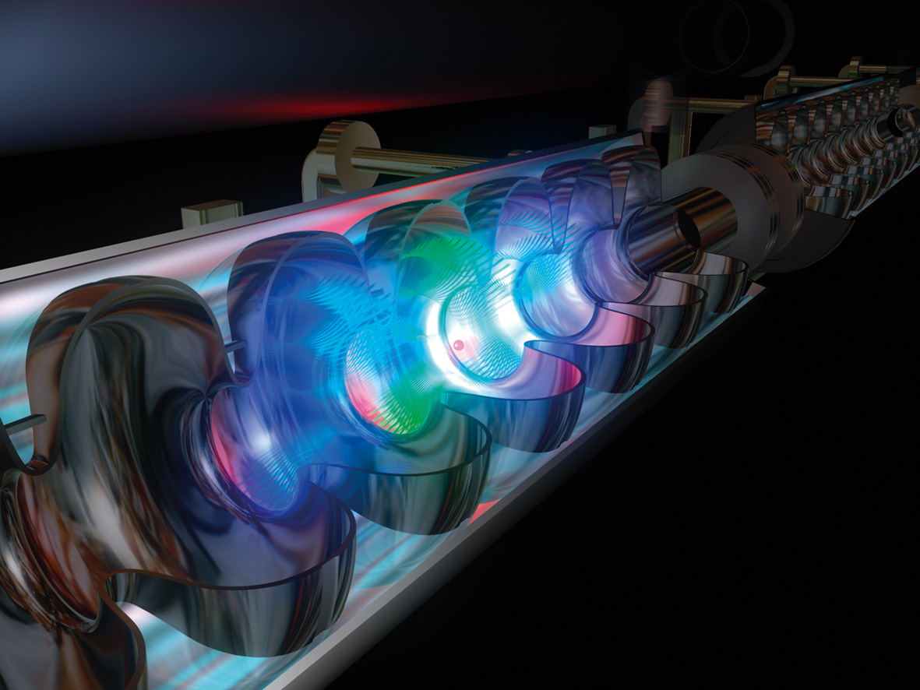


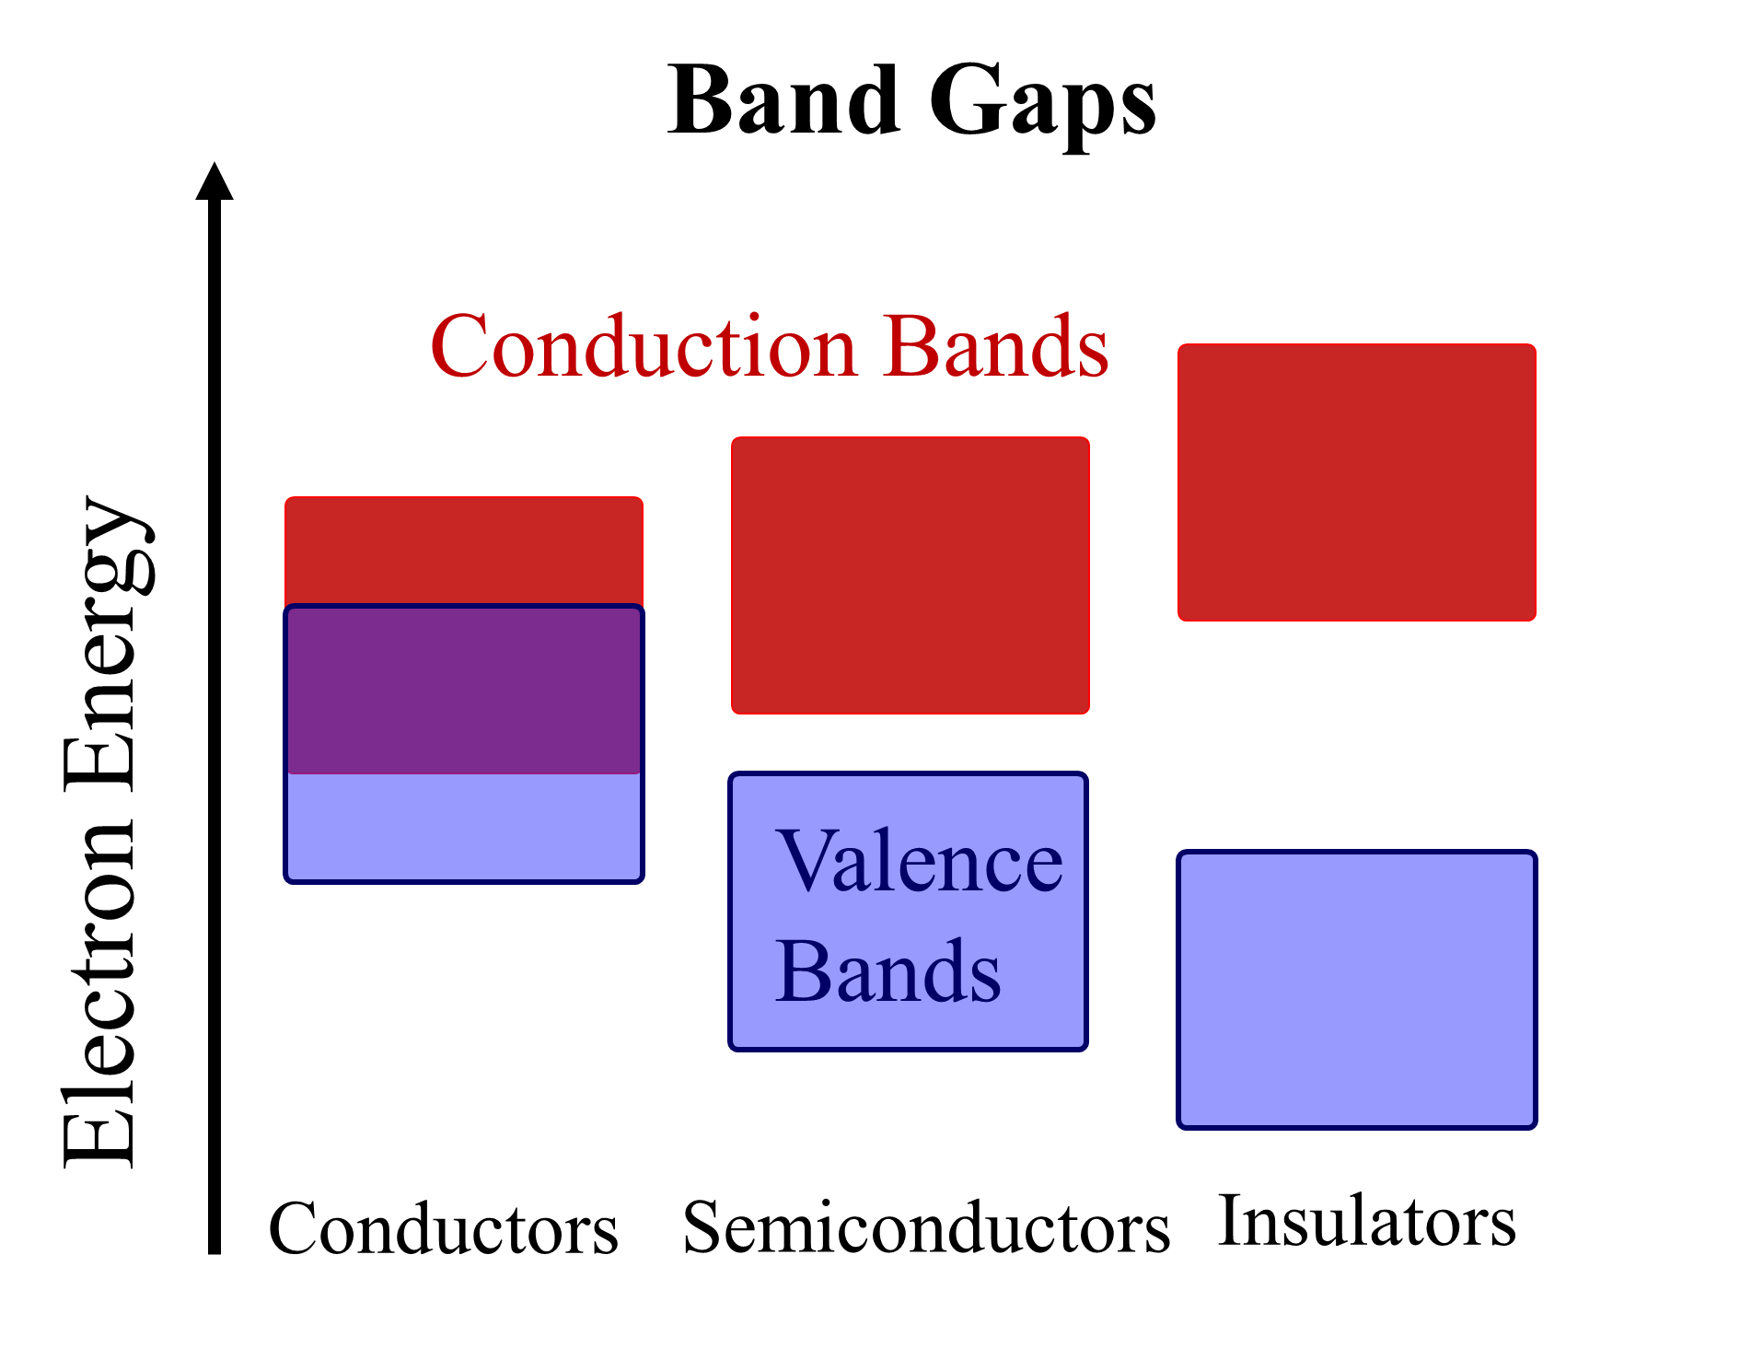
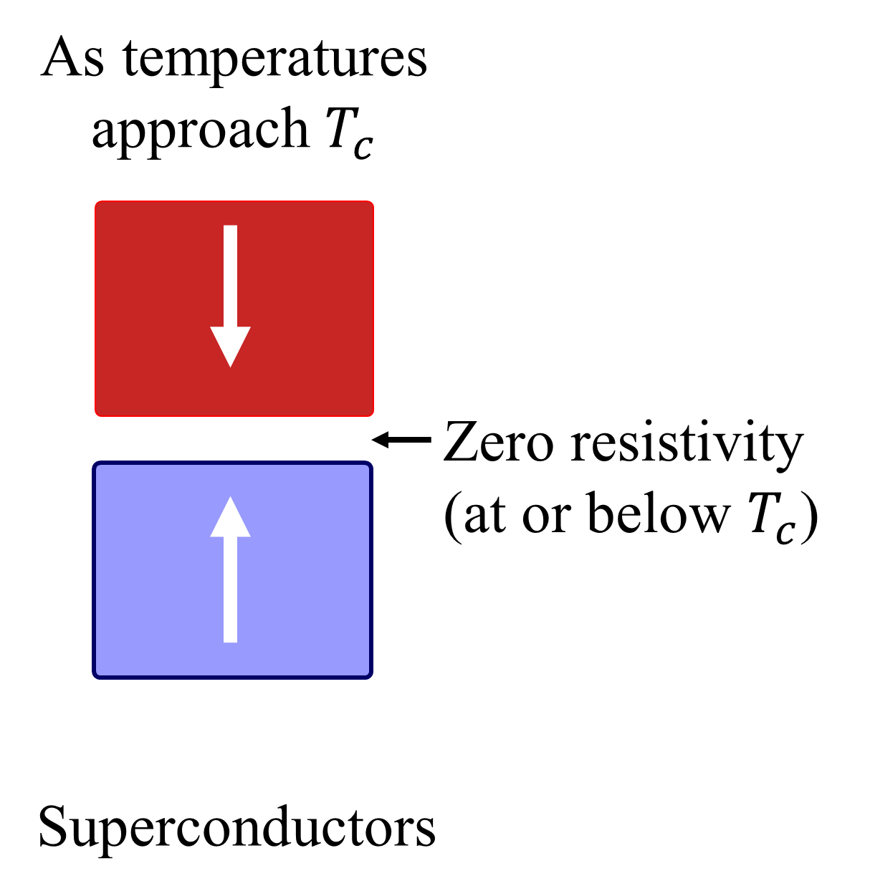
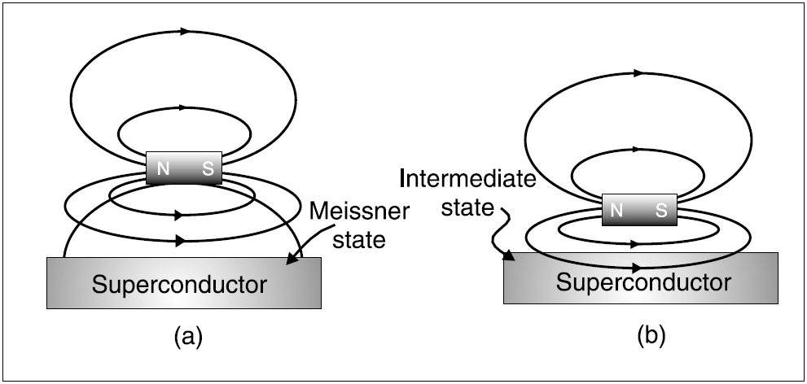
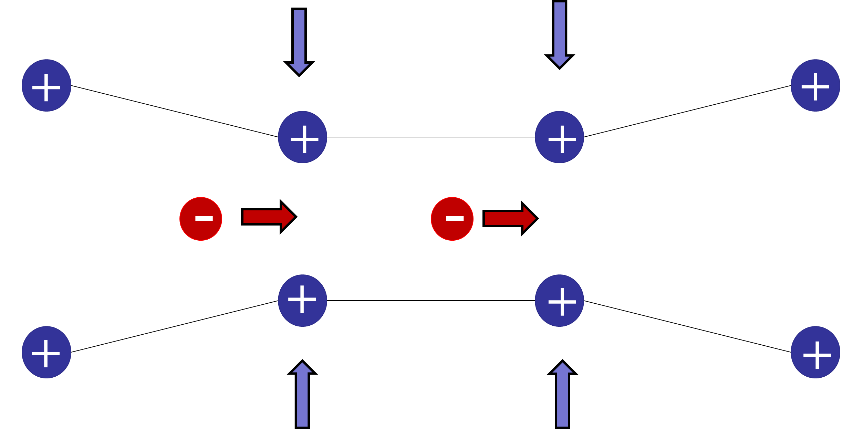

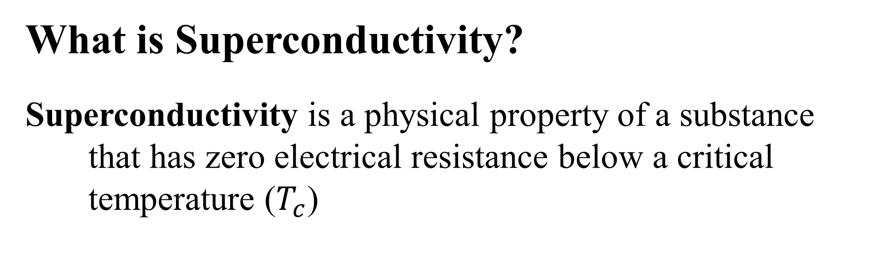

What is Superconductivity?
Superconductivity is a physical property of a substance that has zero electrical resistance below a critical temperature ($T_{c}$)
Bringing Superconductivity into the High School Classroom
Johnson C. Whippie
Physics Department
Kinesiology Department: Outdoor Education
Education Department: Secondary Education
University of New Hampshire
Why is Superconductivity important?
Zero Resistivity and the principles of superconductivity have allowed for greater efficiency in the following:
MRI Scanners
Particle Accelerators
Magnetic Levitation Trains
Imagine what else superconductivity is capable of …
Magic in the Classroom- The Meissner Effect
By super cooling a YCBO Ceramic Disc with liquid Nitrogen, one can levitate a magnet above it so that it is suspended in midair
Materials: YBCO Ceramic Superconducting Disc
Small Magnet
Liquid Nitrogen (Less than 1 Liter)
Petri dish or the bottom half of a Styrofoam cup
Gloves (to protect your hands from cold injury)
Cost: $ 50.00 (Kits can range between $40-$400)
Engaging Demonstrations and Experiences
Mind Capturing Demonstrations are used to hook the learner into a state of curiosity or inspiration to desire further understanding. Physics teachers have the opportunity to teach
Resources for Physics Teachers
There are many resources, here are a few that helped in this
  The Physics Teacher is a fantastic resource that is worth becoming familiar with if you are a physics educator or teach physical science
  PhET Simulations online provide a wide variety of
  http://www.superconductors.org/Play.htm for demonstrations using superconductivity specifically
Networking
- Teachers in the same building
- Science teachers in the region
- Institutions nearby like the University of New Hampshire
- The Leitzel Center for Math, Science and Engineering Education
Superconductivity is COOL!
Approximately -180 $℃$
Meeting National Standards
Through the Common Core standards and curriculum, the science standards for secondary science are deferred to the Next Generation Science Standards (NGSS). The following is one of the standards for the secondary science curriculum:
HS-PS2-6. Communicate scientific and technical information about why the molecular-level structure is important in the functioning of designed materials.
Developing lessons around superconductivity demonstrations that include discussions on using superconducting materials and the value in discovering the molecular properties of this phenomenon.
Another emphasis of the NGSS is the use of Cross-Cutting Concepts while addressing the specific standards and the concept below is readily correlated to superconductivity:
Energy and Matter: flows, cycles and conservation. Tracking fluxes of energy and matter into, out of and within systems helps one understand the system’s possibilities and limitations
The other types of conductivity
Conductivity- the degree to which a material conducts electricity
The Meissner Effect in Action
Understanding the Meissner Effect
The Meissner Effect is an example of how the none-existent resistance affects the magnetic field of a magnet.
(a) the superconductor repels the magnetic field of the magnet and creates a ‘bubble’ that the magnet floats atop
(b) the material is no longer a superconductor and the magnetic field passes through the disc and the Meissner effect is lost
How can there be zero resistivity?
In superconductors, there is zero resistivity because at low temperatures the electrons flow freely through the superconductor!
Electrons pass through the superconducting lattice and attract the positively charged particles toward them.
Cooper pairs occur at low temperatures when two electrons travel together and allow the continual flow through the lattice without losing any energy!
Interdisciplinary Connections
Applying Science and understanding how what is learned in the classroom connects to things happening in the world around us is how students associate science as a relevant subject.
A topic worth discussing in the classroom- MagLev trains are being used in Asia right now. Although they are fast and efficient, the use and construction of these trains needs space and resources while the side-effects of living near such powerful electromagnetic system are still in question. Is the efficiency worth the impact building such trains will have on the people and the environment around them?
Corn field analogy
“If we teach today’s students as we taught yesterday’s, we rob them of tomorrow.” ~John Dewey

