Slide 1



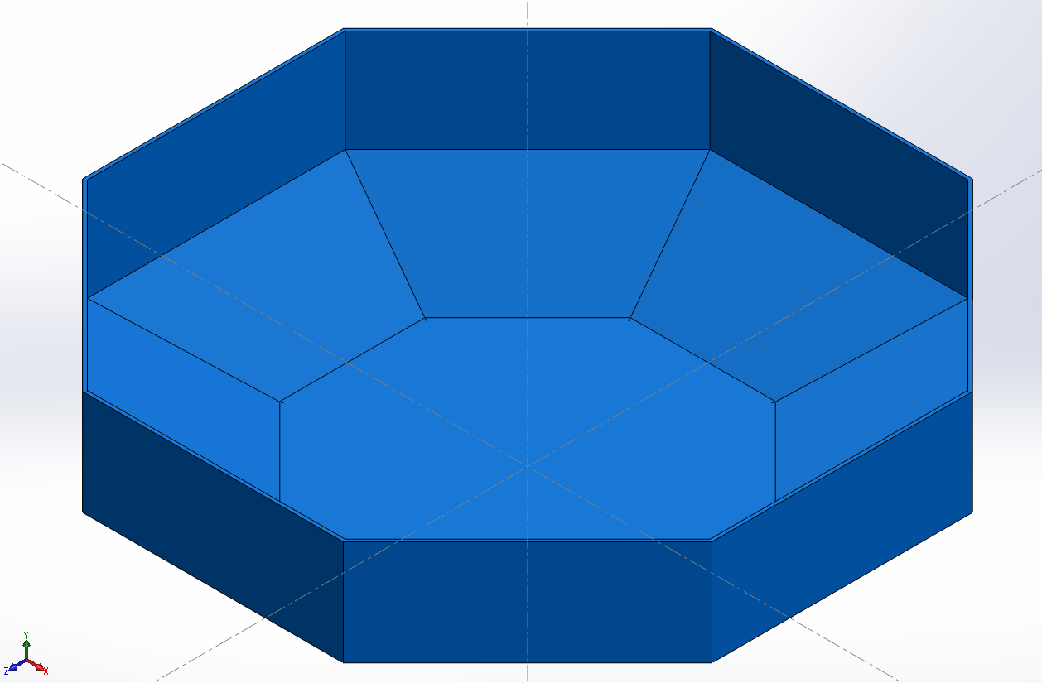
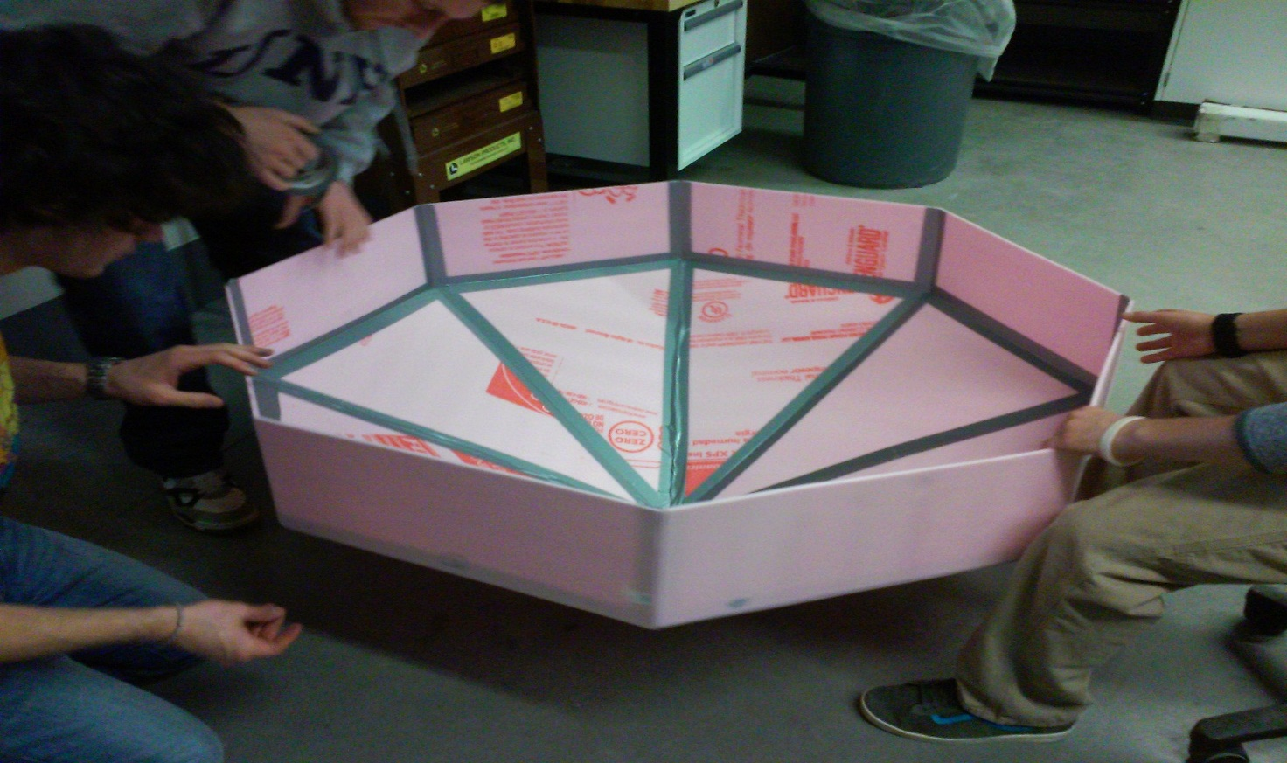
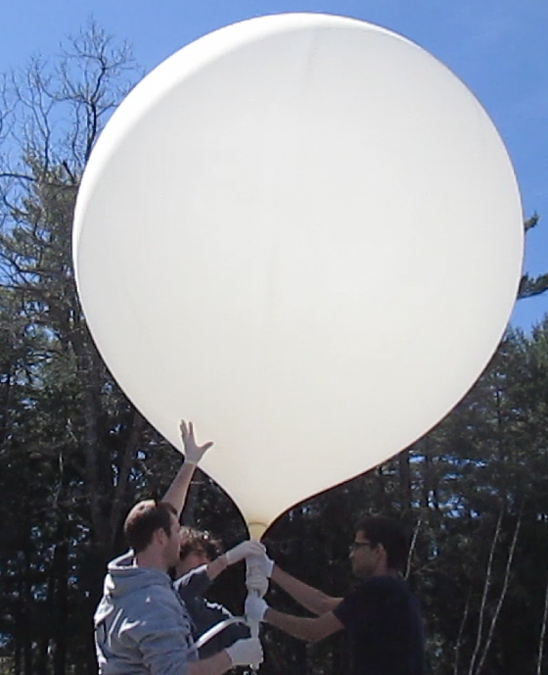
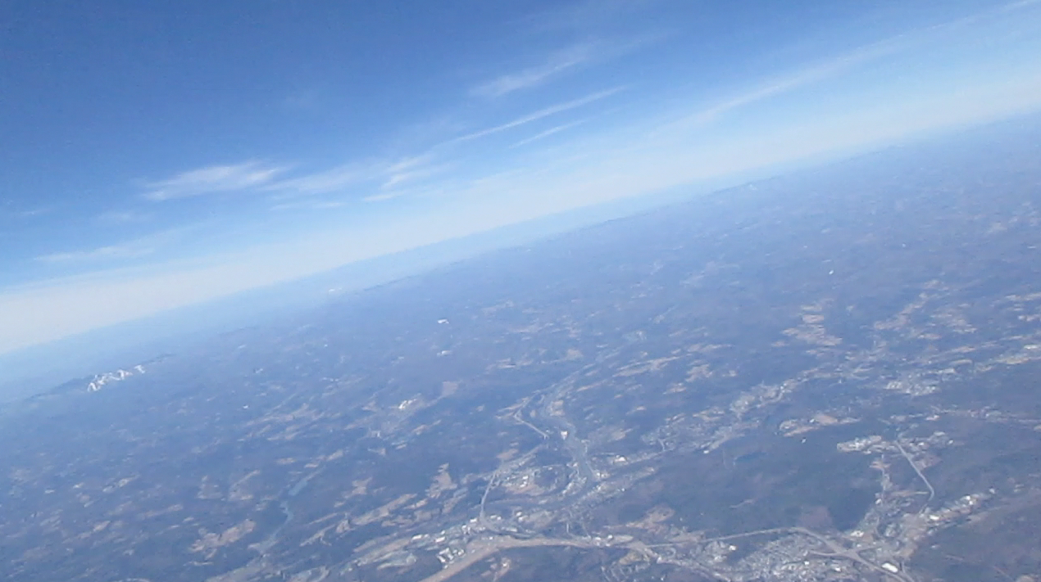
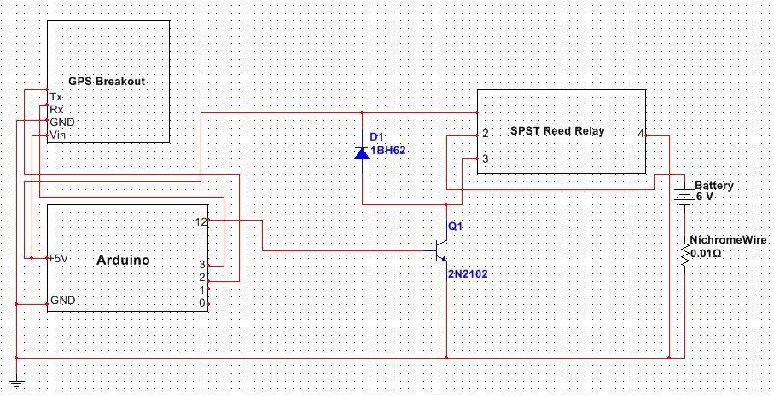
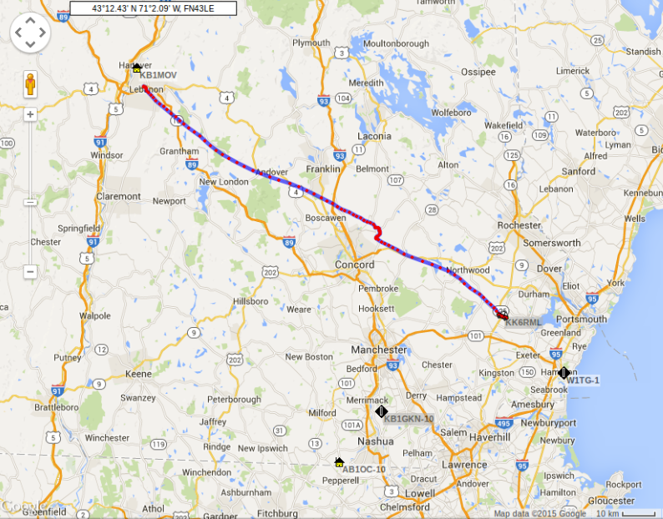
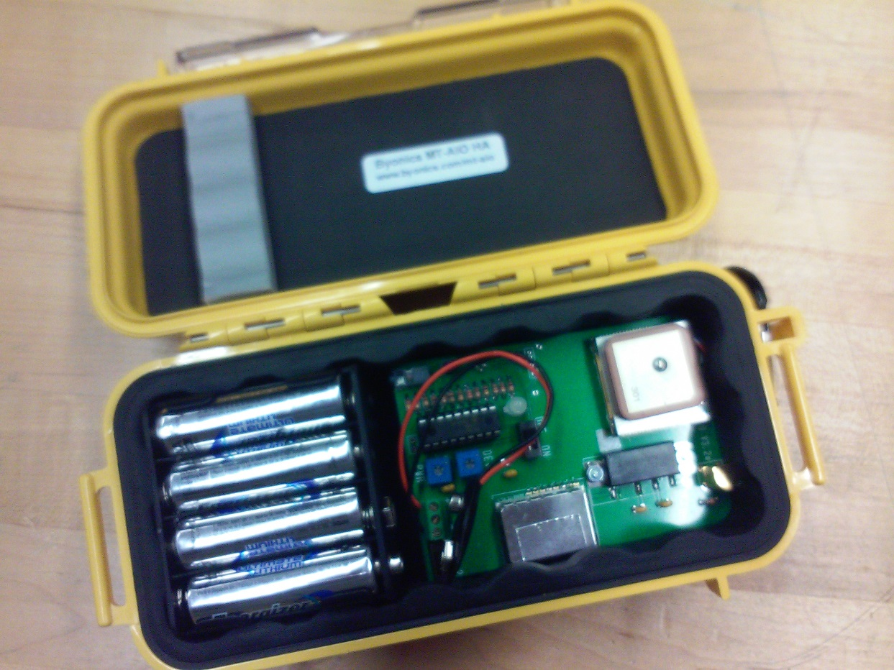
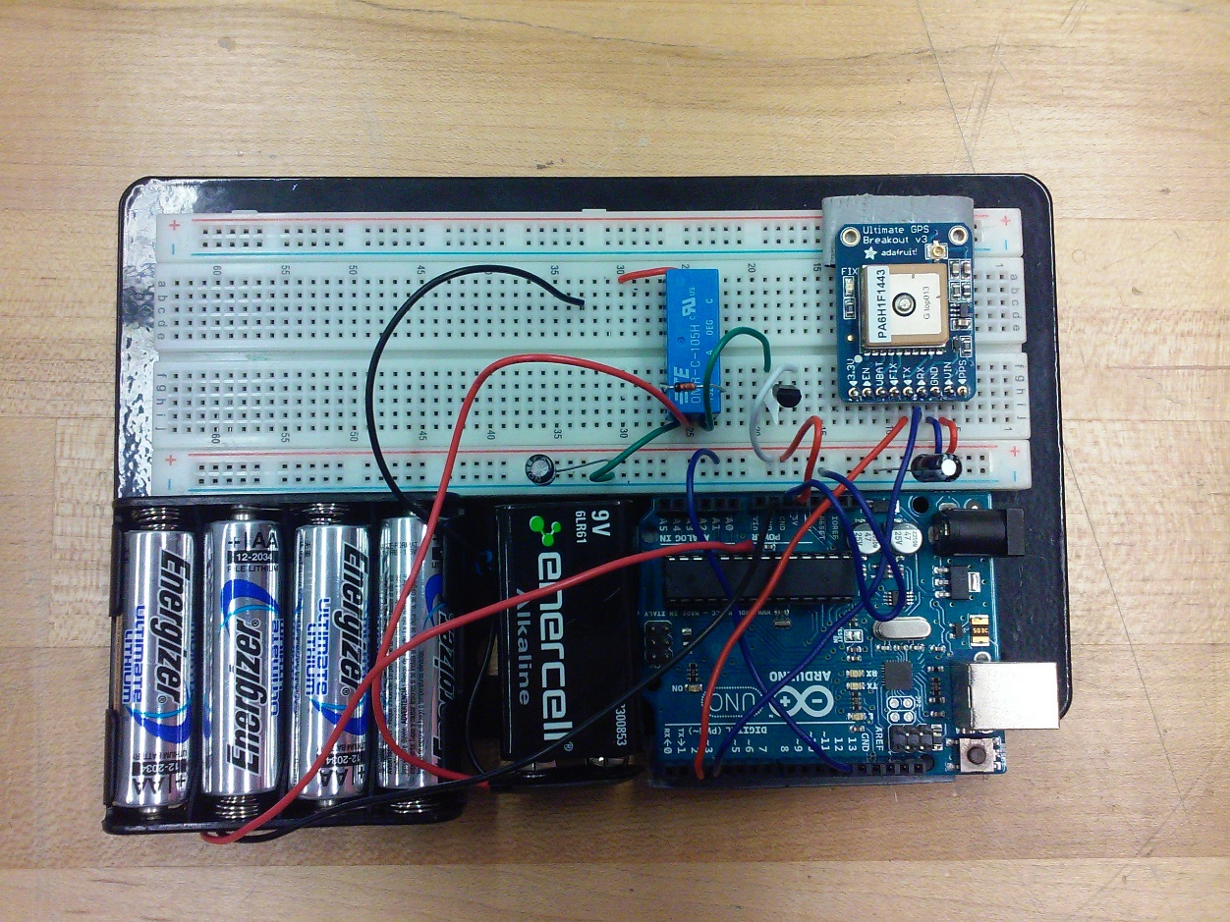
Stabilization of a Balloon Probe for the Exploration of High Altitude Environments
Undergraduate Members: Sital Khatiwada, Kyle Larrabee, Shawn Swist, Tamir Blum, Lucas Lopez, Colin Pellerin, Aaron Rist, Michael Koller, Alec Crimmin, Liam Collins, Andrea Dargie, Christopher Chin, Buddy Young, Tyler Slabinski
Organization Advisor: May-Win Thein
abstract
DIY Engineering is a multidisciplinary student organization focused towards exposing undergraduates to technical engineering projects. The High Altitude Balloon is a flagship experimental platform designed by DIY Engineering to obtain various forms of data from the troposphere and stratosphere. Future plans with the platform include taking radiation data, simultaneous launches, and further payload design modification for flight stability or modularity.
Final Payload Design
Balloon Payload under construction
Objectives
A major problem encountered in high altitude ballooning is the chaotic video feed resulting from the payload’s erratic behavior during its flight, especially during the descent. The main culprit of this behavior is typically three-axial rotation, encountered due to poor payload geometry and aerodynamic drag. In order to produce a high altitude balloon payload capable of re-entry without heavy rotation, several design considerations were implemented in order to ensure that the camera feed obtained after the flight is seamless as possible.
Camera Capture
Kaymont 1500g Balloon Inflation
Thermal Knife Circuit Diagram
Design goals
Stabilized ascent and descent for quality camera feed
Eliminate the requirement of a parachute
Prevent 3-axial rotation
Resistance to impact
Sever balloon remnant from payload to prevent unpredictable drag forces
GPS AIO Module
Thermal Knife Circuit Assembly
methods
Results
Increase in rotational inertia
  Additional mass (PVC) placed at side walls
  Prevent y-axis rotation
Payload Geometry
  Prevent x and z axis rotation
Concentrated mass at payload base
  Control systems placed above payload brace
                Increases payload robustness
Large surface area for payload’s underside
  Aerodynamic drag reduced the falling velocity
Thermal knife
  Nichrome wire triggered after free fall detected
Reduction of the rotational acceleration
  Rotation about y-axis not completely eliminated
  Uneven mass distribution caused minor tipping
  Slightly lower rotational acceleration allowed for stable camera feed
Soft Impact
  Large drag forces effectively slowed payload
  Payload intact after free fall and impact with tree and ground
  Dramatic decrease in free fall velocity after ~10,000 meters
Thermal Knife
  Nichrome wire detached during launch
  Balloon remnant did not separate after rupture
Highest Pinged Altitude | 29170 m
Speed at Maximum Altitude | 35.188 km/h
Maximum Measured Ascent Speed | 198.164 km/h
Lowest Pinged Altitude | 252 m
Speed at Minimum Altitude | 11.112 km/h
Maximum Measured Descent Speed | 183.348 km/h
Flight Path of Payload tracked through APRS Google Maps
conclusions
Increasing rotational inertia doesn't completely eliminate y-axis rotation
  Future methods of complete elimination are being worked on
Increase in drag surface area allows for slower descent rate
Robust circuit design necessary to ensure nichrome wire can remain attached to circuit
Precise mass placement will not completely eliminate x and z-axial rotation due to external factors (e.g. wind gusts, rotation of tether)
Collaborations with: Charles W. Smith, Scott Goelzer, Louis Board, Richard Levergood, Project SMART

