Slide 1



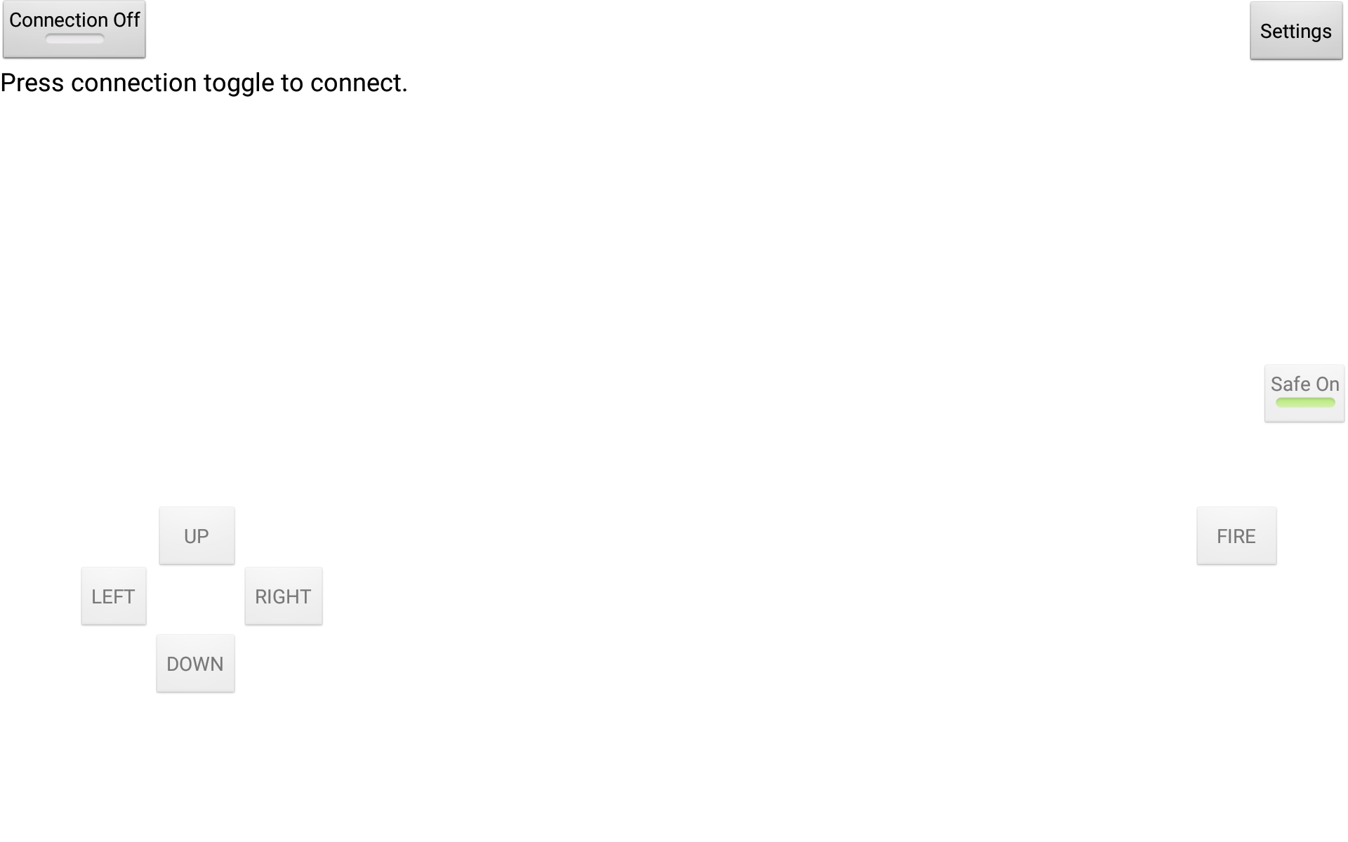
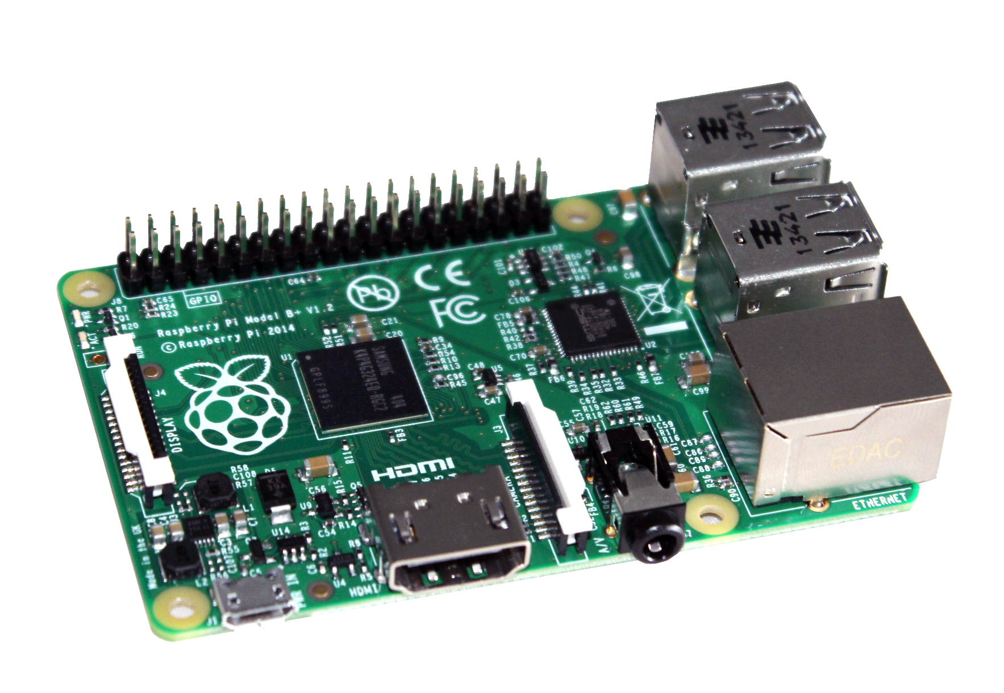
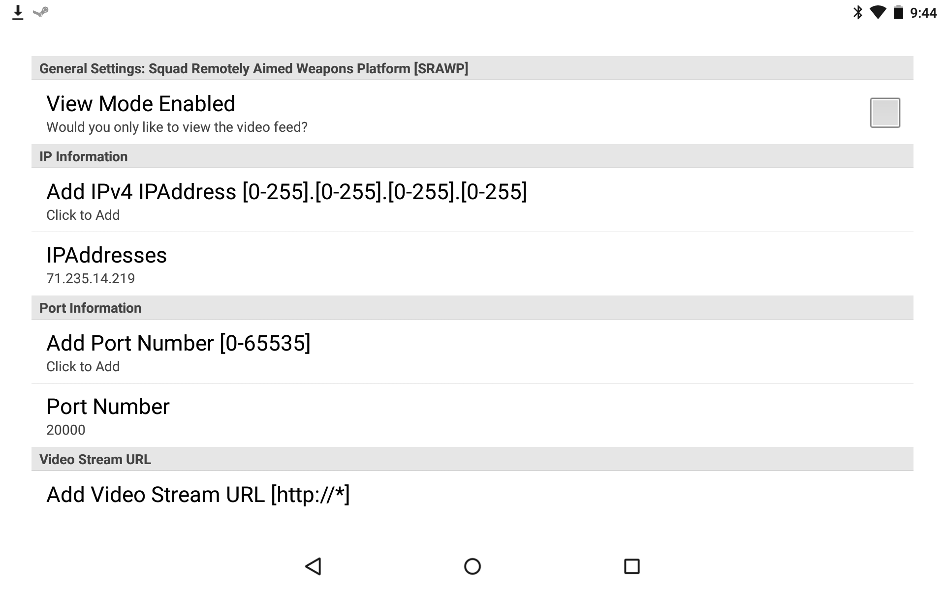
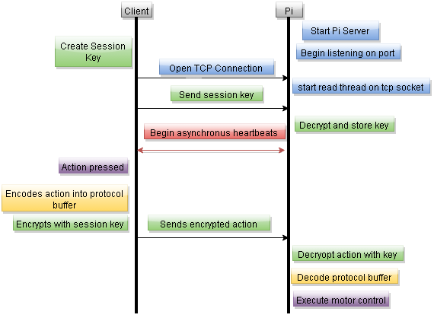
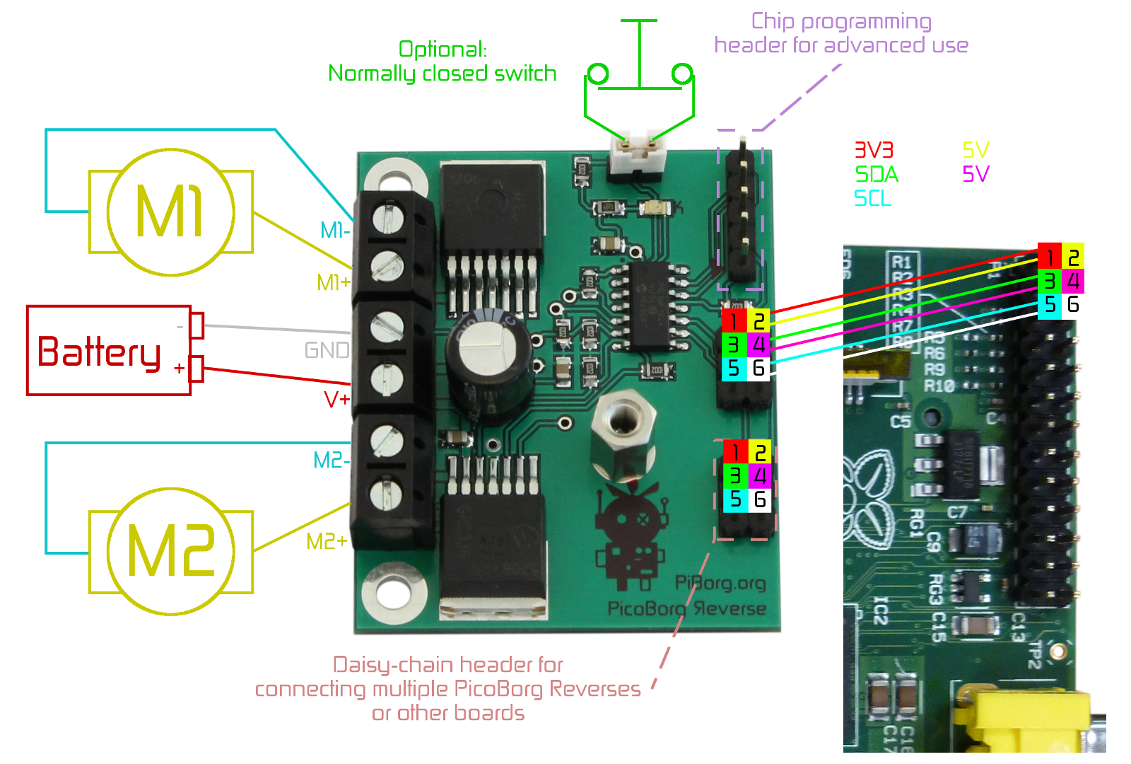
Squad Remotely Aimed Weapons Platform
Department of Computer Science
University of New Hampshire
Undergraduates: William Gravelle, Sam Luszcz, Cameron Weatherby
Advisors: Bence Cserna, András Fekete, Professor Philip Hatcher
Abstract
User Interface
Control Module
The Squad Remotely Aimed Weapons Platform is a rugged, quickly deployable system that can mount all four US standard issue firearms. The system is controllable by a real time video feed displayed and manipulated on any device running Android 4.0+.
The SRAWP addresses two problems of current systems - portability and flexibility. The motor system used was chosen with weight and durability in mind. The system incorporates two small motors which work through a gear ratio to rotate the platform 360 degrees and to adjust the pitch up to 15 degrees in either direction. Weight was kept down by using light weight, high-strength, and easily available Aluminum 6061-T6. Flexibility is achieved by allowing the weapon to mount onto the platform similar to as if a soldier was holding it.
The Raspberry Pi hosts a video stream that allows for multiple parties, including soldiers in the area and commanders, to view an uninterrupted video stream providing real time intelligence and increased battlefield awareness. If either side of the connection is lost, the system will go into a safe mode turning off its ability to fire the weapon while still completing the movements that it was signaled to do before the loss. Targeting of the system is optical line-of-sight targeting with a projected red dot.
∙ Primary interface with user.
∙ Toggleable connection.
∙ Entire screen loads video feed upon
successful connection.
∙ Movement buttons allow 2 degrees of
freedom.
∙ Safety prevents accidental firing.
∙ Settings button in top right opens separate
activity.
∙ Raspberry Pi B+ is responsible
for communication with the
Android application.
∙ Receives an encrypted bytestream of
commands within a protocol buffer which it
must decode.
∙ Processes commands and instructs the Pi
to execute the correct action.
∙ Dispatches python scripts to the motor
controller to control turret movement.
∙ Controls firing trigger through GPIO.
∙ Transmits a high resolution low-latency video
stream to any connected Android device.
∙ Runs a server, written in Java, which allows a
single user to establish an encrypted
connection with an Android device.
Settings
User Interface
∙ Ability to enter a viewing only mode which
disables all user controls and disconnects the
pi, but leaves the camera stream open.
∙ User has ability to add hostnames, port
numbers and the camera URL.
∙ Persistent changes and history preserves the
five latest user entries.
Communication Integrity
∙ Each session uses a new RSA key.
∙ Initial key exchange done using symmetric
keys.
∙ Messages encoded with session key.
Motor Control
∙ Supplies power to the motors and solenoid
by connecting to any suitable outside power
source.
∙ Executes Python scripts to execute
movement of motors and solenoid.
Conclusions
∙ Lessons learned: Communication, integrating
the different software parts should be done
earlier rather than later, and do not be afraid
to ask questions.
∙ Well Done: Integration came together very
well because of good commenting and clean
coding. Interdisciplinary cooperation achieved
and close attention to detail helped make the
project what it is today.
Settings Menu
Sequence Diagram
Notes:
Try to keep a cohesive color scheme. Do NOT put anything close to the edges as it may be cut off during printing (but it will probably be ok to print right up to the edge.
Everything here except for the information and pictures are placeholders. Feel free to change things as you see fit but please try to keep the theme of the poster.
Keep in mind that this poster is HUGE. Things that may look small on your screen are probably going to be gigantic when it is printed.
Need inspiration? Go to this link to see a lot of the posters from last year: http://www.unh.edu/urc/2014-awards-excellence
Try to keep the margins the same!! That means the top, bottom, side, and margins between “blocks” should all be equal. It looks way better that way.
Use ONLY size 6 Arial font for body text. Size 9 arial BOLD for heading text.

