Slide 1

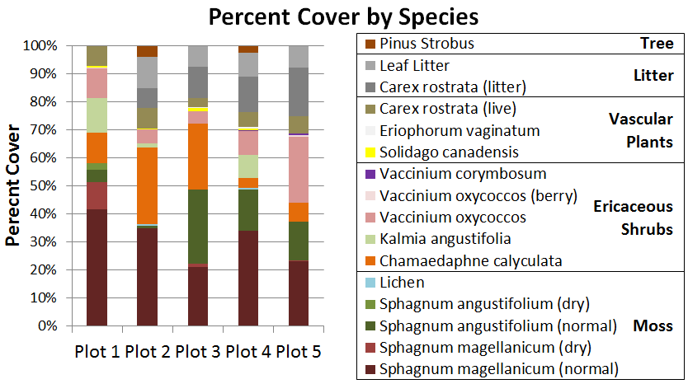
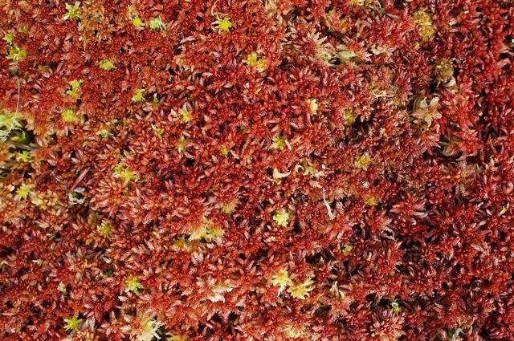
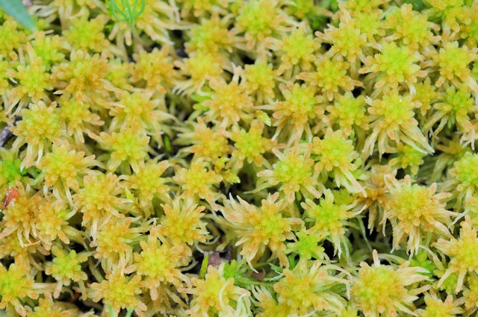
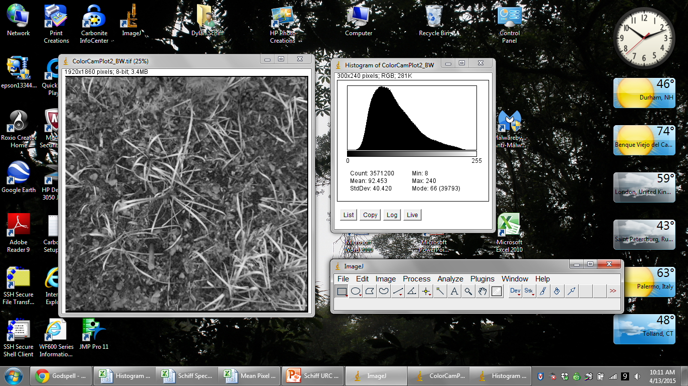
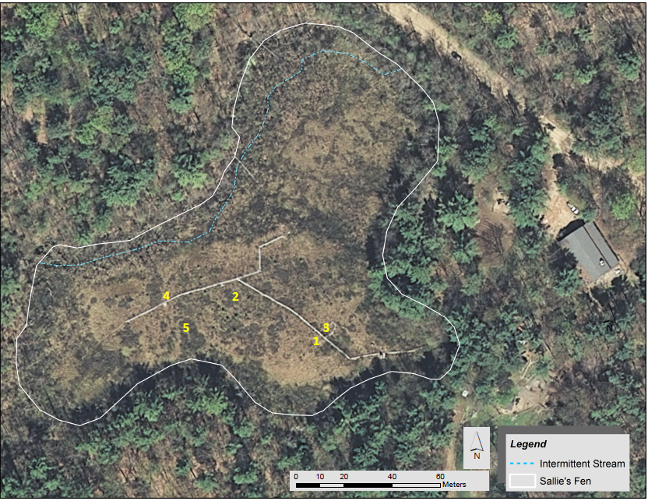
Fine-Scale Plant Species Identification in a Poor Fen and
Integration of Techniques and Instrumentation in a Classroom Setting
E
F
Dylan Schiff¹ (dma87@wildcats.unh.edu), Natalie Kashi², Erik Froburg³, Ruth Varner^{3,4}, Michael Palace⁴, Christina Herrick⁴
¹Department of Natural Resources and the Environment ²Natural Resources and Earth System Sciences ³Joan and James Leitzel Center for Math, Science, and Engineering Education ⁴Institute for the Study of Earth, Oceans, and Space University of New Hampshire, Durham, NH
I
Introduction
Results and Discussion
Classroom Extension
Northern temperate wetlands, such as peatlands, contain large amounts of carbon and contribute roughly 25% of the world’s atmospheric methane (Bubier et al. 1993). Climate warming is altering the amount of carbon being released from these ecosystems into the atmosphere.
The long-term goal of this study is to:
Use fine-scale plant species identification at Sallie’s Fen to refine our understanding of carbon fluxes across the biosphere-atmosphere interface. This will allow us to extrapolate fluxes measured at the site over the larger fen area.
The Next Generation Science Standards (Next Generation Science Standards 2013) call for curricula that cultivate science practice skills and evidence-based explanations. Scientific components of this project were adapted to create a piece of secondary school curriculum to be used in its entirety or as discrete investigations.
Lesson 1: Introduction to dichotomous keys, plant species
identification, biodiversity, and percent cover (HS-LS2-2).
Lesson 2: Introduction to the carbon cycle (HS-LS2-5).
Lesson 3: Introduction to GPS technology and ImageJ (HS-PS4-5).
Lesson 4: Local field trip. Students identify plant species, estimate
percent cover, and collect photographs and GPS points of plots.
Lesson 5: Data entry into Excel. Computation of Shannon’s Index of
Biodiversity and evenness using ground and aerial images
measurements derived from
ImageJ (HS-ETS1-4).
Lesson 6: Analysis of results in
terms of biodiversity and
abundance. Students quantify
biosphere-atmosphere carbon
flux with their data (HS-EES2-6).
Lesson 7: Group discussion of
analysis and extension of
thinking by applying knowledge
in context of ecosystem change
due to climate change and human activity (HS-LS2-7).
J
Figure 3: Stacked bar graphs showing the percent cover distribution of species for each plot. Species are grouped by functional group. The tree functional group was only found in two plots, and the litter group was not present in Plot 1.
The immediate goals of this
project are to:
(1) Develop a protocol for
identifying and quantifying
plant species using ground
measurements.
(2) Determine if spectral images from pole-rigged cameras or Unmanned
Aerial Vehicles can be used to identify fine-scale plant communities.
(3) Investigate how techniques and instrumentation used in this study
can be incorporated into a secondary school classroom setting.
Figure 4: Shannon’s Index of Biodiversity compared with percent cover for the five functional groups. The increasing presence of litter in Plots 2-5 provides evidence for seasonal defoliation. This functional group greatly affected the measured percent cover of the ericaceous shrub and moss functional groups.
Figure 1: Sphagnum magellanicum (left)
and Sphagnum angustifolium (right), the two mosses seen at Sallie’s Fen (Schou 2003).
Study Location
Figure 7: Image of Plot 1 from the digital camera and corresponding histogram produced by ImageJ, a classroom-friendly computer program.
Figure 5: A bivariate linear regression of Sphagnum moss and other plant species revealed a nearly horizontal line of best fit (R²=0.0013, p=0.0059). Approximately the same average percent cover of non-moss species is found regardless of the percent cover of moss as seen aerially.
Conclusion
The presence of Sphagnum moss (as seen aerially) excludes the presence of other species, but the presence of other species (as seen aerially) only excludes the visibility of Sphagnum moss since it resides in the understory of the layered community.
Images taken with digital cameras can successfully identify fine-scale plant communities while saving time in the field. This type of camera is the most accessible for a secondary classroom as well.
This project covered six secondary school NGSS standards across four content areas, introducing students to the interdisciplinary nature of research. If curricular, time, or resource limitations prevent full implementation, individual lessons still allow for curricular alignment and practicality for implementation.
This remote sensing data collection technique is limited in that it only accounts for the canopy structure of the community. Models that include such data will simplify carbon flux, but can be useful.
Figure 6: Ground and aerial measurements were significantly correlated (R²=0.8976, p=0.0144) by a linear regression of vascular plant abundance and fractal dimensions calculated from images taken with a digital camera. Fractal dimensions are a measure of the degree of self-similarity and complexity of gaps among pixels in an image.
Figure 2: Sallie’s Fen and surrounding area, marked with 1-meter by 1-meter quadrat plots.
Sallie’s Fen in Barrington, New Hampshire, is classified as a Chamaedaphne calyculata-Kalmia angustifolia dwarf heath shrub poor fen by the New Hampshire Heritage Inventory (Sperduto et al. 2000). Active biological production occurs from April to October, with senescence beginning in August (Treat et al. 2007). Trace gas emissions have been studied at Sallie’s Fen for the past 25 years.
References:
Bubier, J., A. Costello, T.R. Moore, N.T. Roulet, and K. Savage, 1993, Microtopography and Methane Flux in Boreal Peatlands, Northern Ontario, Canada: Journal of Botany, v. 71, p. 1056-1063.
Next Generation Science Standards: For States, By States. Washington, D.C.: National Academies Press, 2013. Print.
Schou, J.C. Sphagnum angustifolium. 2003. Photograph. Consortium of the North American Bryophyte Herbaria. bryophyteportal.org. Web.
Sperduto, Daniel D., William F. Nichols, and Natalie Cleavitt, 2000, Bogs and Fens of New Hampshire: New Hampshire Natural Heritage Inventory, U.S. Environmental Protection Agency, p. 1-38.
Treat, Claire C., Jill L. Bubier, Ruth K. Varner, Patrick M. Crill, 2007, Timescale Dependence of Environmental and Plant-Mediated Controls on CH4 Flux in a Temperate Fen: Journal of Geophysical Research, v. 112, G01014.

