Slide 1
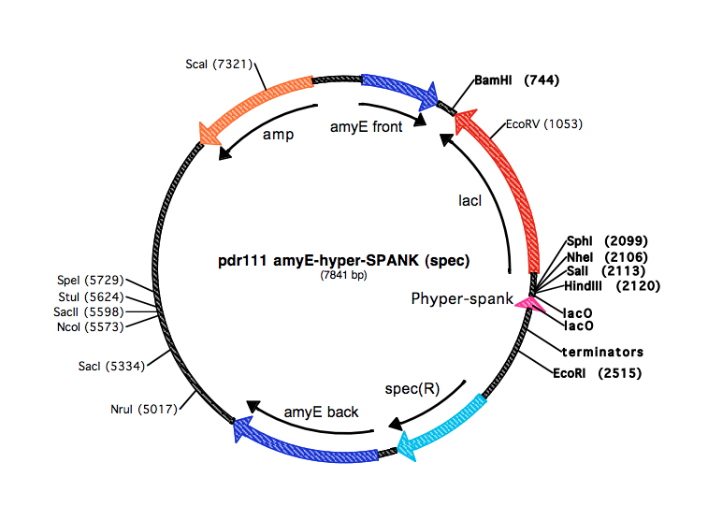
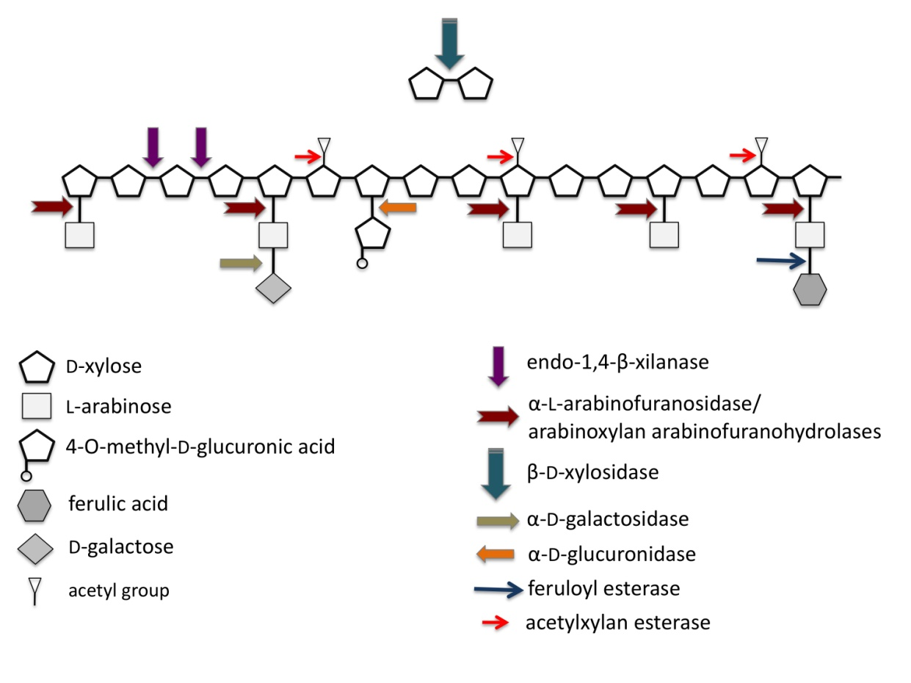
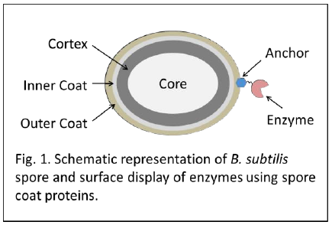
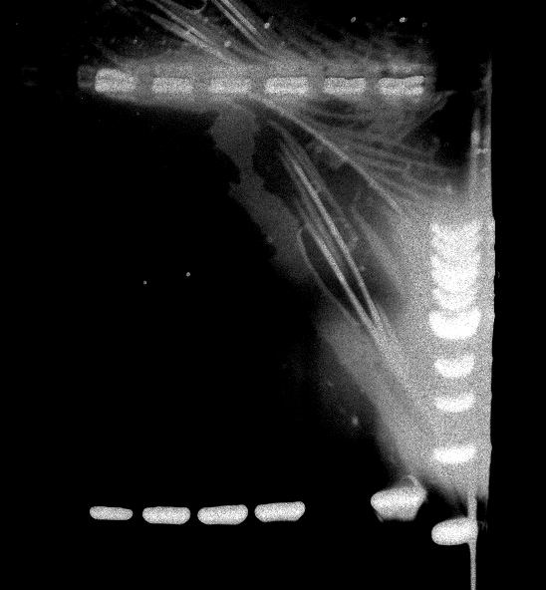
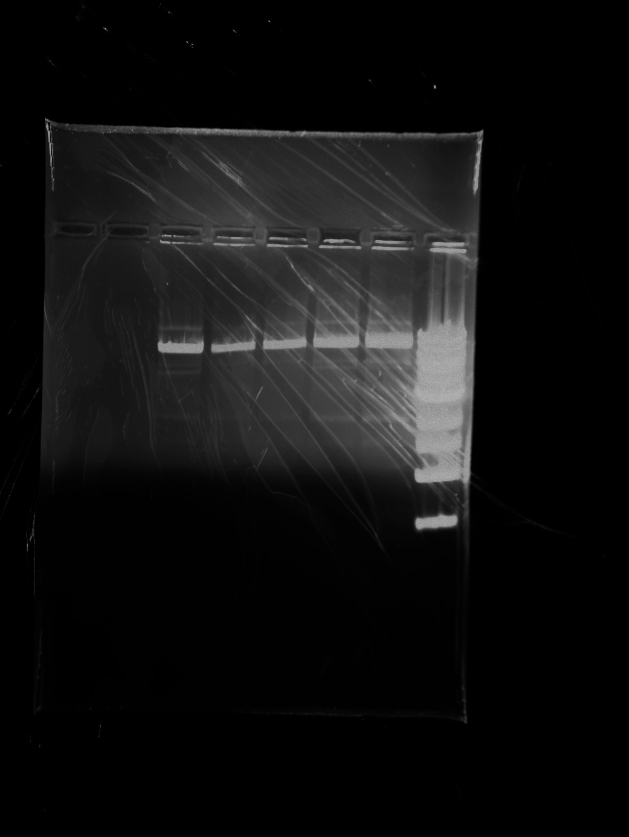
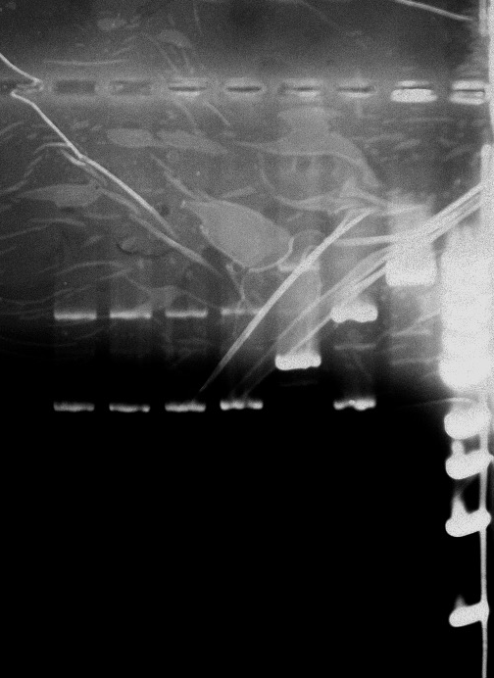
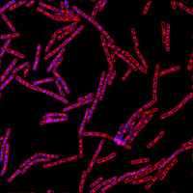
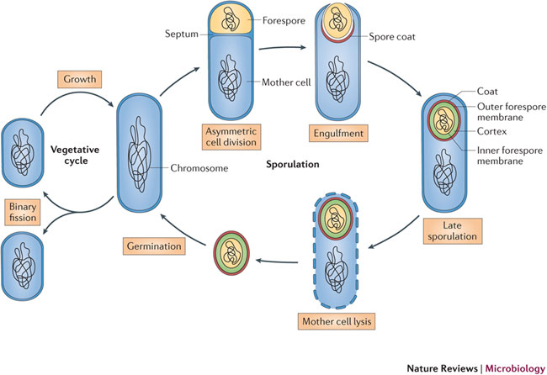
Design of a Tunable Protein Expression and Display System on Bacterial Spore Surface
Sachi Nagada and Dr. Kang Wu
Department of Chemical Engineering
Motivation
Enzymes are used everyday to accelerate the chemical reactions and act as catalysts. The traditional methods to produce enzymes are extremely expensive and have issues with degradation, product costs, stability, and tolerance to inhibitors . This research project examined using spores as a platform for display systems because spores offer the following benefits:
Longer shelf life
More stability
Reusability
Lower cost to produce enzymes from spores
No folding issues with protein
Cheaper separation costs
Limitations to Current Systems
Figure 3. Plasmid map of pDR111. The fluorescent protein will go between the cutting sites of NheI and SphI. The promoter and gene for chimeric protein will go between SphI and EcoRI cutting sites
Figure 8. Multiples enzymes are simultaneously needed to break down biomass [4]
Constructions
Future Work
Complete strain construction
Characterization
  GFP intensity
  Localization of GFP on surface
  Spore integrity (heat, pH, solvent, radiation)
Figure. 1. Schematic representation of B. Subtilis spore and surface display of enzymes using spore coat proteins [1,2].
Figure 4: Fluorescent protein after double digestion
Figure 5: Plasmid HW001 after double digestion
Figure 6: The new construction after integration of GFP
Figure. 9. Fluorescence microscopy for B. subtilis can help find the localizing patterns on CotX-GFP [5].
Experimental Design
Anchor proteins used: CotB, CotC, and CotG
Anchor
Protein
Anchor
Protein
Anchor
Protein
Literature Cited
[1] Henriques AO, Moran CP, Jr. Structure and assembly of the bacterial endospore coat. Methods. 2000;20(1):95-110
[2] Kim J, Schumann W. Display of proteins on Bacillus subtilis endospores. Cellular and molecular life sciences : CMLS. 2009;66(19):3127-36.
[3] For plasmid map
[4]Mckenney, Peter T., Adam Driks, and Patrick Eichenberger. "The Bacillus Subtilis Endospore: Assembly and Functions of the Multilayered Coat." Nature Reviews Microbiology 11.1 (2012): 33-44. Web.
[5] "Review of Fluorescence Microscope Techniques." Review of Fluorescence Microscope Techniques. N.p., n.d. 13 Apr. 2015. <http://microscopy.berkeley.edu/courses/tlm/fluor_review/index.html>.
No linker
Short, linear linker
Long, flexible, linker
GerE binding site
Transcription start site
Native cotC promoter
LacI Binding Site
Hybrid cotC promoter
Acknowledgments
University of New Hampshire for Undergraduate Research
Erin Drufva (PhD Student)
Figure 2: The different combination of anchor, fluorescent proteins, linkers, and promoters
Fig 7. Sporulation cycle showing the germination of spores into cells [3]

