Slide 1

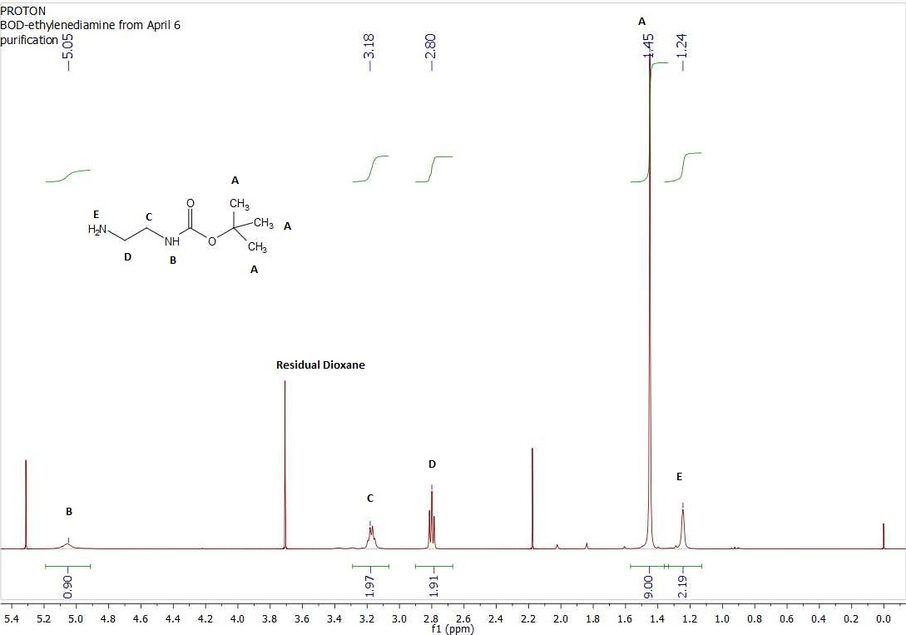
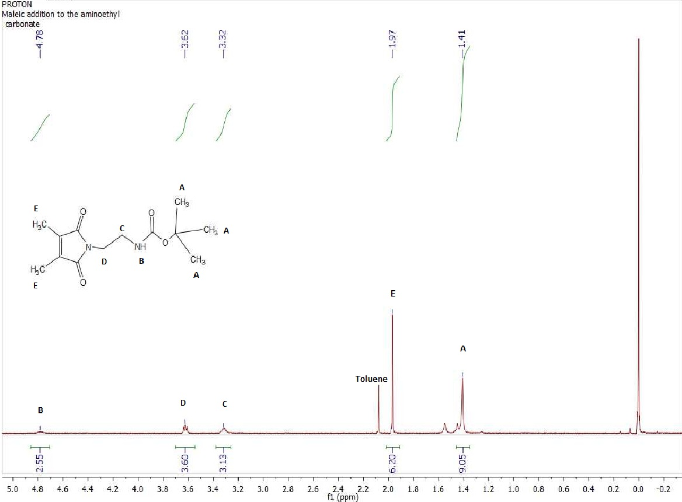
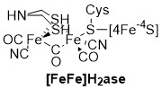
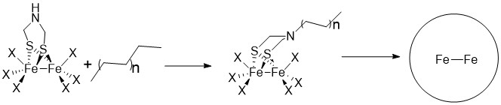

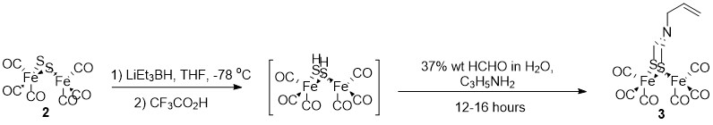


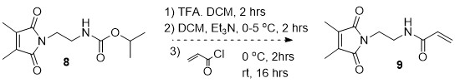
Synthetic Approaches to a Diiron Cluster Complex
Max Bilodeau and Samuel Pazicni
mhr29@wildcats.unh.edu; Parsons Hall, 23 Academic Way, Durham NH 03824
Introduction
Hydrogenases¹ are diverse enzymes:
  Ability to reduce H⁺ to H₂ gas.
  Implications in the search for clean fuel sources, as hydrogen gas producing only water as a combustion product.
Modeling [FeFe] hydrogenases are relevant in that²:
  Reversible reactions catalyzed by hydrogenases allow for capture of H₂
  Oxidation of this H₂ can produce electricity
Hydrogenases have an oxygen sensitivity, leading to an inactivity.³ Collapse of a polymer around these complexes would prevent this interference with oxygen. Because of this, experimentation is being carried out to synthesize different monomers to attach to the complex, and then collapse into a hydrophobic shell. The polymer could also provide a protein-like environment that could confer optimal activity.
The goal of this project is the synthesis of an acrylamide monomer with the ability to polymerize and addition to a diiron cluster complex in a mimic of [FeFe] hydrogenase.
Results and Discussion
The results of this project were the successful synthesis of dithiodiiron hexacarbonyl (Scheme 1) and its successful purification via column chromatography, as well as the synthesis of a dithiodiiron complex with an allylamine bridgehead (Scheme 2).
Also successfully synthesized were the final products of Schemes 3 and 4; t-butyl-N-(2-aminoethyl) carbonate (6) and N-[2-(3,4-dimethyl-2,5-dioxo-2,5-dihydro-pyrrol-1-yl)-aminoethyl]-t-butyl-carbonate (8) respectively. These individual monomers were collected in (0.00384 mol, 32%) for (6) and (0.00187 mol, 64.8%) for (8), characterized by ¹H NMR.
This collected data is being reviewed for purity, and the continuation of synthesis for the desired acrylamide monomer product (Scheme 5) and the eventual polymerization of that monomer, and its attachment to the iron cluster complex.
Figure 1:Active Site of [FeFe] Hydrogenase
Figure 2: Generalized Project Goal
Experimental
Dithiodiiron hexacarbonyl was prepared from iron pentacarbonyl, and was then used in the synthesis of a complex of dithiodiiron hexacarbonyl with an allylamine bridgehead.⁴ (Schemes 1 & 2) The monomer, t-Butyl-N-(2-aminoethyl) carbonate, was prepared to be used to synthesize the monomer N-[2-(3,4-dimethyl-2,5-dioxo-2,5-dihydro-pyrrol-1-yl)-ethyl]-acrylamide.⁵ (Schemes 3-5)
Figure 3: Spectrum of t-butyl-N-(2-aminoethyl) carbonate
Figure 4: Spectrum of N-[2-(3,4-dimethyl-2,5-dioxo-
2,5-dihydro-pyrro;l-1-yl)-aminoethyl]-t-butyl-carbonate
Scheme 1: Synthesis of Dithiodiirion Hexacarbonyl
Future Work
Future work on this project would include:
Improving the yield of the initial monomer (t-butyl-N-(2-aminoethyl)carbonate
Synthesis of the later products in the acrylamide reaction scheme
Polymerization of the monomer and click-addition of the polymer to the prepared diiron clusters.
Conclusions
In this project, several issues were present in the synthesis in the monomers, including poor yield, and extended time in the synthesis of different stages. However, the synthesis of the diiron cluster and the monomers was accomplished, and has potential for improvement and repeatability.
Scheme 2: Synthesis of a Diiron Cluster Model with an Allylamine Bridgehead
Scheme 3: Synthesis of t-butyl-N-(2-aminoethyl) carbonate
Acknowledgments
Extended thanks go to: Christian Tooley for laboratory guidance and project assistance, and the Department of Chemistry, UNH, for funding.
Scheme 4: Synthesis of N-[2-(3,4-dimethyl-2,5-dioxo-2,5-dihydro-pyrrol-1-yl)-aminoethyl]-t-butyl-carbonate
References
Smith, P.R, Bingham, A.S., Swartz, J.R. Generation of Hydrogen from NADPH Using an [FeFe] Hydrogenase. Int. J. Hydrogen Energy, 2012, 37, 2977–2983.
Florin, L., Tsokoglou, A. and Happe, T. A novel type of iron hydrogenase in the green alga Scenedesmus obliquus is linked to the photosynthetic electron transport chain. J. Biol. Chem. 2001, 276 (9), 6125–6132.
Liebgott, P.P., Leroux, F., Burlat, B., Dementin, S., Baffert, C., Lautier, T., Fourmond, V., Ceccaldi, P., Cavazza, C., Meynial-Salles, I., Soucaille, P., Fontecilla-Camps, J.C., Guigliarelli, B., Bertrand, P., Rousset, M., Léger, C. Relating diffusion along the substrate tunnel and oxygen sensitivity in hydrogenase. Nat. Chem. Biol. 2010, 6, 63–70 .
Stanley, J. L., Rauchfuss, T. B., Wilson, S. R. Studies on the Condensation Pathway to and Properties of Diiron Azadithiolate Carbonyls. Organometallics 2007, 26 (8), 1907-1911.
Roy, D., Sumerlin, B.S. Let There Be Light: Photo-Cross-Linked Block Copolymer Nanoparticles. Macromol. Rapid Commun. 2014, 35, 174-179.
Scheme 5: Synthesis of N-[2-(3,4-dimethyl-2,5-dioxo-2,5-dihydro-pyrrol-1-yl)-ethyl]-acrylamide

