Slide 1

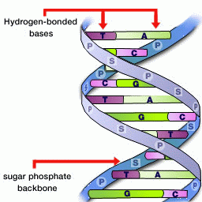
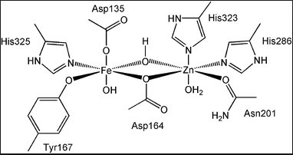
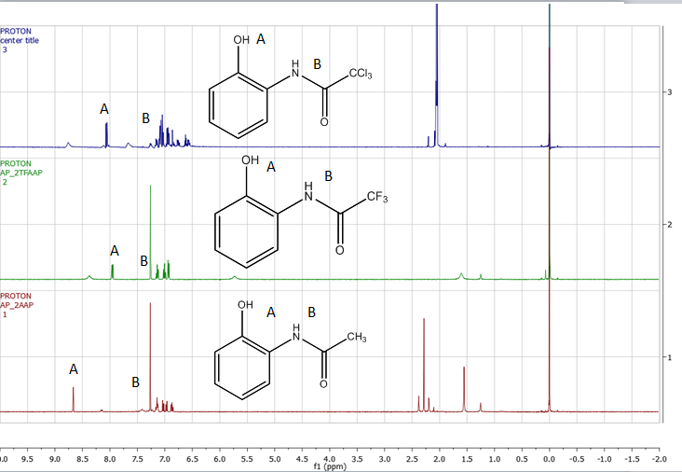
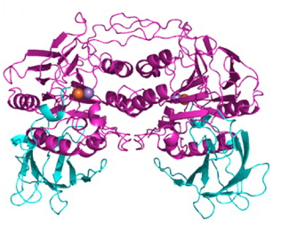
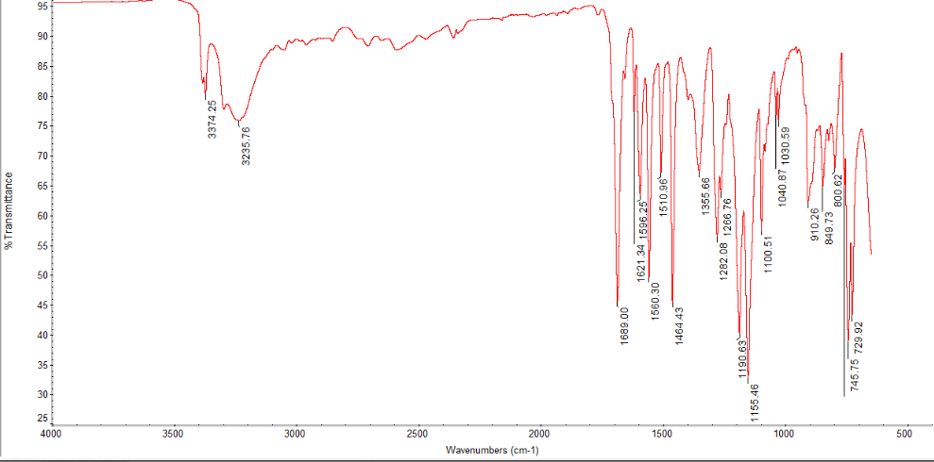
Hydrogen Bonding within Tyrosinate-Bound Iron Complexes
Austin Power and Samuel Pazicni
adc54@wildcats.unh.edu; Parsons Hall, 23 Academic Way, Durham NH 03824
Introduction
Hydrogen bonding is an interaction that happens between three centers, hydrogen and two other atoms that are more electronegative than hydrogen¹. In nature, it is most commonly found in water and DNA. This interaction can happen between atoms of different molecules (intermolecular), as seen in water, or between atoms in the same molecule (intramolecular), as seen in DNA (figure 1). d
Experimental
Tyrosine is one of twenty naturally occurring amino acids. Tyrosine has functionality through the hydroxyl group which can be deprotonated or phosphorylated. It has been seen to be used as a precursor for neurotransmitters and a psychoactive for humans².
Figure 7: Synthesis of acetylated products Figure 8: Synthesis of acetylated salts
Results and Discussion
2-aminophenol was acetylated using three different acetic anhydride derivatives. Yields were increased by cooling the crude acetylated product before rotary evaporation. ¹H NMR of each product showed impurities with a peak around 1.5 ppm that corresponds to water. NaOH was used to deprotonate the phenol, but didn’t yield the salt. The pKa values of the phenol and NaOH should have deprotonated the ligand at equilibrium. Infrared spectrum showed that the ligand didn’t deprotonate due to a peak at 3300 cm⁻¹.
Figure 1: Intermolecular and intramolecular
hydrogen bonding in water (left) and DNA (right)
Figure 2:L-tyrosine
Tyrosine can serve as a metal ligand in metalloproteins in nature. One example of this is purple acid phosphatases (PAP). They are able to catalyze the hydrolysis of phosphomonoester and amide substrates. There are two different structures of purple acid phosphatase. The metallic center is composed of an Fe³⁺ and another metal. PAP are very flexible in the mechanistic strategy they employ while binding to substrates. These metalloenzymes are being studied by medicinal chemists for their possible use in chemotherapy to treat osteoporosis³.
Figure 3: Tyrosine iron binding site of PAP for plants
Figure 4: Plant PAP
Figure 5: ¹H NMR of acetylated products
Thesis Goal
The goal will be to synthesize ligands modelled after tyrosine that hydrogen bond intramolecularly. Ideal hydrogen bond angles are 180 degrees, which can be seen in water. The hydrogen bond angle for the N-H----O bond will be approximately 100 degrees. Previously designed model complexes have shown positive shifts in redox potential due to increases in hydrogen bond donation and increases in inductive effects from neighboring functional groups. The modelled ligands will have both of these characteristics.
Figure 5: Proposed overall reaction mechanism to form complex
Conclusions
The ligands were attempted to be synthesized and attached to a iron center. Products of each step were analyzed using NMR and IR spectroscopy. IR spectroscopy revealed the acetylated salt wasn’t formed due to a broad peak at 3300 cm⁻¹ indicating a hydroxyl group. Reactions could be run in a dry box to ensure water in the air doesn’t react with the reactants.
Figure 6: IR of acetylated salts
Future Work
Formation of the acetylated salts will be continued using other strong bases and superbases. After formation of the original target complex is complete, another complex with ligands without hydrogen bonding and similar structure to the proposed ligands will be formed and Fe-O bond distances will be measured for further comparison on the effects of intramolecular hydrogen bonding.
Acknowledgments
I would like to thank Kyle Rodriguez and Christian Tooley for advising me through my research. And also, the Department of Chemistry, UNH, for funding.
References
T. S. Moore and T. F. Winmill . The State of Amines in Aqueous Solution. J. Chem. Soc. 1912, 101. p. 1635.
Leathwood P. D., Pollet P. Diet-Induced Mood Changes in Normal Populations. .Journal of Psychiatric Research 1982, 17. p. 147–154.
Schenk, G., Mitic, N., Hanson, G. R., Comba, P., Purple Acid Phosphatase: A Journey into the Function and Mechanism of a Colorful Enzyme. Coor. Chem. Rev. 2013, 257. p. 473-482.

