Slide 1

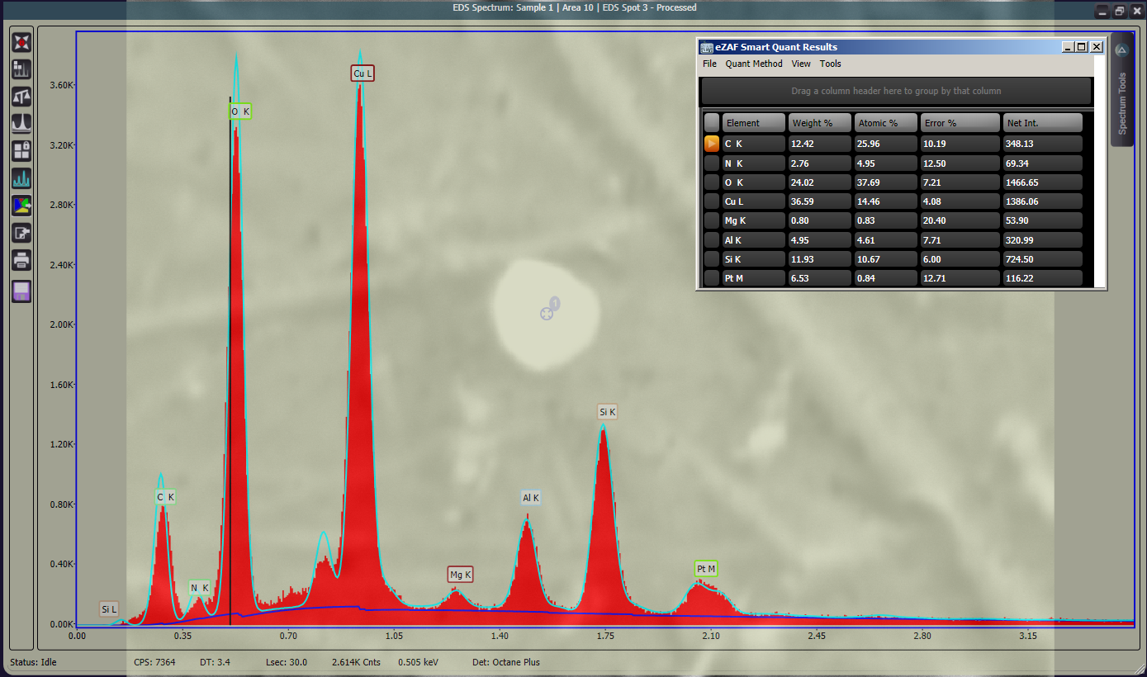
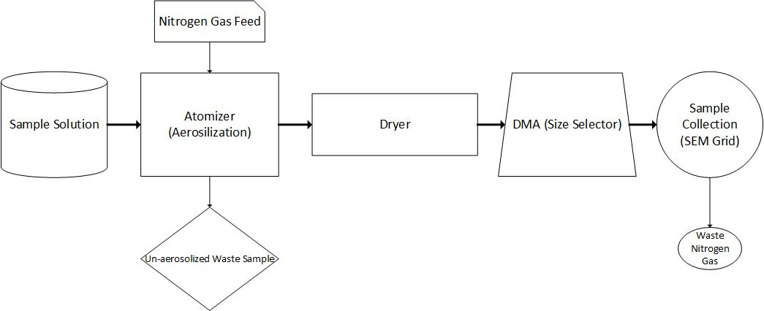
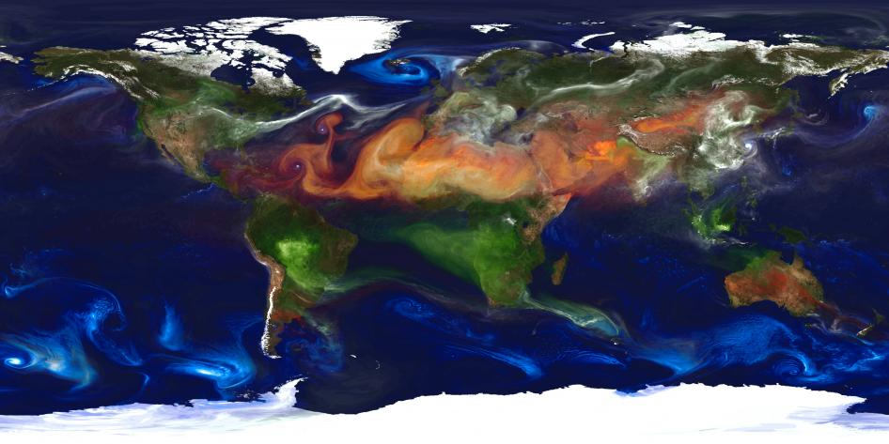
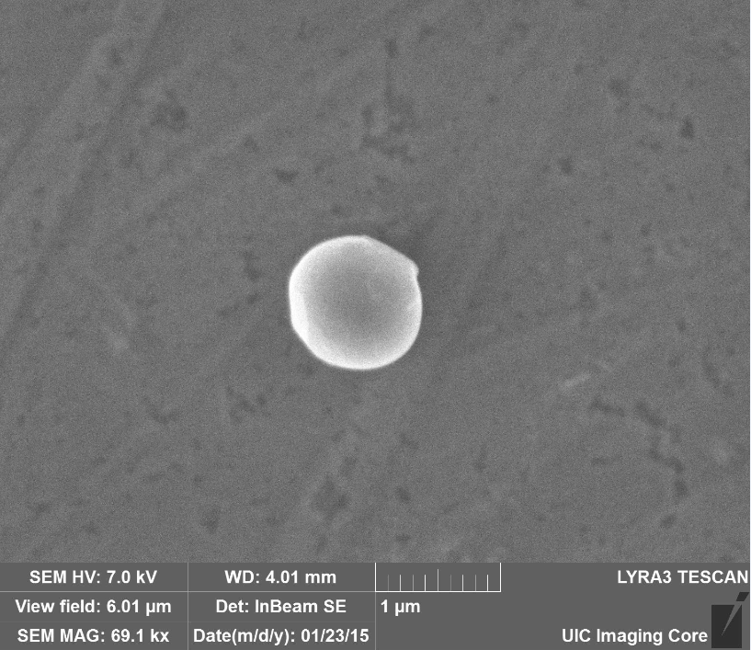
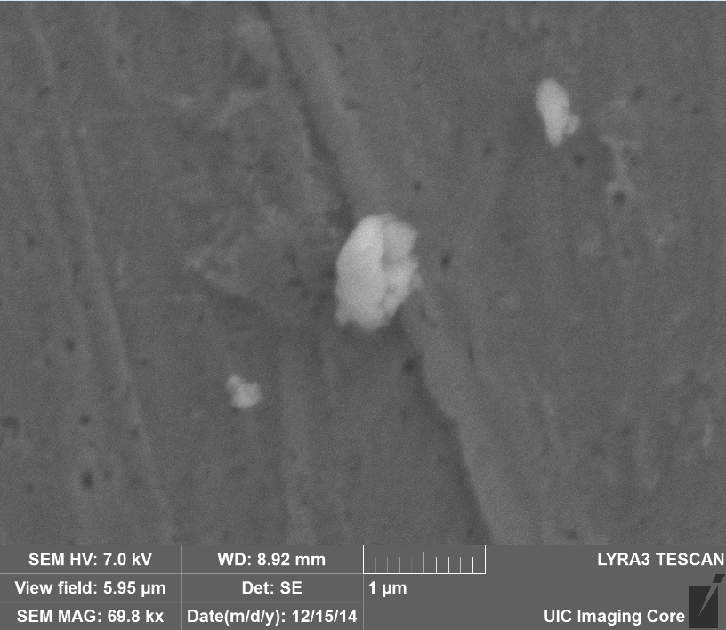
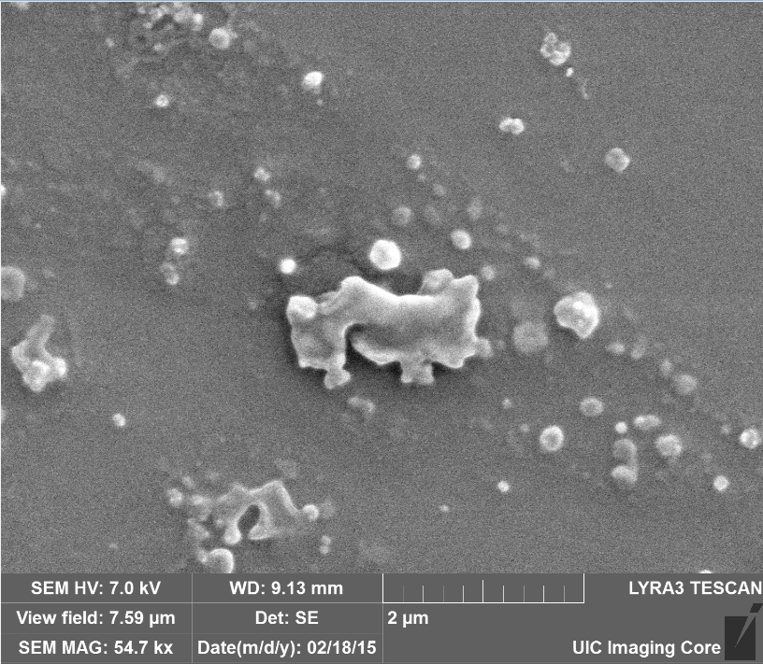
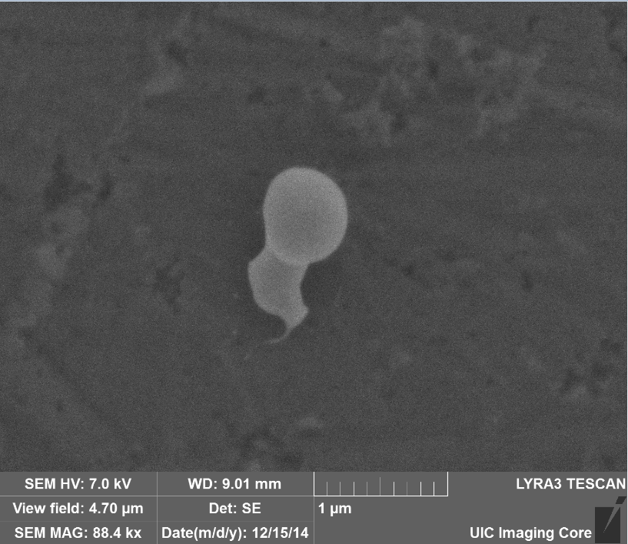
Imaging and X-Ray Spectroscopy of Aerosolized Montmorillonite and Malonic Acid
Christopher Redus, Departments of Chemistry and Chemical Engineering, University of New Hampshire
Spectroscopy analysis returns elemental compositions closely matching the chemical formula before aerosolization.
Introduction
Methods
Conclusions
Aerosols , both natural and anthropogenic, are one of the least understood global climate phenomena.
Many climate models incorporate aerosols, though with a large magnitude of uncertainty.
Mineral aerosols account for about 45% of the global aerosol load, the majority of which is produced naturally. Desertification and agriculture will cause this number to increase.
Whether mineral aerosols scatter light, a cooling effect, or absorb, a heating effect, is dependent on a particular aerosol’s size and chemical composition.
Past research has shown that a clay mineral generated with a dicarboxylic acid will have a different extinction coefficient than a pure clay mineral particle.
Aerosolization
A sample to be aerosolized is first mixed in water. The sample is drawn up from a reservoir using a small pump into a machined block where it is exposed to a high velocity nitrogen gas feed. The liquid sample is blown apart and the resulting particles are entrained in the nitrogen gas flow.
Results have shown that clay particles can be aerosolized, collected, imaged, and chemically identified with SEM and EDS.
Observed morphology changes affirm the idea that malonic acid coats montmorillonite. EDS provides additional evidence that this is the case. Spectroscopy results have been inconsistent and this should be addressed by modifying the sample collection method or other experimental variables.
Larger malonic acid particles appear to decompose in real time as the electron beam hits them. Small aerosolized particles can be seen with the SEM, EDS produces no distinct indicators of malonic acid presence.
SEM grids used contain carbon and oxygen, which makes samples such as malonic difficult to isolate and identify using EDS based on these elements alone. Elements unique to the aerosol being studied need to be used as indicators, such as aluminum and silicon in montmorillonite.
10% clay, by weight, with a balance of water was too thick to be pumped and aerosolized. When 1% malonic acid was added, aerosolization was possible. This could be because the malonic acid coats the clay.
The suspended particles are dried, then pass through a Differential Mobility Analyzer (DMA, TSI, 3081L), which is used to select a specific particle size. Particles of diameters of 250, 300, and 350 nanometers. These aerosol particles are then directed to an imaging grid or silicon wafer (Ted Pella Inc.).
Imaging
  The grid is applied to a metal stub using carbon paint. A thin coating is then applied to the sample, where to date Pt and Pd-Au sprays have been used. The sample is imaged using a Scanning Electron Microscope (SEM, Tescan LYRA3 GM). The coating enhances image resolution and protects the sample.
  X-Ray Spectroscopy
  While in the SEM chamber, the aerosol samples are also measured with Energy-Dispersive X-ray Spectroscopy (EDS) to analyze elemental content.
Results of X-ray spectroscopy of a pure montmorillonite aerosol particle. Each peak indicates the presence of a specific element. In the top right is a chart quantifying the molar and weight percentage of each element, with error.
The chemical formula for montmorillonite varies depending on the location of it’s source. The cation content changes, but the clay contains silicon, aluminum, carbon, and oxygen regardless of source. One theoretical formula for a single nanoscale montmorillonite particle (Uddin) is (Na CA)_{0.33}(Al Mg)₂(Si₄O₁₀)(OH)₂·nH₂O. The SEM grid is made of copper (Cu) and has both a carbon (C) film and a formvar (C and O) coating. The sample is coated in platinum (Pt), before being imaged. The stub the grid is held on is made of aluminum (Al), but the X-rays do not penetrate through the sample enough for it to show up in the spectroscopy results. Thus the elements used to indicate the presence of montmorillonite are aluminum (Al) and silicon (Si).
Next Steps
Map generated by NASA of worldwide aerosol load. Orange indicates dust aerosols, white indicates sulfates, green indicates fire soot particles, and blue indicates sea salt.
Results
Modify aerosol collection method to yield more substantial malonic acid sample on the SEM grid.
Reproduce measurements on malonic acid mixed with montmorillonite.
Investigate collection, imaging, and spectroscopy process for a number of other chemicals. These will include a different clay, kaolinite, and two other dicarboxylic acids, succinic and glutaric acid.
Attempting to coat a clay particle with sodium chloride. This is a very important process to study, as a large amount of aerosols are generated from ocean salt water and may yield more unique EDS signatures.
Objectives
Generate aerosols using accepted methods and analyze the effectiveness of said techniques for imaging and spectroscopy purposes.
Determine if any chemical change occurs as a result of aerosolization.
Investigate methods to determine elemental composition of individual aerosols.
Study the chemical and physical structures of aerosols generated from montmorillonite and malonic acid together, and aerosol structure of each individual component.
SEM images of generated samples have been taken which clearly indicate particle presence.
(a)
(b)
References
The Comparison of averaged mole fractions of a sample of pure montmorillonite particles to a sample of an aerosolized solution of montmorillonite mixed with malonic acid. Results are averaged over 5-6 individual aerosol particles. Both the mole fractions and error were obtained from spectroscopy data. Error bars indicate standard deviation with the sample.
Mixed particles have lower, but still present, aluminum and silicon contents, and higher carbon contents. This indicates that a percentage of the particle is not montmorillonite, but instead a more carbon-rich chemical. This is likely malonic acid. Oxygen is abundant in both chemicals, which makes it a bad indicator of change.
Putnam, William. Portrait of Global Aerosols. Digital image. NASA. NASA, 28 July 2013. Web. 15 Apr. 2015.
Alexis Rae Attwood & Margaret E. Greenslade (2011) Optical Properties and Associated Hygroscopicity of Clay Aerosols, Aerosol Science and Technology, 45:11, 1350-1359, DOI: 10.1080/02786826.2011.594462
Uddin, Faheem. "Clays, Nanoclays, and Montmorillonite Minerals." Metallurgical & Materials Transactions 39.12 (2008): n. pag. EbscoHost. EBSCO Publishing, 01 Dec. 2008. Web. 10 Apr. 2015.
Laskinaa, Olga, Mark A. Young, Paul D. Kleiber, and Vicki H. Grassian. "Infrared Extinction Spectroscopy and Micro-Raman Spectroscopy of Select Components of Mineral Dust Mixed With Organic Compounds." Journal of Geophysical Research: Atmospheres 118.12 (2013): 6593-606. Print.
Laskinaa, Olga, Mark A. Young, Paul D. Kleiber, and Vicki H. Grassian. "Infrared Optical Constants of Organic Aerosols: Organic Acids and Model Humic-Like Substances (HULIS)." Aerosol Science And Technology 48.6 (2014): 630-37. Print.
References
Margaret Greenslade
Research Adviser
Assistant Professor, UNH Department of Chemistry,
Nancy Cherim
Instrumentation Scientist, SEM Wizard, University Instrumentation Center
(c)
(d)
Tyler Galpin
Graduate Student, Department of Chemistry,
James Hendricks
Graduate Student, Department of Chemistry,
Sample SEM images of: a) a mixed montmorillonite-malonic acid particle, b) A pure montmorillonite particle, c) A large number of pure malonic acid particles conglomerating, d)A pure malonic acid particle.

