Slide 1

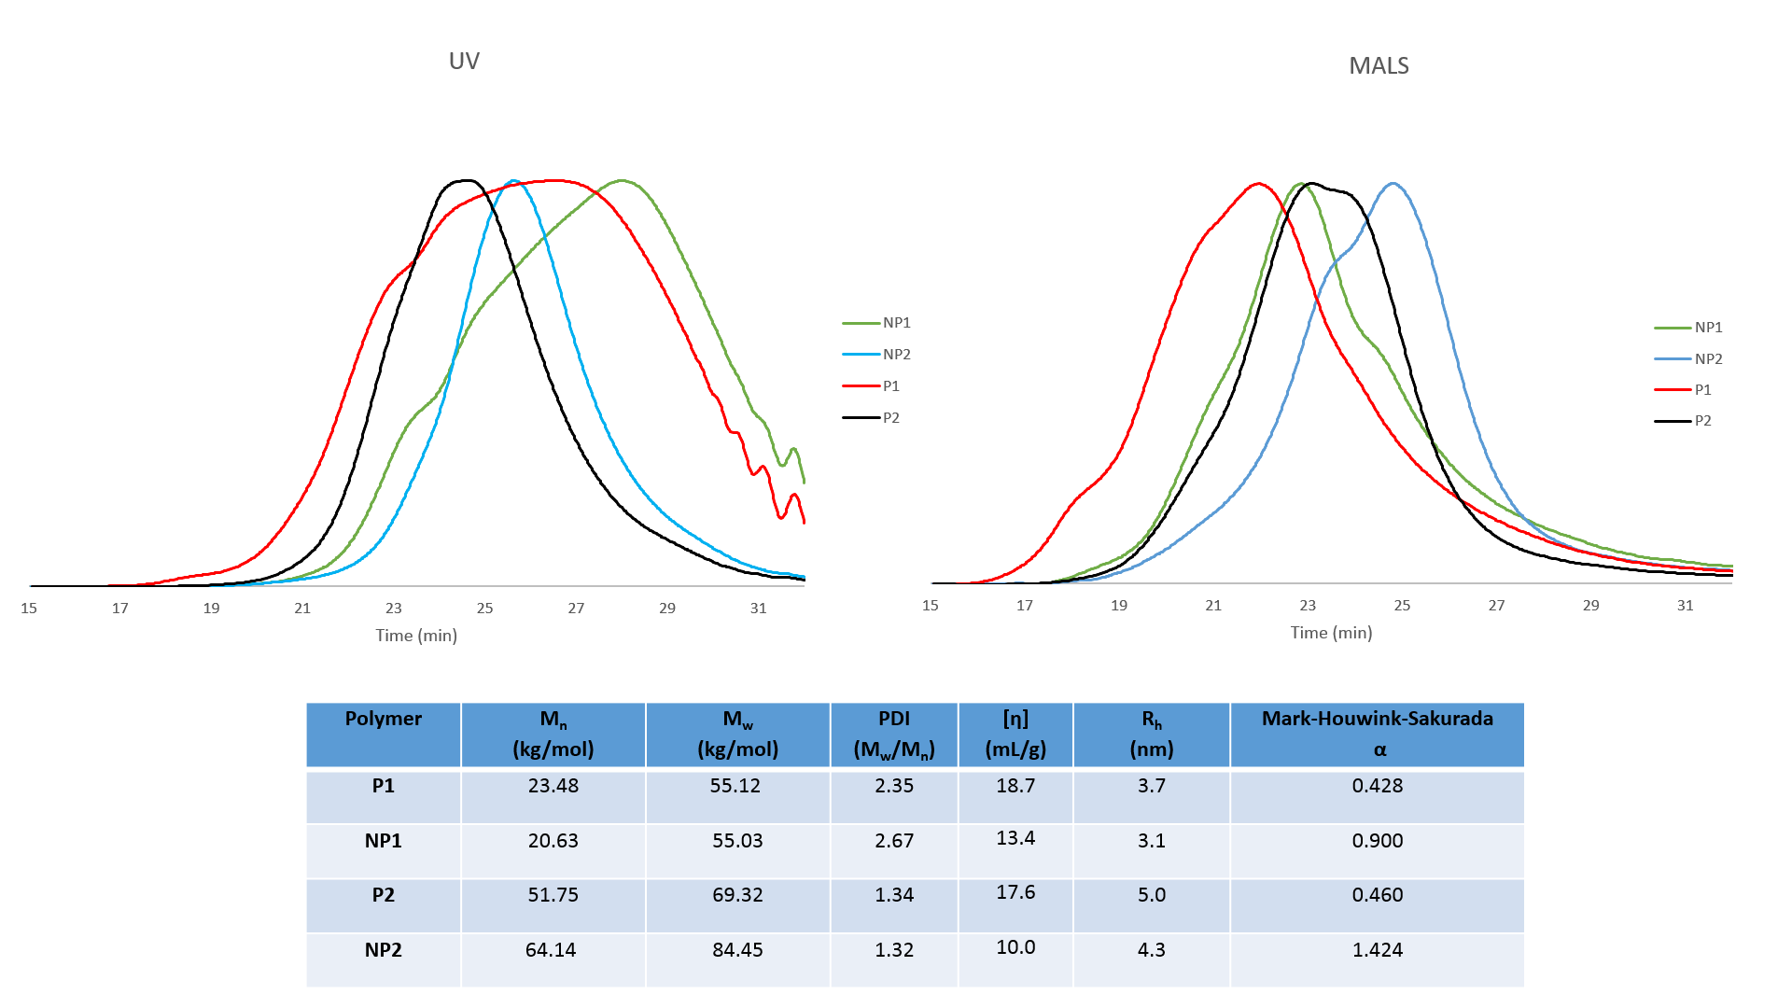
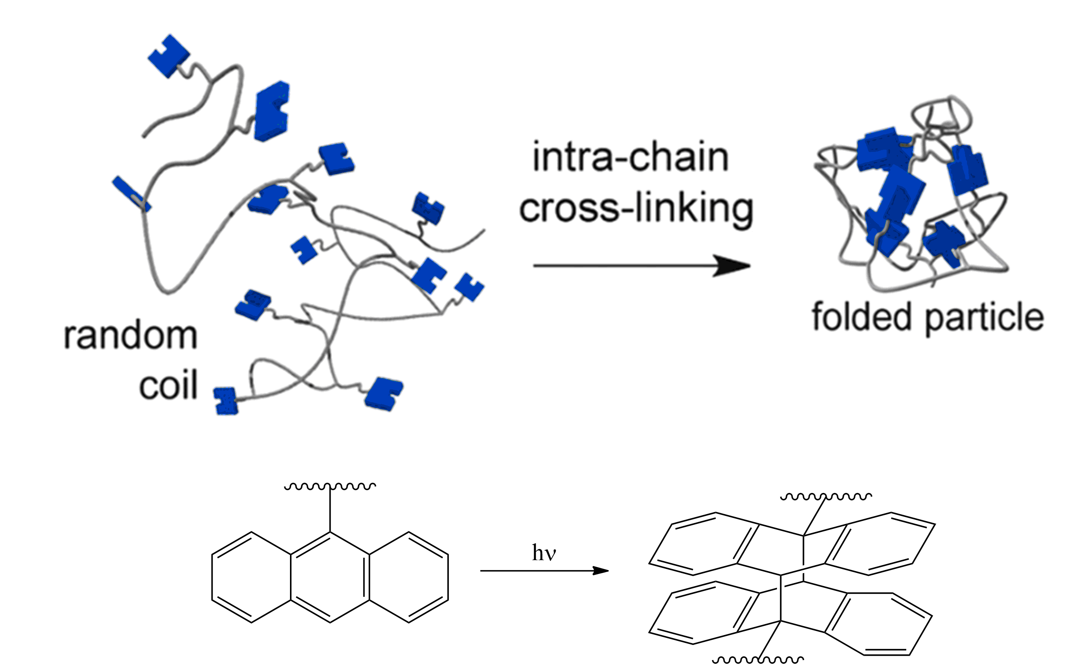
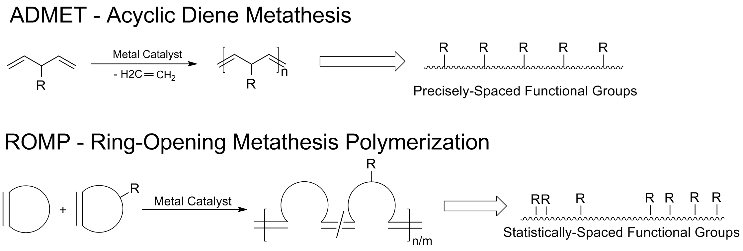
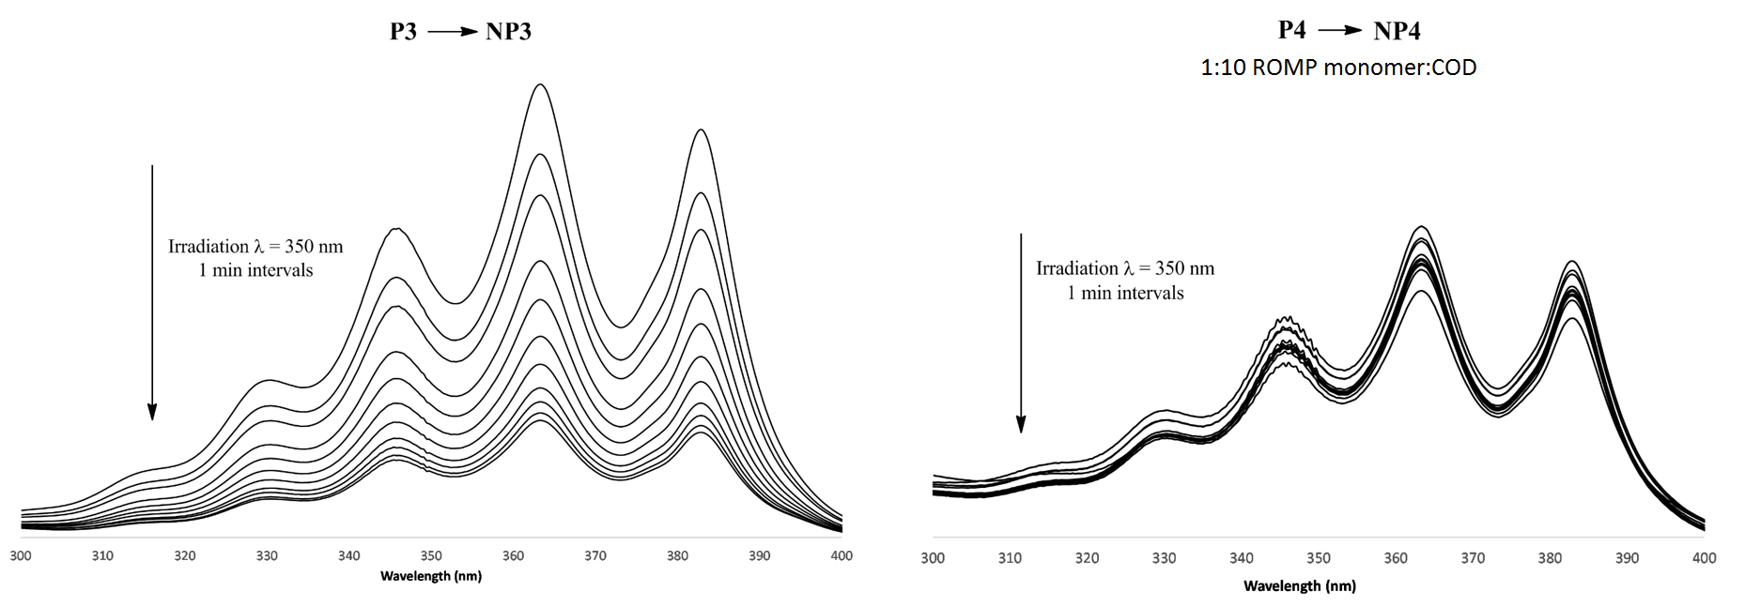
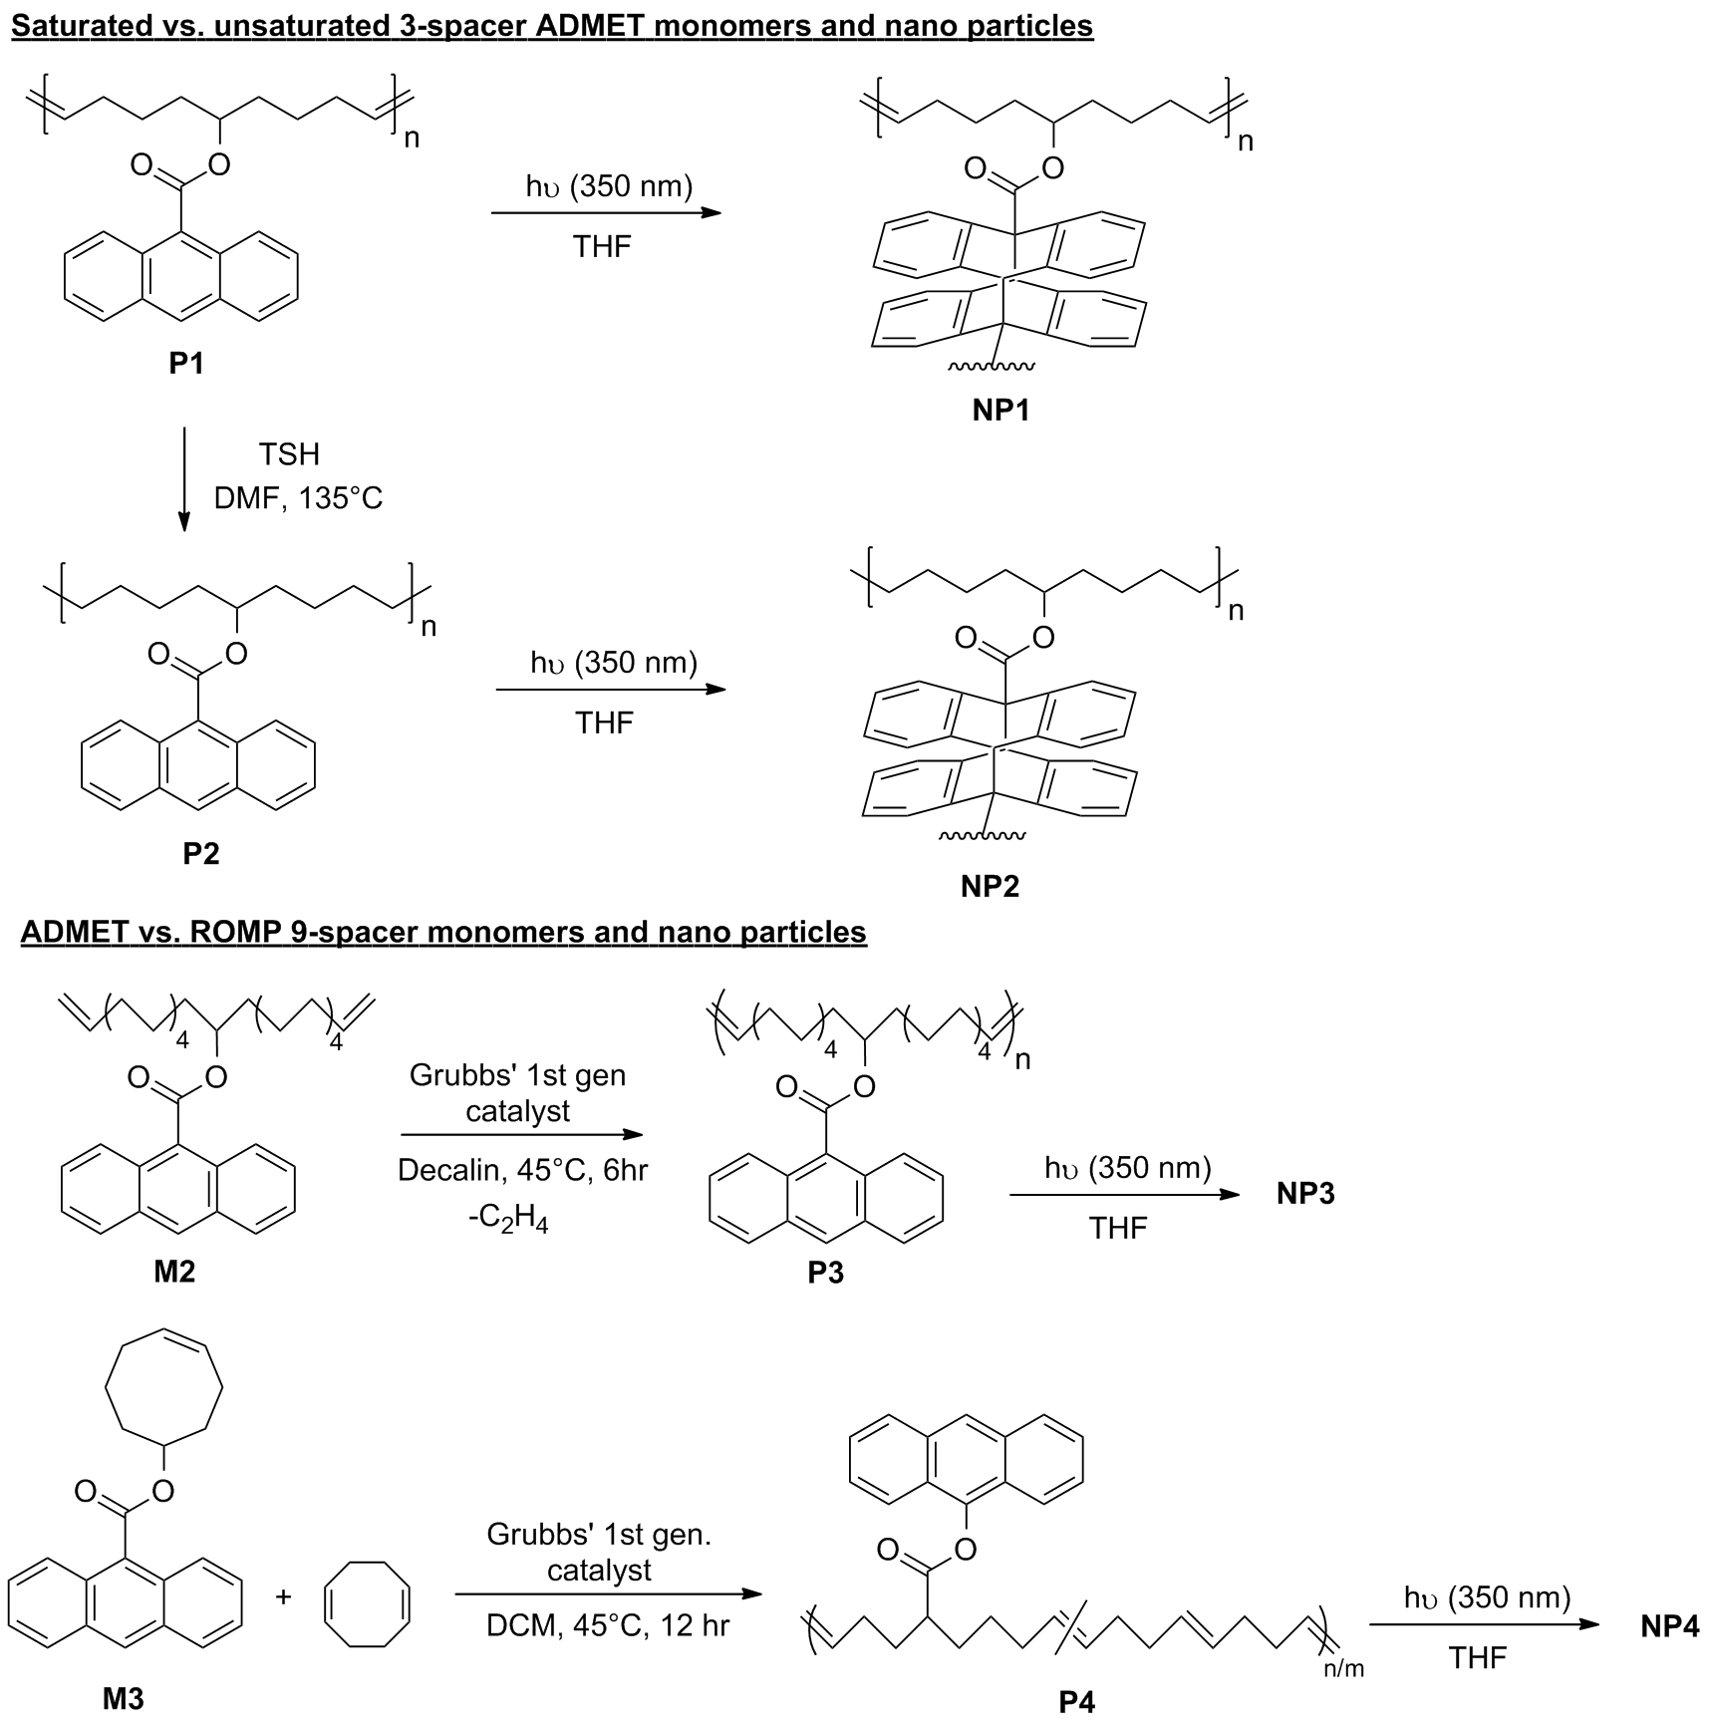
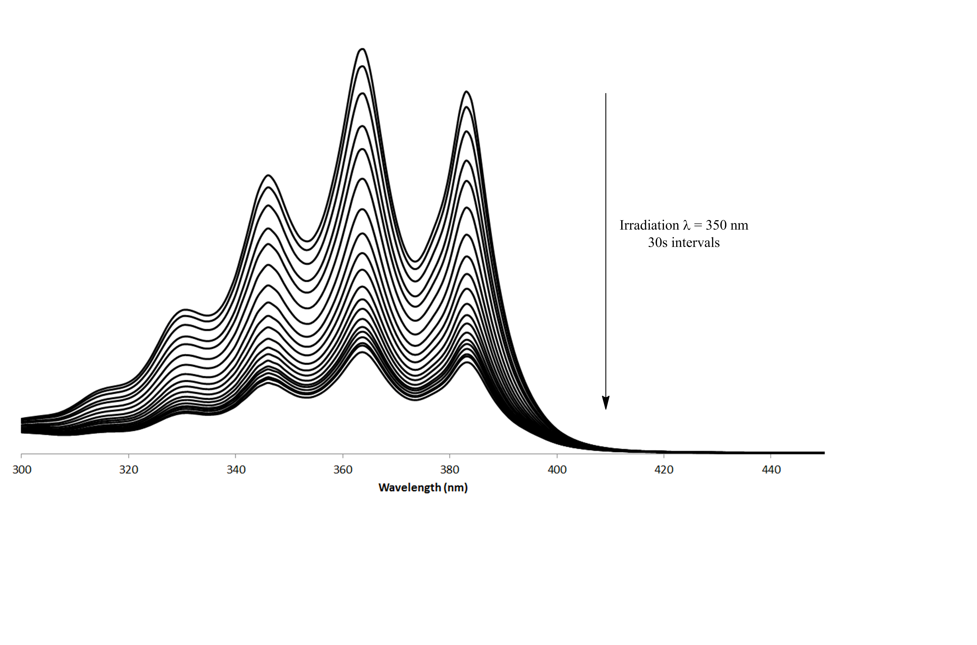
Single-Chain Nanoparticles from Sequenced Polyolefins
David Waste, Christopher Lyon, Erik Berda
dws33@wildcats.unh.edu; Parsons Hall, 23 Academic Way, Durham NH 03824
Introduction
Single chain nanoparticles (SCNPs) are mimics to natural macromolecules. By synthesizing and polymerizing multiple functionalized monomer subunits and collapsing these chains by intra-chain crosslinking, nanoparticles with tunable size, shape, and a vast range of capabilities, including targeted drug delivery and fluorescent sensors, are formed.
It is important to understand how polymer structure affects the formation of architecturally defined nanoparticles in order to tune these characteristics. It is the goal of this research, using anthracene-functionalized polymers, to determine the affect of backbone saturation and functional group spacing on the collapse of polymer chains to form SCNPs.
Figure 4. GPC traces of polymers P1, P2, and respective nanoparticles
Figure 1. Linear polymer chains are collapsed via anthracene dimerization crosslinking reactions
Figure 2. Polymerization techniques used to create polymer chains with varying positions of functional group placement
Results and Discussion
The synthesis of all four polymers proved successful by characterization by NMR spectroscopy. Two versions of P4 were created, with a 1:10 and 1:1 ratio of M3:1,5 cyclooctediene (COD) respectively. Unfortunately the gelling of the 1:1 polymer disallowed its solvation in any solvent system, and so the 1:10 polymer was used instead for SCNP formation and studies, however it is a future goal to extract the 1:1 polymer as it is a better analog to P3, with a similar statistical group placement backbone structure.
Upon collapse of ADMET polymers P1, P2, and P3 a decrease in the characteristic peaks of anthracene was noted, as well as a shift in the retention times from the parent polymer to the nanoparticles by Gel Permeation Chromatography (GPC) using UV and Multi-Angle Light Scattering (MALS) detectors. These traces show the successful formation of SCNPs. The most notable difference between P1 and P2 is the increase in the α-value, corresponding to P2 being more rod-like and rigid than P1. UV-Vis spectra of P3 and P4 show a significant difference in the decrease of the anthracene absorption lines, indicating that the different spacing of the functional groups may indeed have an effect on the collapse of the polymer into a nanoparticle.
Figure 5. UV-Vis spectra of P3 and P4 photodimerization collapses
Conclusions
Successful synthesis of both sequences of polymers was achieved and characterized by NMR spectroscopy. Collapse of these polymer chains was also shown to have occurred by UV-Vis spectrometry. These spectra show that for the comparison of functional group spacing between ADMET and ROMP nanoparticles, there is a notable difference in the anthracene absorption peaks. GPC traces of ADMET polymers P1 and P2 show both that nanoparticles were successfully formed and there is a differentiation in the rigidity of the nanoparticles. Both sets of polymers and their respective effects on SCNP collapse and folding are the subject of future research by members of our research group.
Figure 6. TEM images of speculated nanoparticles
Future Work
The collection of GPC data on P3 and P4, as well as the ongoing extration of 1:1 M3:COD gelled copolymer to retrieve single polymer chains, which will then undergo collapse and analysis by UV-Vis and GPC in order to better compare ADMET NP3 nanoparticles to the respective ROMP copolymer nanoparticles are the primary focus of current work.
The synthesis of future polymers by the hydrogenation of P3 and P4 is intended to compare how a combination of backbone saturation and functional group placement affects the conformation of their respective nanoparticles.
Acknowledgments
Thank you to Dr. Erik Berda and the Berda research group for allowing me to join their group and helping me through every aspect of my research. I would also like to thank Dr. Patricia Wilkinson and Nancy Cherim for their help with NMR/UV-Vis spectra and TEM images respecfully, and the UNH Department of Chemistry for the funding of this research.
References
Lyon, C.L. et al. Polym. Chem., 2015, 6, 181-197.
Frank, B.G et al. Macromol. Rapid Commun., 2014, 35 (2), 249-253.
Synthetic routes in the creation of the desired monomers and nanoparticles
Figure 3. UV-Vis spectrum of P2, showing decrease in characteristic anthracene peaks before and after irradiation

