Slide 1

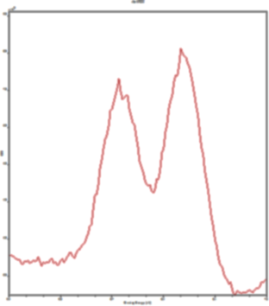
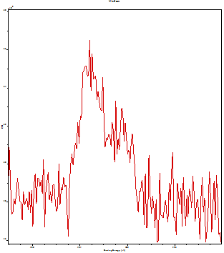

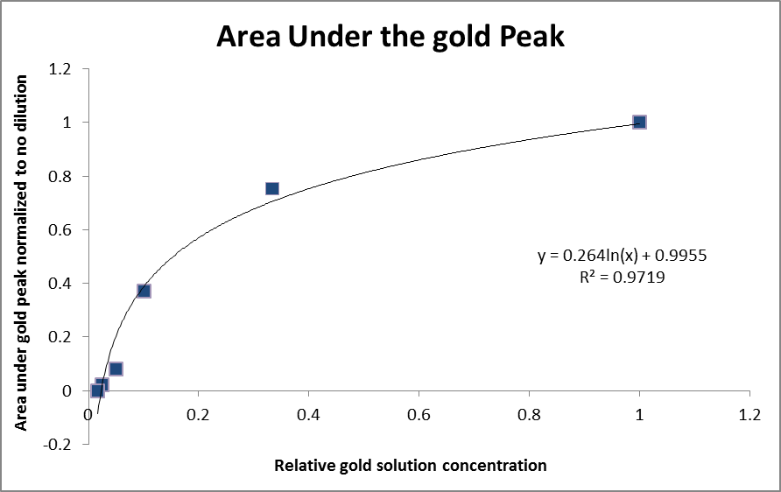
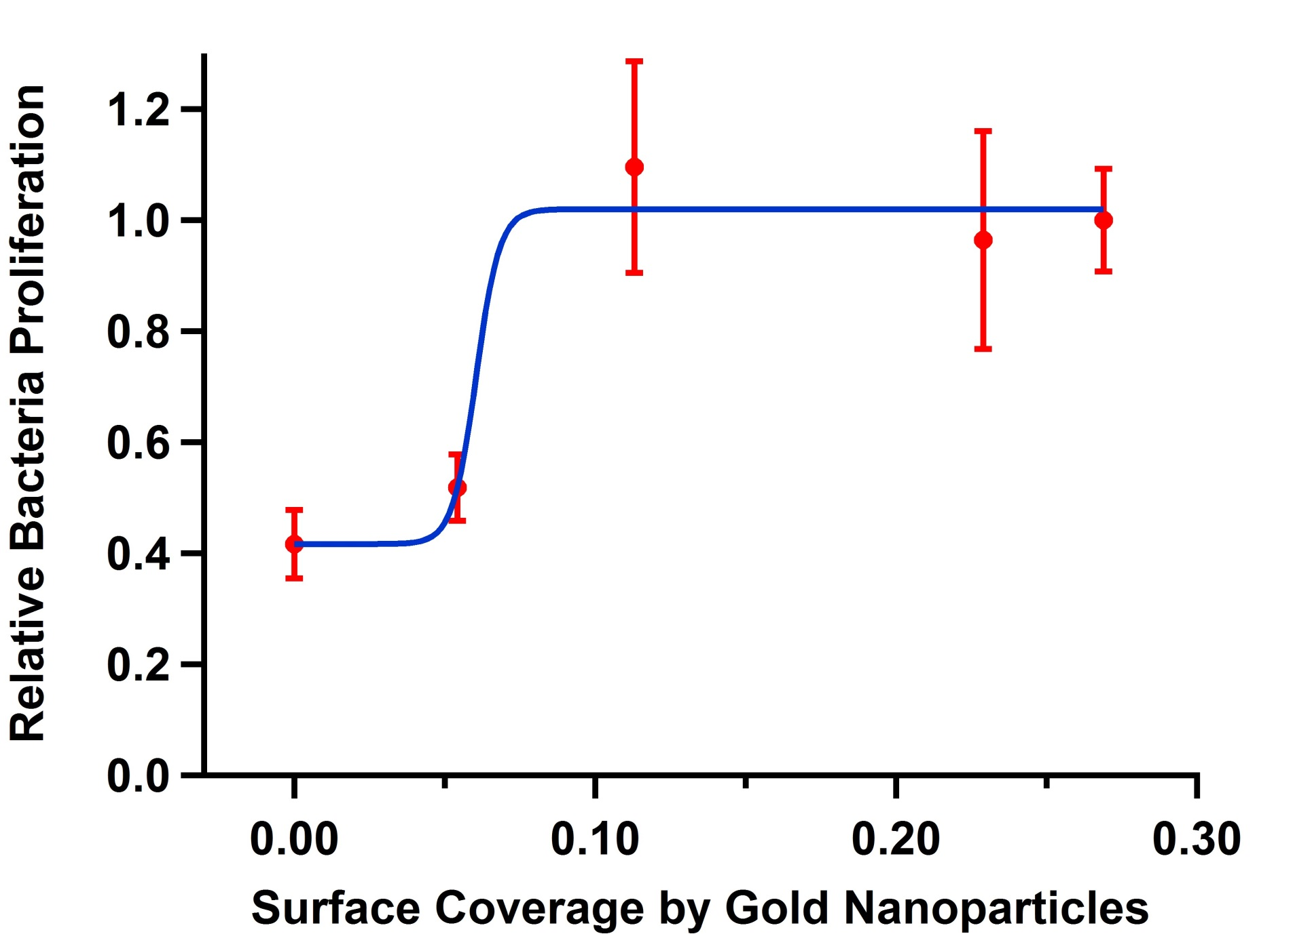
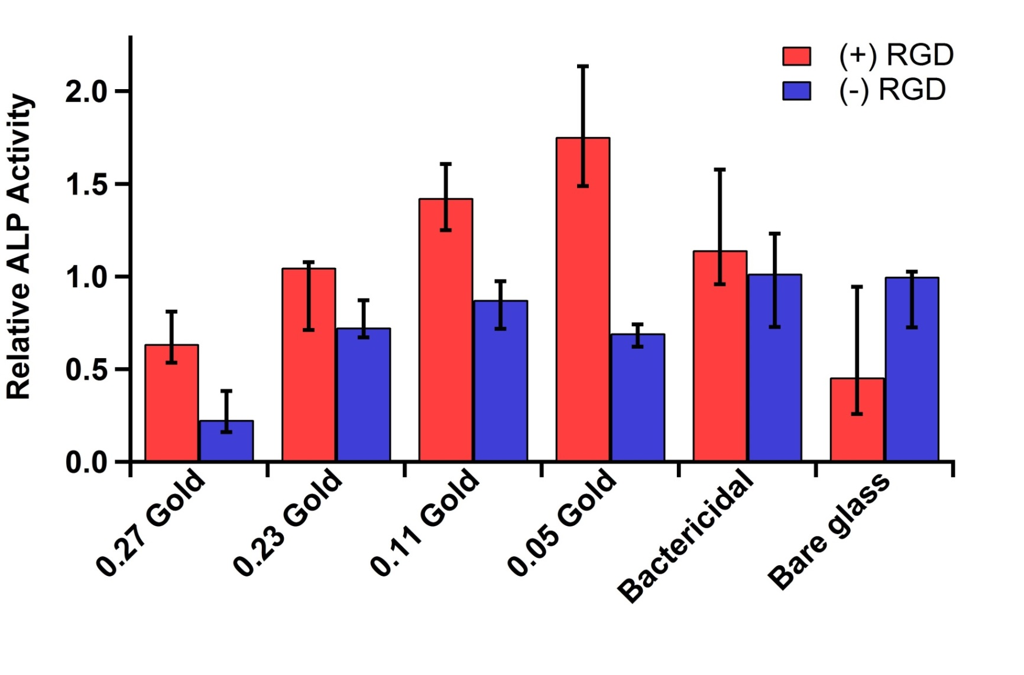
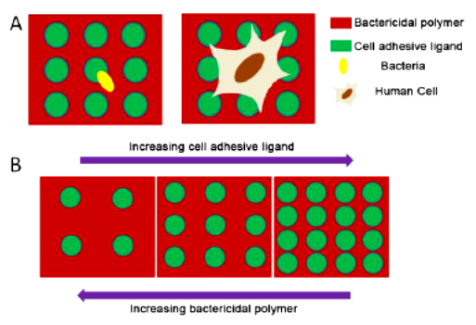
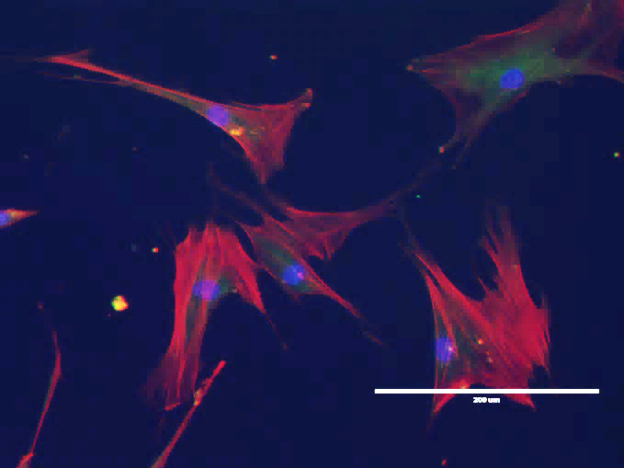
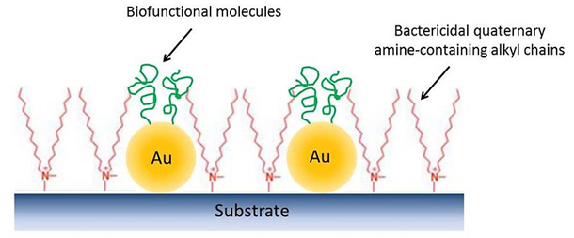
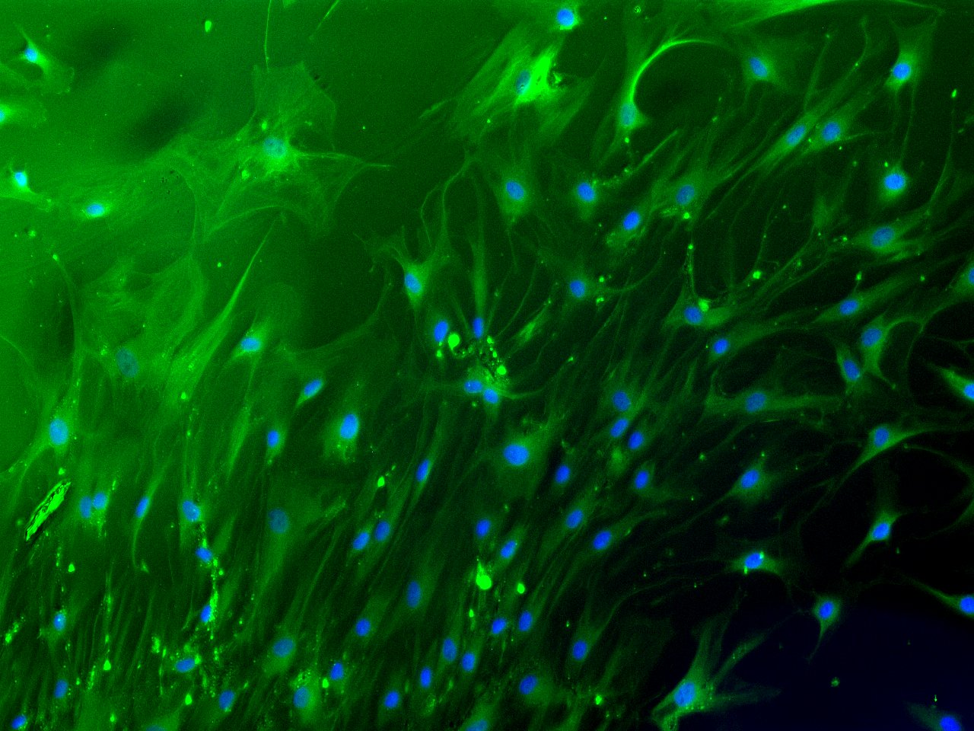
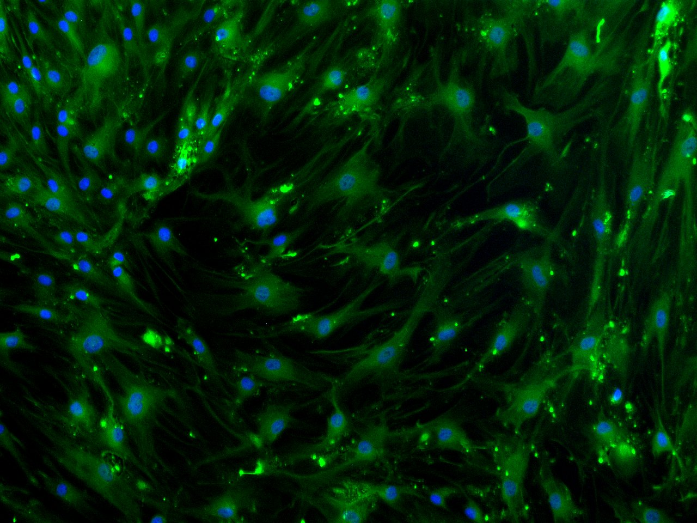
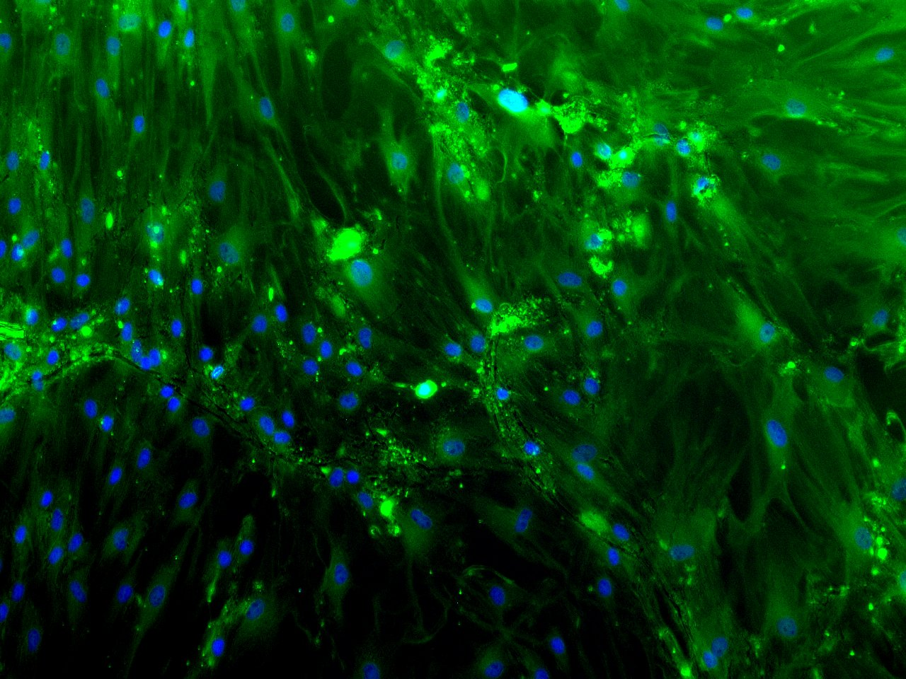
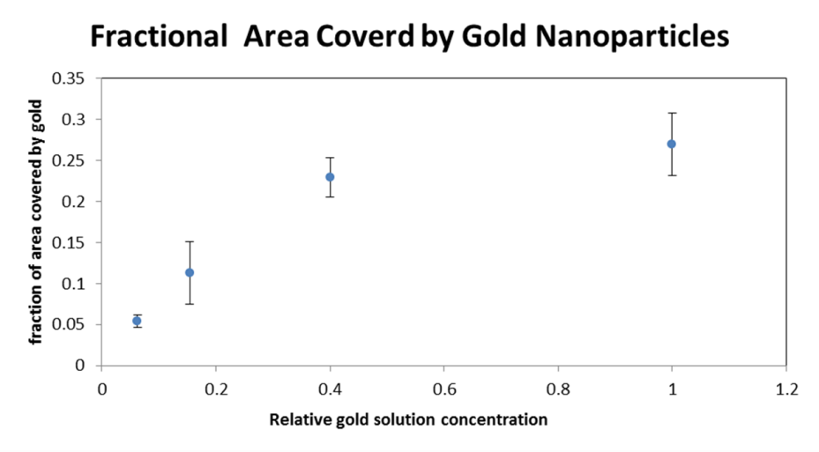
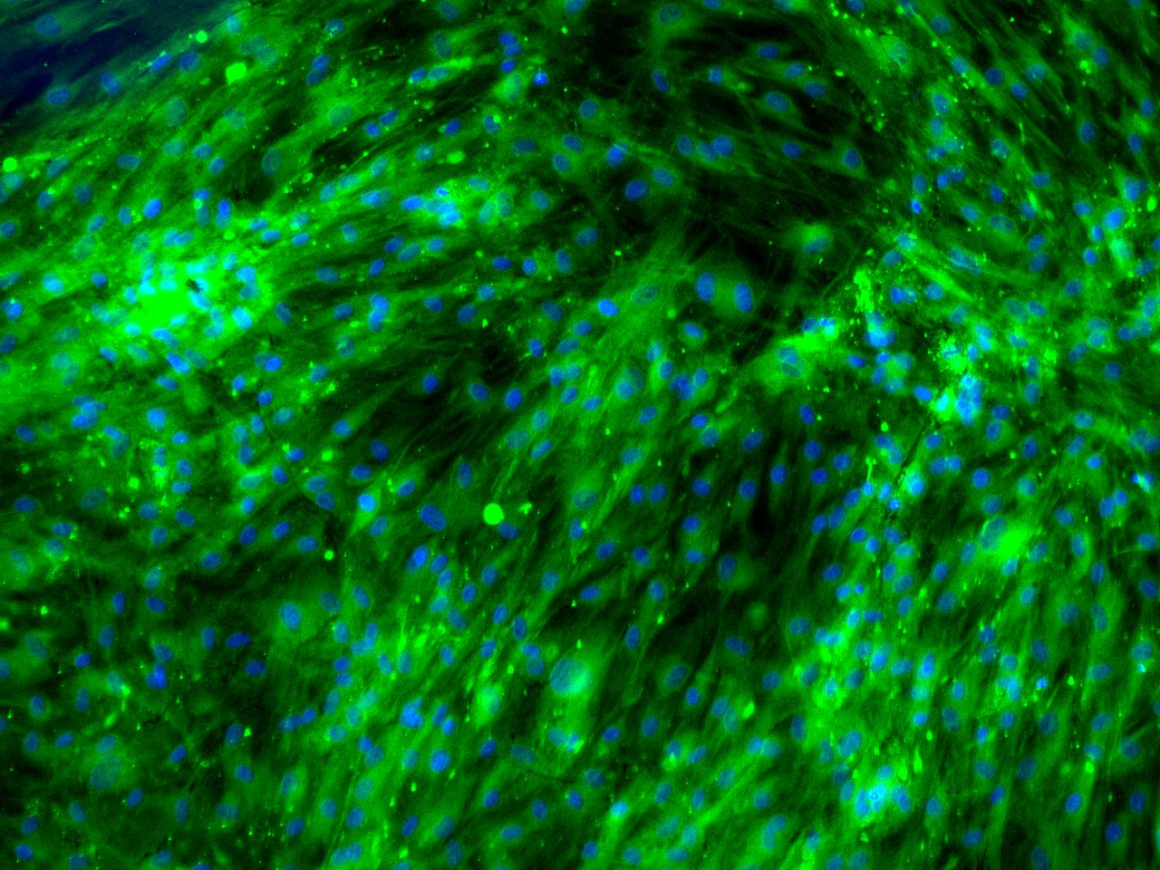
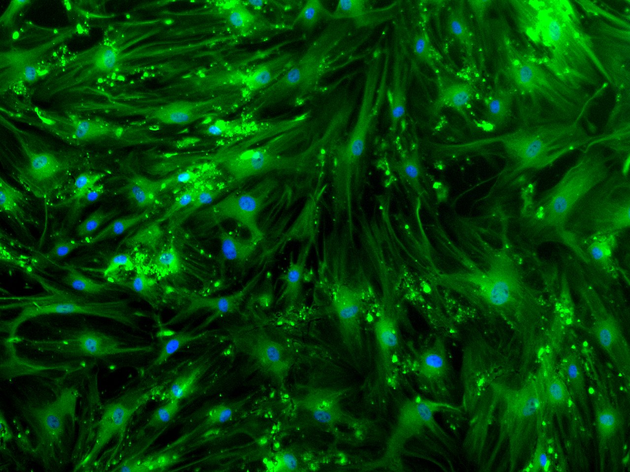
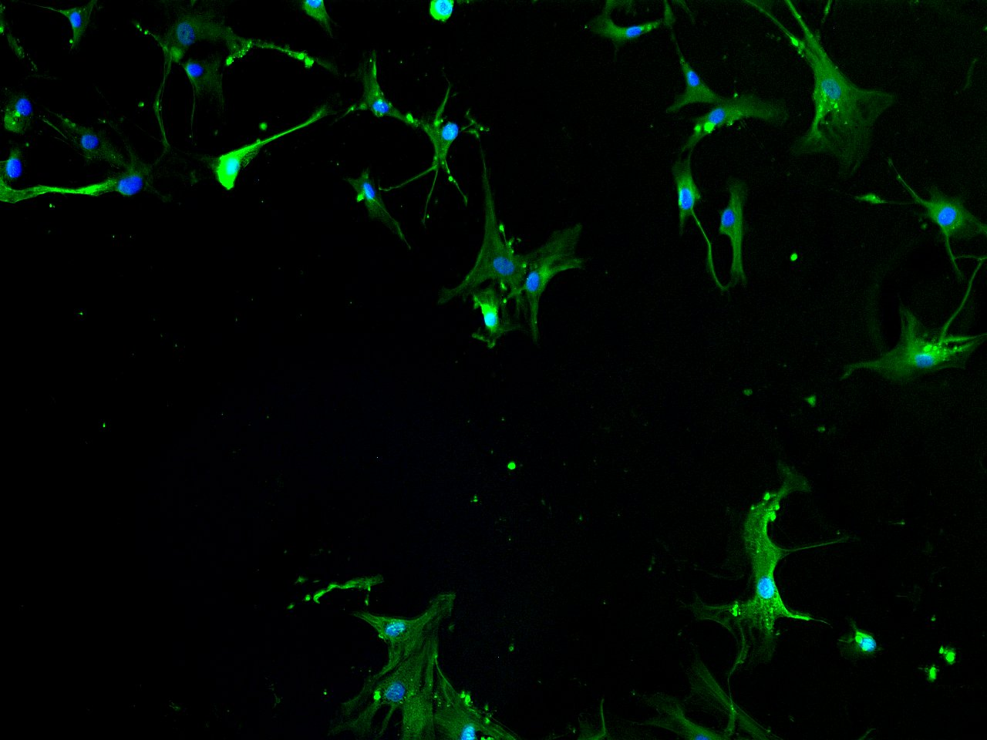
Bactericidal Surface that Enhances Integration of Biomaterials with Tissue
Shujie Hou*, Alison Deyett* and Kyung Jae Jeong
Department Chemical Engineering, University of New Hampshire, Durham NH, USA
*Equal contribution
Introduction
Surface Characterization
Cell Study
Bacteria Test
Implants for years have been a vital tool in the medical field, but these implants often integrate poorly with the recipient tissue which can eventually lead to the implant failure. Bacterial infection is another major concern associated with the implantation procedures. Implant failure requires the removal surgery which is costly and invasive. In order to address this important issue, we propose a multifunctional surface chemistry that enables the implant surface to integrate with the surrounding tissue and at the same time suppresses bacterial growth. The main feature of this surface chemistry is the presence of nanopatterns of cell adhesive ligands (RGD peptide) on top of the bactericidal coating. The silane chemistry was used to coat the glass substrate with the quaternary amine-based antibacterial molecules. Nanopatterns were created by the adsorption of gold nanoparticles, onto which cell adhesive RGD peptides were immobilized. The surface chemistry was characterized by X-ray photoelectron spectroscopy (XPS) and field-emission scanning electron microscopy (FE-SEM). The antibacterial property of the surface was tested by culturing E.coli on the surface and measuring its proliferation. Human mesenchymal stem cells (MSCs) were cultured on the surfaces, and the initial adhesion and the long term differentiation into osteoblasts (bone-forming cells) were observed. In order to assess the potential adverse innate immune response, the secretion of pro-inflammatory cytokines by the surface adhered cells was also measured. These surfaces have the potential to advance the use of medical implants by improving implant integration and reducing the risk of bacterial infection associated with the implantation procedures.
X-Ray Photoelectron Spectroscopy (XPS)
Method
Method
Au 4f
Mesenchymal stem cells (MSCs) were cultured on the modified glass surfaces and their differentiation into osteoblasts over 2 weeks was monitored by (1) alkaline phosphatase assay and (2) immunofluorescence microscopy.
E.coli were added to the samples and incubated for three hours.
The survived E.coli were collected and cultured in fresh LB broth for 24 hours.
The absorbance at 600 nm of the culture media was measured and converted to the relative E. coli concentration.
Alkaline Phosphatase (ALP) Assay
ALP activity increases as osteoblasts secrete bone.
It is a standard measure of MSC differentiation into osteoblasts.
  The clean glass coverslips were first coated with bactericidal silane. The surfaces were immersed in gold nanoparticle (20 nm) solution of varying particle concentrations.
  N1s was used to quantify the amount of bactericidal coating.
  Au 4f peaks were used to calculate the amount of gold nanoparticles on the surface.
  XPS results (1) confirmed the proposed surface chemistry and (2) allowed us to find the correlation between the concentration of gold nanoparticle solution and the amount of gold nanoparticles on the surface.
The current bactericidal coating achieved 60% reduction of E. coli proliferation.
The addition of gold nanoparticles on the surface decreased the bactericidal property.
The sample with 0.05 gold surface coverage still maintained the bactericidal property.
All data was normalized to the bare glass surface without RGD.
The surface that has 5% gold coverage with RGD promotes the cell adhesion and differentiation into osteoblasts the best.
Objective:
Scanning Electron Microscopy (SEM)
Conclusion
The sample with 5% gold surface coverage with RGD showed the best results for both the promotion of biointegration and the prevention of biofilm.
Fluorescence Microscopy
Future Work
The cells were fixed with formaldehyde and stained for osteocalcin (green) and cell nuclei (blue).
Osteocalcin is another marker for bone-forming cells.
Initial cell adhesion test by staining the focal adhesion complex.
Monitoring pro-inflammatory cytokine release by the adherent MSCs.
More bacterial test for RGD coated surface
More long term cell studies to get statistical significance
0.27 Gold
0.23 Gold
0.11 Gold
Develop a multi-functional surface chemistry that prevents biofilm formation and enhances implant biointegration
Prevent biofilm formation
By modifying the substrate with N,N-didecyl-N-methyl-N-(3 trimethoxysilylpropyl) ammonium chloride silane, which is known to attract the negatively charged bacteria and rupture the cell membrane.
Acknowledgement
Professor Kang Wu, Department of Chemical Engineering
Erin Drufva, Department of Chemical Engineering
Kenan Mazic, Department of Chemical Engineering
Avery Normandin, Department of Biochemistry
Mohammadjavad Mohammadi, Department of Chemical Engineering
Nancy Cherim, University Instrument Center
Mark Townley, University Instrument Center
John Wilderman, University Instrument Center
  From the SEM images,
  The presence of gold nanoparticles on the surface was confirmed.
  The actual surface coverage of gold nanoparticles as a function of the gold solution concentration was obtained.
0.05 Gold
Bactericidal
Bare Glass
2. Enhance Biointegration
These images reconfirm the results from the ALP assay that 5% gold coverage with RGD enhances bone differentiation of MSCs.
  Nanopatterns of cell adhesive ligands were created by depositing gold nanoparticles on the bactericidal coating, and immobilizing RGD peptides through gold-thiol binding.

