Slide 1



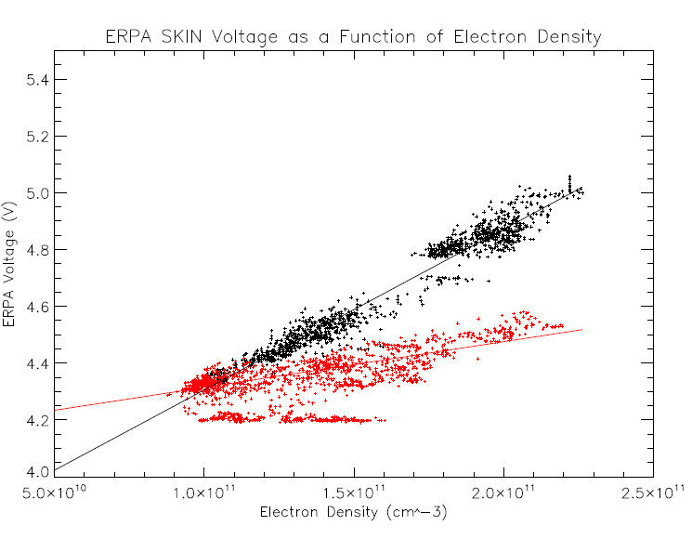
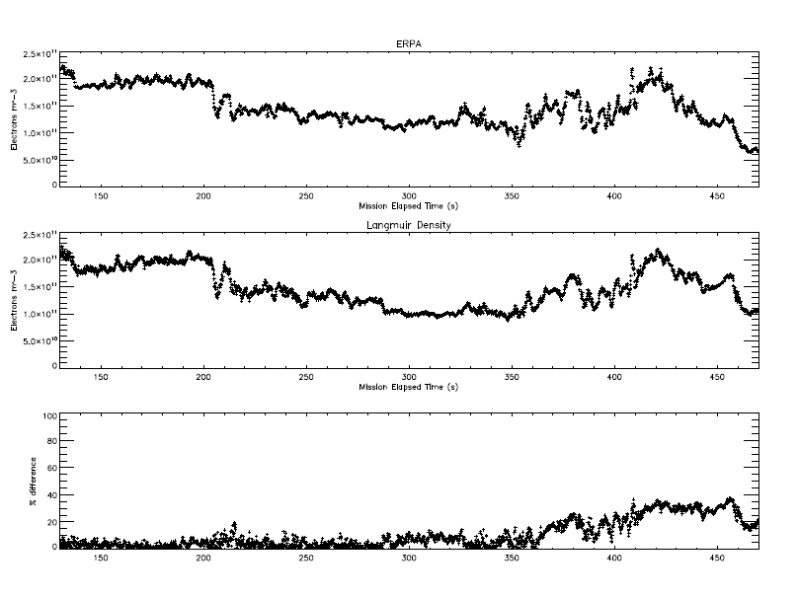
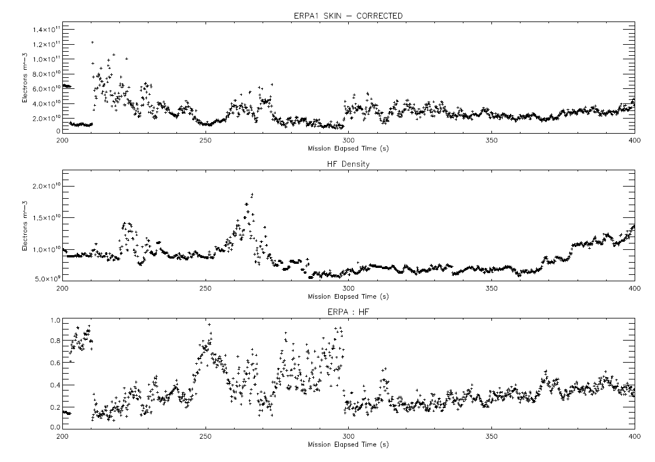
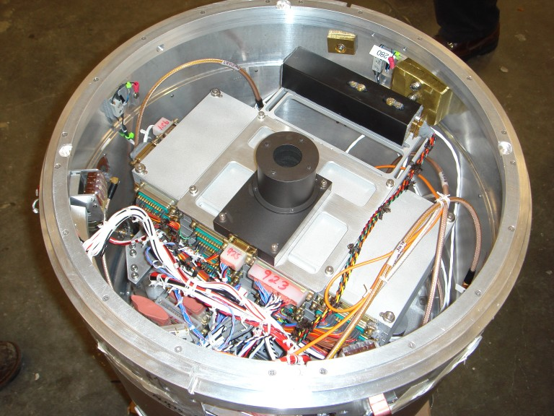
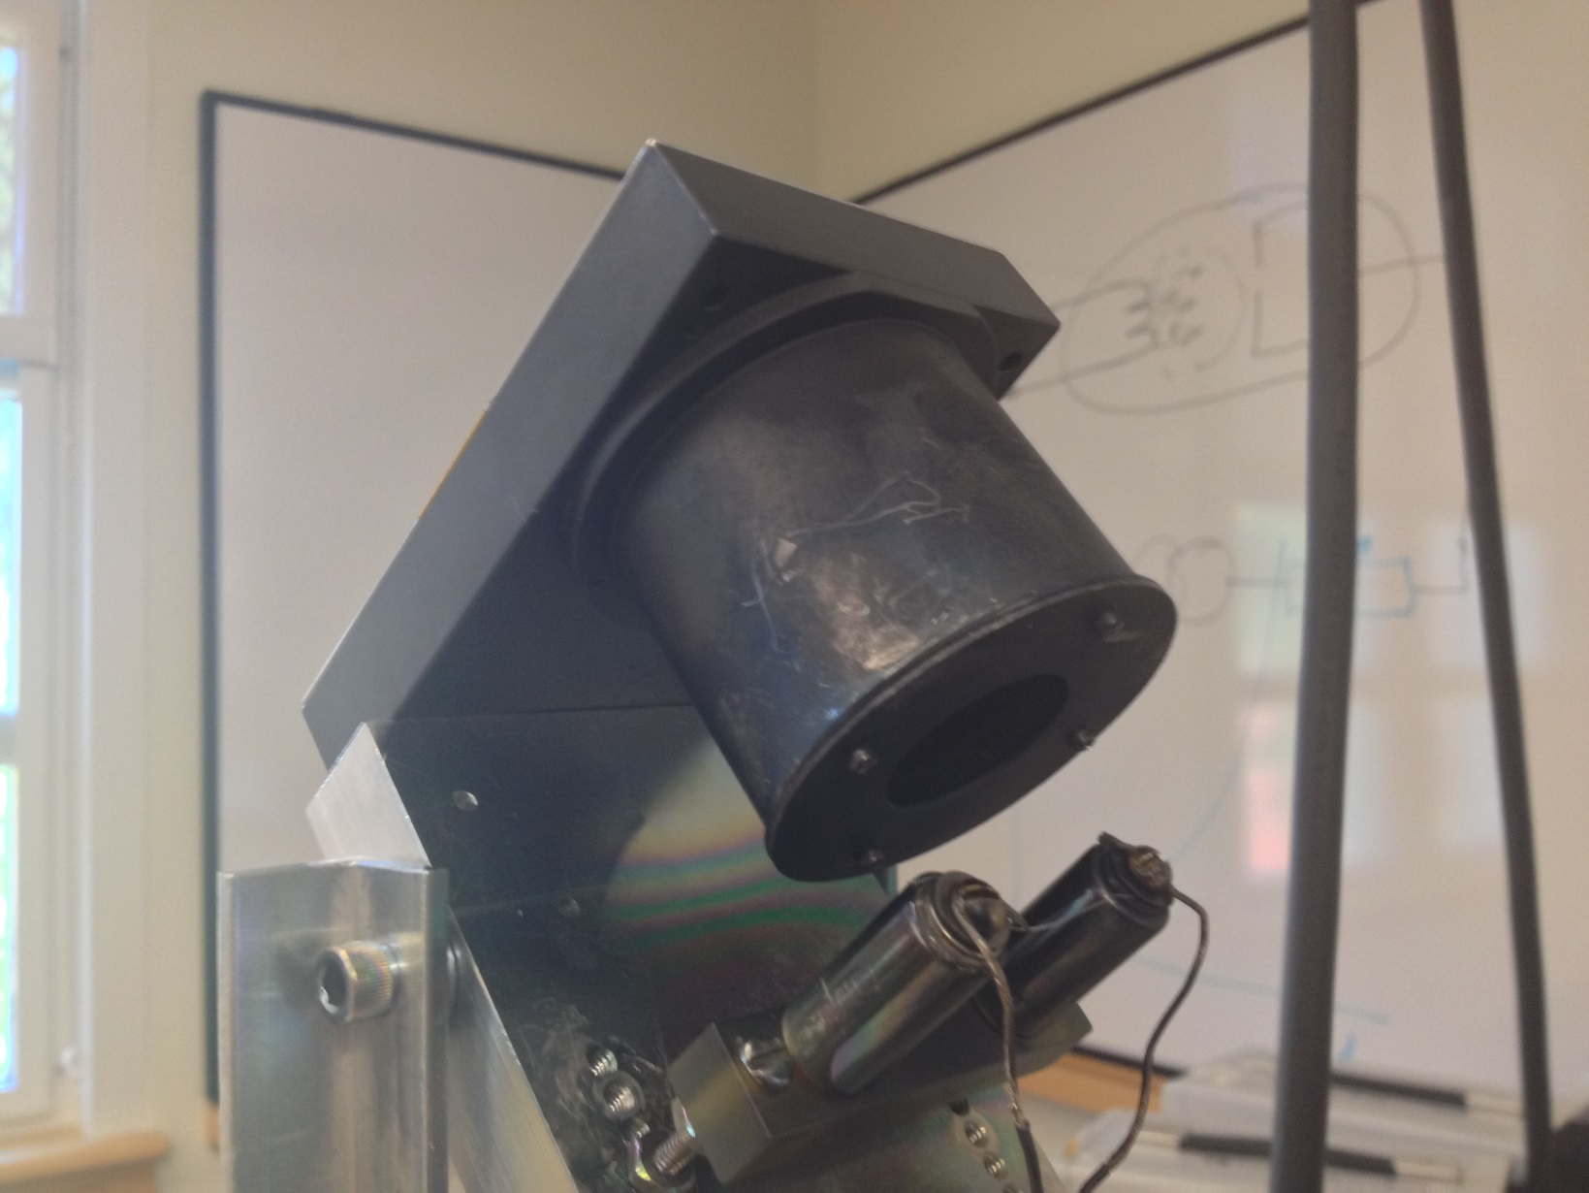
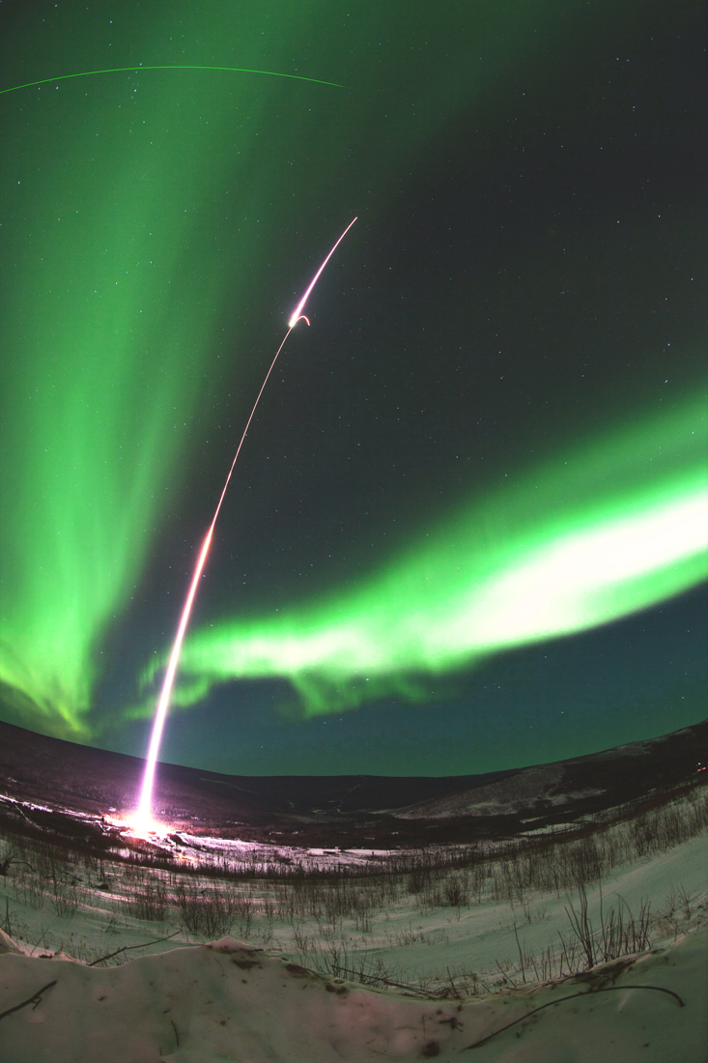
Analysis of MICA Data and Instrumentation
John Heavisides; Dr. Marc Lessard, faculty adviser
Department of Physics, University of New Hampshire, Durham NH
In February 2012, the suborbital rocket mission MICA was launched from Poker Flat rocket range near Anchorage, Alaska. The rocket was used as a mobile platform to carry sensors that were studying the aurora, more commonly known as the Northern Lights. One of these instruments was an Electron Retarding Potential Analyzer (ERPA) sensor, designed to measure the ambient electron temperature of the aurora the rocket was flying through. This allows a profile of the aurora to be created as the rocket flies through it. In addition, another sensor called m-NLP is used to measure the ambient electron density. This project investigated the potential use of the ERPA sensor to measure both electron temperature and electron density.
A strong correlation between MICA data sets (Fig. 1)
  When readings from both the ERPA and the multi-needle Langmuir Probe were compared from the same time, two clear linear patterns emerged. As the ambient electron density increased, the voltage reading rose proportionally.
Two different slopes emerged (Fig.1)
  The dichotomy of the two linear data sets was later traced to the different conditions as the rocket was ascending and descending, due to change in sensor orientation.
Reproducibility of the density data was achieved (Fig. 2)
  Tabulated data was generally within 2-5% of recorded data.
Introduction
Preliminary Results
Key Findings
Under and IROP grant from the UNH Hamel Center, I worked at the University of Oslo’s (UiO) Physics Department attempting to correlate data from UNH’s ERPA sensor and UiO’s m-NLP probe to see if there was a correlation between data sets. At UiO, I consulted with the team members that created the sensor, and worked with them to derive some kind of governing theory behind the relations we observed. In addition, I also worked to analyze the MICA mission in its entirety, looking beyond the instrumentation to understand the environment in which the rocket mission took place. The initial results look promising, but it also became apparent that more work is needed to understand the sensor’s response before it can be used in this manner.
Figure 1: The correlation of the two sensors
Figure 2: Re-deriving the density
Failure to reproduce effects with other data sets (Fig. 3)
  When the same technique was used on data from an different mission, the results demonstrated none of the linear dependence that the MICA mission did
  Future work is recommended to determine the origin of this difference, whether it stems from flight geometry or other factors. Comparisons with other data sets should be made to evaluate the sensor response in various environments.
Decreased sensitivity on downward leg (Fig. 1)
  The sensor demonstrated a flattened response to changes in density on the way down. This might imply that wake effects of the rocket might negatively affect sensor performance.
Project Outline
Difficulties and Future Work
Figure 3: A similar effort is made with new data, to mixed results
Figure 4: The ERPA sensor that generated the studied data, mounted on the MICA rocket sub-payload.
Langmuir probes are conductive devices that are inserted into a plasma. It is possible to measure an electrical potential from this, and thereby deduce the abundance of free electrons in a plasma. The ERPA sensor is a variation on this, creating a varying potential in the cylindrical section that repulses electrons of different energies, allowing a temperature profile to be created. However, the outer face is unshielded and exposed to the plasma, acting as a conventional Langmuir probe. However, there are difficulties in modeling this geometry, so the project sought to find an empirical rather than theoretical solution. This necessitated the expertise of the UiO team, who had much experience creating Langmuir probes.
Many thanks to the UNH Hamel Center for making the IROP project possible.
Additionally, this project would have never been possible without the support of the team at the University of Oslo.
P.-L. Blelly and D. Alcaydé, Ionosphere, in: Y. Kamide/A. Chian, Handbook of the Solar-Terrestrial Environment, Springer-Verlag Berlin Heidelberg, pp. 189–220, 2007.
M. Lessard, P. Kintner. Magnetosphere-Ionosphere Coupling in the Alfvén Resonator (MICA). 2010. Official MICA rocket grant proposal, used with permission from investigator Marc Lessard.
I. Cohen, M. Lessard, M. Widholm, and P. Riley. Details and Error Analysis of the Electron Retarding 1 Potential Analyzer (ERPA). Tech. 2013. Draft copy of ERPA documentation, currently unpublished.
T. A. Bekkeng. Prototype Development of a Multi-Needle Langmuir Probe System. Thesis. University of Oslo, 2009. Documentation for the m-NLP probe.
M. Widholm. "ERPA(Electron Retarding Potential Analyzer)." ERPA Description. University of New Hampshire. Web. 18 Mar. 2013
The Instrument
Langmuir Probes
The MICA Mission
Acknowledgements
Standing for Magnetosphere
- Ionosphere Coupling in the Alfvén resonator, the MICA mission investigated how electromagnetic waves propagate in the aurora. It was launched from Poker Flat Rocket Range in Alaska on February 18, 2012.
References
Figure 3:
The ERPA sensor being tested with a cathode

