Slide 1

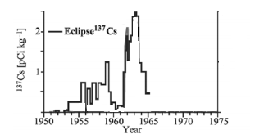
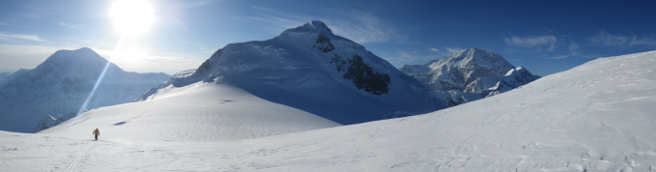
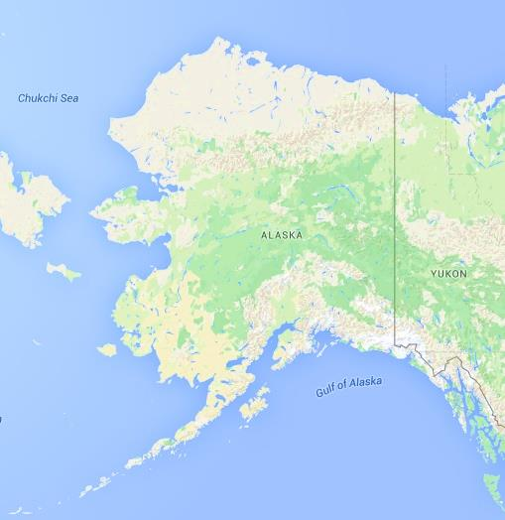
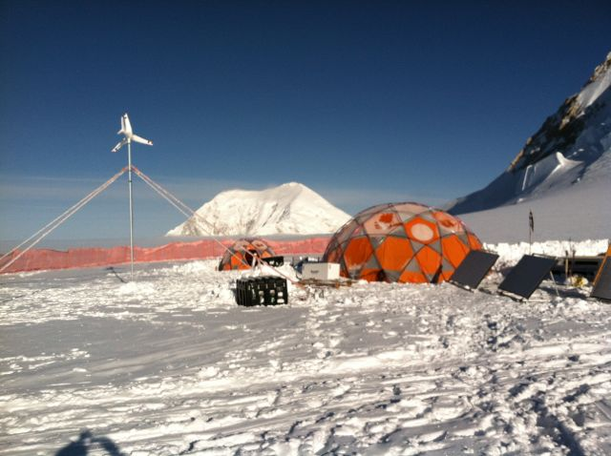
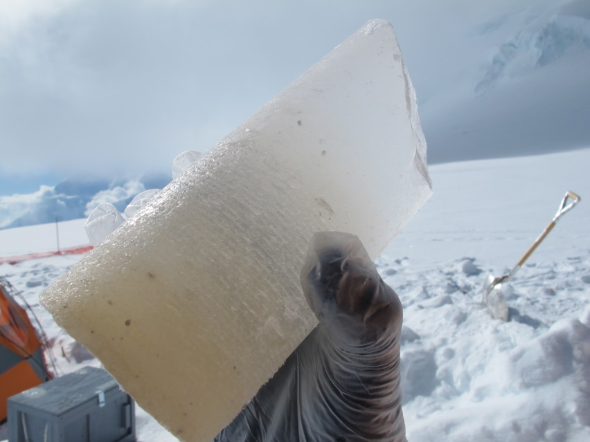
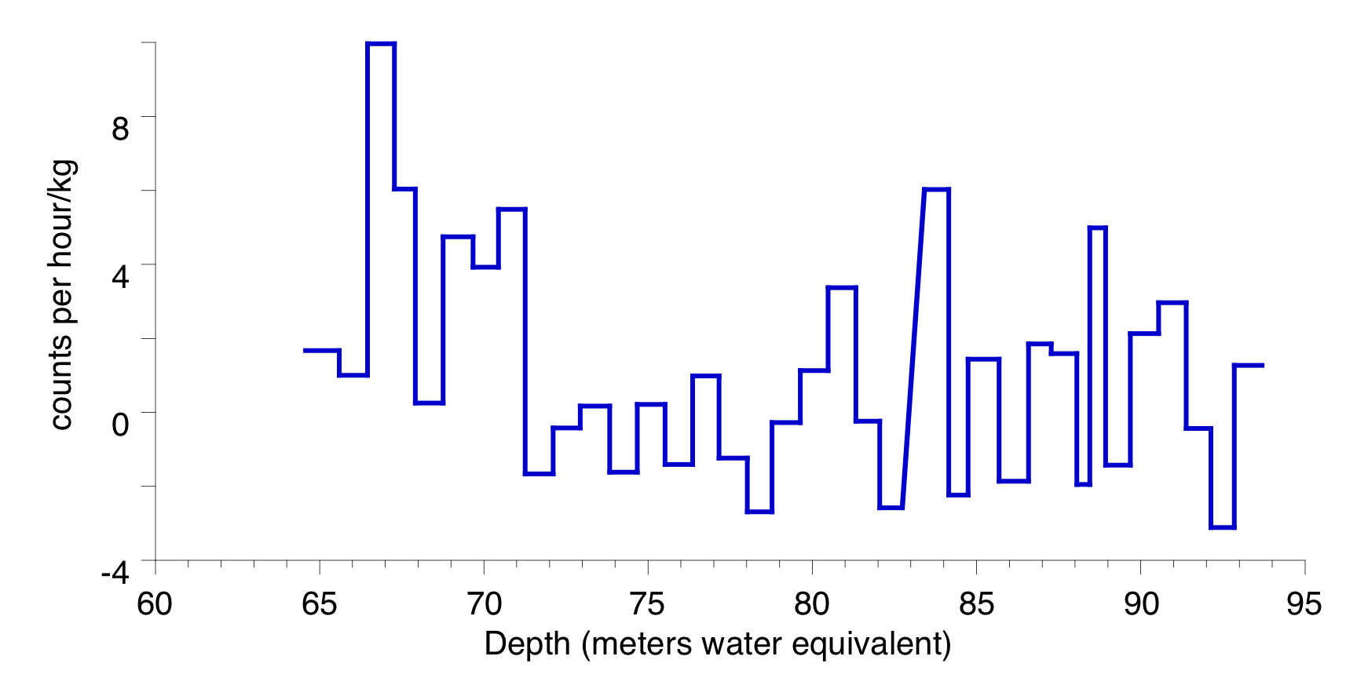
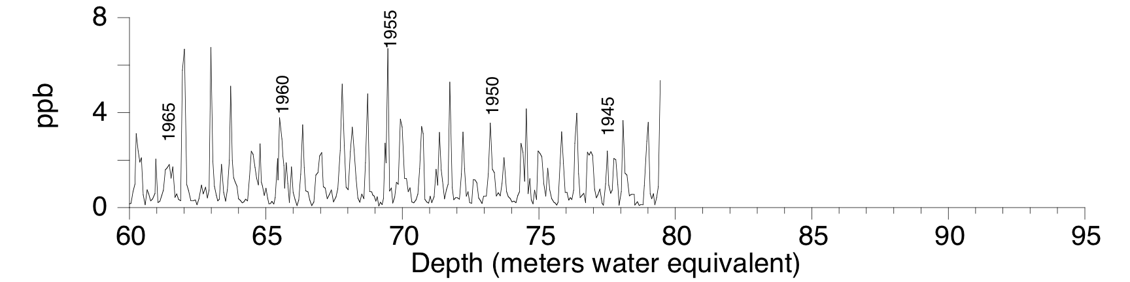
Atmospheric Nuclear Weapon Testing Horizons: Establishing Depth-Age Relationships in an Alaskan Ice Core
Megan Dalton, Environmental Science/COLSA
Faculty Mentor: Cameron Wake, Earth Systems Research Center/EOS
University of New Hampshire
Cesium-137 Reference Horizons
Results: ¹³⁷Cs Peaks & Magnesium Annual Layer Counting
Cesium-137 was released into the atmosphere from thermonuclear weapon testing which ramped up in 1954 when the Cold War escalated and continued until 1963 with the signing of the Limited Test Ban Treaty. ¹³⁷Cs was quickly removed from the atmosphere by precipitation, accumulated on Earth’s surface, and was preserved in glaciers (Figure 1). Researchers use ¹³⁷Cs reference horizons to identify 1954 and 1963 layers in the glacier and establish reliable depth-age relationships.
a)
1963
Figure 4. Depth profiles of (a) ¹³⁷Cs and (b) magnesium. Note ¹³⁷Cs peaks at 67 m and the other at 84 m, which are assumed to represent 1963 and 1954 layers, respectively.
The annual layer counts in the magnesium profile suggest a dept- age relationship that is similar, but not exactly the same as, the 137Cs profile. Ultimately, the two dating techniques will be reconciled.
1954
Figure 1. ¹³⁷Cs from the Eclipse (St. Elias mountains, south-west Yukon) ice core identify the 1963 and 1954 layers. From Yalcin et al., 2007.
b)
Mt. Hunter Ice Cores
Future Work
• Additional samples for ¹³⁷Cs outside the sampled area.
• Reconcile 1963 and 1954 radioactive layers with annual layer counting
• Count layers over entire length of the ice core (and use volcanic reference horizons via sulfate)
• Document annual changes in accumulation over the last 1000 years.
Methods
Figure 2. Mt. Hunter Plateau Drill site visible in the distance.
Using annual accumulation approximations of 1.7 m/yr (from the magnesium record), the depth of the 1954 and 1963 layers was estimated. Approximately 1 m long sections of the core over this depth range were weighted, melted, acidified, and filtered through cation exchange filters. Dry filters were analyzed using nondestructive gamma spectrometry for ¹³⁷Cs. Background concentrations of ¹³⁷Cs were subtracted from the samples.
Ice cores were recovered from Mt. Hunter Plateau in Denali National Park (Figure 2 & 3), in the spring of 2013 and being analyzed for a variety of chemical constituents at UNH, Dartmouth, and UMaine. The main objective is to produce the first high-resolution record of central Alaskan snow accumulation spanning the past 1000 years.
References and Acknowledgements:
Yalcin, K., et al., (2007) Ice Core Paleovolcanic Records from the St. Elias Mountains, Yukon, Canada. JGR 112, D08102.
This research was supported by the National Science Foundation Grant Number AGS-1203863. We also thank our colleagues Erich Osterberg and Dom Winski (Dartmouth), Karl Kreutz (UMaine), Seth Campbell (CRREL), Brad Markle (U Washington) and our superb driller Mike Waskiewicz (Ice Drilling Design and Operations).
Figure 3. Location of Mt. Hunter central Alaska (left) and the drill site (right).
Notes:
Short Draft 2
Note: if this one is used I will edit graph so the depth is reversed like the Eclipse graph

