Slide 1



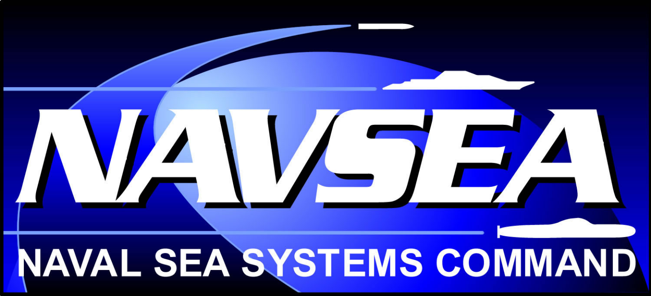
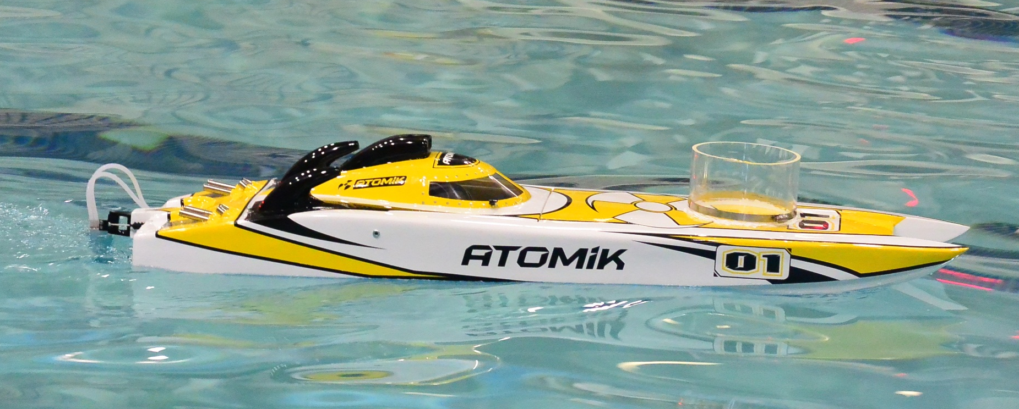
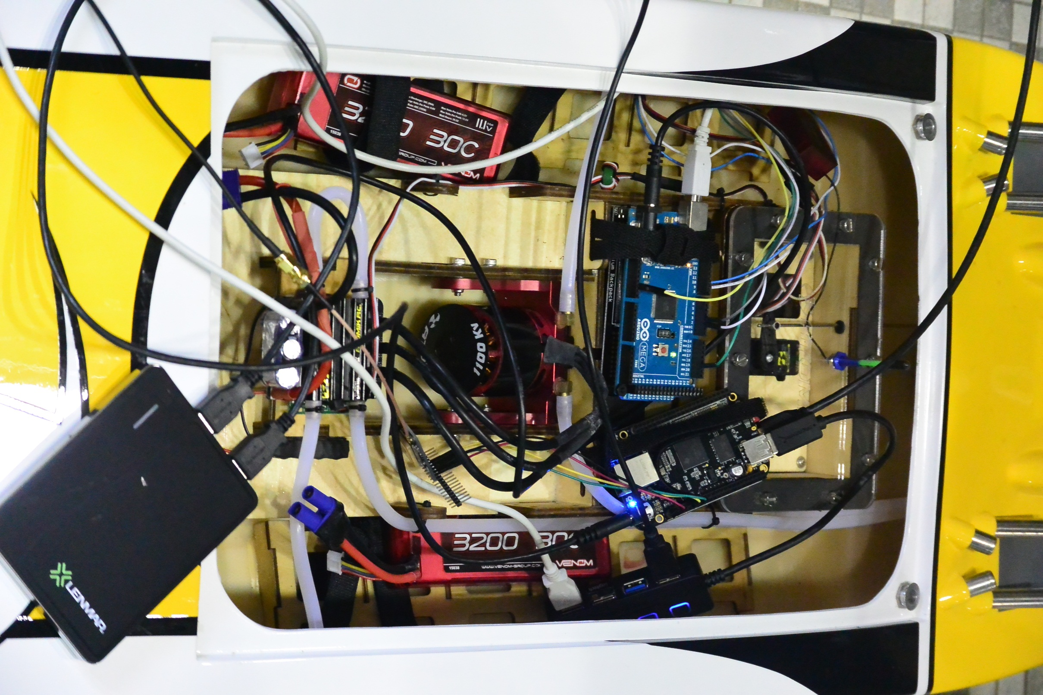
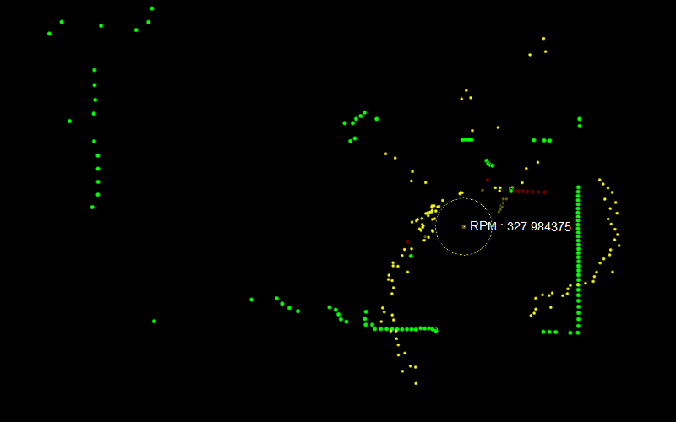
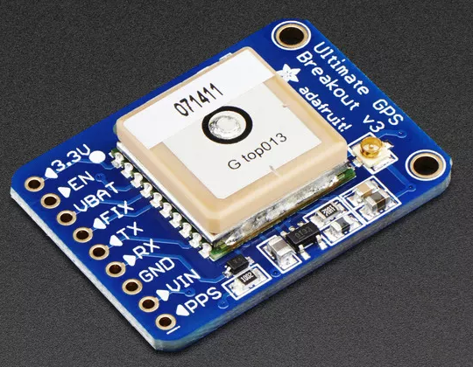
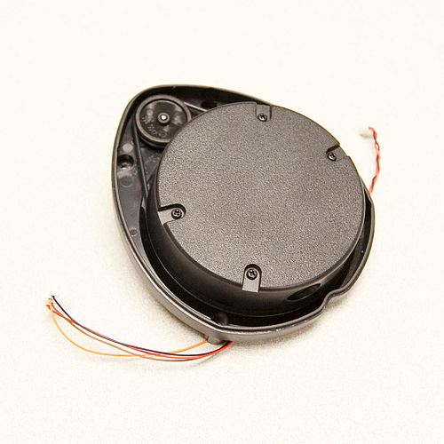
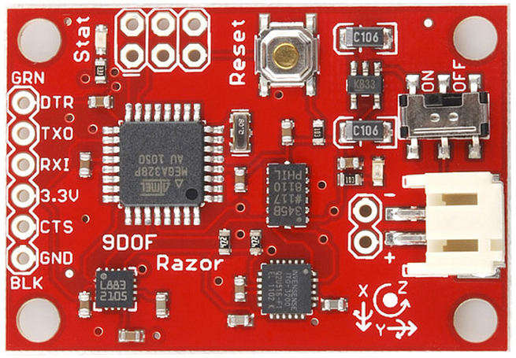
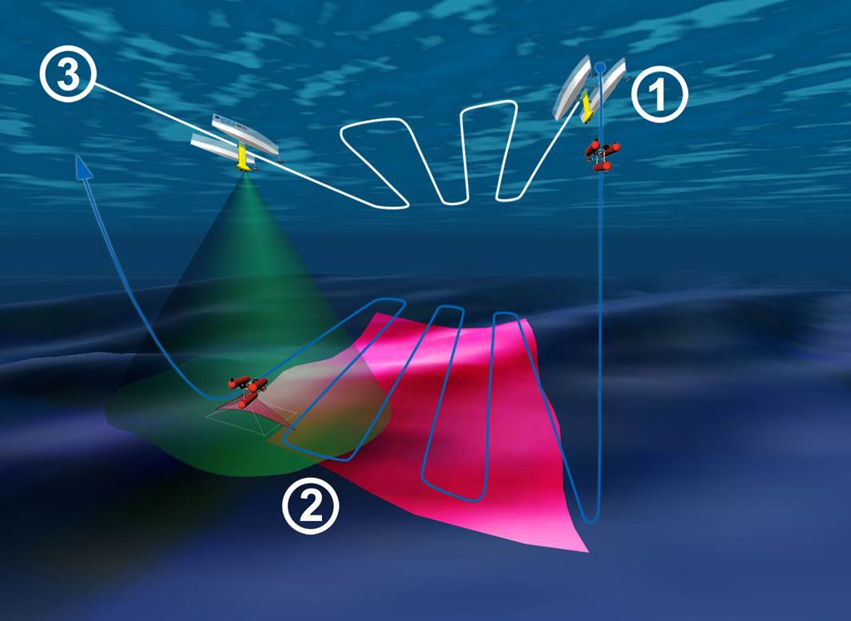
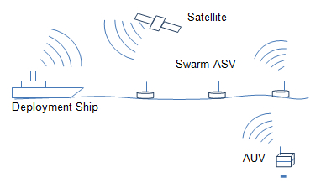
Development of Control for Multiple Autonomous Surface Vehicles (ASV)
Co-Leaders: Forrest Walen, Justyn Sterritt Team Members: Andrea Dargie, Paul Willis, Phil Goff, Lucas Davies, Ben Novak
Advisor: Dr. May-Win Thein Graduate Advisors: Andrew D’Amore, Damian Manda
Fit Commercial Platform with Autonomous Control System
Stages of Autonomy
58” length
15 lbs
Maximum speed 40 mph
Brushless electric motor for propulsion
Servo-powered rudder
Autonomy Control Program: MOOS-IvP
First Stage Autonomy: Basic point to point navigation using GPS navigation integrated with an IMU to increase the reliability of the navigation system.
MOOSDB: Mission Orientated Operating Suite. MOOS stores information related to its operating mission and coordinates communication between sensors and other processes.
Autonomous Control System
Monitoring and Logging
pShare
pLogger
Autonomy and Control
d
uFldNodeBroker
Shore
Command
ASV Posn,
Status
All Info
pHelmIvP
Second Stage Autonomy: Second stage autonomy involves pairing point to point navigation with obstacle avoidance, thereby creating a self sufficient navigation algorithm to serve as a platform for more complex tasks.
Position, Heading,
Waypoints, Depth, Obstacles
2 11.1V 3200mAh battery packs to run the motor and servo
IP Address
Shore Station Info
Desired Heading, Speed
Start/Stop Log
pMarinePID
BeagleBone Black: Used as the brain of autonomy. Runs MOOS-IvP
Battery Pack: Outputs 5 V. Powers Arduino and BeagleBone
Ɵ
pHostInfo
IP Address
pShare Config
Desired Hdg, Speed
Current Hdg, Speed
MOOSDB
Rudder, Throttle
IvP Helm: Interval Programming Helm. The IvP helm is able to take information from MOOS and make control decisions for the boat. Complex autonomous scenarios can be developed from package supplied or custom developed behaviors
Rudder, Throttle
Depth, Swath Width,
Posn, Heading
iMOOSArduino
Posn, Velocity, Attitude
Min Swaths
pRecordSwath
Position
Obstacles
Waypoints
iGP9/iGPS
Start/
Stop Log
Depth,
Swath Width
Min Swaths,
Op. Boundary
Servo used to steer rudder.
1100 Kv Brushless motor
Third Stage Autonomy: The third stage of autonomous control is to allow for a leader/lagger formation to be implemented on one of these platforms, specifically the ability for an autonomous vehicle to follow a sister vehicle with the intention of completing a more complex task in tandem.
iLidar
pSurveyPath
Sensor Interfaces
iSonar
Survey Path Planning
Supplied Application
Custom Application
120A Water-cooled ESC
LIDAR: Distance sensing by analyzing the response of an object to a laser. The LIDAR module is a rotating head with laser and image sensor with an onboard microprocessor to compute angle and distance data of objects via serial. The beaglebone runs a program to interpret the serial stream and send messages to MOOS for obstacle recognition.
Arduino Mega 2560: Used to control motor and servo
Second Stage Autonomy Schematic
ASV Systems and Control
Sensors
ASV Tasks
ASV subsystem requires integration of multiple fields of engineering (e.g., mechanical, electrical, and software). Inherent issues in integration involve system and subsystem communication and control. MOOS-IvP software platforms (incorporating ROS) are used to integrate multiple vehicle sensors and actuators, along with user-defined command inputs. Advanced modeling and control techniques are to be implemented to ensure performance, robustness, and reliability for autonomous obstacle avoidance and required path planning.
Search and rescue operations, a swarm could cover more ground without endangering more human lives.
Ocean mapping, eliminates human error and cost of human labor in large scale ocean mapping projects.
A swarm could also work together to form a large scale passive barrier to protect the naval borders of nations around the world.
In general this vehicle is meant to perform tasks that have been deemed either too dangerous or too inefficient for human involvement.
GPS: Adafruit Ultimate GPS Breakout used for point to point navigation.
https://www.adafruit.com/products/746
http://www.sparkfun.com/images/newsimages/XV11Teardown/TheGoodStuffMasked.jpg
Razor IMU: This IMU is used to correct the short term velocity and acceleration being used by MOOS for predictive navigation.
LIDAR: Light detection and ranging system. Used Neato Robotics XV-11 LIDAR for proof of concept object detection programming.
http://www.robotshop.com/media/files/images/9-degrees-of-freedom-razor-imu-ahrs-compatible-large.jpg

