Slide 1
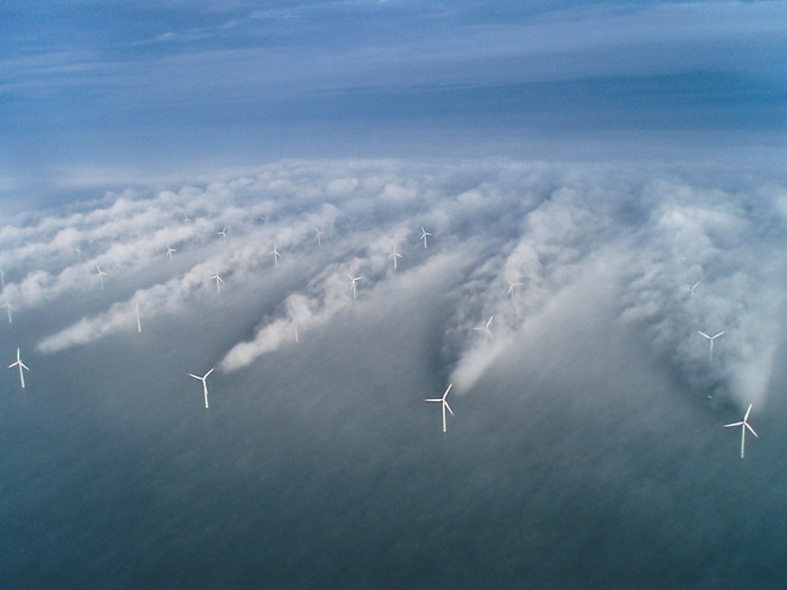
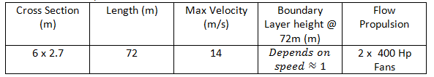
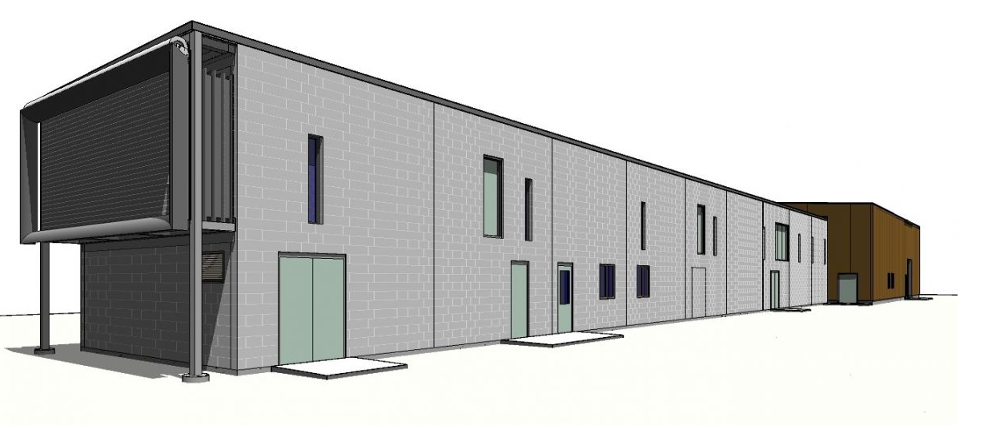
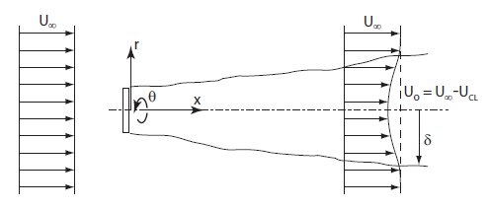
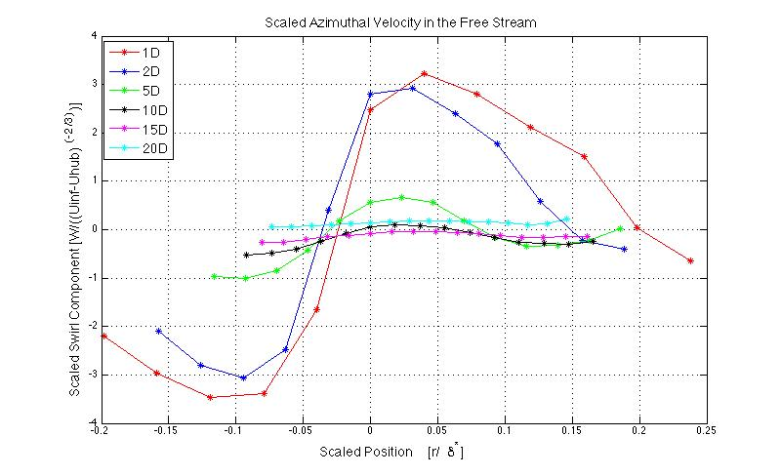
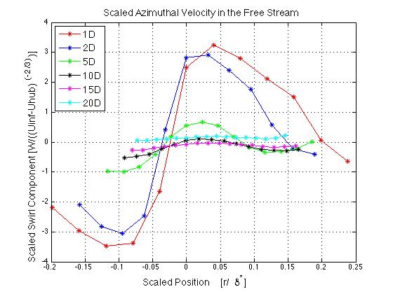
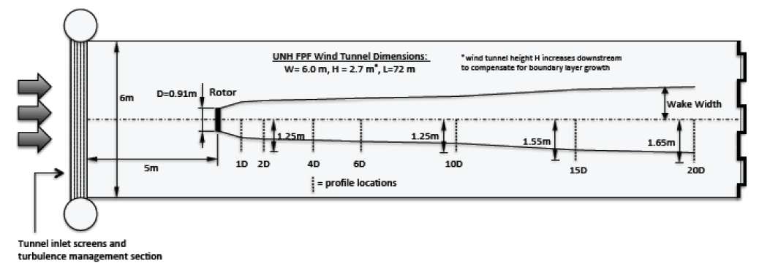
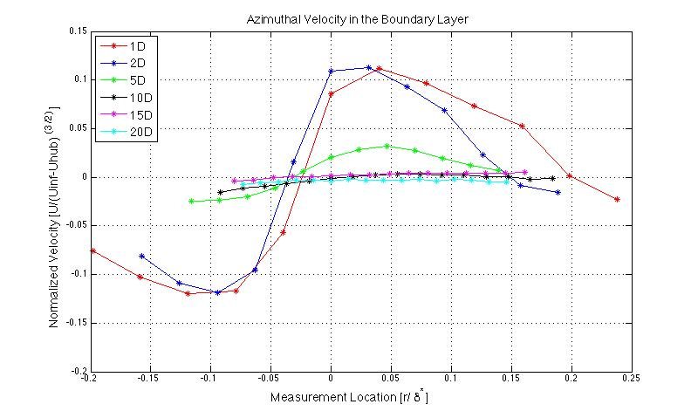
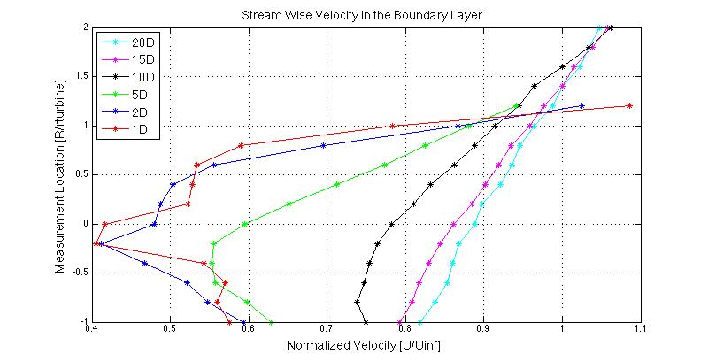
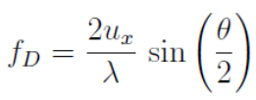
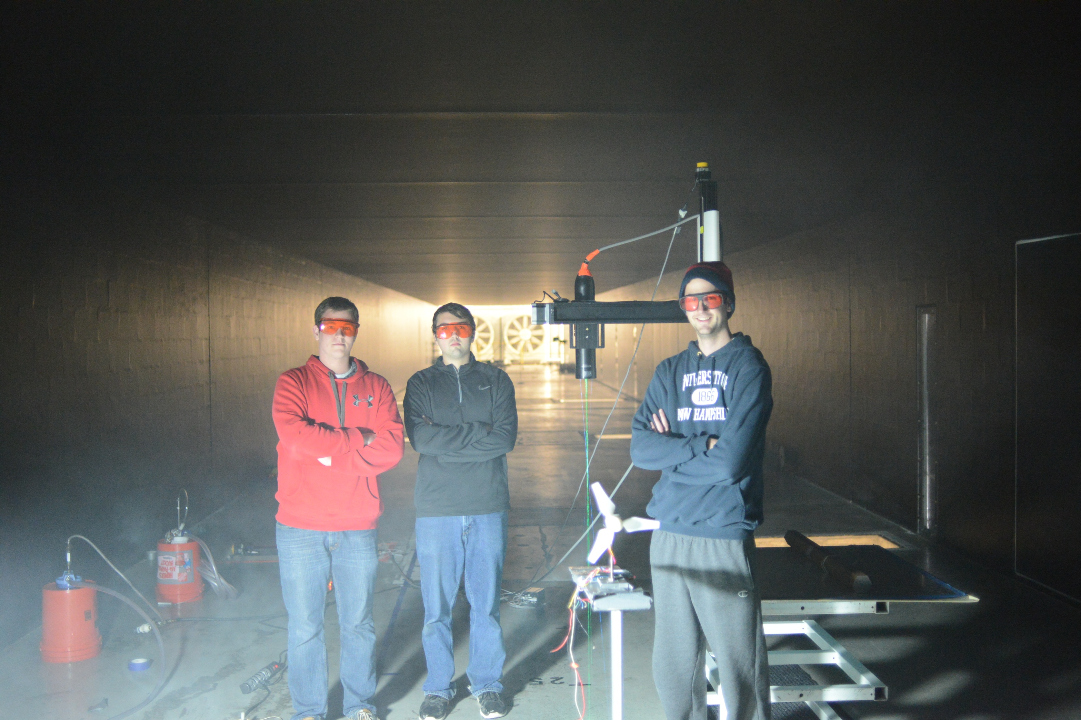

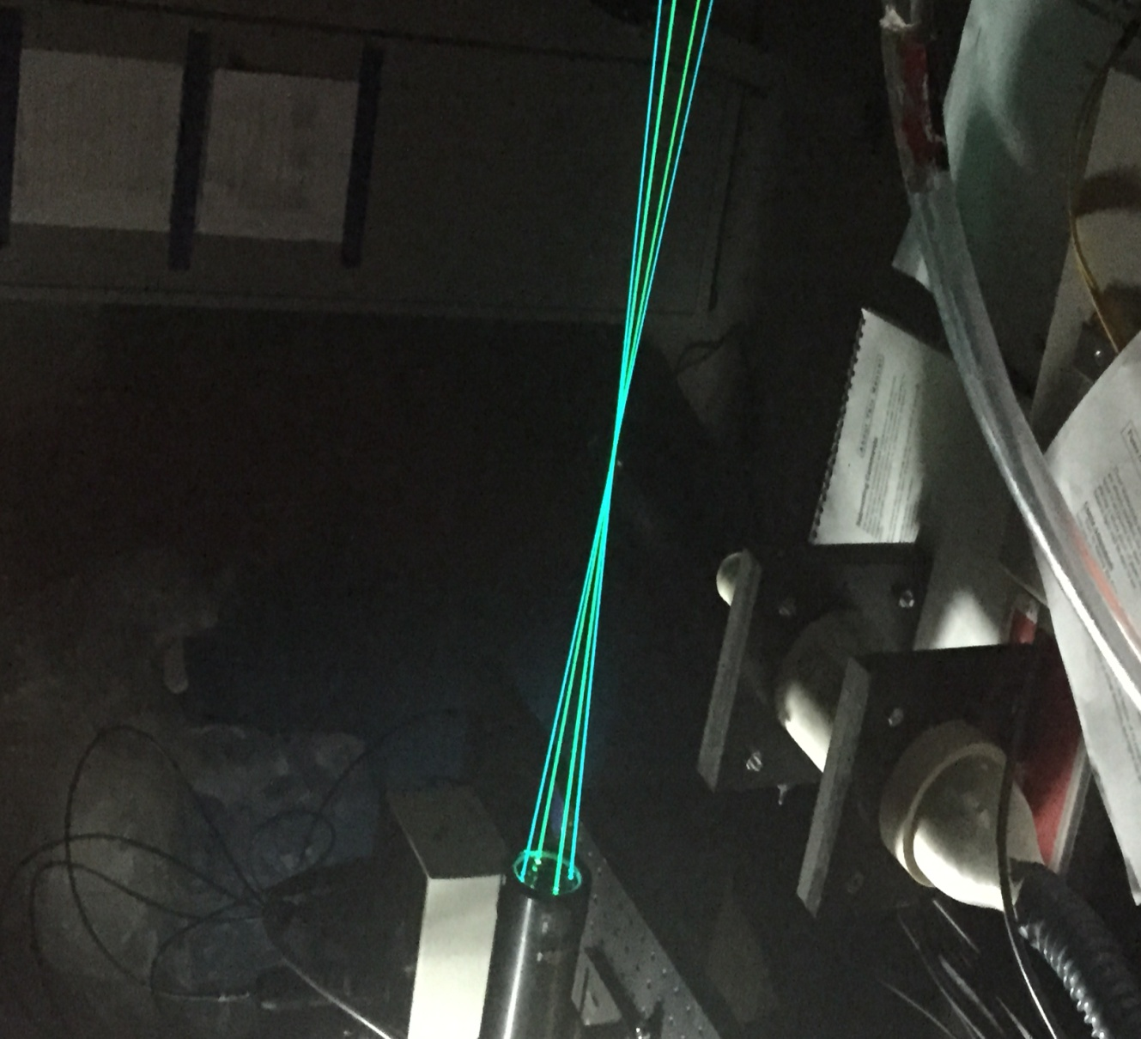
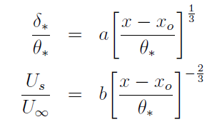


Turbulent Axisymmetric Wake with Rotation
Austin Trombino – Brian Donahue – Sheldon Baker
Advisors: Dr. Martin Wosnik - John Turner V
Motivation &
Background
In 2014, wind energy provided 4.4% of all electricity in the United States, compared to only 0.1% in 2000 [1]
In wind farms, the turbulent wake flow created by upwind turbines affects the efficiency (energy production) of the downwind turbines and also causes fatigue loading on the rotors.
The wake of a realistically scaled model wind turbine was measured in the UNH Flow Physics Facility, a large boundary layer wind tunnel, using pitot tubes and Laser Doppler Velocimetry (LDV).
Wake profiles were measured starting close behind the rotor to 20 turbine diameters downstream, in the free stream and in the turbulent boundary layer.
Flow Physics Facility
Experimental Setup
Data taken at 1,2,5,10,15,20 diameters downstream behind the turbine
Measurements in the boundary layer (27m downstream, thickened by Irwin spires)
Measurements in free stream (23 m downstream)
Results
[1] DOE U.S. Energy Information Administration, Monthly Energy Review.http://www.eia.gov/totalenergy/data/monthly/#electricity
Laser Doppler Velocimetry
Light scattered from particles in motion undergoes change in frequency due to the velocity of the particle (doppler shift)
The doppler shift depends on the particle velocity and angle between incident and scattered (observed) light, seen below:
When 2 beams of coherent light are crossed, they will form an interference pattern.
Fringe spacing only depends on incident light wavelength and beam angle.
The distance between fringes is
Particle (flow) velocity therefore is
Similarity Solution Scaling
RANS equations: Conservation of mass, momentum and the transport equations for Reynolds stresses
Order of Magnitude Analysis (within thin shear layer assumption): keep leading terms in governing equations
Similarity solution: the use of scaling functions that collapse profiles onto a state of self preservation
Results:
Growth
Stream wise deficit
Rotation
From left: Brian Donahue, Sheldon Baker, Austin Trombino with the LDV and wind turbine

