Slide 1


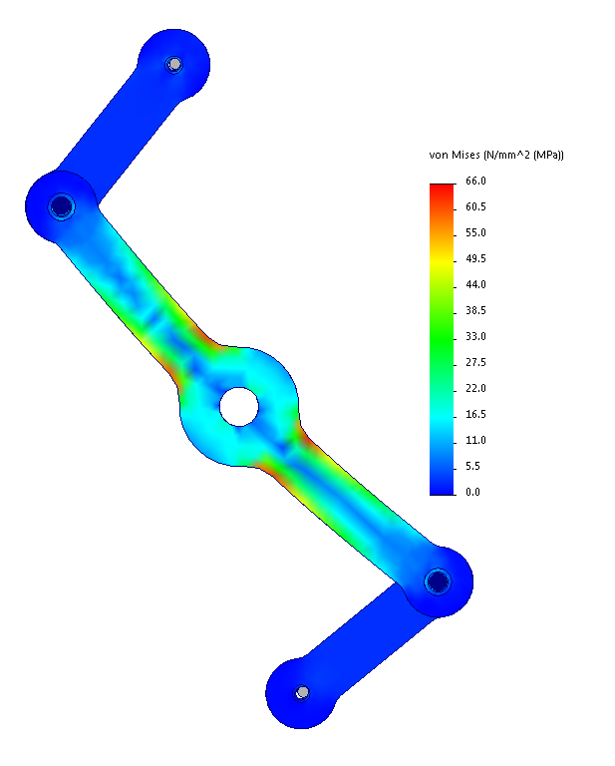
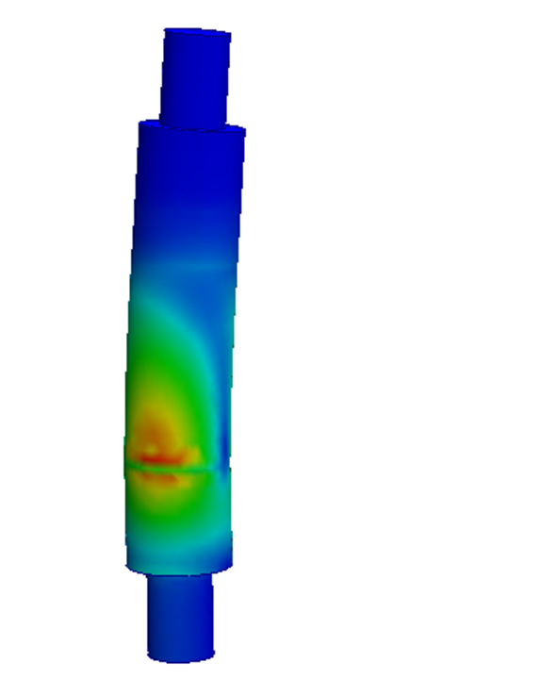
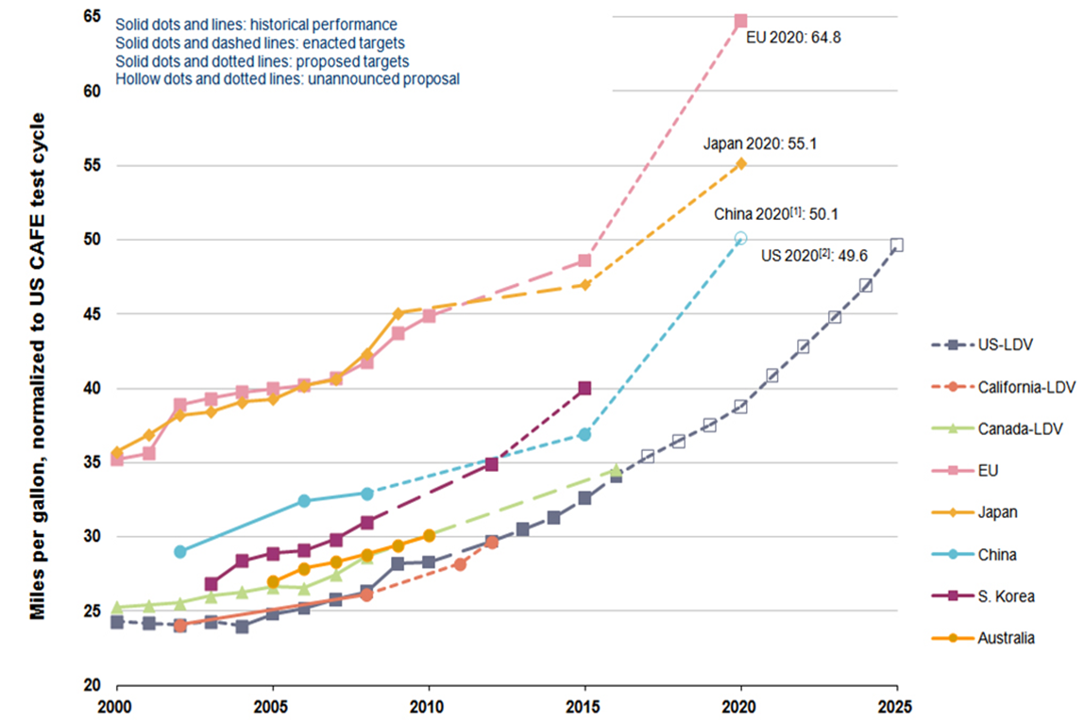
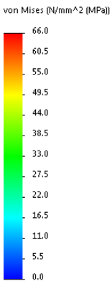
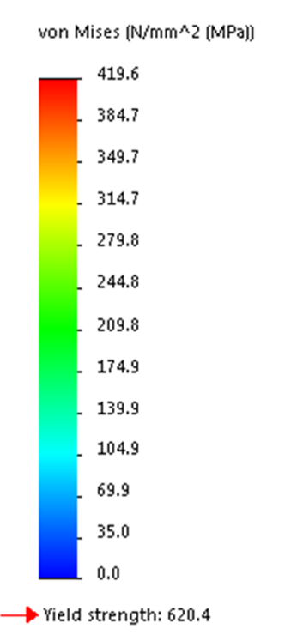
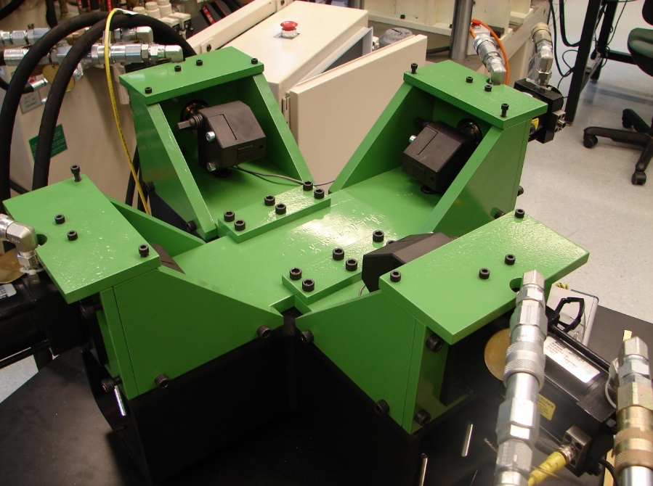
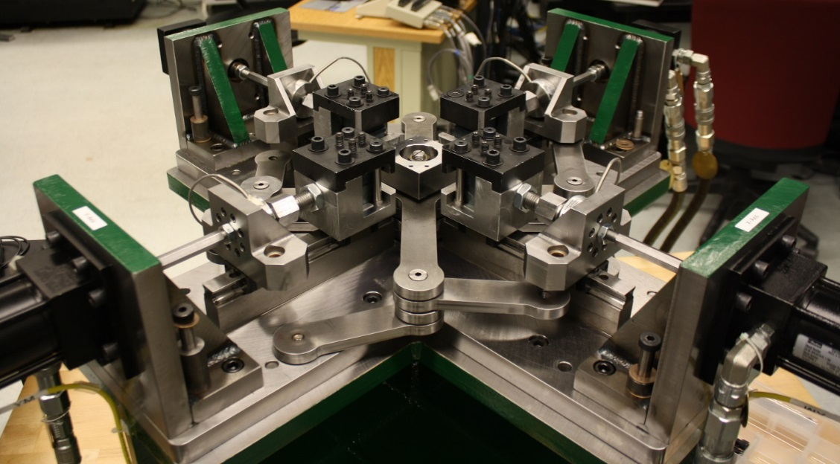
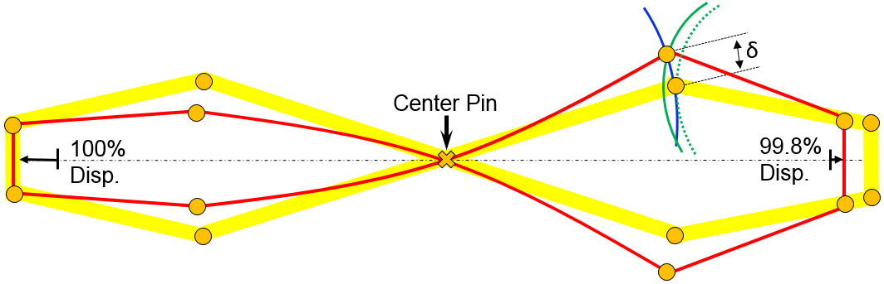
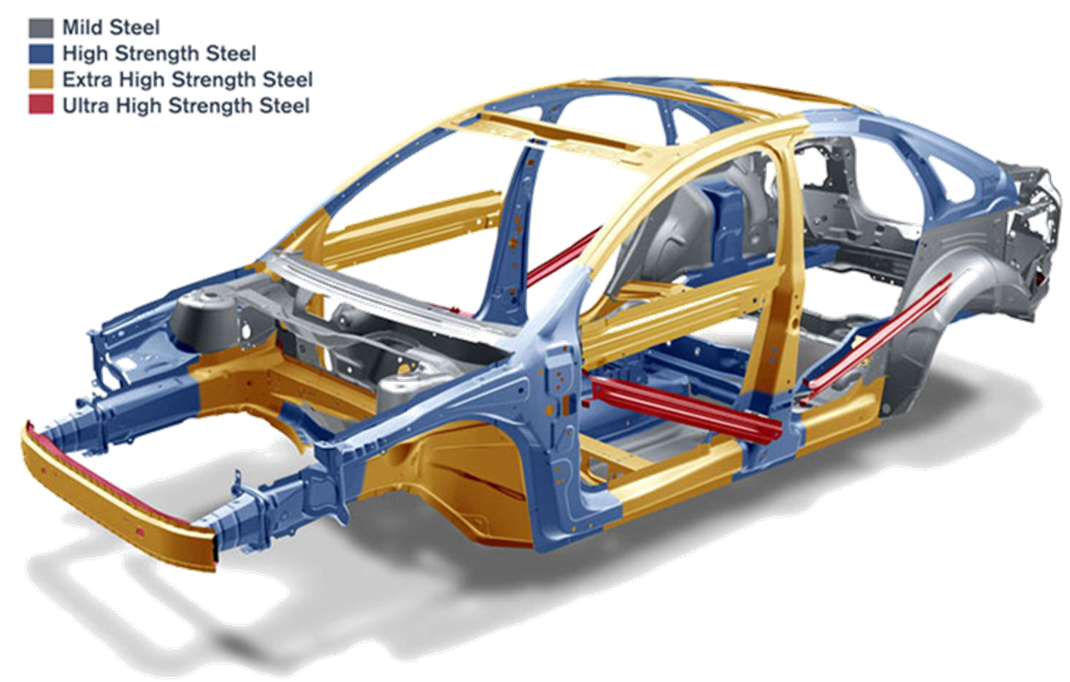
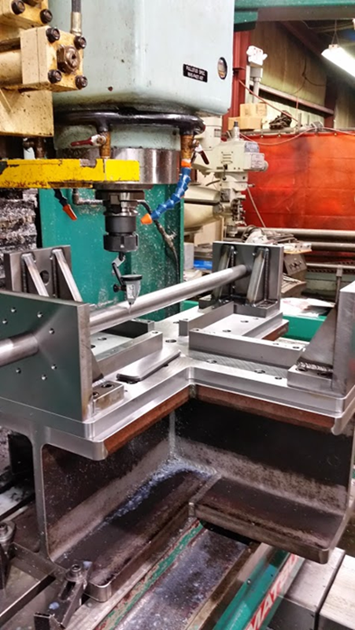
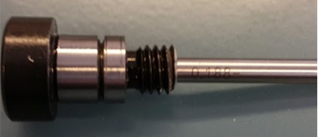
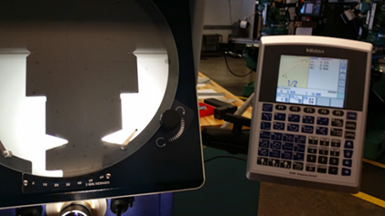
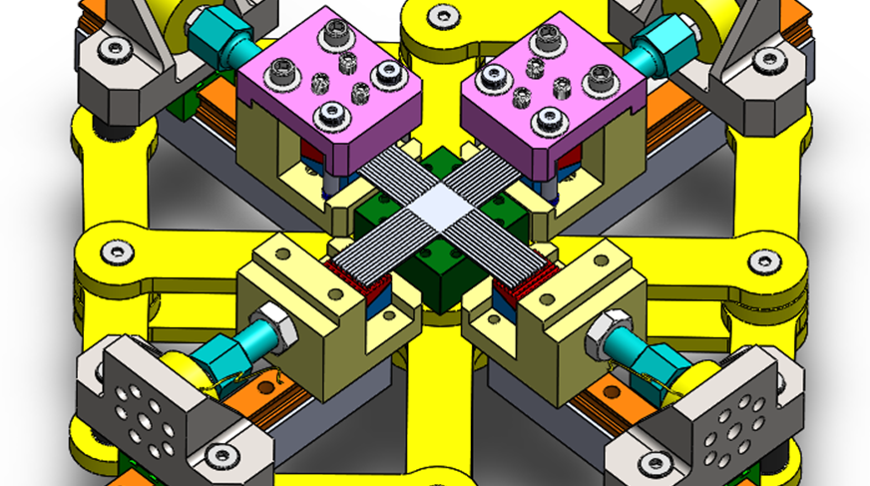
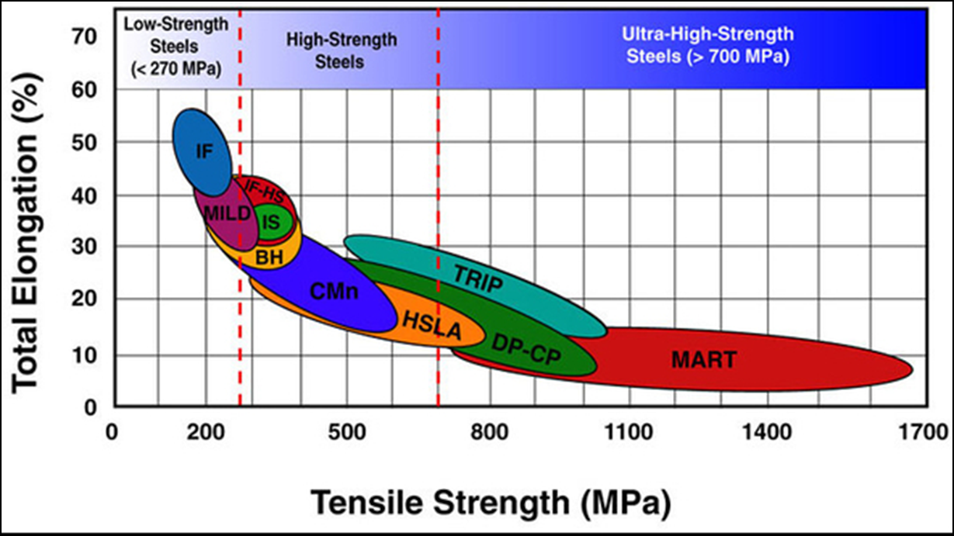
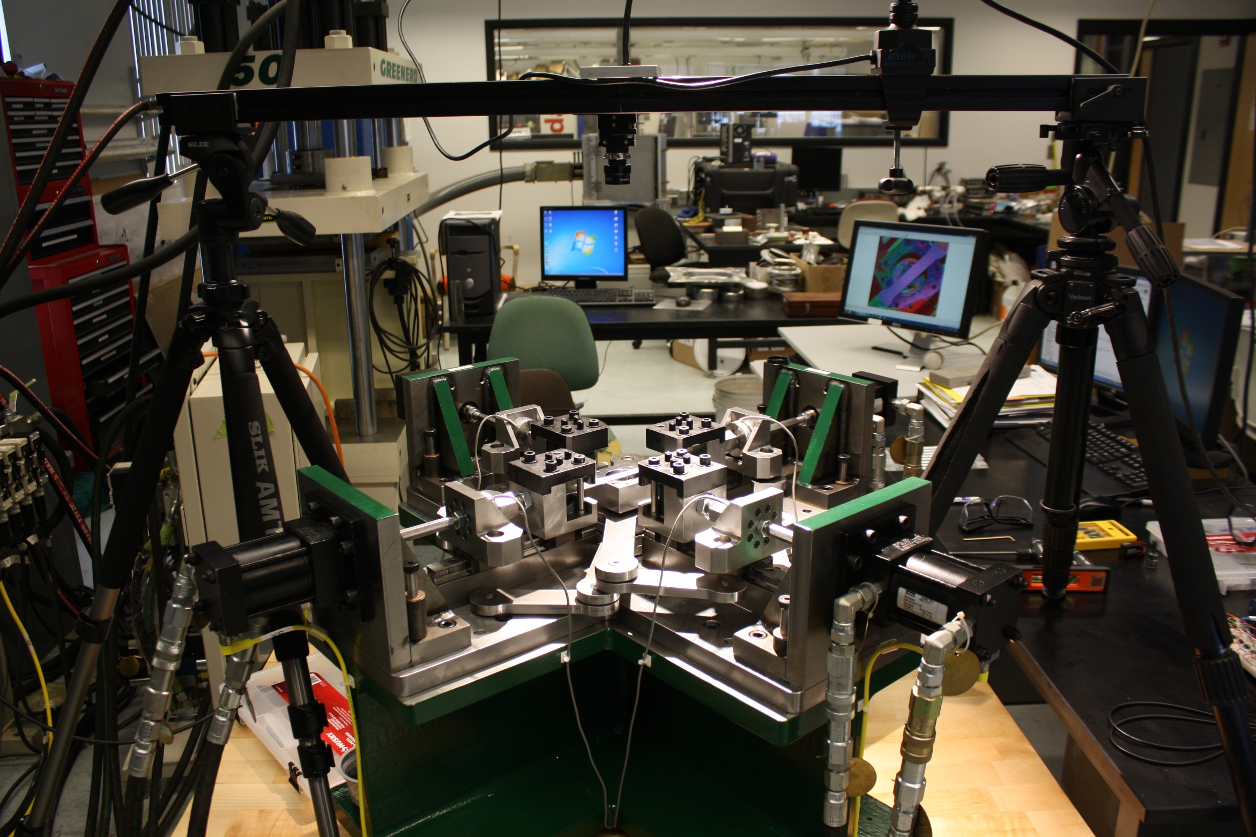
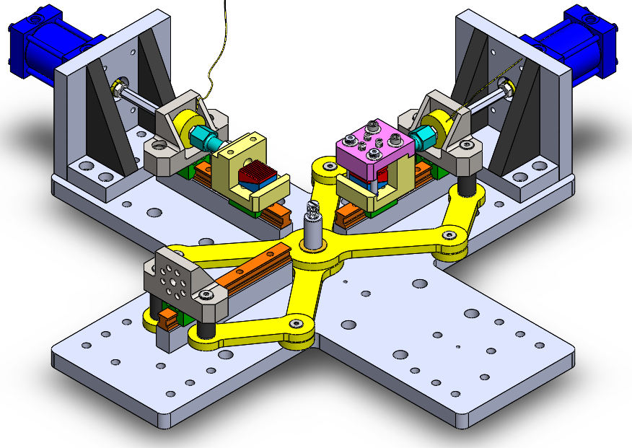
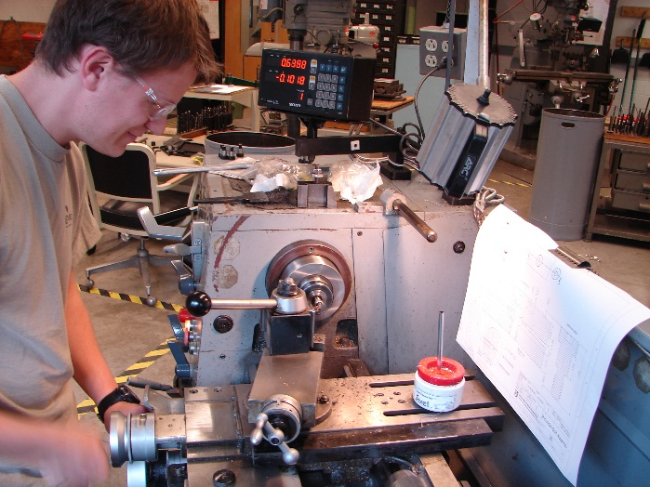
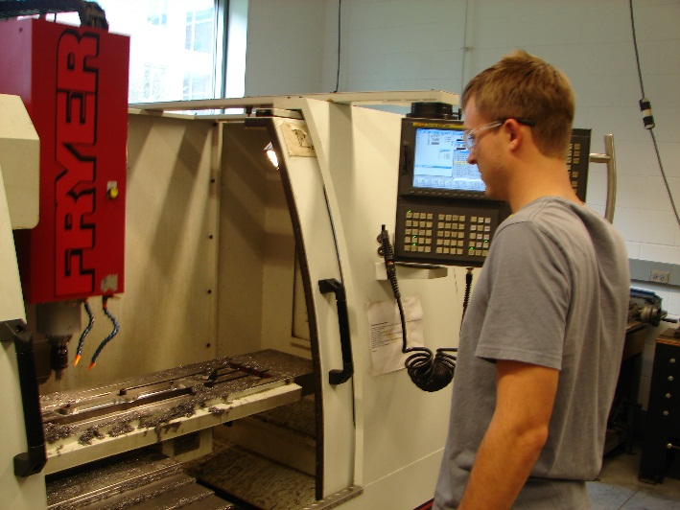
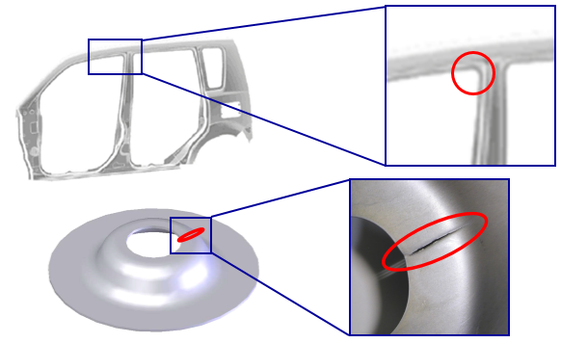
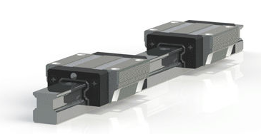
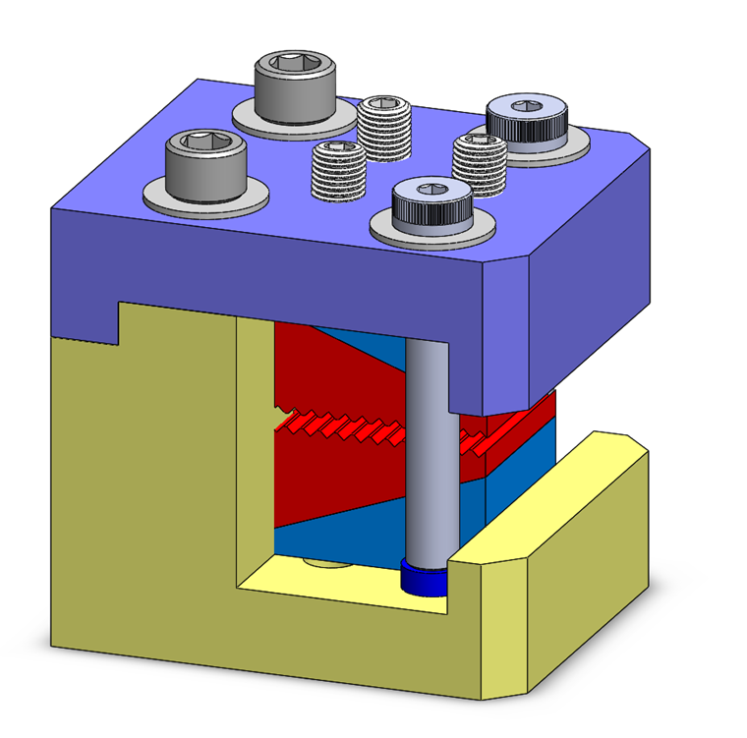
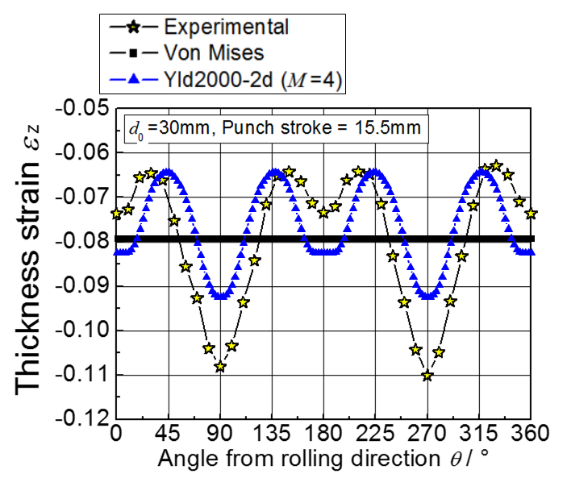
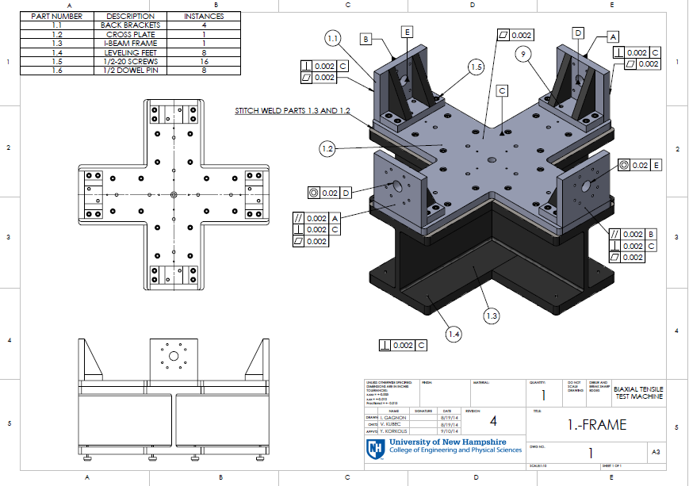
Bi-Axial Tensile Testing Machine for Anisotropic Materials
Ian Gagnon BS ME ‘15, Vojtech Kubec MS ME ‘15
Motivation
Design
Analysis
US and other countries demanding higher fuel economy while maintaining or improving vehicle crashworthiness.
One way to do this is to “lightweight” cars.
Although vehicle performance has increased over the past 30 years average vehicle weight has not improved
First Generation Machine
Second Generation Machine
von Mises (MPa)
Hand calculations, SolidWorks FEA and MATLAB analysis was used
Various methods were used to validate others
Experimental testing performed and Gen. I machine results used in design process
Unequal load cell readings in same axis caused by:
  Frame misalignment
  Unequal grip displacement
Difficult Grip Operation
Pantograph
Linear Guides
Redesigned Frame
Center Block
Redesigned
Ref: International Council on Clean Transportation. Global passenger vehicle standards. Np., 2014. Web.
Manufacture
Half of components manufactured at UNH
  CNC machining of pantograph arms
  Custom shear pins cut and tested
Half of components manufactured at PTE Precision Machining in Kittery ME
  Precise alignment of frame
Pantograph
Grips (Translate)
Center Block
Center Pin (Fixed location)
Mild steels used in vehicle construction for over a century
Mild steels are much more ductile but have less strength
High strength steels and other alloys allow designers to use less material
These higher strength materials are much less malleable and will fracture more easily than mild steel during the forming process
Linear Guides
Center Block is used to align specimen before tests
Pantograph to ensure equal grip displacement
Pantograph analyzed for 0.2% displacement mismatch
Nook linear guides to ensure displacement is only axially
Linear guides also eliminate bending on load cells
http://us1.webpublications.com.au/static/images/articles/i1097/109717_7lo.jpg
Ref:
To prevent fracture during forming computer models are used to predict material behavior and eliminate trial from the design process
Trial and error increases cost and decreases speed of development
Redesigned Grips
Validation
New grips are faster to operate, put specimen in tension during loading, and allow for a wider range of specimen designs
Ref: Kuwabara, T., NUMIFORM 2013
Gen. II Frame
Initial validation experiments performed
Uniaxial tests on both axis compared to uniaxial test on MTS servo-hydraulic machine
Future work will include comparing biaxial tests to other researcher's biaxial tests
First set of tests are in planning with first customer
Computer models use yield criteria
Basic yield criteria (Von Mises) can be calculated by hand, but do not predict complex behaviors such as anisotropy
To use more complex models input parameters are necessary to calibrate the model
Experiments are needed to accurately determine these parameters
A biaxial tensile testing machine is used for studying the anisotropy of sheet materials
New frame designed for precise alignment
Cross plate ground, pinned, and bolted to I-Bream Frame
Back brackets ground flat and parallel on bottom and back faces
Back brackets aligned to be parallel to opposing brackets and perpendicular to opposite axis brackets then pinned and bolted to frame
Acknowledgements
Validation experiments performed by V. Kubec
Professor Yannis Korkolis, Joseph Wilson, Scott Campbell, Funding provided by National Science Foundation, MMM Lab Colleagues, and many more
Ref: Kuwabara, T., NUMIFORM 2013

