Slide 1

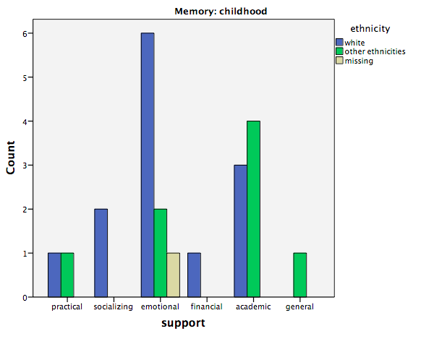
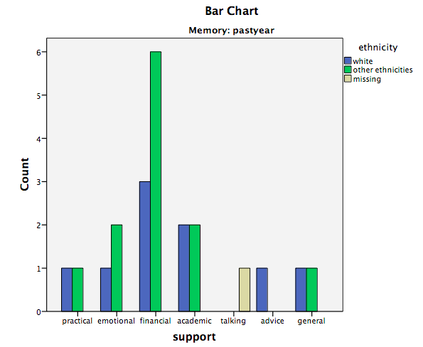
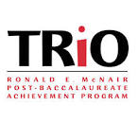
Overparenting: A Cross-Cultural Analysis
Janice Disla, Karalyn Enz, & Dr. David Pillemer
Psychology Department
Introduction
Results
This study examined the effects of overparenting on students of different cultures. Overparenting has been associated with various negative consequences in young adults (Segrin et al., 2013). However, previous research has been geared towards European-American families in individualistic cultures. Collectivist cultures value community over individual achievements (Sorkhabi et al, 2012). Bornstein et al. (2011) found that overparenting is viewed as more normative in collectivist cultures. Children of collectivist cultures may also receive different types of parental support and have more positive views of support received. We tested this hypothesis using memory narratives (Pillemer, 2001) and rating scales.
54 participants completed all rating scales, but only 22 provided memories
Memory coding for types of support:
  Added academic and general support
  Childhood memory support by ethnicity (Top graph)
  Past year memory support by ethnicity (Bottom graph)
Memory ratings:
  Positive: Past year M = 5.39, SD = 1.92
    Childhood M = 5.48, SD = 1.75
  Negative: Past year M = 2.70, SD = 2.16
    Childhood M = 2.78, SD = 1.91
  Typical: Past year M = 4.96, SD = 1.58
    Childhood M = 5.17, SD = 1.75
No differences between cultural groups on Individualism/Collectivism scores (p > .05)
Individualism/Collectivism scores did not predict memory ratings (p > .05)
Methods
Participants:
98 young adults (13.85% male, 86.15% female) recruited from UNH organizations
Age 18 – 26
Ethnicities: 56.92% White, 15.38% Hispanic, 16.92% Asian, 10.77% African-American/Black
Questionnaire:
Memories (childhood from 5 – 12 y/o, past year)
  Prompt: Recall a situation when your parent/guardian gave you more support than you felt you needed
  Narrative description of memory
  Ratings: positive, negative, typical (scale from 1 not at all – 7 extremely)
Individualism/Collectivism scale (Sivadas et al., 2008)
  14 rating scale items (from 1 extremely disagree – 7 extremely agree)
  Sample item: “I am a unique individual.”
Intergenerational Support Index (Fingerman et al., 2012)
  Types of support: emotional, technological, practical, talking about daily events, advice, financial
  Rated frequency of each type of support for each parent (1 daily – 8 less than once per year or never)
Discussion
Perhaps there was not enough cultural variability in the UNH sample. The students were recruited from offices that promote equality and social justice theory which may have impacted students’ personal views on Individualism/Collectivism, regardless of their cultural background. Only a small number of participants provided memories. It is possible that this may be due to the prompt and most participants felt they always received an appropriate amount of support. Perhaps, the word “support” was too positively charged and led to more positive memory recall, explaining why our results differed from Bornstein et al. (2011), who found that views and attitudes toward overparenting differed across cultures.
Acknowledgements
This research was funded by the McNair Scholars Program and mentored by Karalyn Enz and Dr. David Pillemer. I also want to thank my McNair Summer Cohort and Prof. Barbara White for all their support.
References
Bornstein, M., Putnick, D., & Lansford, J. (2011). Parenting Attributions and Attitudes in Cross-Cultural Perspective. Parenting: Science and Practice, 11, 214-237.
Fingerman, K., Cheng, Y., Wesselmann, E., Zarit, S., Furstenberg, F., & Birditt, K. (2012). Helicopter Parents and Landing Pad Kids: Intense Parental Support of Grown Children. Journal of Marriage and Family, 74, 880-896.
Pillemer (2001). Momentous Events and the Life Story. Review of General Psychology, 5(2), 123-134.
Segrin, C., Woszidlo, A., Givertz, M., & Montgomery, N. (2013). Parent and Child Traits Associated with Overparenting. Journal of Social and Clinical Psychology, 32(6), 569-595.
Sivadas, E., Bruvold, N., & Nelson, M. (2008). A reduced version of the horizontal and vertical individualism and collectivism scale: A four-country assessment. Journal of Business Research, 61, 201-210.
Sorkhabi, N. (2012). Parent Socialization Effects In Different Cultures: Significance of
Directive Parenting. Psychological Reports, 110(3), 854-878.

