Slide 1



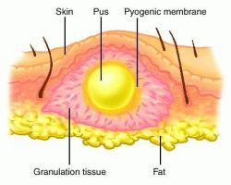

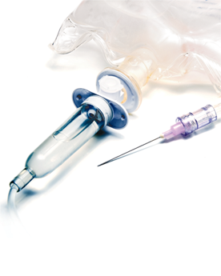
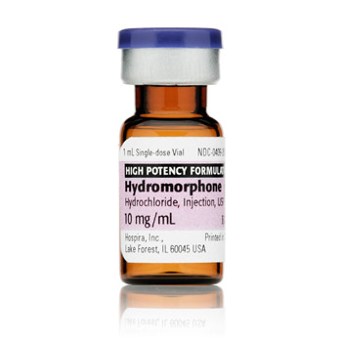
Case Study Presentation
Left Arm Abscess Related To Suspected IV Heroin Use
Amalia O’Neil
^{University of New Hampshire,} ^{DEMN}
Patient Information
Medications
Treating Opioid Withdrawal
30 year old female who presented to the ED with temperature of 103.0 F, extreme pain, swelling, chills, and foul smell coming from LUE. Left antecubital with abscess measuring 2.3cm. Incision and drainage performed to abscess, antibiotic treatment started. Denies IV drug use, displaying symptoms of withdrawal.
  Current diagnoses:
  Left arm abscess
  Heroin / Opioid use
  Malnutrition
  Patient noncompliance
  Ischemia and necrosis of muscle and skin
  Past medical history:
  Lumbar disc disorder
  Migraines
  History of kidney stone
  Fall 12/27/14- contusion to left hip
  17 pack year smoker
Medication | Dose | Time | Route | Indication
Clindamycin (Dilute with D5W 50ml) | 900mg (30ml/hr) | Q8hrs | IV | Abscess of left arm
Vancomycin (Dilute with D5W 200ml) | 1gm (133ml/hr) | Q8hrs | IV | Abscess of left arm
0.9% saline (NS) (Used to flush IV) | 10ml | BID | IV | Patency of IV
Senna-S | 2 tabs (8.6-50mg) | QD | PO | Bowel management
Hydromorphone (Cannot exceed 6mg in 4hrs) | 0.2mg/ml | PCA | IV | Pain
Hydromorphone | 4-8mg | Q4hrs | PO | Severe pain
Lorazepam | 1mg | Q6hrs | IV | Anxiety
Ondansetron | 4mg | Q8hrs PRN | IV | Nausea
Phenergan | 6.25mg | Q4hrs PRN | IV | Nausea
Dicyclomine | 20mg | Q4hrs PRN | PO | GI upset
Hydroxyzine | 50mg | Q6hrs PRN | PO | Itching
Clonidine (Administer x2 days, taper to BID) | 0.1mg | TID | PO | Withdrawal
Clonidine (Administer x2 days, taper to QD) | 0.1mg | BID | PO | Withdrawal
Clonidine (Administer x2 days and discontinue) | 0.1mg | QD | PO | Withdrawal
Clonidine is most commonly used medication to treat symptoms of withdrawal (anxiety, agitation, muscle aches, sweating, runny nose, and cramping).
Medication is tapered, starting with a higher and/or more frequent dose to prevent the ill feelings of withdrawal
Clonidine is an alpha-2 adrenergic agonists with a primary use for hypertension although used for various conditions by inhibiting the release of norepinephrine
Lab Results
Vancomycin Trough | 6.2 | 10-20
WBC | 9.71 | 4-10
RBC | 4.19 | 4.2-5.4
Hemoglobin | 11.5 | 12-15
Hematocrit | 34.9 | 36-47
Platelet | 248 | 150-400
Neutrophil | 78.0 | 54-75
Lymphocytes | 11.9 | 25-40
Monocytes | 9.0 | 2-8
BUN | 11 | 6-20
Creatinine | 0.56 | 0.5-1.0
Calcium | 8.9 | 9-11
Determining Antibiotic Use
Susceptibility of culture not yet determined, vancomycin & clindamycin are being administered until the therapeutic level is reached and culture results are obtained.
Vancomycin dose is determined by daily blood trough
Vancomycin if often used if suspected infection , especially when Staphylococcus is present
Once a culture and sensitivity is determined, the antibiotic will be adjusted and/or changed
Diagnostic Tests and Cultures
Wound Culture-LUE Abscess | Heavy streptococci, final results pending
CT scan-LUE | Fluid filled abscess with large cavity extending to lateral bicep
References:
http://www.naabt.org/documents/cows_induction_flow_sheet.pdf
http://www.nlm.nih.gov/medlineplus/ency/article/000949.htm
http://wk-trusted-auth.ipublishcentral.com/services/trustedauth/reader/isbn/9781451187663

