Slide 1

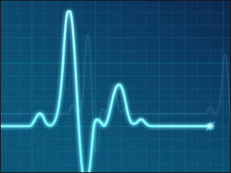
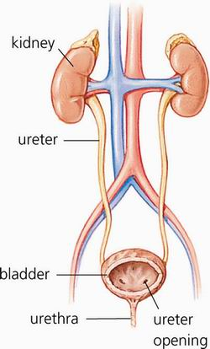
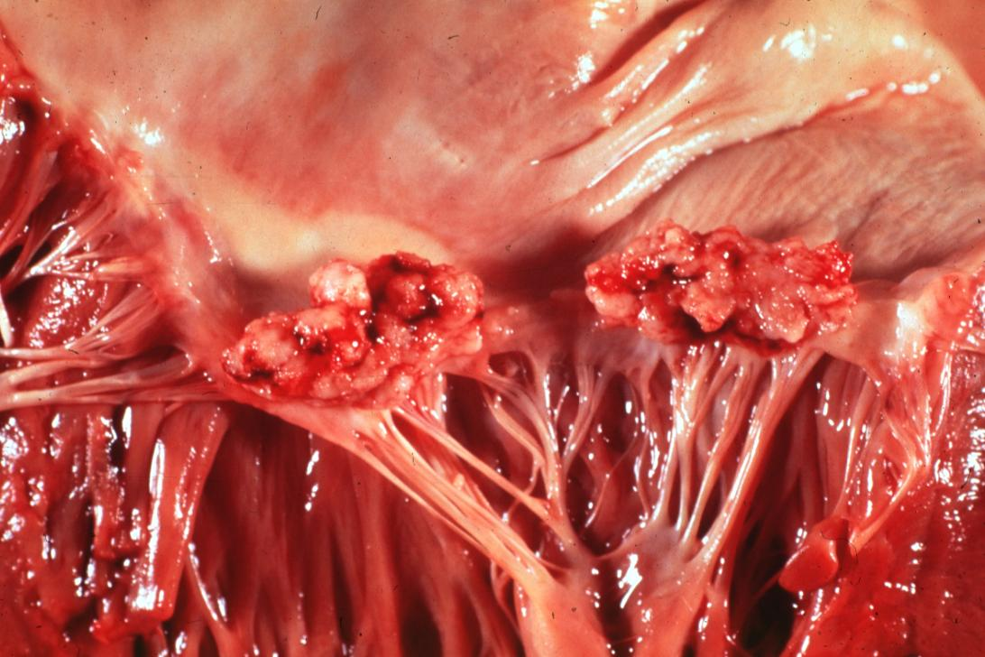
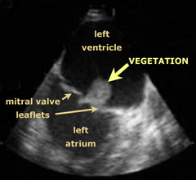

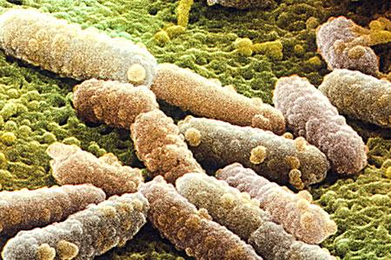

Urosepsis Case Study
Amy Poisson
Nursing Department, College of Health & Human Services
University of New Hampshire Durham, NH
Medication | Dose/Route Frequency | Class | Action | Adverse Effects
Albuterol | 3ml/inhaler/bid | Beta Agonist | Bronchodilator | bl.pressure,,anxiety
Aspirin | 81mg/oral/qd | Salicylates | Antiplatelet | bleeding
Budesonide | 320mcg/inhaler/q12h | Glucocorticoid | Anti-Inflammatory | dry mouth
Docusate | 100mg/oral/bid | Stool Softener | Stool softener | cramping, gas
Gabapentin | 600mg/oral/tid | Benzodiazopine | Inhibits GABA | clearance in kidneys
Heparin | 5000unit/Subq/q8h | Anticoagulant | Prevents blood clots | bleeding
Hydralazine | 25mg/oral/bid | Vasodilator | Lowers blood Pressure | angina, nausea
Lispro | 300unit/Subq/tid | Insulin | Lowers blood glucose | hypoglycemia
Isosorbide | 30mg/oral/bid | Osmotic diuretic | Lowers intraocular pressure | hyponatremia
Metoprolol | 25mg/oral/bid | Beta-Blocker | Controls hypertension | hypotension
Nystatin | 500,000units/oral/qid | Treats fungal infection | Antifungal | mild nausea
Polyethylene | 17G/oral/qd | Bowel Evacuant | Laxative | bloating, nausea
Spironolocatone | 25mg/oral/qd | K sparing diuretic | Promote Na & water excretion | gynecomastia
Tamsulosin | 0.4mg/oral/q48h | Alpha-adrenergic antagonist | Decreases blood pressure | first dose syncope
Torsemide | 20mg/oral/q48h | Loop diuretic | Decreases pulmonary edema | P-450
Vancomycin | 250ml/IV/q12h | Vancomycin | Antibiotic | ototoxicity
Lispro | Sliding scale | Lowers glucose | Insulin | hypoglycemia
Acetominophin | 1000mg/oral/prn | NSAID | Analgesic | Nausea, vomiting
Patient Presentation
Vitals
81 year old male
Admitted to ED with chest pain and weakness
Ht: 5’8” Wt: 130lbs BMI: 21.63kg/m2
Allergies: Lisinopril, Monopril, Trusopt (Dorzolamide) eye drops, inflammation with penicillin
Blood Pressure 108/50
Pulse 70
Respiratory Rate 16
Temperature 100.4 F
Pain 8/10
Medical History
COPD
Cardiomyopathy
Coronary Artery Disease
Valvular Disease
Dyslipidemia
Diabetes
Neuropathy
Microalbuminuria
Complete Heart Block
Chronic Kidney Disease Stage II
Chronic Arterial Fibrillation
Billiroth II
Hypertension
Cerebrovascular Disease
Peripheral Vascular Disease
Osteoarthritis
Glaucoma
Kidney Stones
Diverticulosis
Cholelithiasis
Aortic & Mitral Valve Replacements
Lab Test Results
Labs | Results | Normal Range
Sodium | 137 | 135-145
Potassium | 4.9 | 3.4-5.0
BUN | 11 | 6-20
Creatine | 1.5 | 0.6-1.2
Troponin | 0.07 | <0.01
WBC | 26.8 | 3.8-10.8
Hemoglobin | 13.1% | M 13-18%
Hematocrit | 41.5% | M 37-49% of RBC’s
Platelets | 229,000 | 130-400,000
Neutrophils | 92.4% | 45-75%
Lactic Acid, arterial | 2.1 | 0.5-1.6
Glucose, plasma | 202 | 70-110
Blood Culture | Positive for E.Coli | negative
Echocardiogram
showing vegetation
Mitral valve vegetations in a patient
with bacterial endocarditis.
Admitting Diagnosis
Urinary System
infection can occur here
Client presents to ED with chest pain and generalized
weakness upon minimal exertion, nausea, with leukocytosis, difficulty urinating, and evidence of early sepsis.
Pathophysiology of Urosepsis
Urosepsis is a serious secondary infection which occurs when a bacterial infection in the urinary tract spreads to the bloodstream, causing vasodilation and inflammation throughout the body. If the inner lining of the heart (endocardium) becomes infected, it is referred to as infective endocarditis. When this occurs, small masses called vegetations can occur. Endocarditis typically involves the valves of the heart; prosthetic valves in particular.
Symptoms of urosepsis can include fever, nausea, weakness, difficulty in urination, increased respiratory rate, warm skin, tachycardia, elevated white blood cell count, and positive cultures. If at least three of the symptoms are present, urosepsis should be suspected.
Core Patient Variables
Quit smoking in 1990 after a 120 pack a year history
Age
Depression after Bypass surgery
Paternal history of Heart Disease
Hard of hearing
Macular Degeneration
E. coli
Positive Blood Test for E. Coli

