Slide 1






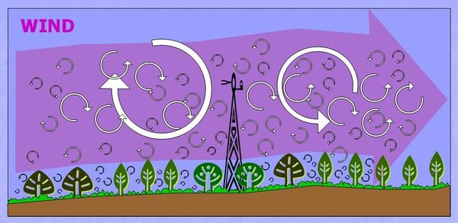
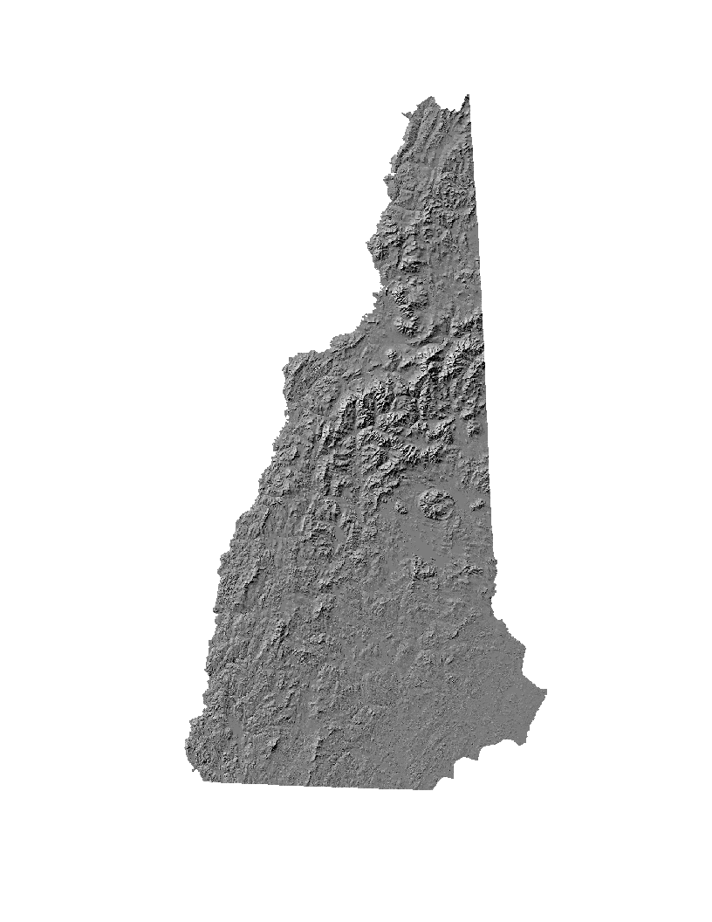
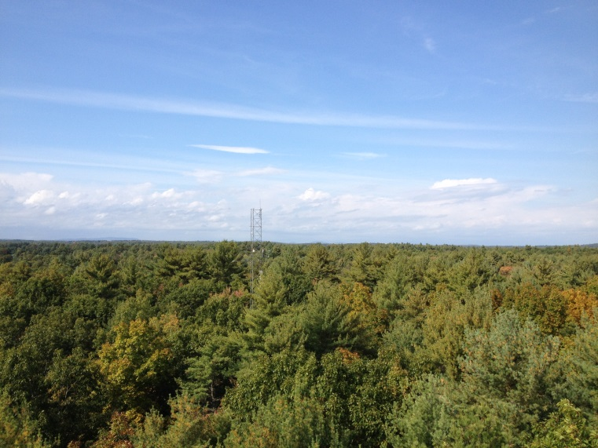
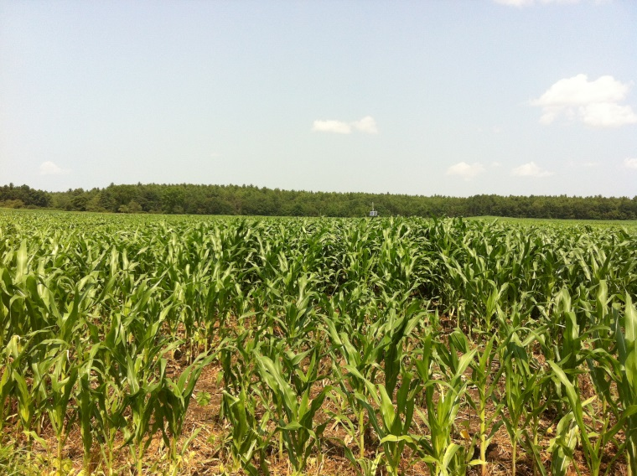
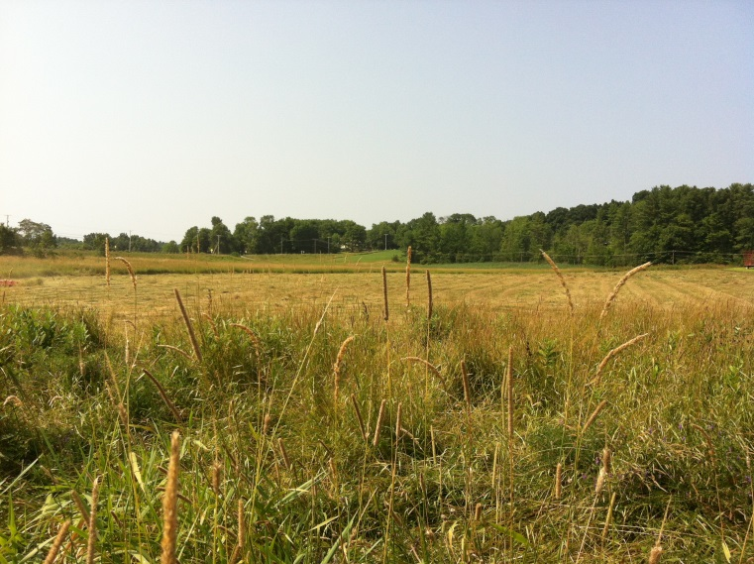
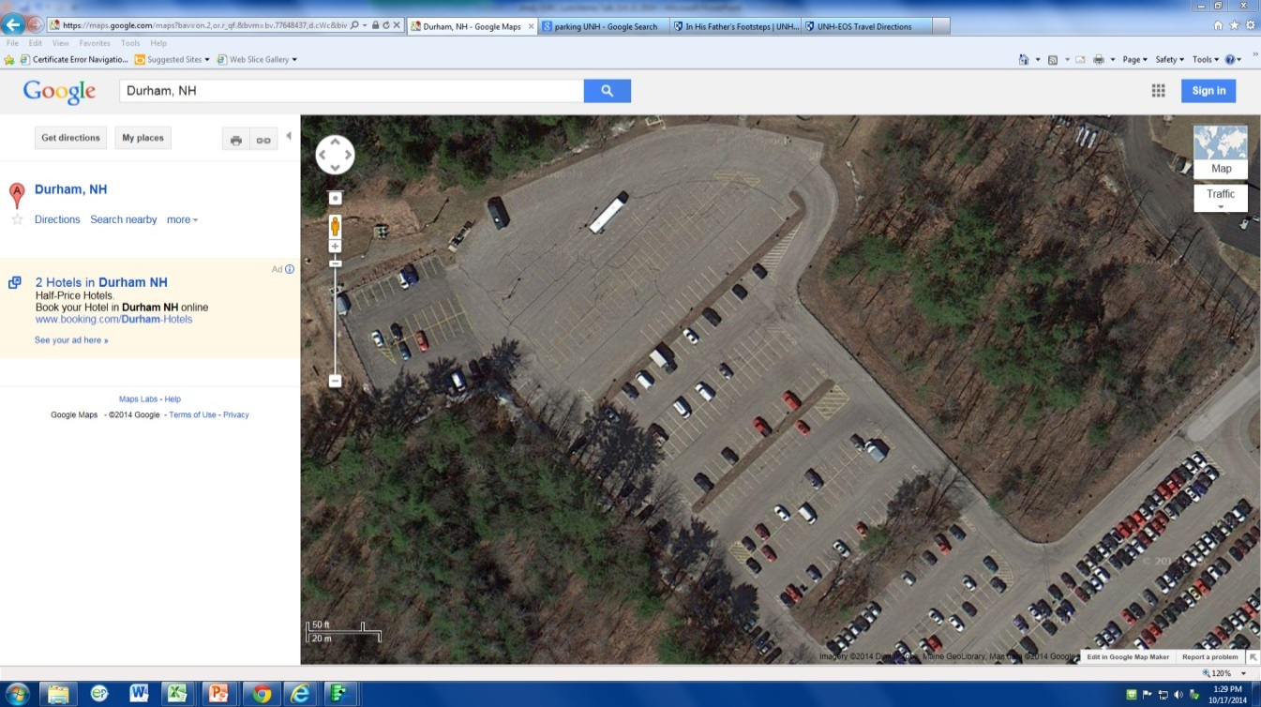
Carbon Fluxes Across Four Land Use Types in New Hampshire
Sean Z. Fogarty, Lucie C. Lepine, Andrew P. Ouimette — University of New Hampshire, Durham NH
Abstract
Carbon Fluxes
As part of the EPSCoR Ecosystems & Society project, researchers across the state of New Hampshire are studying the environment in an effort to support better management of the state's natural resources, so that population growth and development proceed in a sustainable fashion, without threatening the quality of life that makes New Hampshire a desirable place to live and visit. We are interested in understanding the interactions between land use/land cover and climate in order to better assess the impacts of land use change.
The land surface interacts with the atmosphere primarily through the movement of greenhouse gases (e.g. CO₂) and energy (e.g. heat, light), and these fluxes of gas and energy vary by land use/land cover type. Using the eddy covariance method and biometeorological sensors, we are measuring CO₂ fluxes, evapotranspiration, and albedo over four land use types that broadly represent the NH landscape: forest, hayfield/pasture, corn/agriculture, and residential/paved. Understanding how these fluxes vary over different land cover types will help us to better assess the future impacts of land use change on local and global climate. Here, we present preliminary results from our first year of data, comparing CO₂ fluxes across the four land use types.
Liquid manure
Negative flux values represent CO₂ uptake by the ecosystem (through photosynthesis). Carbon sequestered through photosynthesis is stored in the form of plant tissues and sugars within plants.
Positive values represent CO₂ emissions from the ecosystem. These fluxes are mostly attributable to root and microbe respiration. Respiration uses the products of photosynthesis to power plant, animal, and microbe metabolism.
Kingman Farm
(Hay field)
Frost
Mowing
Mowing
Mowing
Solid manure
Corn planted
Liquid herbicide
Helicopter seeding of winter rye cover crop
Frost
Moore Fields
(Corn field)
Land-Climate Interactions
Plowing & liquid manure
Albedo
Latent and sensible heat
Gas exchange
“Reflectivity”
“Sweating”
“Breathing”
Thompson Farm
(Forest)
Flow module failed
Relevance
~
Greenhouse
Gases
~
~
Data derived from the eddy flux systems will be used by terrestrial and hydrologic modeling groups, and to assess climate and future land-use scenarios. By understanding the components of the landscape that contribute to the surface energy budget and gas fluxes, we will be better able to estimate climate forcing under a variety of land-use scenarios. This knowledge will help to inform decisions about future land use in New Hampshire.
~
~
~
West Edge
(Paved/residential)
Future Work
Streamline eddy flux tower maintenance, data collection, and processing.
Install SMARTFlux (Synchronization, Management And Real Time flux) systems at all 4 sites.
Design and apply data filters to clean up data including:
  1) logical filters to exclude values that are outside of the range of values that are reasonable,
  2) u* filtering to remove data when wind conditions are inadequate to create sufficient friction to meet method assumptions,
  3) footprint filtering to remove data that represent land area outside of the land cover type of interest.
Gap-fill missing values and provide annual radiation, energy, and greenhouse gas flux estimates across the 4 land cover types.
Partition net ecosystem exchange (NEE) into gross primary production (GPP) and ecosystem respiration (R_{e}).
Determine the drivers of radiation, energy, and carbon fluxes across the 4 land cover types using supporting meteorological and biometric data.
Compare the climate forcing of the 4 different land cover types under present climate to derive a climate forcing for the state of New Hampshire.
Estimate future climate forcing of New Hampshire under various future land use scenarios.
How can we measure these interactions?
Thompson Farm
Durham, NH
Moore Fields
Durham, NH
Eddy flux systems use the eddy covariance method to measure covariance of H₂O and CO₂ concentrations and vertical wind speed in eddies over the land surface, and allow for measurements of greenhouse gas fluxes and sensible heat and latent heat (e.g. evaporative water loss).
A suite of meteorological, solar radiation, soil and canopy sensors will help interpret these flux data, and fill in data gaps:
Kingman Farm
Madbury, NH
West Edge
Durham, NH
Incoming and outgoing short and long-wave radiation
Incoming photosynthetically-active radiation
Soil and air temperature and humidity probes
Rain gauge tipping bucket
Acknowledgments
Support for the NH EPSCoR program is provided by the National Science Foundation’s Research Infrastructure Improvement Award # EPS 1101245.

