Slide 1
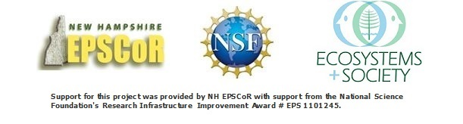

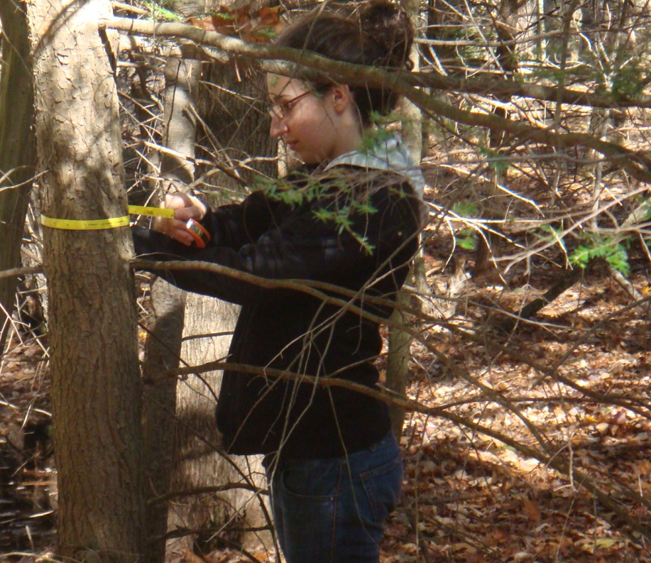
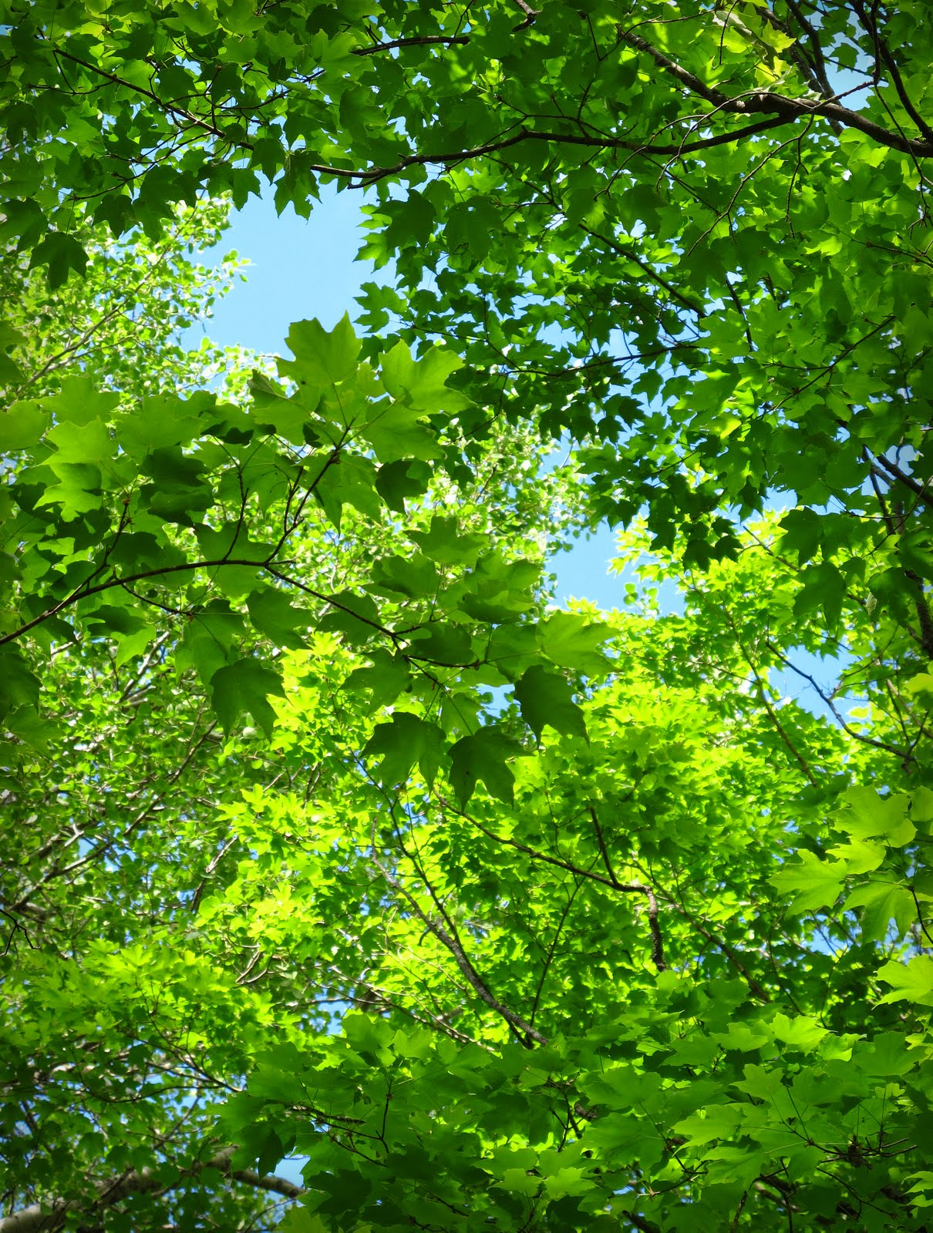
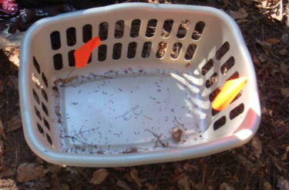
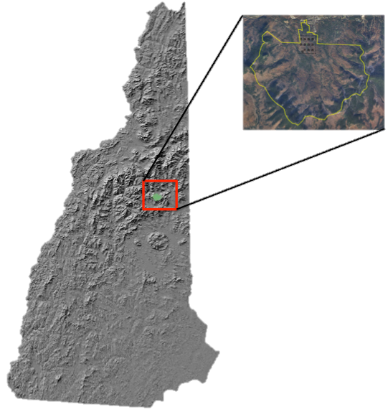
Comparison of Multiple Methods Used to Estimate Foliar Production and Canopy Composition of a Forest
Jake DeBow, Andrew Ouimette, Lucie Lepine, University of New Hampshire, Durham, NH
Methods
Canopy composition was estimated using three methods:
1. Percent Basal Area – Diameter at breast height (DBH) is measured and recorded by species for all trees within a plot. The percentage of total stem basal area of a species is then used to
estimate canopy composition,
assuming the relationship of stem size
is equivalent to the relationship of foliage
within the canopy.
2. Camera Point-Quadrat – A standard SLR camera equipped with a telephoto lens
Abstract
Accurate estimates of forest species composition and foliar production are crucial for understanding the role of forests in the carbon cycle, particularly under changing climate regimes. While harvesting entire forests would yield the most accurate estimates of foliar production, this method is clearly not feasible. For this reason, estimates of both foliar production and canopy composition rely on making measurements for a number of targeted field locations within a forest, and applying methods to scale those measurements to the entire forest. This study presents results from a comparison of multiple methods for estimating foliar production and canopy composition. Specifically, litterfall data and allometric equations based on measured tree diameter at breast height (DBH) are compared for foliar production by species in a northern temperate forest in New Hampshire. Three different methods of estimating canopy composition are also assessed, including those based on litterfall, camera point-quadrat, and stem basal area data. Results indicate that allometric equations tend to overestimate foliar production as compared to production estimates from litterfall. Estimates of canopy species composition derived from basal area were more variable than those from litterfall and camera point methods.
Introduction
Accurate measurements of foliar production and canopy composition are key to improving our understanding of changes in biodiversity, habitat quality, climate, and nutrient cycling. For instance, in the face of a changing climate it is vital to understand the role of forests in the carbon cycle (e.g.. photosynthetic rates, respiration rates, nutrient contents). In addition, many organisms rely on forested environments—and sometimes specific tree species—for habitat. Understanding foliar production and canopy composition can therefore allow scientists to better understand the presence of microhabitats within a forest and provide insight on the effects of phenomena such as disease and parasite epidemics, large-scale fires, or even selective forestry practices and how they would affect ecosystem interactions at a number of scales.
A variety of methods are used to estimate foliar production and canopy composition, each of which include tradeoffs in the time involved to collect and process the data as well as in their accuracy. Finding a rapid yet accurate way of obtaining these data could allow for more people to gather and access data of this sort. This project sought to compare tradeoffs across methods in terms of time and accuracy.
Study Site
All physical data collected and assessed
in this project were gathered on site at the
Bartlett Experimental Forest (BEF),
a USDA Forest Service field laboratory
located in northern New Hampshire.
Field plots are located in a ~1km area
around an eddy covariance tower.
Results
Canopy Composition
Camera point and litterfall are most closely related (Figure 5).
While easy to collect, basal area cannot be used for more than analyzing general trends.
When a four-year retention rate is used for hemlock/spruce, camera point and litterfall become more similar.
Figure 2: Field technician measures basal area using a DBH tape.
and gridded eyepiece is mounted on a tripod and pointed straight up. Through this the user can see the canopy as well as the height of individual leaves. Using the grid as an optical quadrat the lens is focused on a leaf that is covered by a quadrat intersection. The observer now identifies the leaf species and height above the lens mount at which the leaf resides. By using these point-quadrat counts in the equation described by Aber (1979) a vertical profile of the canopy by species is derived (Smith & Martin 2001.)
R² and slope values
Basal area vs. litterfall R² = .53 and slope = .87
Three year retention time camera point vs. litterfall R² = .89 and slope = 1.07
Four year retention time camera point vs litterfall R² = .97 and slope = 1.10
Figure 3: A forest canopy as seen through the viewfinder using the gridded eyepiece.
3. Litterfall – Within designated plots, laundry baskets are placed on the forest floor to collect falling leaf litter. Litter within these baskets is collected periodically throughout the year (usually 2-3 times
in fall and once in spring before leaf-out, in order to
capture a growing season) and sorted by species.
Each species is then weighed and recorded to
obtain percentages of composition. Final numbers
can be extrapolated to assess total canopy
composition of a given plot using the known
area of the litterfall baskets. Retention time
of coniferous trees is also taken into
consideration during data analysis.
Foliar production was estimated using two methods:
1. Litterfall – Same methods were used for data collection as described above. Retention time of coniferous trees was also taken into consideration when analyzing this data.
2. Allometric Equations – These equations were taken from Young (1980), who derived allometric equations through whole tree harvest, and measured all components of a tree compared to the tree’s DBH. Because we measured DBH of trees throughout all plots at our study site, we could simply use our measured DBH in the Young (1980) equations to calculate estimates of the amount of foliage a tree of the given size would have within its canopy.
Foliar Production
Litterfall collections and allometric equations based on DBH differed significantly in both annual and total biomass.
Allometric equations doubled litterfall in grams per meter squared (Figure 7).
Figure 4: Litterfall collection basket.
Allometric equations used include all material under one inch though (Including twigs and stems).
When a twig retention rate of 12 years is applied to the data analysis of allometric equations the foliar production numbers are very similar (Figure 8).
References Cited
Aber, J.D. 1979. A method for estimating foliage-height profiles in broad-leaved forests. Journal of Ecology, 67(1): 35-40.
Smith, M.-L., M.E. Martin. 2001. A plot-based method for rapid estimation of forest
canopy chemistry. Canadian Journal of Forest Research, 31: 549–555.
Young, H. E., Ribe, J. H.,Wainright, K. 1980. Weight tables for tree and shrub species in Maine. Life Science and Agriculture Experiment Station Miscellaneous Report 230.
Figure 1: Bartlett Experimental
Forest location within
New Hampshire.

