Slide 1
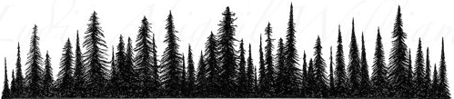

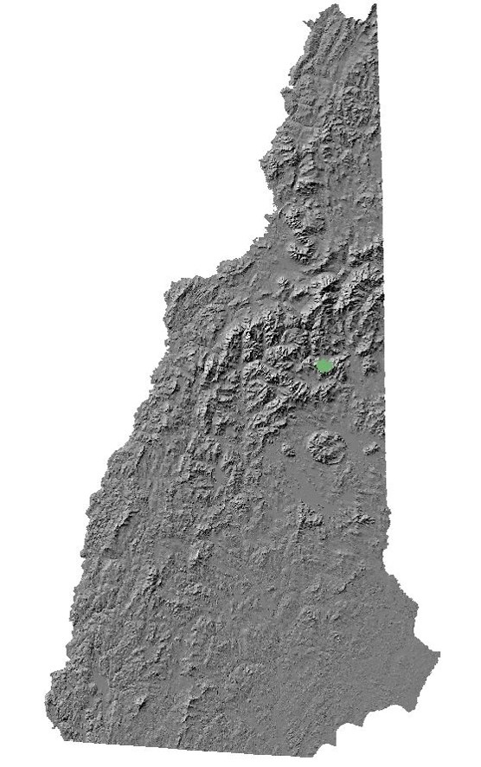
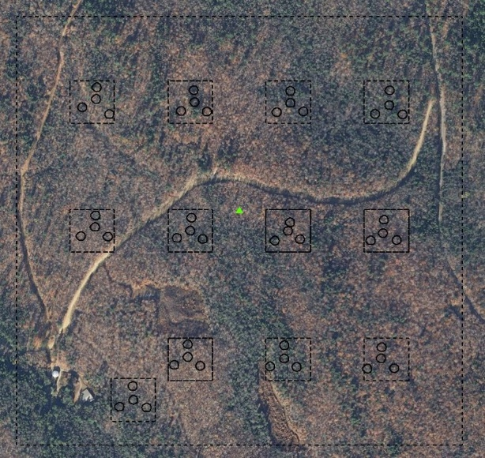
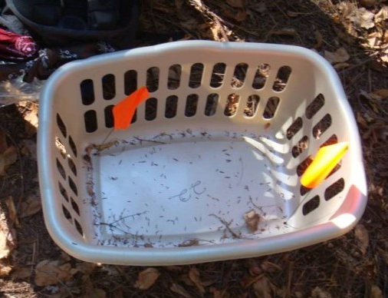
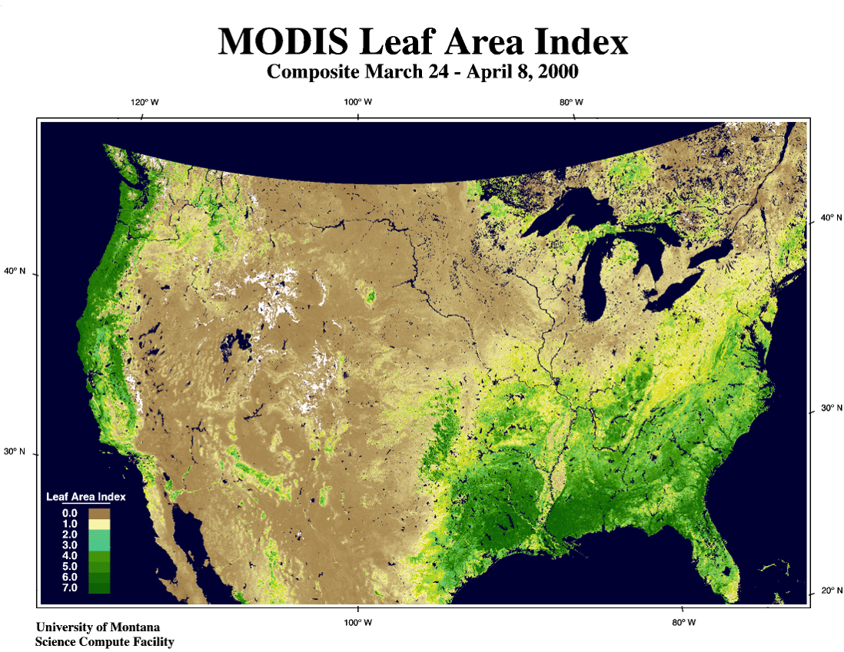
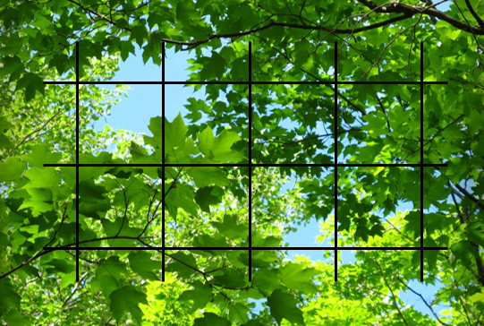
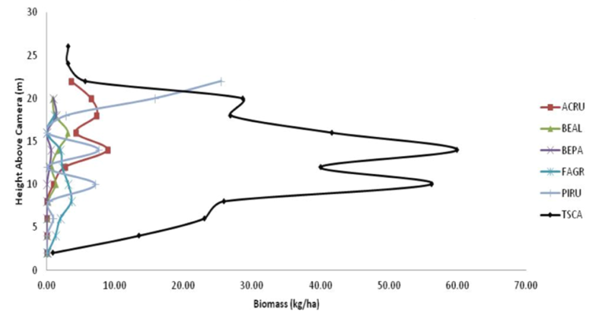
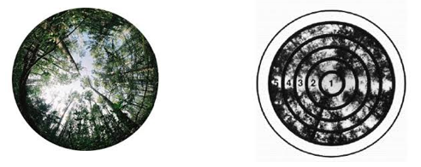
Assessing Methods for Generating Estimates of Leaf Area Index in Bartlett Experimental Forest
John Hastings¹, Andrew Ouimette², Lucie Lepine²
¹Department of Natural Resources and the Environment, ²Earth Systems Research Center
Introduction
Hybridized Methods
Results
Abstract
Study Site: Bartlett Experimental Forest (BEF)
Leaf area index (LAI) is generally defined as the total surface area of foliage in a canopy per unit of ground area. Leaf surface area is directly correlated to forest productivity. Obtaining accurate measurements of LAI is important for evaluating and understanding different forest ecosystem fluxes, including those of light, heat, moisture, carbon and nitrogen. Because measuring LAI is labor intensive and time consuming, there are many different techniques for estimating LAI, and each comes with its own advantages and disadvantages. Here, we compare optical LAI measurements from MODIS and LAI 2000, to those from a hybrid technique utilizing leaf litter biomass measurements and camera point foliage height profiles.
Established in 1932 by the USDA Forest Service, BEF is a field laboratory for studying the ecology and management practices of northern forest ecosystems (Figure 3a).
Measurements were taken at 12 plots surrounding an eddy flux tower. Each plot consists of 4 subplots (Figure 3b).
Figure 3a. BEF location within NH
Figure 8. Comparison of LMA obtained from literature to LMA varied by height.
Questions
Figure 3b. 12 experimental plots (four subplots per plot) surrounding an eddy flux tower
LMA values derived from the literature (Smith and Martin, 2001) were compared to LMA varied by height (Figure 8). For Tsuga canadensis, Pinus strobus, and Populus grandidentata (Indicated by * in Figure 8) LMA values from several sources were averaged to create a proxy for variability by height. Further measurements are required to estimate LMA trends in these species.
How do different methods of calculating LAI compare?
Does varying Leaf mass per area (LMA) with height affect LAI estimates?
Leaf Litter Collection
Figure 4. Example of the leaf litter collection baskets, area = 0.24 m².
Leaf litter collection is one way to estimate foliar biomass. Leaf litter was collected in 96 litterfall baskets (Figure 4) (2 per subplot), each with an area of 0.24 m². To obtain an estimate of biomass for 2012 leaf litter was collected in October and November of 2012, and May of 2013. Foliar biomass was estimated to be 293 g/m².
The MODIS 2012 LAI estimate is 5.5; the 14 year average is 5.4. LAI 2000 average estimates in 2004 is 4.68; 2007, 4.81; 2008, 4.77; three year average, 4.75. Hybrid estimate using Smith values is 3.75; estimate using varied LMA by height is 4.34
Optical Methods
MODIS
Camera Foliage Height Profiles
NASA’s Moderate-resolution Imaging Spectroradiometer (MODIS) composites global satellite estimates of LAI every 8 days at 1km resolution. MODIS can be an effective method for estimating LAI on large-scales. Mean LAI estimates were filtered with June, July, and August as quality control flags. We obtained LAI year values (2000-2013) for the nine 1km pixels encompassing the experimental plots.
Camera point is a method for determining canopy composition by height. Using a 35mm telephoto lens as a range finder, the height of the lowest leaf covering each grid point (Figure 5) was measured. 15 observations were recorded at plot center and each of the four cardinal and off-cardinal directions. The result was a total of 135 measurements per plot used to construct a vertical profile of the canopy (Figure 6).
Figure 9. Comparison of LAI estimates between optical methods and hybridized method.
Varying LMA was found to affect LAI estimates, resulting in a ~13.5% increase in estimated LAI over LAI estimated utilizing Smith and Martin, 2001 LMA values (Figure 9).
Figure 5. Example of the view seen through the camera point range finder
Summary
Figure 1. Example of MODIS large-scale LAI estimates for the contiguous United States
LAI estimates using varied LMA have the potential to increase if Tsuga canadensis, Pinus strobus, and Populus grandidentata are found to vary with height in the canopy, as observed with other species.
A study by Yang et al., 2006 found MODIS to overestimate LAI by about 12%. Correcting for overestimates, MODIS LAI is 4.84, comparable to LAI 2000 estimates.
Among compared LAI estimation techniques, LAI 2000 appears to be the most cost- and time-efficient, and accurate method for estimating LAI at small scales.
LAI 2000
Leaf Mass per Area
LAI can be calculated from measurements of how quickly radiation attenuates as it passes through the canopy. LAI-2000 is a handheld device that takes 5 simultaneous measurements at different angles from the zenith (Figure 2) and compares it to measurements taken in the open sky. LAI estimates improve with increased sampling. LAI 2000 can be an effective method for small-scale LAI estimates. Estimates were obtained for 2004, 2007, and 2008.
LMA is the ratio of dry leaf mass per area (g/m²). As seen in Figure 7, some tree species’ LMA have been found to vary with height through the canopy, with leaves at the top of the canopy tending to have the highest LMA. Often LAI estimates incorporating LMA tend to neglect foliar density distribution, using one LMA for the whole canopy. When data were available, we varied LMA across canopy height based on canopy species distribution, to accurately reflect LMA.
Figure 6. Example of the canopy profile constructed from camera point data.
Thank you to Lucie Lepine and Andrew Ouimette for help in preparation for the URC
References
Asner, G., Scurlock, J., & Hicke, J. (2003). Global synthesis of leaf area index observations: Implications for ecological and remote sensing studies. Global Ecology and Biogeography, 12, 191-205.
Smith, M., & Martin, M. (2001). A plot-based method for rapid estimation of forest canopy chemistry. Canadian Journal of Forest Research, 31, 549-555.
Yang, W., Tan, B., Huang, D., Rautiainen, M., Shabanov, N., Wang, Y., . . . Myneni, R. (2006). MODIS leaf area index products: From validation to algorithm improvement. IEEE Transactions on Geoscience and Remote Sensing, 44(7), 1885-1898.
Figure 2. Examples of data captured with LAI 2000 optical sensor.
Figure 2
Figure 7. Example of how LMA can vary with height, as seen in American Beech (Fagus grandifolia).

