Slide 1
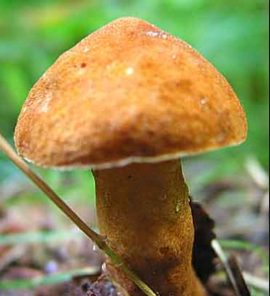
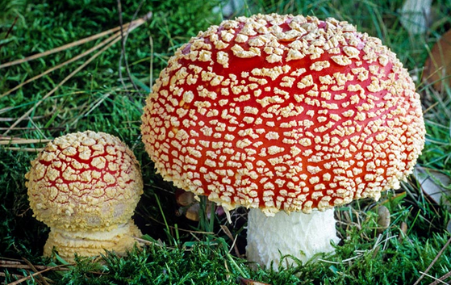
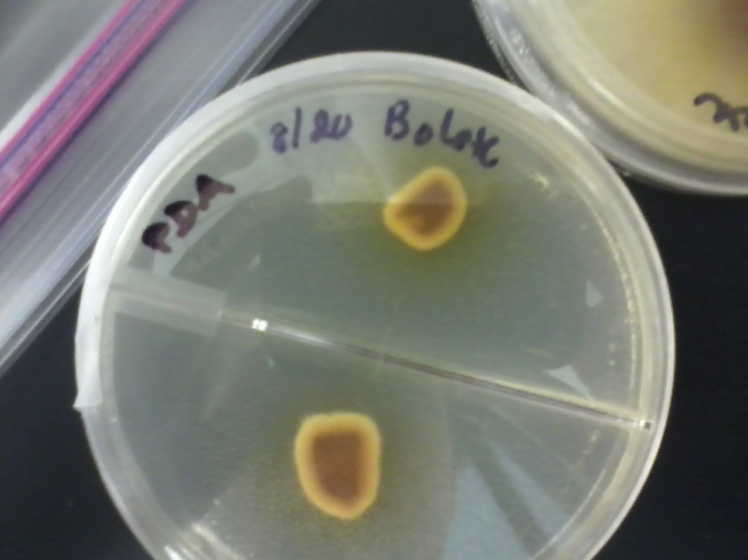
Insights into carbon assimilation in ectomycorrhizal fungi through use of ¹³C-labeled glucose and amino acids
Megan Grass¹, Janet Chen², Andrew Ouimette², Erik Hobbie²
Presentation #:27
¹Department of Biology, ²Earth Systems Research Center, University of New Hampshire, Durham, New Hampshire, USA
Contact information: mgrass22@aol.com
Introduction
Results
The uptake of amino acids by ectomycorrhizal fungi is essential in expanding the range of nitrogen sources of their host plants to include organic forms. Many studies have examined the uptake of amino acids using specific ¹³C-labeled amino acids such as glycine but the generality of these results is questionable because microbes assimilate a broad range of amino acids, which vary greatly in the extent of fungal retention of the amino acid carbon. The purpose of our study is to quantify the assimilation of carbon into two ectomycorrhizal fungi from isotopically labeled glucose and amino acids. Boletus has better capabilities to enzymatically degrade proteins and complex carbohydrates than Amanita¹, and also produces organic acids such as citrate.
The fraction of amino acid-derived carbon assimilated into cultures varied with the supplied C/N of 10, 24, and 75. For these values, it was estimated for Amanita at 0.350, 0.275, and 0.149 and for Boletus at 0,437, 0.246, and 0.049.
The δ¹³C was highest in the two ¹³C-labeled glucose treatments and ¹³C-labeled ammonium cultures were higher than amino acid cultures in δ¹³C.
Boletus and δ¹³C Amanita δ¹³C correlated strongly across treatments (Figure 5), with Boletus about 56% of Amanita δ¹³C. Phytagel in Boletus plates liquefied.
Treatment explained most of the variability for δ¹³C (Table 1).
Figure 2:
Boletus Species.
http://www.wildmanstevebrill.com/Mushrooms.Folder/Chestnut%20Bolete.html
Table 1: Multiple regression analysis.
The adjusted r² of the model is 0.984.
Effect Tests
Source (DF) %Var Prob > F Source (DF) %Var Prob > F
Fungus (1) 0.32 <0.0001 Fungus*C/NTreat*Treat (8) 2.99 <0.0001
C/NTreat (2) 0.75 <0.0001 ln C/N(1) 0.21 0.0014
Treatment (4) 87.94 <0.0001 Fungus*ln C/N(1) 0.09 0.0371
Fungus*C/NTreat (2) 2.32 <0.0001 Treatment*ln C/N(4) 0.15 0.1162
Fungus*Treat (4) 0.48 0.0002 C% (1) 0.25 0.0005
C/NTreat*Treat (8) 4.05 <0.0001 Treat*C% (4) 0.47 0.0002
Figure 1: Possible Carbon Uptake Pathways: Carbon can be assimilated into fungal tissues from either glucose via the Krebs cycle, direct uptake of organic nitrogen, or a combination of both (Figure 1).
Figure 3:
http://www.shroomery.org/10224/Hunting-Fly-Agarics-in-North-America
Amanita muscaria Species.
Figure 5: ¹³C recovery in mycorrhizal biomass: Mycorrhizal biomass δ¹³C indicates that Boletus has used another carbon source such as the Phytagel the fungi were grown on.
A
Methods
Amanita muscaria and a Boletus sp. (Figure 2 & 3) were cultured on potato dextrose media (Figure 4) and plugs were plated on a Phytagel® media at three C:N ratios of 10, 24, and 75 to simulate a potential range in nitrogen availability.
Five treatment were used: ¹³C-labeled glucose and ammonium, unlabeled glucose and ammonium, ¹³C-labeled glucose and unlabeled amino acids, unlabeled glucose and ¹³C-labeled amino acids, and unlabeled glucose and unlabeled amino acids.
Discussion and Conclusions
Based on the slope of the regression in Figure 5, Boletus appeared to have assimilated carbon from Phytagel that was solubilized by Boletus-produced citrate.
Assimilation of organic nitrogen varied two-fold in Amanita and eight-fold in Boletus with shifts in supplied C:N. We saw little evidence of synthesis of amino acids from glucose in amino acid-supplied cultures, which would have lowered ¹³C labeling in cultures compared to that expected from the hypothesized protein content of the hyphae. We did see indirect evidence for gluconeogenesis from amino acids, in that the labeling levels when supplied with ¹³C-labeled amino acids were higher than could be accounted for by ¹³C labeling of the protein alone based on the C:N of protein versus bulk fungi.
Organic nitrogen probably preserves a carbon signature in fungal protein after uptake, and furthermore it appears likely that some carbon skeletons from supplied amino acids enter the Krebs cycle and are subsequently incorporated into non-protein compounds.
We can now use information from this study to quantify organic nitrogen uptake from isotopic measurements into the field.
Amino acids were from hydrolyzed cyanobacteria, and therefore included all microbial amino acids. We studied the relative flux of ¹³C-labeled carbon from these two sources into fungal biomass.
Phytagel dissolves with addition of citrate, making collection of hyphae easy.
The bulk fungi from the labeled Phytagel plates were collected and dried.
The bulk fungi were run on an isotope ratio mass spectrometer.
2
2
Figure 4: Fungi were grown on potato dextrose agar prior to plating onto the labeled experimental plates.
Citations
¹Lilleskov E, Hobbie E, Horton T. 2011. Conservation of ectomycorrhizal fungi: exploring the linkages between functional and taxonomic responses to anthropogenic N deposition. Fungal Ecology 4: 174-183.
Acknowledgements
This work was supported by grants DEB-1146328 and OPP-1108074 from the US National Science Foundation and an REU supplement. Special thanks to Francesca Scandellari, Serita Frey, and Jesse Sadowsky.
Notes:
Italicize genus and species names. Capitalize phytagel. Superscript 13C. AA biosynthesis under Krebs cycle arrow. 12C should be 13C. Same font size for all results bullets. Give adjusted r2 for entire regression.
Organic Acids cycling around without nitrogen (citric acid tricarboxylate acid cycle – citrate most important)
Fix Figures
Fix
Protein alone in C:N of protein is 3 and measured the bulk biomass =10 if there is no other N sources – labeling was higher than expected

