Slide 1
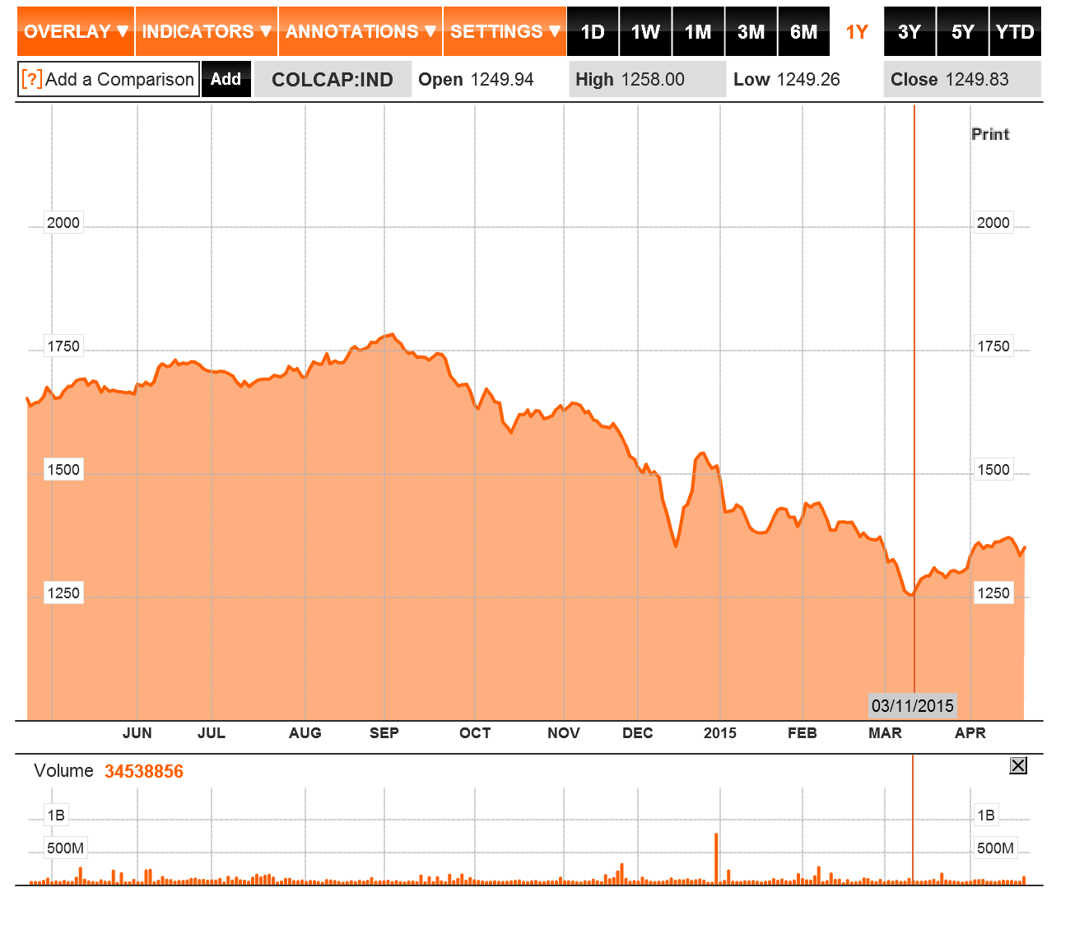

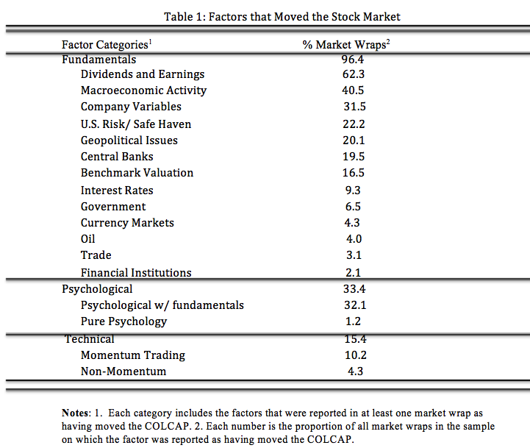
Do Fundamentals Matter when Valuating Stock Prices in Latin America? The Case of the Colombian Stock Market
David Mesa
Michael D. Goldberg , Faculty Advisor
Department of Economics, University of New Hampshire
Abstract
Several behavioral economists argue that many times, asset prices are far from their intrinsic value, and that market participants base their forecasts of asset prices on psychological factors alone, such as fear and optimism, and completely ignore fundamental factors, thus creating a “bubble”.
This research seeks to demonstrate that market participants not only use fundamental factors to influence their forecast about stock prices, but that they explicitly rely on those fundamental factors to make their forecasting decisions. Psychological factors are also found to be important for market participants at the time of making forecasting decisions, but they are almost always included along with fundamental factors. This research looks in particular at the case of the stock market of one of the biggest emerging economies in Latin America: Colombia.
Evidence of Fundamentals
The manual-reading approach for analyzing the market wraps reports, reveals that market participants’ in Colombia rely heavily on a wide range of fundamental factors in order to valuate stock prices.
The market wraps also show that psychological and technical factors also play an important role in the market participants’ forecasting of prices. More importantly, when psychological factors are mentioned, they are almost always mentioned along fundamental factors.
Source: Bloomberg Business
Methods
Conclusion
This study makes use of a data set for 2014, which is composed of market wraps that are published by the major financial newspaper in Colombia: Portafolio. The wraps summarize the daily activity on the stock market, based on interviews and comments by analysts, fund managers, and other major market participants.
Manually reading the market wraps allows the researcher to identify the factors that are strictly mentioned to have moved the major market index in the country (COLCAP) on a given trading day. It also allows the researcher to code those factors numerically as having a positive or negative effect on the index.
In order to score the wraps consistently, the researcher has to adhere to a strict set of rules.
This research provides empirically evidence that market participants in Colombia rely mostly on fundamental factors to make their predictions about future stock prices. Psychological factors also take an important stand in actors’ forecast but the majority of the time, these factors are mentioned along fundamental factors. There is further research to be done in order to determine if there is quantitative structural change in the fundamental factors in which market participants rely on.

