Slide 1

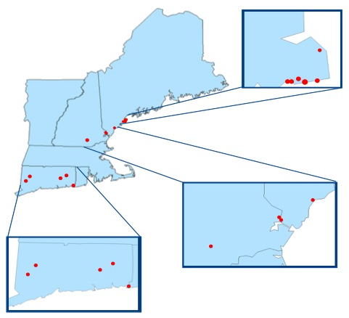
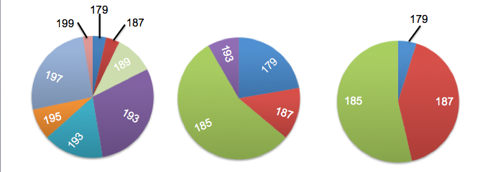

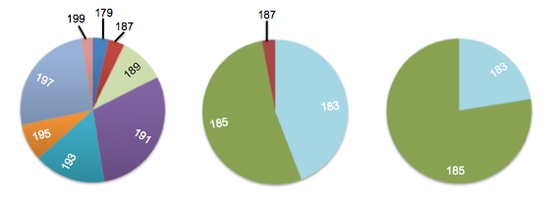
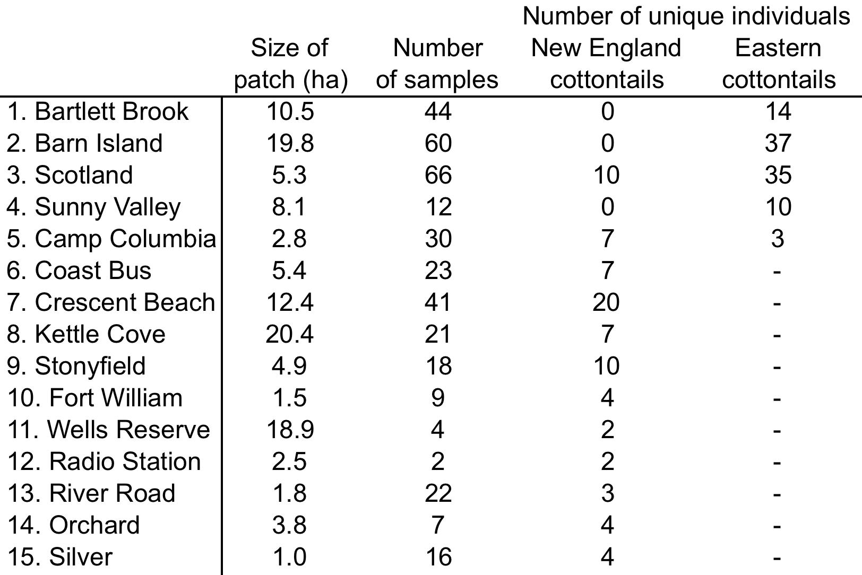
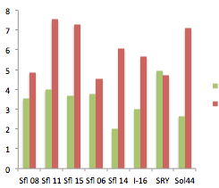
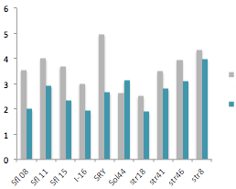
Evaluating Genetic Diversity Between Populations of New England Cottontail
(Sylvilagus transitionalis) and Eastern Cottontail (Sylvilagus floridanus)
Tricia Gunther, Thea Kristensen, and Adrienne Kovach
Department of Natural Resources and the Environment, University of New Hampshire
Introduction
The New England cottontail (Sylvilagus transitionalis) is an early successional specialist that is native to New England and New York¹.
Over the last 50 years, populations of this species have greatly declined, primarily due to habitat loss¹.
As the populations become smaller and more isolated, increased inbreeding and decreased gene flow can occur. This can cause a reduction in genetic diversity, which may have consequences for long-term species persistence.
Another threat to this species is competition with the growing populations of eastern cottontail (Sylvilagus floridanus), which overlap the same range and habitat as the New England cottontail, with the exception of Maine².
Figure 1. Locations where samples were collected from patches occupied by New England
cottontail in southern Maine, New Hampshire and CT, and eastern cottontail in CT.
Table 1. Patch area, number of fecal pellets sampled, and number of individuals identified
by their unique genotypes for New England and eastern cottontails from 15 patches in
Maine, New Hampshire and Connecticut.
Methods
Fecal pellets and tissue samples were collected from 15 patches in Connecticut, Maine, and New Hampshire from 2011 to 2013³.
Each sample was genotyped at the following eight microsatellite loci Sfl 08, Sfl 11, Sfl 15, Sfl 14, Sfl 06, I16, SRY, Sol44.
New England cottontail samples were also genotyped at five additional loci: Str 18, Str 41, Str 46, Str 08.
GenAlEx was used to identify individuals from their unique genotypes and all subsequent analyses were performed using these individuals.
Allele frequencies were estimated using GenAlEx.
HP Rare was used to calculate allelic richness^{4;5}.
Relatedness of individuals was estimated using ML Relate and mean relatedness was compared between populations and species using ANOVA in R.
Results
Comparison of Allele Frequencies at Locus Sfl15
Figure 2. Allele frequency distributions at microsatellite loci Sfl 15 of Eastern cottontail (EC), Connecticut
New England cottontail (CT NEC), and Maine/New Hampshire New England cottontail (ME/NH NEC).
Comparison of Allele Frequencies at Locus I16
Figure 3. Allele frequency distributions at microsatellite loci I16 of Eastern cottontail (EC), Connecticut
New England cottontail (CT NEC), and Maine/New Hampshire New England cottontail (ME/NH NEC).
Allelic richness in Eastern and New England cottontails
Figure 4. Comparison of allelic richness by locus for Eastern Figure 5. Comparison of allelic richness by locus for New
and New England cottontails in Connecticut. England cottontails in Connecticut and ME/NH.
Results cont.
Eastern cottontails have more alleles per locus than New England cottontails in Connecticut. New England cottontails in Connecticut have a greater number of alleles per locus than New England cottontails in Maine and New Hampshire (Figures 2, 3).
Eastern cottontails have higher average and private allelic richness at each locus than New England cottontails in Connecticut (EC: 6.0; 4.8, NEC: 3.5; 2.3) (Figure 4). New England cottontails in Connecticut have a higher average and private allelic richness at each locus than New England cottontails in Maine and New Hampshire (CT: 3.6; 1.5, ME/NH: 2.7; 0.6; Figure 5).
The mean relatedness was lower for Eastern cottontail than New England cottontail in Connecticut (F-value =19.74, p=9.49E06). The mean relatedness of Maine and New Hampshire New England cottontails did not differ from Connecticut New England cottontails (F-value =0.06, p=0.81) (Table 2).
  Table 2. Mean relatedness of Eastern and New England cottontails
Conclusions
Both of my hypotheses were supported: Eastern cottontails have greater genetic diversity than New England cottontails. New England cottontails in Connecticut have greater genetic diversity than New England cottontails in Maine and New Hampshire.
The New England cottontail populations in Maine and New Hampshire are isolated and therefore have limited dispersal and gene flow. The results of this study indicate that genetic diversity has been lost as a consequence. This study also provides evidence that genetic drift is occurring separately in the isolated New England cottontail populations. Genetic diversity of these declining populations is lower than that of the expanding eastern cottontail populations.
EC
CT NEC
ME/NH NEC
EC
CT NEC
ME/NH NEC
New England cottontails in CT
Eastern cottontails in CT
New England cottontails in CT
New England cottontails in
ME/NH
Acknowledgements
We would like to thank Katrina Papanastassiou, Allison Duquette, Kate O’Brien, Kelly Boland, Heidi Holman, and Walter Jakubas for their contributions to this project. We would also like to thank Howard Kilpatrick with the Connecticut Department of Energy and the Environment for supplying samples. This project has been funded by the U.S. Fish and Wildlife service and the New Hampshire Agricultural Experiment Station.
Hypotheses
Eastern cottontails will have higher genetic diversity and lower within-patch relatedness than New England cottontails.
New England cottontails in Connecticut will have higher genetic diversity and relatedness than those found in Maine and New Hampshire.
Literature Cited
¹Litvaitis, J. A., and R. Villafuerte. 1996. Wldlfe Soc Bltn 24:686-693.
²Litvaitis, J. A. et al. 2006. Wldlfe Soc Bltn 34:1190-1197.
³Brubaker, D.R. et al. 2014. Wldlfe Soc Bltn 38:513-523
⁴Kalinowski, S.T. 2004. Con Gen 5:539-543
⁵Kalinowski, S.T. 2005. Mol Ecology Notes 5:187-189.

