Slide 1


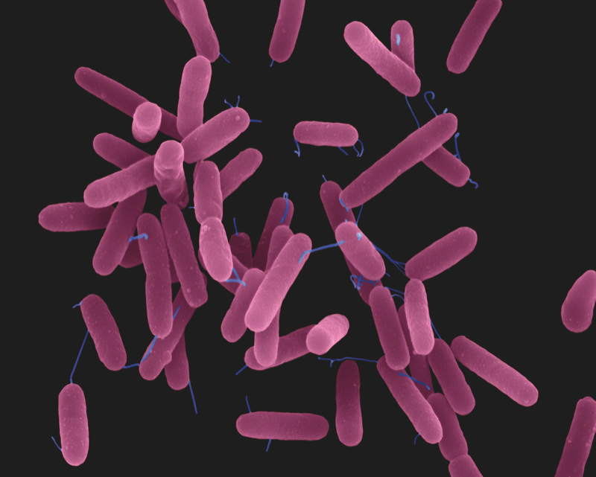
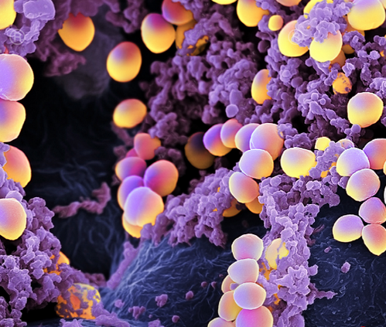
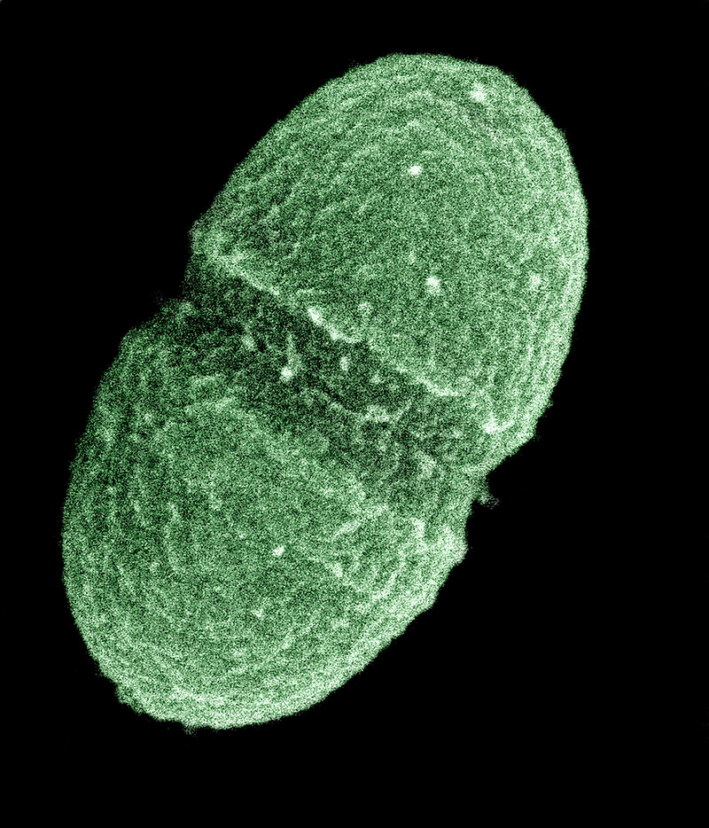
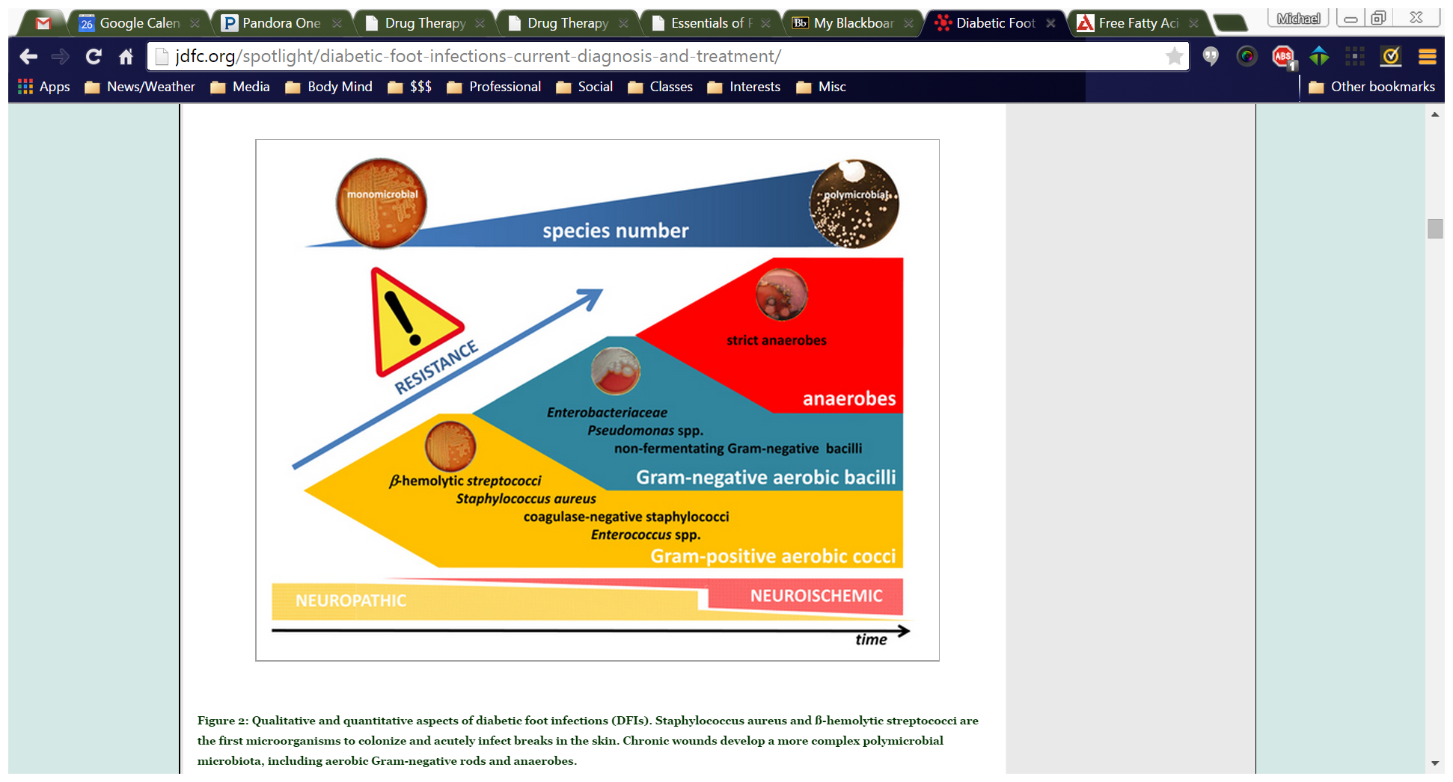
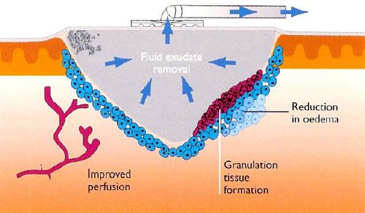
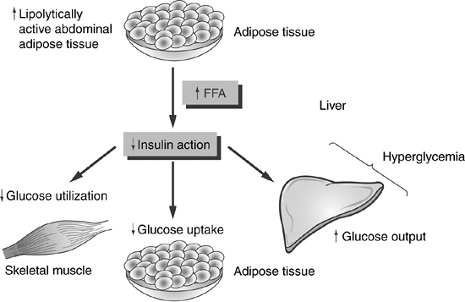
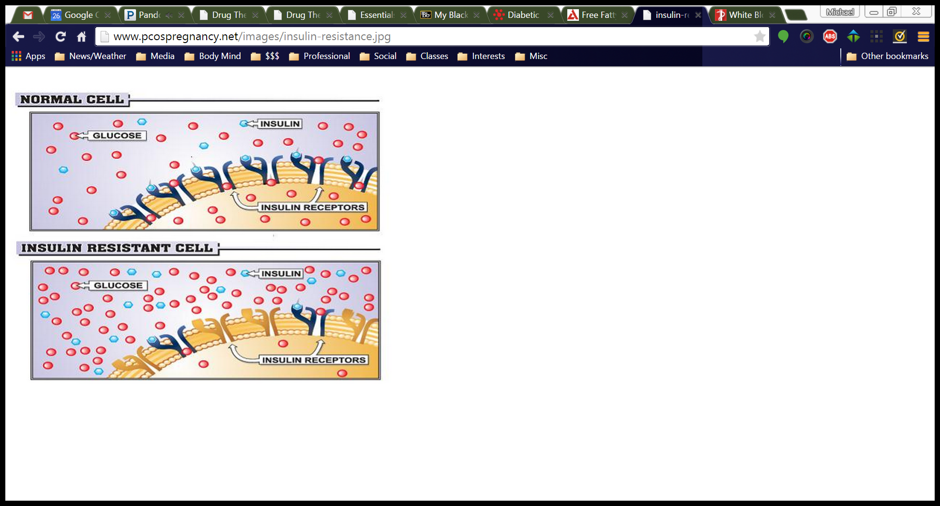
Michael Savage
Direct Entry Masters of Nursing
Pharmacology Case Study:
Uncontrolled Diabetes & Osteomyelitis
Core Patient Variables
67 Year Old Male BMI 57.9 Very Limited Mobility Live with family Divorced Non-Smoker Occasional ETOH Use Non Rec Drug User
Culture Present | Location | Notes | Image
Pseudomonas aeruginosa (G-) | Right Foot Wound | Assoc. with necrosis Aerobic
Staphylococcus aureus (G+) | Left Big Toe Wound | Can be AB resistant (eg. MRSA) Facultative Anaerobe
Enterococcus Species (G+) | Left Big Toe Wound | Resistant to many antibiotics Assoc. with osteomyelitis Facultative Anaerobe
Medications
Medication | Dose | Route | Frequency | Class | Indication
Dextrose (50% syringe) | 12.5 g | IV | PRN | Caloric Agent | Hypoglycemia
Warfarin Sodium (Coumadin)* | 5m g | PO | Once | Anticoagulants | Atrial Fibrillation
Furosemide (Lasix)* | 80 mg | PO | Daily | Diuretics | Edema
Hydrocortisone | As needed | Topical | BID PRN | Anti- Inflammatory | Rash
Digoxin* | 0.25 mg | PO | Daily | Cardiac | Arrhythmia
Metoprolol (Lopressor)* | 50 mg | PO | BID | Beta Blocker | HTN
Diphenhydramine | 25 mg | PO | Q4H PRN | Anti- histamine | Hyper-sensitivity
Valium (Diazepam)* | 10 mg | PO | Q8H PRN | Benzodiazepines | Anxiety & Spasms
Tylenol (Acetaminophen)* | 650 mg | PO | Q4H PRN | Analgesics | Minor/Mod Pain
Novolin 70/30* | 40 units | SC | Q24H | Insulin | Hyperglycemia
Dilaudid (Hydromorphone) | 0.25-0.5 mg | IV Push | Q4H PRN | Opiate Agonists | Major Pain
Senna (Senokot)* | 2 tabs | PO | QHS | Laxatives | Constipation
Daptomycin | 100 ml @ 200 ml/hr | IV | Q24H | Antibiotics | Infection
Situation
HTN: BP >150 systolic Paresthesia below knees Stage 4 Pressure Ulcer R Heel R Calcaneus Fracture Under Body Wt. Recent L Big Toe Amputation
Background
Poorly Controlled DM2 Diabetic Neuropathy Severe Peripheral Edema Venous Insufficiency Colon Cancer Chronic Atrial Fibrilation Hyperlipidemia Obesity Hypoventilation Syndrome Morbid Obesity
Chronic wounds develop a more complex polymicrobial microbiota, including aerobic Gram-negative rods and anaerobes.
A negative pressure wound vacuum was used to increase blood flow and increase healing. The bandage consisted of open cell foam adjacent to tissue and an occlusive dressing.
Diagnostics
Test | Value | Range
Digoxin | 0.9 | 0.8-2.0 ng/ml
WBC | 7.0 | 3.9–10.7 x 10^3 cells/μL
RBC | 4.5 | 4.7-6.1 x 10^6 cells/μL
Hct | 43.1 | 41-51%
Hgb | 14.3 | 13.5-17.5 g/dL
BUN | 23.2 | 7-20 mg/dL
Creatinine | 1.6 | 0.7-1.3 mg/dL
Platelet Count | 272 | 150–350 x 10 3 /μL
Neut # | 47.6% L | 54-62%
ESR | 81 H | 0-22 mm/hr
* Home Medication. Other Home meds include Lisinopril, Pravachol.
Recommendations
Plan for surgery on R calcaneus fracture as soon as possible Obtain MRI when patient can be mobilized. He requests not to walk without walker. Replace wound vacuums on L toe and R heel every other day Monitor FSBS and caloric intake Continue education on diabetes management
Assessment
Denies pain at rest Movement of R foot causes severe pain Pulse Irregular; rate 65 Temp: 97.1, Tympanic Respiratory Rate: 18 BP: 150/70 Oximetry: 95% on room air 2+ Pitting Edema on LLE/LRE No Sensation Below Knees Skin (below knees): Mottled, Ashen, Cool, Dry
Increased free fatty acids are linked to insulin resistance. This causes a positive feedback loop and explains why DM2 is strongly correlated with obesity.
References
Aschenbrenner, D. S., & Venable, S. J. (2012). Drug Therapy in Nursing (4 ed.). Philadelphia, PA: Wolters Kluwer Health | Lippincott Williams & Wilkins. Boden, G., She, P., Mozzoli, M., Cheung, P., Gumireddy, K., Reddy, P., ... Luo, Z. (2005, Decmeber 20, 2005). Free Fatty Acids Produce Insulin Resistance and Activate the Proinflammatory Nuclear Factor-κB Pathway in Rat Liver. American Diabetes Association, 54. http://dx.doi.org/10.2337 Mendes, J., & Neves, J. (2012, ). Diabetic Foot Infections: Current Diagnosis and Treatment. Journal of Diabetic Foot Complications, 4(2), 26-45. Retrieved from http://jdfc.org/spotlight/diabetic-foot-infections-current-diagnosis-and-treatment/ Porth, C. M. (2011). Essentials of Pathophysiology (3 ed.). Philadelphia, PA: Wolters Kluwer Health | Lippincott Williams & Wilkins.
Insulin Resistance is the result of cells’ inability to use insulin. This may be due to target cell defects or circulating antagonists.

