Slide 1

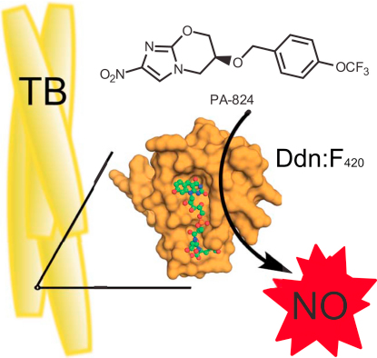
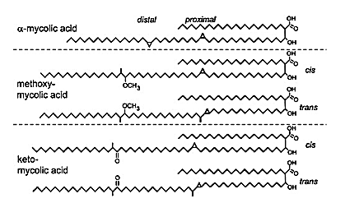
TBA-354, Nitroimidazoles, and their Effects Against Drug-Resistant Tuberculosis
By: Audrey E. Phillips, Department of Chemistry, University of New Hampshire, CHEM689
Introduction: The drug TBA-354 notroimidazole derivative is currently being tested by research groups at the University of Auckland and University of Illinois for the pharmacokinetic profile and activity against replicating and non-replicating tuberculosis. TBA-354 has exhibited results better than PA-824 and delaminid, two drugs further along in clinical research.
TBA-354: TBA-354 is a promising new antituberculosis nitroimidazole derivative that was tested for pharmacokinetic profile and activity against M. tuberculosis. The effects of TBA-354 were compared against PA-824 and delaminid, two other nitroimidazole derivatives proven effective against the bacteria. The researchers synthesized 170 compounds in an effort to find a drug effective against TB. ²
Results: TBA-354 was found to be activated by specific M. tuberculosis deazaflavin-dependent nitroreductase^{4.} Reactive nitrogen species are produced which inhibit mycolic acid biosynthesis.⁴
Background: Tuberculosis (TB) is caused by the bacteria Mycobacterium tuberculosis. The bacteria cell walls are rich in mycolic acids. These β-hydroxy fatty acid α alkyl side chains protect the bacteria from the bodies immune system allowing for the bacteria to replicate uninhibited.³
The oxazine alcohol reactant was a product from an earlier series of reactions. The alcohol was reacted with 2,4-(bromomethyl )pyridine via a simple alkylation of an alcohol to produce structure 160 from the study. Structure 160 and 4-(trifluoromethoxy)phenylboronic acid were reacted under Suzuki coupling conditions to produce TBA-354.²
This figure shows the breakdown of the nitroimidazole derivative PA-824 by deazaflavin-dependent nitroreductase into nitric oxide in M. tuberculosis¹
Results showed that TBA-354 had a larger potency in vivo than PA-824 due to TBA-354 having a longer half-life within mice. The pharmacokinetic profile of TBA-354 suggest the drug absorbs easily enough to be taken as a once-daily dose. In vitro studies predict low risk for drug-drug interactions.⁴
The figure shows the three different types of mycolic acids and their different cis and trans isomers³
Nitroimidazoles: Nitroimidazoles are a class of chemicals effective against drug-sensitive and drug resistant M. tuberculosis. They use bioreduction to form chemical species that attack the pathogen. ⁴
Future Work: The researchers plan to perform a comparison of efficacy of delamanid, PA-824, and TBA-354 in other mouse models as well as with different strains of M. tuberculosis. The contribution of TBA-354 to bactericidal and sterilizing efficacy of drug combinations must further be studied. More information is still needed on the safety and toxicology of TBA-354 as well.⁴
References:
¹Cellitti, S.E., Shaffer, J., Jones, D.H., Mukharjee, T., Gurumurthy, M., Bursulaya, B., Boshoff, H.I., Choi, I., Nayyar, A., Lee, Y.S., Cherian, J., Niyomrattanakit, P., Dick, T., Manjunatha, U.H., Barry, C.E., Spraggon, G., Geierstanger, B.H., Structure of Ddn, the Deazaflavin-Dependent Nitroreductase from Mycobacterium tuberculosis Involved in Bioreductive Activation of PA-824. Structure. 2012, 20, 101-112
²Kmentova,I., Sutherland, H.S., Palmer, B.D., Blaser, A., Franzblau, S.G., Wan, B., Wang, Y., Ma, Z., Denny, W.A., Thompson, A.M., Synthesis and Structur– Activity Relationships of Aza- and Diazabiphenyl Analogues of the Antitubercular Drug (6S)-2-Nitro-6-{[4-(trifluoromethoxy)benzyl]oxy}-6, 7-dihydro-5H-imidazo[2,1-b][1,3]oxazine (PA-824). J. Med. Chem. 2010, 53, 8421-8439
³Takayama, K., Wang, C., Besra, G.S., Pathway to Synthesis and Processing of Mycolic Acids in Mycobacterium tuberculosis. Clin. Microbiol. Rev. 2005, 18, 81-101
⁴Upton AM, Cho S, Yang TJ, Kim Y, Wang Y, Lu Y, Wang B, Xu J, Mdluli K, Ma Z, Franzblau SG. 2015. In vitro and in vivo activities of the nitroimidazole TBA- 354 against Mycobacterium tuberculosis. Antimicrob Agents Chemother 59:136 –144.

