Slide 1
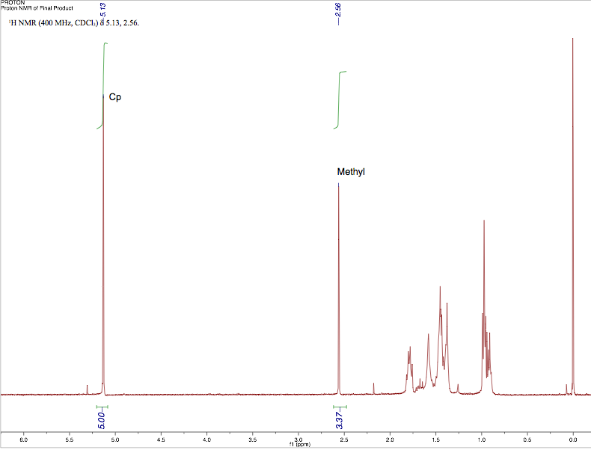
Synthesis of [MoCp(CO)₂(COCH₃)(P(n-Bu)₃)] : Investigation of an Air-Sensitive Migratory-Insertion
Ryan Hall, Luke Fulton, Roy Planalp
RLL367@wildcats.unh.edu; Parsons Hall, 23 Academic Way, Durham NH 03824
Introduction
Reactions producing a carbon-carbon bond are hugely important in organic synthesis. Amazingly, one way to produce this bond is with a mechanism unique to inorganic complexes. This reaction, generally called a migratory-insertion, is a reversible intramolecular reaction that can be forward-biased with the addition of a strongly-binding incoming ligand. This project utilized an inert atmosphere glove box to perform the air-and-moisture sensitive organometallic reactions shown below in Figure 1. The molybdenum-Cp moiety is found in similar complexes that possess catalytic activity¹. Investigation into the binding of an unreported phosphine complex, 3, can give insight into the selectivity of phosphine binding as it pertains to varying alkyl groups.
After purification, the air-stable product 2
was reintroduced to the glove box.
In order for the phosphine ligand to bind, the
metal electron count of 2 must be lowered.
The migratory-insertion is a way to reduce the metal
electron count, in this case from 18 to 16 electrons,
making phosphine binding possible.
Figure 5: Migratory-insertion and phosphine addition
C-H
Figure 1. General Synthetic Scheme
Results and Discussion
C-O
Figure 6. FT-IR spectrum of [Mo(CO)₂(COMe)(η⁵-C₅H₅)(P(n-butyl)₃]
Figure 7: ¹H NMR of [Mo(CO)₂(COMe)(η⁵-C₅H₅)(P(n-butyl)₃]
The FT-IR spectrum of the final product 3 shows alkyl C-H stretches, supporting successful phosphine binding. The ¹H NMR spectrum supports migratory-insertion success, since the methyl protons are now seen at 2.56 ppm. The geometry of the final complex 3 is determined to be trans due to the presence of two v. three carbonyl peaks in Figure 6.
Figure 2. Cleavage of Mo-Mo bond followed by methylation
Using a sodium/potassium alloy as a powerful reducing agent, the Mo-Mo bond can be severed. The resulting anionic molybdenum complex can then be subjected to methylation using CH₃I to form complex 2.
Future Work
Obtaining ³¹P{¹H} NMR to further confirm phosphine presence.
Obtaining ¹H NMR as a purity test on the phosphine, as PBu₃ can oxidize in air.
C-H
Conclusions
A small-scale migratory-insertion reaction was investigated. Both FT-IR and NMR interpretation support the successful formation of the final product 3. Phosphine addition has made the product of the carbon-carbon bond forming migratory-insertion reaction both isolable and air-stable.
C-O
Acknowledgments
I’d like to thank the Advanced Inorganic Chemistry Lab instructors for their assistance during the course of this project. I’d also like to thank the UNH Department of Chemistry for funding and the University Instrumentation Center for use of the NMR and IR Spectrometer.
C-O
Figure 3: FT-IR spectrum of [CpMo(CO)₃]₂ Figure 4: FT-IR spectrum of CpMo(CO)₃ (CH)₃
Comparing the two FT-IR spectra, there is strong evidence that the molybdenum bond was cleaved and methylation occurred. The carbonyl shift from 1850 → 1893 cm⁻¹ is indicative of a more electron-withdrawing substituent, CH₃ replacing the metal-metal bond.
References
(1) Neves, P.; Pereira, C.; Paz, F.; Gago, S.; Pillinger, M.; Silva, C.; Valente, A.; Romão, C.; Gonçalves, I. Cyclopentadienyl molybdenum dicarbonyl η³-allyl complexes as catalyst precursors for olefin epoxidation. Inorg. Chem., 2010, 695 (21), 2311– 2319.
(2) Whited, M.; Hofmeister, G. Synthesis and Migratory-Insertion Reactivity of CpMo(CO)₃(CH₃): Small-Scale Organometallic Preparations Utilizing Modern Glovebox Techniques J. Chem. Educ., 2014, 91 (7), 1050–1053.

