Slide 1

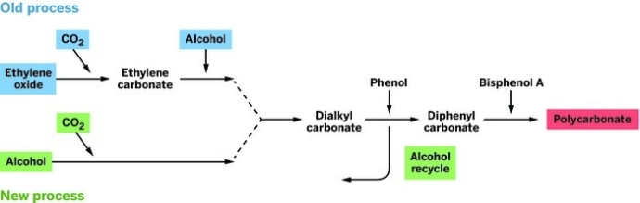
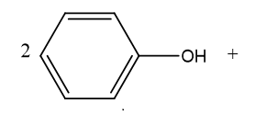
Greener Routes to Production of Polymers
Steven Young
Department of Chemistry, University of New Hampshire, Durham, NH
May 1, 2015
Introduction:
Asahi Kasei Chemicals has improved on their phosgene-free process to produce polycarbonate by removing the need of ethylene oxide. Discovering this process caused Asahi Kasei to be awarded the ACS Heroes of Chemistry Award in 2014.¹
Polycarbonate is a thermoplastic polymer used in a variety of applications. It is most commonly used in electronic and telecommunication hardware. Some other applications of polycarbonate include include construction, and data storage such as CD’s and DVD’s
There are currently three processes commonly used in industry to produce polycarbonate. One process involves using phosgene. A second process involves using ethylene oxide. A third process, being very similar to the process that uses ethylene oxide, uses methanol and carbon dioxide as a substitute for ethylene oxide.
Scheme 1: Process of producing polycarbonate using phosgene
In this process, bisphenol A is deprotonated using NaOH to form the diphenoxide. The diphenoxide then reacts with phosgene to produce a chloroformate, which reacts with another phenoxide to form polycarbonate and sodium chloride. This process is growing less common in industry considering phosgene is extremely hazardous.
Since the 1930’s, ethylene oxide (oxirane), C₂H₄O, has been used widely in industry in large-scale chemical production. It is commonly used in the production of plastics such as polycarbonate and polyethyleneglycols. Ethylene oxide is classified as a class 1 carcinogen by the International Agency for Research on Cancer (IARC)
Methanol and carbon dioxide react together with an inorganic catalyst to produce DMC.³ This produces DMC in one step. This process has been known for years, but is considered thermodynamically unstable because water is built up as a byproduct. Asahi Kasei discovered a catalyst to make this reaction much more favorable.⁴
Scheme 4: Producing diphenyl carbonate
DMC then goes through a transesterification with phenol and a catalyst to produce diphenyl carbonate. In this process methanol gets recycled.
Scheme 5: The final step in producing polycarbonate
Diphenyl Carbonate reacts via trans-esterification with bisphenol A to produce polycarbonate. These materials are melted and mixed together with a catalyst and heated to the trans-esterification temperature. (~200ᵒC) Phenol is given off as a vapor in this process.⁵
Conclusions and Future Work:
Asahi Kasei has improved on their phosgene-free process in producing polycarbonate. This process contains one less step than previously. Instead of a two-step process of using ethylene oxide to produce dimethyl carbonate, just a one step process is needed of reacting carbon dioxide and methanol. This process no longer requires the use of ethylene oxide
To validate the process for licensing, beginning in 2017, Asahi Kasei plans on starting up a 1000-metric-ton-per-year plant at Mizushima Works in Kurashiki, Japan.
Results and Discussion:
Scheme 2: Process of producing dimethyl carbonate (DMC) using ethylene oxide
In Asahi Kasei’s old process of producing the dialkyl carbonate, ethylene oxide reacts with carbon dioxide using an inorganic catalyst to produce ethylene carbonate. Ethylene carbonate then reacts with methanol using another inorganic catalyst to produce dimethyl carbonate as well as ethylene glycol. ²
Scheme 3: Process of producing dimethyl carbonate using methanol and CO₂
.
Acknowledgements:
Special thanks to the UNH Chemistry Department for the funding of this poster. Thanks to Professor Greenberg as well as Professor Wilkinson for their assistance and insight in this research.
References:
1. Thayer, Ann M. "Greener Routes to Polymers." Chemical and Engineering News. Chemical and Engineering News, 26 Jan. 2015. Web. 25 Feb. 2015. http://cen.acs.org/articles/93/i4/Greener-Routes-Polymers.html
2. 3. Okada, Y., T. Kondo, and S. Asaoka. "Dimethyl carbonate production for fuel additives." PREPRINTS OF PAPERS-AMERICAN CHEMICAL SOCIETY DIVISION FUEL CHEMISTRY 41 (1996): 868-873.
3. Ofélia de Queiroz F. Araújo, José Luiz de Medeiros and Rita Maria B. Alves (2014). CO2 Utilization: A Process Systems Engineering Vision, CO2 Sequestration and Valorization, Mr. Victor Esteves (Ed.), ISBN: 978-953-51-1225-9, InTech, DOI: 10.5772/57560.
4. Bian, Jun, et al. "Highly effective synthesis of dimethyl carbonate from methanol and carbon dioxide using a novel copper–nickel/graphite bimetallic nanocomposite catalyst." Chemical Engineering Journal 147.2 (2009): 287-296.
5. EPC Group. “Polycarbonate Production Plants’”. EPC.com [Online]. Accessed April 13, 2015.

