Slide 1


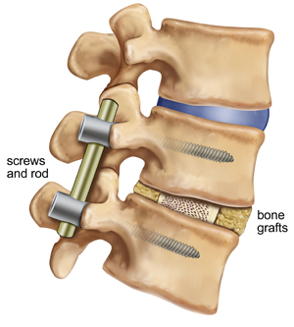
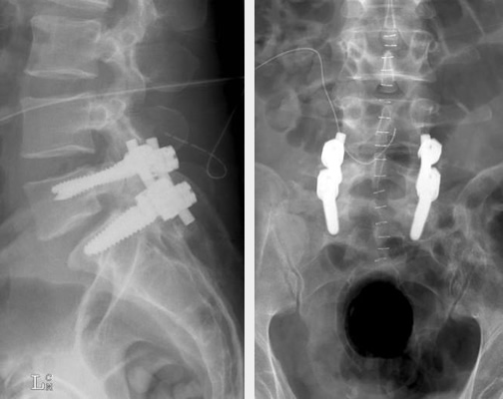
L5-S1 Spinal Infusion
Bryce St.Cyr
University of New Hampshire Direct Entry Master’s in Nursing
Assessment
Surgical Intervention
Medications
74 y/o white male, 6’ 2”- 230lb, with history of low back pain and bilateral lower limb radiculopathy, admitted for elective lumbar surgical intervention. Client is three days post-op from L5-S1 posterolateral instrumental infusion. Incision site is dry, approximated, and shows no signs of infection. Client has not had a bowel movement in four days; recently started on Magnesium Hydroxide 30mL prn 4 times daily. Client has been instructed to limit movement and requires a two person assist when out of bed. Client initially adhered to narcotic administration, but is now refusing due to constipation and risk for addiction and tolerance.
Vital Signs:
Oral Temperature: 97.7º F
Heart Rate: 96 bpm
Respiratory Rate: 18
Blood Pressure: 135/72
SpO₂: 95% on room air
Pain: 8/10
Medical History:
Sleep Apnea
Hypertension
Hyperlipidemia
Atrial Arrhythmia
Type 2 Diabetes Mellitus
Benign Prostate Hyperplasia
Removal of L5-S1 Synovial Cyst
L5-S1 Bilateral Facetectomy
L5-S1 Laminectomy
L5-S1 Bilateral Posterolateral Instrumental Fusion
Client Education
Client will maintain limited movement and use two person assist while in the hospital.
Upon discharge, client will wear a back brace at all times to limit movement for up to three months and will ambulate with a walking device per physical therapy order.
Upon discharge, client will verbalize signs and symptoms of infection and will notify the provider if infection occurs.
Client will continue use of prn pain medications/antibiotic medication and will follow frequency and dosage guidelines.
At three months post-op, client will begin physical therapy to regain range of motion and strength.
Client will have regular follow-up appointments with the surgeon to determine healing progression and continuity of care.
Client should be pain free and attain full mobility by six months post-op.
Lab Results
L5-S1 bilateral facetectomy and L5-S1 laminectomy were performed to reduce pressure on the spinal cord resulting in the elimination of radiculopathies. A bone graft was used between the articulating surfaces of the L5 and S1 vertebrae in combination with bilateral posterolateral instrumental infusion to decrease pain and eliminate movement.

