Slide 1

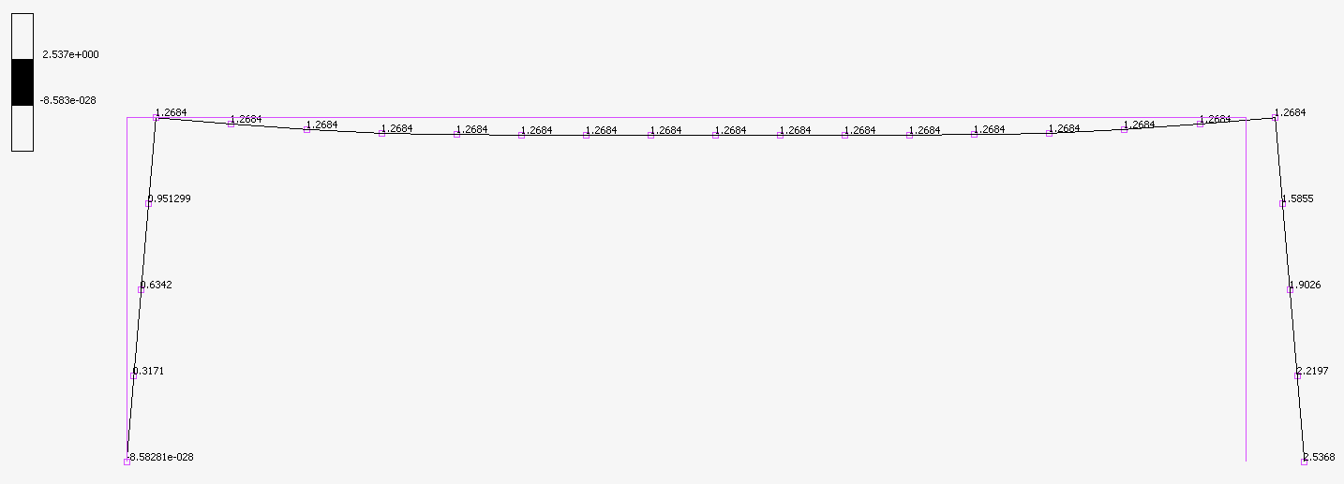
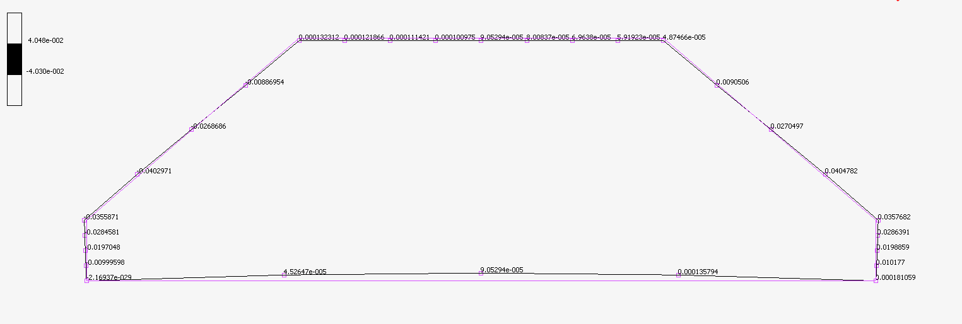
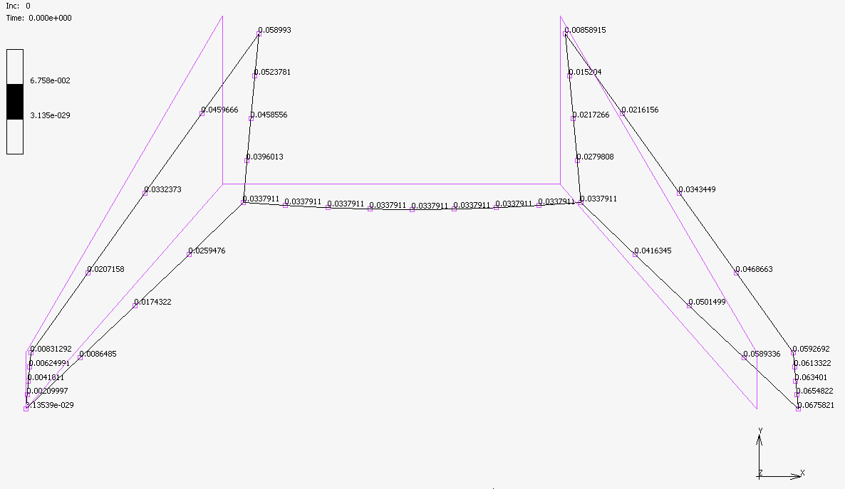
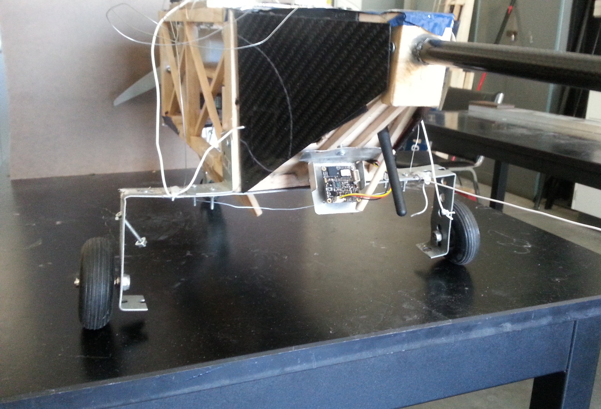
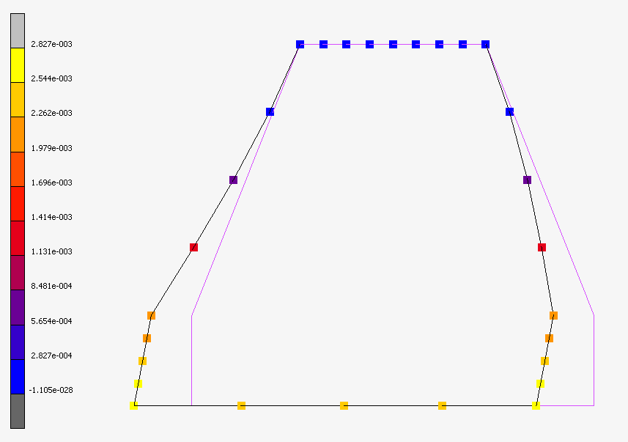
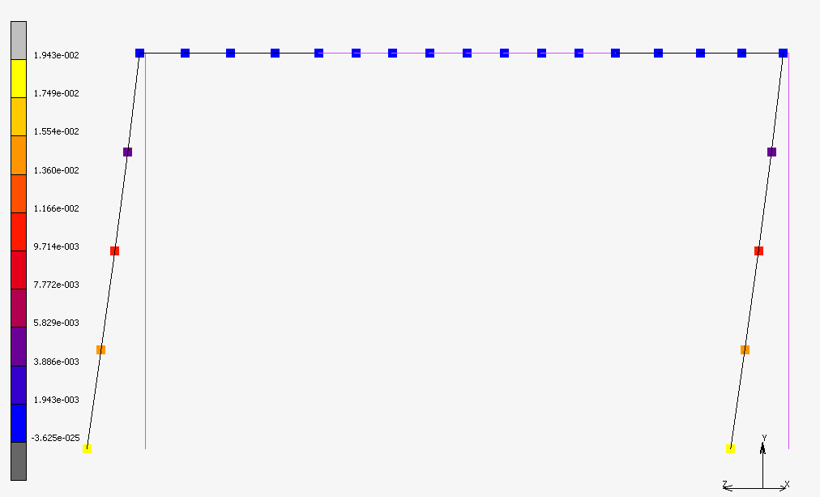
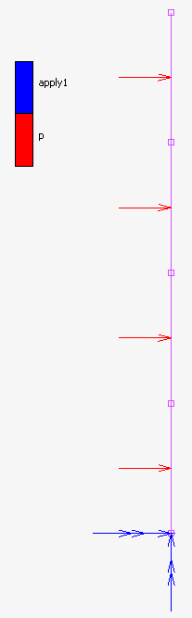
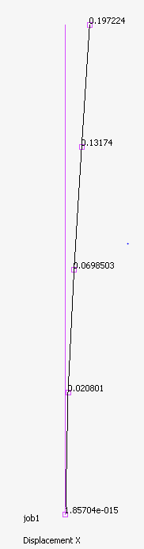
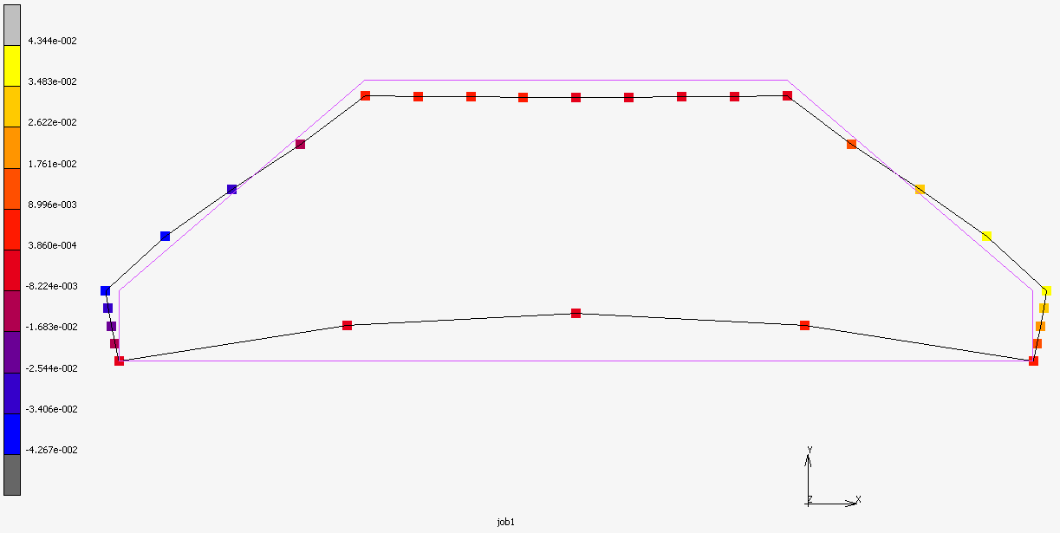
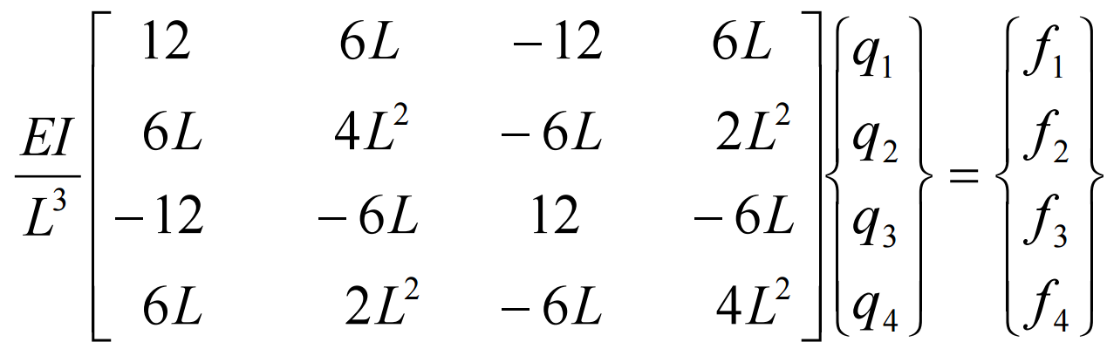
Steel Analysis
X-Deflection of Right Point of Steel Landing Gear
Cross-section | Original (in) | Alternative 1 (in) | Alternative 2 (in)
1.375 x .0625 | 2.54 | 0.036 | 0.0676
1 x .0625 | 3.49 | 0.0358 | 0.0676
.75 x .0625 | 4.65 | 0.0657 | 0.124
1.375 x .125 | 0.317 | 0.00451 | 0.00845
1 x .125 | 0.436 | 0.00621 | 0.0116
.75 x .125 | 0.581 | 0.00827 | 0.0155
Cross-section | Original (lbs) | Alternative 1 (lbs) | Alternative 2 (lbs)
1.375 x .0625 | 0.5131 | 0.7384 | 0.9068
1 x .0625 | 0.3732 | 0.537 | 0.6595
.75 x .0625 | 0.2799 | 0.4028 | 0.4946
1.375 x .125 | 1.0262 | 1.4768 | 1.8136
1 x .125 | 0.7464 | 1.074 | 1.319
.75 x .125 | 0.5598 | 0.8056 | 0.9892
Aerocats Landing Gear
ME 786
Lance Marstaller, Nathan Kowalczyk, Alex Neufeld, Brett Packard
Marc Displacements of original design made of steel
X-Deflection of Right Point of Carbon Fiber Landing Gear
Cross-section | Original (in) | Alternative 1 (in) | Alternative 2 (in)
1.375 x .0625 | 12.684 | 0.166 | 31.46
1 x .0625 | 17.44 | 0.23 | 43.258
.75 x .0625 | 23.25 | 0.305 | 57.68
1.375 x .125 | 1.585 | 0.021 | 3.93
1 x .125 | 2.18 | 0.029 | 5.41
.75 x .125 | 2.9 | 0.0385 | 7.213
Cross-section | Original (lbs) | Alternative 1 (lbs) | Alternative 2 (lbs)
1.375 x .0625 | 0.1304 | 0.1876 | 0.2304
1 x .0625 | 0.0948 | 0.1365 | 0.1676
.75 x .0625 | 0.0711 | 0.1023 | 0.1257
1.375 x .125 | 0.2608 | 0.3752 | 0.4608
1 x .125 | 0.1896 | 0.273 | 0.3352
.75 x .125 | 0.1422 | 0.2046 | 0.2514
Problem
The UNH AeroCats team designed and flew a plane at the SAE International Aero East Competition. The landing gear was not strong enough to withstand the landing force applied to the plane. The landing gear was also heavy adding to the overall weight of the plane. For next years team a better landing gear must be designed to ensure full flight success.
Marc analysis of redesign option 1
Landing Friction Force
Marc analysis of redesign option 2
Validation
Landing Gear Frictional Force Resulting Displacement and Stress
 | Original |  | Alternative 1
Cross-section | Displacement | Stress | Displacement | Stress
1.375 x .0625 | 0.01943 | 59.8745
.75 x .125 |  |  | 0.00867 | 75.9
Different landing gear designs were analyzed as well materials. The original landing gear seen in the figure above was made of bent steel and weighed approximately 1/2 pound (without wheels). In order to reduce weight, different beam cross sections and carbon fiber were compared to steel. Analysis was done using finite element analysis. The optimal landing gear is light and bend resistant.
Material Properties | Steel | Carbon Fiber
Young’s Modulus [E] (psi) | 2.7E7 psi | 5.8E6
Yield Stress (psi) | 29579 | 29007
Density (lb/in^3) | 0.284 | 0.0722
Carbon Fiber Alternative
Analysis
Three loads were applied to landing gear:
1. Direct Dynamic Impact Landing Force
Distributed impulse force of 13.75 pounds/inch.
2. Landing Friction Force
Calculated friction force of 19.94 pounds.
3. Resistance to Drag Force
Calculated to be under 0.06 pounds.
Validation of displacement of a beam element with a force applied in the x direction affirming hand calculations.
Carbon Fiber alternative of the chosen steel design
MARC MENTAT Finite Element Software was used to analyze the maximum displacement of the bottom leg of the landing gear. Boundary conditions on the landing gear include a pin restricting x,y,z motion on the bottom left node and a roller support restricting movement in the y direction on the bottom right node. The fuselage of the plane restricted rotation of the landing gear at the center six inches so a boundary condition restricting this was applied.
Conclusion
Based on the analysis performed in MARC and the requirements of the project, the team reached the conclusion that redesign option 1 should be pursued. This design made out of carbon fiber with a cross section .75” x .125”. This design would decrease the weight by 2.3 pounds or 60% while decreasing the deflection of the landing gear by 2.5 inches or 98%.
Hand calculations associated with beam validation

