Slide 1

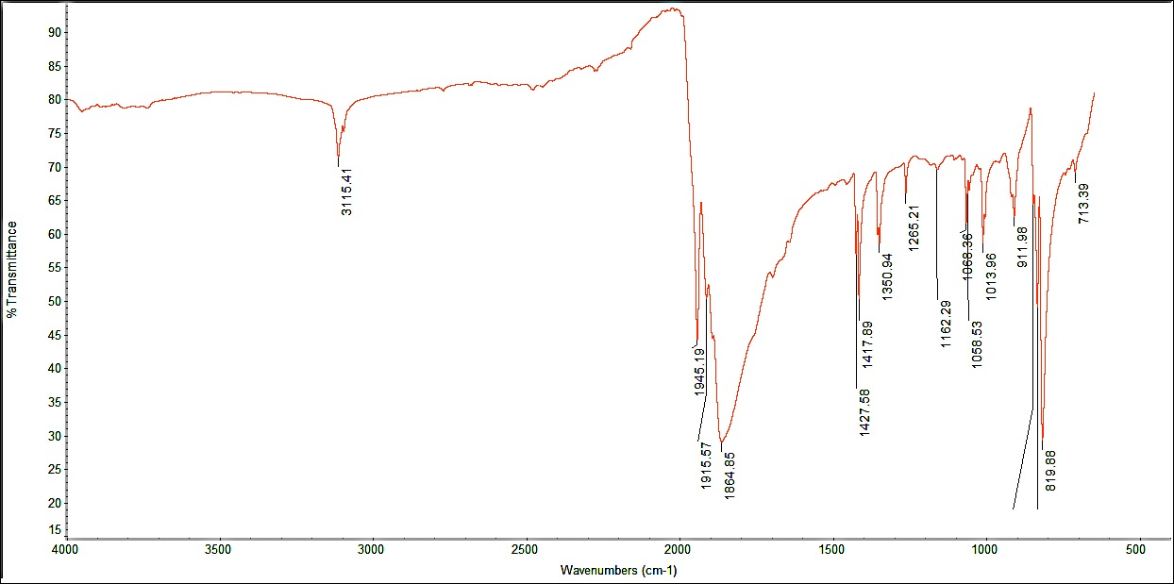
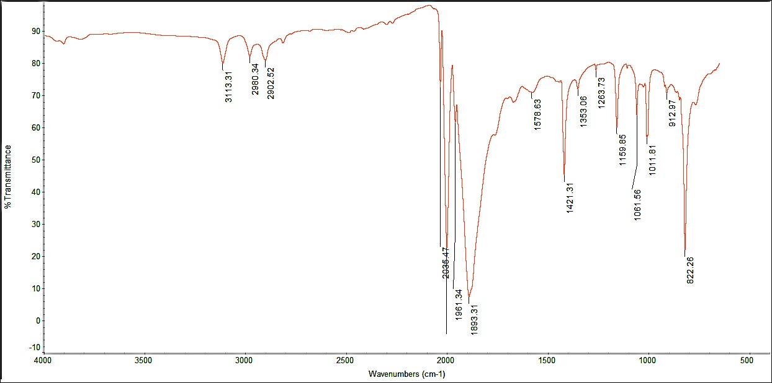
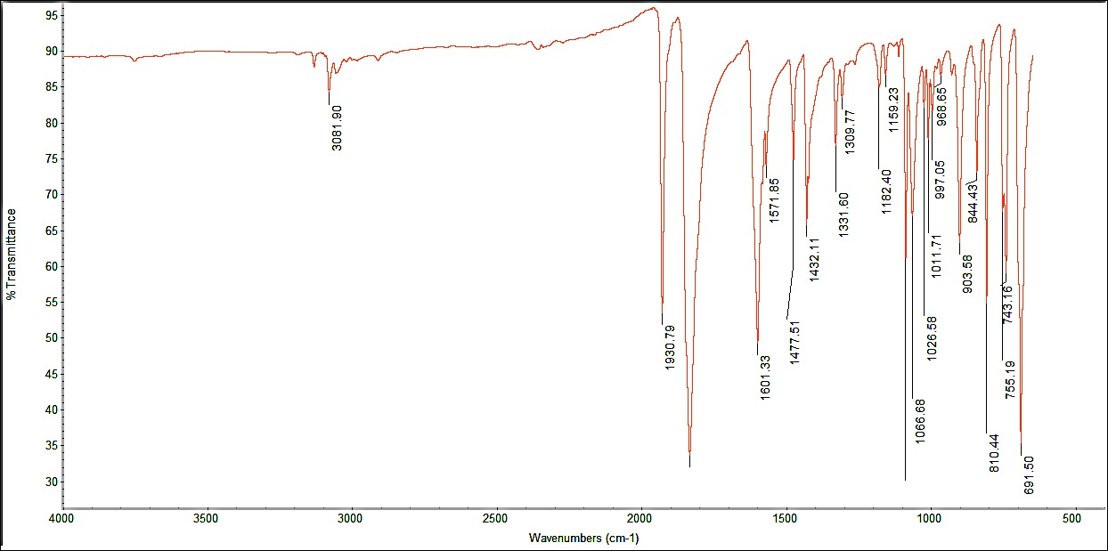
Synthesis and Phosphine-Induced Migratory-Insertion Reactivity of CpMo(CO)₃(CH₃)
Mark F. Cashman, Luke Futon*, Roy Planalp*
Department of Chemistry, University of New Hampshire, Durham, NH
4/30/15
Introduction:
In this experiment various cyclo-pentadienyl-supported molybdenum complexes will be prepared—using small scale glovebox and organometallic chemistry techniques—to assess the migratory-insertion reactivity of CpMo(CO)₃(CH₃), a stable, intermediate-product in the reaction mechanism. Migratory insertion is an organometallic reaction method wherein two ligands on the designated metal complex coalesce.¹ Often the full, electron-pushing mechanism for such reactions is unknown; rather, the mechanism is delineated by the overall regiochemistry of the ligand-migrated bond-interposition, which occurs between the most geometrically favored CO ligand and the CH₃ ligand of the CpMo(CO)₃(CH₃) complex, upon interaction with the designated incoming ligand (PPh₃).
Manipulating this migratory-insertion reactivity using various phosphine ligands can lead to various industrial applications. Literature suggests that Mo(II) acetyl derivative’s decarbonylation reactivity can be manipulated based on readily identifiable trends in the reactive-effects of bulkiness and electron-richness of the specific phosphine ligands, to explore and improve kinetic and spatiotemporal control.^{3,4}
Experimental:
The dihydrogen reduction of starting material Cp₂Mo₂(CO)_{6.} 1 was induced by sodium-potassium alloy—because triethylborohydride wasn’t a strong enough reducing agent.
All reactions and transfers took place in an inert-atmosphere glovebox and all solvents were anhydrous and purged thoroughly with nitrogen, due to the extreme oxygen and moisture sensitivity of the reactions.
NMR spectrum was gathered via a Varian 400MHz NMR spectrometer; IR spectra were gathered via an ATR-Nicole iS 10 FT-IR Spectrometer.
Results and Discussion:
The reaction mechanism (Scheme 1) will begin with the dihydrogen reduction of starting material Cp₂Mo₂(CO)₆ 1 via Na/K, breaking down the dimer, producing monomeric potassium complex salts: K[CpMo(CO)₃] 2, with a sodium hydride byproduct.
Scheme 1
The molybdenum salt 2 was subsequently reacted methyliodide (Scheme 2), via an S_{N­}2-type nucleophilic displacement, to produce CpMo(CO)₃(CH₃) 3, with a potassium iodide salt byproduct.
Scheme 2
CpMo(CO)₃(CH₃) 3 was further reacted—in the final step of the reaction mechanism—with PPh₃ (Scheme 3), via a phosphine-induced migratory insertion, producing the final product: CpMo(CO)₂(COCH₃)(PR₃) 4.²
Scheme 3
Isolated products 3 and 4 were analyzed and characterized via IR and NMR spectroscopic techniques. Interpreting the geometries of the Cp-supported molybdenum complexes and resulting reactivity effects will help stress the importance of symmetry considerations when characterizing resultant molecules.^{2,5}
IR spectra of starting material 1 and isolated product 3 were analyzed and compared for C=O stretches (1864.85, 1915.57, 1945.19 cm⁻¹ and 1893.31, 1961.34, 2035.47 cm⁻¹, respectively), retention of the Cp ring (3115.41 cm⁻¹ and 3113.31 cm⁻¹, respectively), and the addition of the CH₃ ligand (C-H stretches: 2860.52, 2902.52, and 2980.34 cm⁻¹). The number of C=O stretching bands indicates successful, unobstructed stereochemical binding of the desired CH₃ ligand in the product.
IR spectrum of product 4 was analyzed for C=O stretches (1835.89 and 1930.79 cm⁻¹) and aliphatic (2800-3000 cm⁻¹) and aromatic (3000-3200 cm⁻¹) stretches; NMR was analyzed for the Cp ring, phenyl substituents, and acetyl ligand formation via the migratory-insertion of a C=O ligand into the CH₃—Mo bond. The number of C=O stretching bands indicates the complex’s retention of all of the carbonyls throughout the mechanistic process; this coupled with the aromatic stretches of the phenyl substituents indicates the stereochemical formation of the acetyl ligand in the product, by exhibiting the successful binding of the phosphine ligand, which initiates the migratory-insertion of the carbonyl ligand. The NMR spectrum additionally indicates that a C=O ligand effectively underwent migratory-insertion with the CH₃ ligand by exhibiting the formation of the resulting acetyl ligand, the effective binding of the PPh₃ ligand to the complex, and the retention of the Cp ring still bound in the product.
Literature was consulted for comparison of experimentally gathered IR and NMR spectra.^{1,2,5}
Conclusions:
The extreme oxygen and moisture sensitivity of the starting materials and intermediates was surmounted via the delicate use of a pressure/atmosphere-controlled glovebox. By implementing all necessary precautions, undesired interference of external oxygen and water was minimalized, maximizing reaction efficiency.
IR and NMR analyses were performed on the isolated products and interpreted to ensure mechanistic success, characterize isolated complexes, and define purity.
Future Work:
The final synthesis step can be readily adapted to encumber a variety of commercially available phosphines, allowing for the characterization and reactivity-analysis of previously unreported complexes; this in-depth chemical analysis could further introduce new—and possibly improved—mechanistic pathways, for organometallic reactions involving catalysts (for example) of similar reactive-tendencies, by utilizing the unique and experimentally determined reactivity of these Cp-supported molybdenum complexes. This could lead to uncovering more fiscally and/or kinetically desired mechanistic pathways.
Figure 1: IR spectrum of starting material Cp₂Mo₂(CO)_{6.}
Figure 2: IR spectrum of stable, intermediate-product CpMo(CO)₃(CH₃)
Acknowledgements:
Special acknowledgements to Luke Futon and the Planalp Group, the Berda Group for their generous hospitality and overall gratuity, and the Department of Chemistry, UNH, for funding.
References:
Elschenbroich, C. ”Organometallics”. Wiley-VCH: Weinheim. 2006.
Whited, T. M., Hofmeister, E. G., Synthesis and Migratory-Insertion Reactivity of CpMo(CO)₃(CH­₃): Small-Scale Organometallic Preparations Utilizing Modern Glove-Box Techniques. Chem. Ed. Am. Chem. Soc. 2014, 91, 1050-1053.
Barnett, K. W.; Solomon, T. W.; Pollman, T. G. J. Organomet. Chem. 1972, 36, C23.
Barnett, K. W.; Pollmann, T. G. J. Organomet. Chem. 1974, 69, 413
(a) Bercaw, J. E. Chemistry 5b Laboratory Manual. http://chemistry.caltech.edu/courses/ch5/5bmanual.pdf (accessed Jul 2013); (b) Bercaw, J. E. California Institute of Technology, Pasadena, CA. Personal communication, 2009.
Figure 3: IR spectrum of purified final product CpMo(CO)₂(COCH₃)(PR₃)
Figure 4: NMR spectrum of purified final product CpMo(CO)₂(COCH₃)(PR₃)

