Slide 1
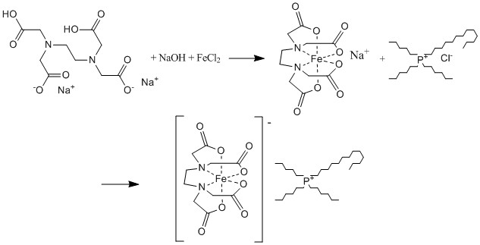
Electrochromic Transition Metal Based RT Ionic Liquids
Joshua Lewis, Luke Fulton, Dr. Roy Planalp , jjm73@wildcats.unh.edu; Parsons Hall, 23 Academic Way, Durham NH 03824
Introduction
An electrochromic material is a substance that changes its chemical properties upon oxidation or reduction by an electric potential that results in a change in the substances physical appearance based off absorption of the visible region of the EM spectrum. These materials are the basis of many “smart” optical devices that are currently being manufactured and used commercially. The synthesis that was performed can be seen below in Figure 1
Results and Discussion
From the IR spectra taken (Figure 2) the metal-EDTA complex was assumed successfully synthesized due to corresponding peaks. The Uv/Vis spectrum taken while performing potential controlled electrolysis on the RT-Ionic Liquid confirms that the electrochromic material was successfully synthesized. The spectrum clearly shows that upon reduction of [P_{6,} _{6,} _{6, 14}}⁺ [FeEDTA]⁻ the absorption in the visible light region decreases constituting the indication of an electrochromic material.
Figure 1. The multistep synthesis reaction for electrochromic RT ionic liquid.
Experimental
Disodium Ethylenediaminetetraacetato dihydride was dissolved in 1M NaOH and Iron (II) Chloride Tetrahydrate was added and heated until Na₂[FeEDTA] precipitated out, which was characterized by IR (Figure 2). Trihexyltetradecylphosponium Cloride [P_{6, 6, 6, 14.}]Cl was dissolved in ethanol and aqueous Na₂[FeEDTA] was added to solution and stirred for 24 hours to yield the Ionic Liquid.
The electrochromic properties were analyzed by Uv/Vis spectroscopic spectrum of the Ionic Liquid integrated with a potential controlled electrolysis being run in tandem.
Figure 3. Absorbance spectrum taken of the Ionic Liquid as it is reduced by electrolysis, Blue line: 0 mins; Orange: 5 mins; Grey: 20 mins; Yellow: 25 mins.
Future Work
If this experiment were to be repeated again the main focus of the experiment would be the use of different counter cations in the ionic liquid and its effect on oxidation/reduction rate.
Conclusions
The final product that was synthesized was in fact an electrochromic material based of analysis by electrolysis integrated Uv/Vis spectroscopy. Although the process was long and tedious a successful synthesis was performed.
Acknowledgments
We thank the Department of Chemistry, UNH, for funding and instrumentation, Luke Fulton and Professor Planalp for technical support.
References
[1] Branco, A. Electrochromic and magnetic ionic liquids. [Online] 2010.
[2] Hart, J. Roger. Ethylenediaminetetraacetic Acid and Related Chelating Agents. Ullmann's Encyclopedia of Industrial Chemistry.
Figure 2. The IR Spectrum taken of Na₂[FeEDTA] carbonyl peak at 1601.75 cm⁻¹ Carbon-Nitrogen peaks at 3381 and 3369 cm⁻¹ .

