Slide 1

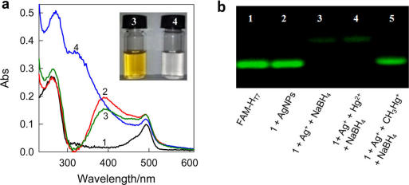
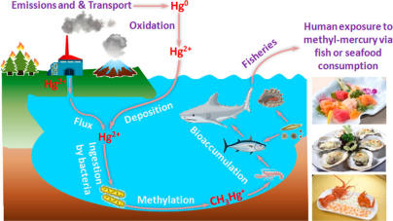
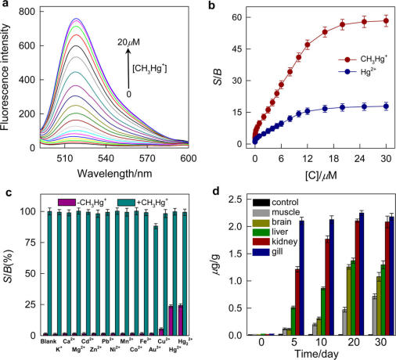
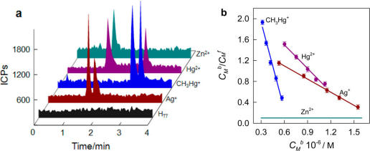
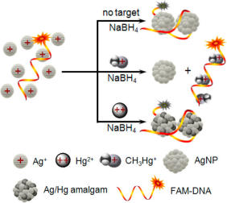
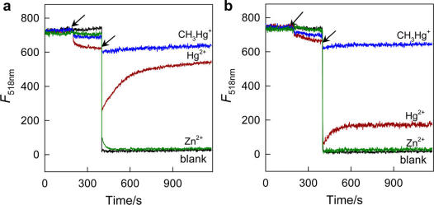
Detection Of Bioaccumulated Methyl-Mercury via Ag⁰/Hg⁰ Amalgamation
Presented By: Ryan Cox
background
methods
results
Methyl-mercury (CH₃Hg⁺) is a well known toxic substance that can cause severe tissue and neurological damage. This organic form of mercury, the most common and most toxic compared to other forms of mercury, is typically a problem within oceanic organisms such as fish where levels of methyl-mercury are consistently higher than the levels deemed safe by the EPA and WHO. Methyl-mercury is generated by bacteria which are then processed through the food chain to fish where it accumulates until human consumption.
Standard methods of detection of mercury typically include AA spectrometry, ICP atomic emission and ICPMS because of the low natural concentration of mercury in aquatic systems. Even though these methods are sensitive, they have the limitation of being able to only quantify the overall mercury content within the sample and not have the selectivity of quantifying just methyl-mercury.
Consequences of this are that further instrumentation separation is required. Typically this is done by GC or HPLC in order to properly separate and identify the different mercury species. All these processes together add up to a lot of time and money which gives an economical limitation on top of the analytical limitation described above.
Currently mercury specific sensors are being made via many different avenues; however these sensors are being made to detect the Hg²⁺ ion and not CH₃Hg⁺. Fluorescent sensors have also been developed but have shown greater selectivity of the Hg²⁺ ion and not CH₃Hg⁺.
The stock solutions of CH3Hg+ was prepared by first dissolving varying amounts of CH₃HgCl in dimethylformamide (DMF), diluting with highly pure water, and then stocked in 30% DMF at 4 °C.
The DNA-templated AgNPs were prepared using a procedure previously reported. An aliquot of stock solution of AgNO3 was transferred into a 1.0 mL volumetric pipe, and a certain volume of FAM-labeled DNA (FAM-HT7) stock solution was added. The mixed solution was diluted to 1.0 mL with Tris-HNO3 buffer to obtain final concentrations of 5.0 μM FAM-HT7 and 800 μM AgNO3. The solution was incubated at 0°C for 15 min to form the DNA/Ag+ complex and stored at 4°C for further usage.
For detection of CH₃Hg⁺ in buffer solutions, 5 μL of the DNA/Ag⁺ mixture were added to a 500 μL volumetric pipe containing 465 μL of Tris-HNO₃ buffer sample. Then 10 μL of CH₃HgCl solution of various concentrations were added. After incubating for 10 min with gentle shaking, 20 μL of NaBH₄ (1 mM) were added to the mixture. The samples were incubated for 10 min at room temperature before fluorescence measurement.
To test the hypothesis, a 25-mer T-rich DNA was designed according to the literature. Binding affinities of H_{T7} with Ag⁺, Hg²⁺, CH3Hg⁺, and Zn²⁺ (as a typical interfering agent) were studied by capillary electrophoresis with online inductively coupled plasma mass spectrometry (CE−ICPMS)45 and compared with those of a random DNA (H_{R}).
(a) UV/Vis spectra (b) Gel electrophoresis of products
(a)Fluorescence emission spectra of FAM-H_{T7}/Ag⁺ in the presence of different amounts of CH₃Hg⁺ (b) Response sensitivity, S/B, as functions of the concentrations of Hg²⁺ and CH₃Hg⁺ (c) The response sensitivity, S/B, of the sensing system for selected metal ions (10.0 μM, x-axis markers) and CH₃Hg⁺ (10.0 μM) + the metal ions (d) Time-dependence of CH₃Hg⁺ distribution in various tissue samples of crucian carp
Results
(a) Electropherograms (b) Scatchard plots
Fluorescence emission (a) FAM-H_{R} DNA (b) FAM-H_{T7} DNA
Hypothesis
Prove that through the natural process of silver/mercury amalgamation, in combination with a fluorophore labeled CH₃Hg⁺ -specific DNA probe, a more selective method of quantifying CH₃Hg⁺ can be done by means of fluorescence enhancement.
The design of the experiment is based upon the higher affinity of thymine (T)-rich DNA nucleotides for CH₃Hg⁺ over Hg²⁺ and the formation of silver/mercury amalgams . It is this difference in affinity and amalgam formation that provides the selectivity desired.
conclusions
Silver/mercury amalgamation combined with a CH₃Hg⁺ -specific DNA can be used to detect CH₃Hg⁺ with higher selectivity and sensitivity than other methods.
Based upon the higher affinity of nucleotide for CH₃Hg⁺ over Hg²⁺ and the formation of amalgams between Ag⁰ and Hg⁰ over CH₃Hg⁺, an optimal DNA was chosen.
The system can detect pico-molar concentrations and is not effected by 50x and 10⁶x levels of concentrations of Hg²⁺ and other metal ions respectively.
References: Deng, L.; Li, Y.; Yan, X.; Xiao J.; Ma C.; Zheng J.; Liu S.; Yang R.; Anal. Chem., 2015, 87 (4), pp 2452–2458, Publication Date (Web): January 22, 2015; http://pubs.acs.org/doi/abs/10.1021/ac504538v

