Slide 1

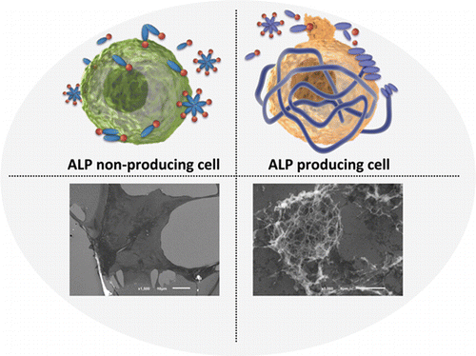
Self-Assembling Carbohydrates and their Application in the Fight Against Cancer
By: Kelly Hunt
University of New Hampshire, Department of Chemistry
Introduction and History
Experiment
Future Work
Many cells in the body are surrounded by an extracellular matrix. This is a web of biomolecules that surrounds the surface of the cell and provides structure. It then aids in communication between other cells and traps nutrients from the body.
This extracellular matrix gave scientists at Brandeis University an idea for a recent study. Bing Xu and his colleagues wanted to create a drug that would have minimal effects until it was initiated by a cancer cell. This initiation would cause the drug to form a matrix around the cell. Rather than providing nutrients and aiding the cell, this matrix would block any nutrients from coming in and waste from going out. Over time, this would eventually kill the cancer cell.
Alkaline phosphatase (ALP) is an enzyme that is given off in large quantities by cancer cells. This enzyme dephosphorylates molecules that it comes in contact with. Xu and his colleagues created a peptide with a phosphate group attached to one end. The phosphate group provided electrostatic repulsion, so the peptides wouldn’t bond together. With the phosphate group removed, the peptides became amphiphilic and could assemble into this nutrient-blocking matrix.
Rein V. Ulijn (City University of New York), Iva Pashkuleva (Univerisity of Minho), and their colleagues decided to make a drug with similar properties that was carbohydrate-based, leading to more diverse structures and new applications. They combined a hydrophobic aromatic group and the hydrophilic carbohydrate, glucosamine, bonded to a phosphate group. This created their amphiphilic drug, (N-fluorenylmethoxycarbonyl) glucosamine-6-phosphate.
A cancer cell producing ALP would be expected to remove the phosphate from the glucosamine end, initiating the drug’s reaction. The hydrophilic and hydrophobic ends then allow the creation of a ribbon-like structure to surround the cancer cell.
Separate cultures of bone cancer cells and healthy cartilage cells were made, and the same amount of the drug was added to each. The amount of ALP produced in the healthy cell culture was about 5% of that in the cancerous cell culture.
The cultures were incubated at 37°C in a 5% CO2 atmosphere.
Xu explained that the concentration needed to reach these results was much higher than a typical drug dosage. It is important to lower this dosage in the future to lower the chances of side effects.
The possible side effects of the drug also need to be determined with more testing.
15% of healthy cartilage cells died in this experiment. Although it is much lower than the 95% of cancerous cells, it’s important to minimize this number. In the future, more drugs should be made to target enzyme activity, but different enzymes than ALP should be targeted to find the most effective drug.
Conclusions
This study showed that targeting certain enzymes produced by cancer cells is a promising way to kill them.
95% of cancerous cells died, and only 15% of healthy cells died.
There is still much more testing to do with this drug before it could be available for use.
Figure 2
Glucosamine-6-phosphate (left) and 9-fluorenylmethyloxycarbonyl chloride (right).
References
[1] Pires, R.A.; Abul-Haija, Y.M.; Costa, D.S.; Novoa-Carballal, R.; Reis, R.L.; Ulijn, R.V.; Pashkuleva, I. Controlling Cancer Cell Fate Using Localized Biocatalytic Self-Assembly of an Aromatic Carbohydrate Amphiphile, J. Am. Chem. Soc., 2015, 137 (2), 576–579.
[2] Kuang, Y.; Shi, J.; Li, J.; Yuan, D.; Alberti, K.; Xu, Q.; Xu, B. Pericellular Hydrogel/Nanonets Inhibit Cancer Cells. Angewandte Chemie International Edition, 2014, 53(31), 8104-8107.
Results
After the cultures were incubated for seven hours, about 95% of the bone cancer cells had been killed. In the same amount of time, only 15% of the healthy cartilage cells were killed.
SEM images of the cultures, seen in the Figure 1, show a web-like hydrogel around the bone cancer cells (right), which produce much more ALP than the healthy cartilage cells (left).
The mechanism of the cell death is unknown, but Ulijn hypothesizes that the drug eventually suffocates the cell, blocking nutrients out and keeping waste in.
Acknowledgements
Figure 1: Artist representations (top) of the scanning electron micrographs (bottom) of the cartilage cells (left) vs. bone cancer cells (right) in the presence of the self-assembling drug.
Thanks to Patricia Wilkinson for help with the organization and clarification of information.
Thank you to the entirety of the UNH Chemistry Department.
Pires et. al.

