Slide 1

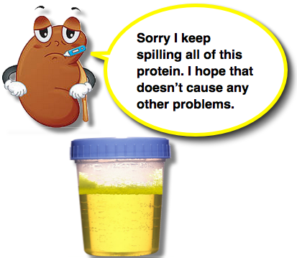
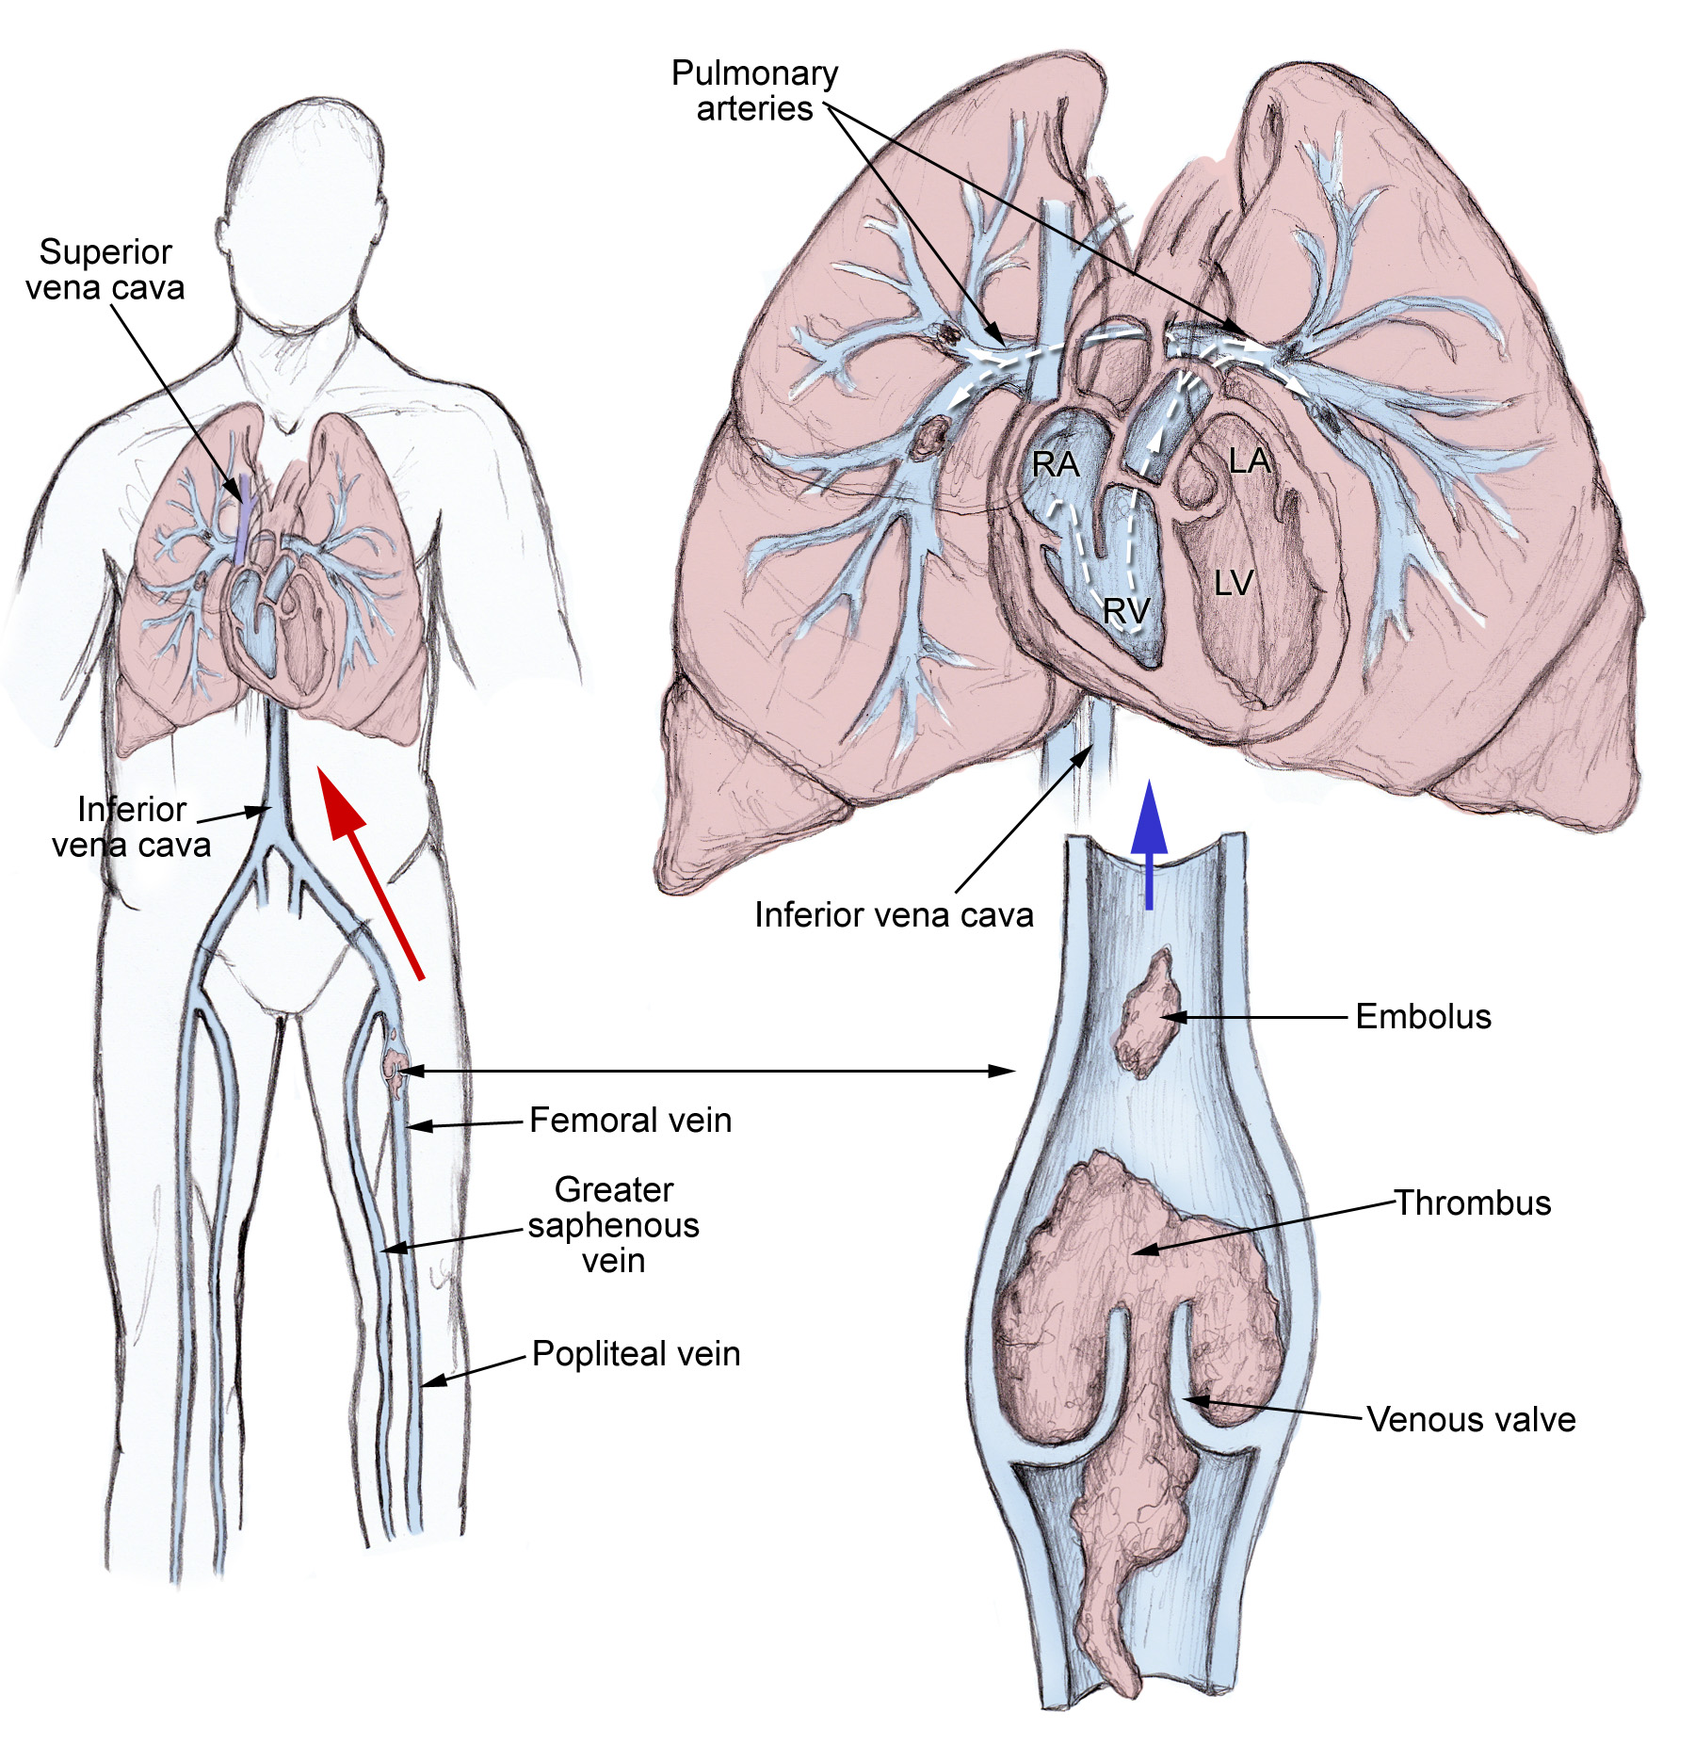
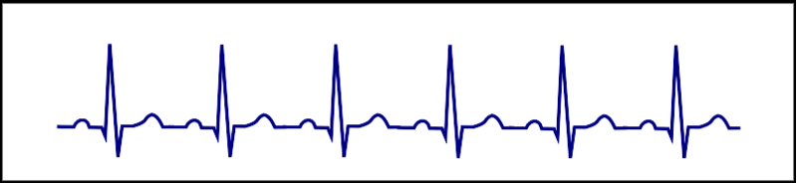
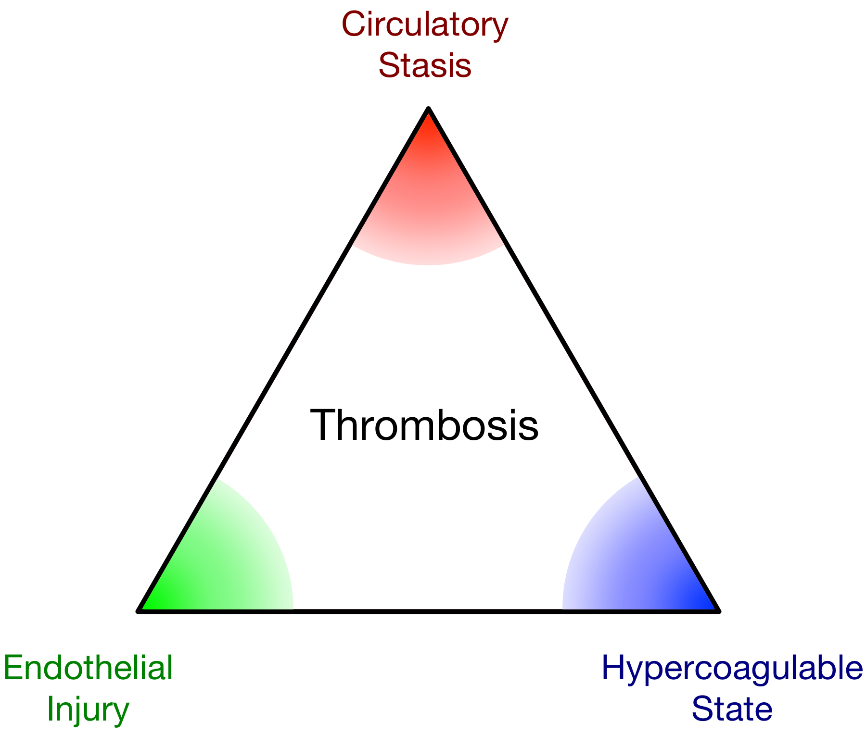
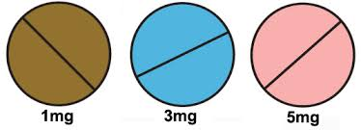
Pharmacology Case Study
Nursing Department: College of Health and Human Services
Meredith Willett
Diagnosis:
Pulmonary Embolism
Situation
Medical History
A 26 year-old Caucasian female presented to the Wildcat ED on 4/11/15, complaining of shortness of breath, right-sided chest discomfort (8/10), dyspnea upon exertion, and palpations for the past five days. She also recently noticed a cough producing bloody sputum.
Nephrotic Syndrome (MCD)
Osteopenia
Hypercholesterolemia
Depression
Anxiety
Narcotic abuse (past)
Labs
EKG: Sinus tachycardia - HR=130
CT Angiography: Significant DVT in the right pulmonary artery with minimal right pleural effusion. Scattered streaky lung opacities are likely atelectasis.
Risk Factors
Nephrotic Syndrome (MCD)
Birth control: Mirena IUD
Prolonged sitting: Computer desk job
Extended travel: Trip to D.E. 2 weeks prior
TEST | 4/11/15 | 4/13/15
Troponin | 0.05 ng/mL | -
PT (sec) | 10.6 | 14.9
INR | 1.0 | 1.5
PTT | 26.4 | -
Factor V Leiden Mutation | In progress | -
Lupus Anticoagulation Reflexive Panel | In progress | -
Pathophysiology
A pulmonary embolism (PE) is a partial or complete occlusion of a pulmonary artery or one of its branches, typically caused by a thrombus that originates in the deep veins of the legs or pelvis. A PE can also arise from a nonthrombotic source, such as a foreign body, air or amniotic fluid. Once the thrombus develops it can potentially dislodge and travel through the venous system and the right side of the heart, obstructing blood and oxygen supply. Consequences depend on several factors including size and number of emboli, underlying cardiopulmonary status, and the body’s intrinsic ability to dissolve the clot. Most massive clots lead to right ventricular failure, ultimately causing death.
Vitals
-HR: 104 -BP: 118/74 -Sat O2: 100% (1.5L/min-NC)
-RR: 16 -TEMP: 36.7 -PAIN: 6/10
*Allergies: Sulfa
Medications
DRUG | DOSE | ROUTE | FREQUENCY | CLASS | INDICATION
1. Acetaminophen | 1000 mg | PO | q6h | Analgesic & antipyretic | Minor aches & pain
2. Enoxaparin | 95 mg | SQ | q12h | Anticoagulant | Clot treatment & prophylaxis
3. Prednisone | 120 mg | PO | qod | Corticosteroid | Nephrotic Syndrome (MCD)
4. Oxycodone | 5 mg | PO | q4h | Opioid Antagonist | Severe pain
5. Warfarin | 1 note | PO | - | Anticoagulant | Clot treatment & prophylaxis
References
Merck Sharp & Dohme Corp. (2015). Pumonary Embolism (PE). Retrieved from http://www.merckmanuals.com/professional/pumonary.disorders/pulmonary.embolism.pe/pulmonary.embolism.pe
MedicineNet (2015). Pulmonary Embolism. Retrieved from http://www.medicinenet.com/pulmonary_embolism/article.htm
Mayo Clinic (2015). Pulmonary Embolism. Retrieved from http://www.mayoclinic.org/diseases-conditions/pulmonary-embolism/basics/definition/con-20022849

