Slide 1
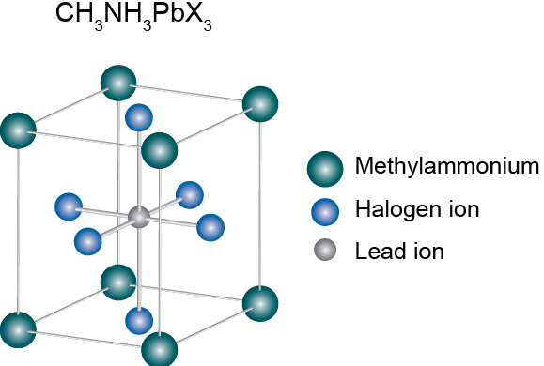
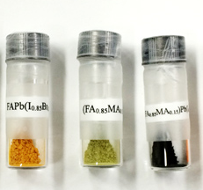
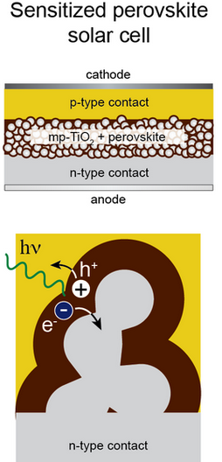
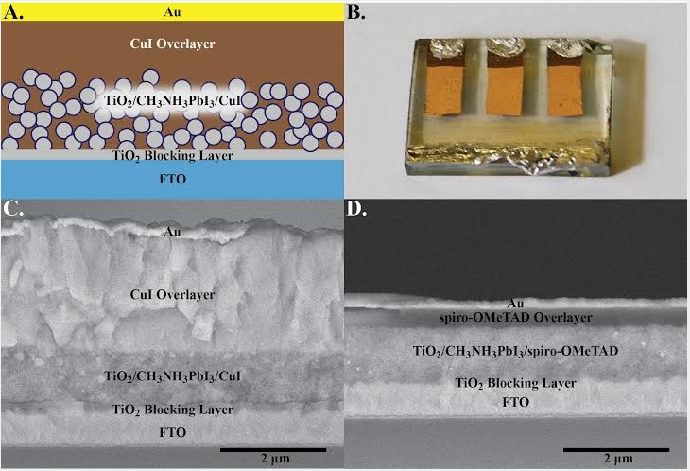
Efficiency Increase in Photovoltaic Solar Cells from Perovskite Semiconductor
Joshua Lewis, jjm73@wildcats.unh.edu; Parsons Hall, 23 Academic Way, Durham NH 03824
Introduction
Perovskite is an organo-metallic semiconducting material that can be integrated into photovoltaic (PV) solar cells as an absorptive compound. The perovskite solar cell has experimentally shown to have greater efficiency than traditional silicone based PV solar cell. The synthesis of perovskite material is also more simple and more cost effective than silicone based semiconducting absorbers.
Results and Discussion
Perovskite solar cells are thought to be the future of solar energy generation because of their cheap and simple synthesis as well as their performance over silicone based PV solar cells. The synthesis steps show the simplicity over silicone synthesis being readily synthesized in solution at low temperatures. The phenomenon of increased efficiency is more difficult to characterize. Two characteristics could help explain the efficiency boost, one being that perovskite solar cells have an electron-hole diffusion length much greater than silicone.³ Second being that crystalline silicone is a reflective material, meaning many photons are reflected rather than absorbed.
Figure 1. Crystalline structure of perovskite
Figure 2: Perovskite mixtures synthesized in lab
Experimental
Perovskite material can be synthesized in solution from readily available chemical reagents. Polycrystalline methylammonium Lead Iodine (MAPbI₃) can by synthesized by dissolving lead (II) acetate in 57% aqueous hydroiodic acid. Next methylammonia, also dissolved in aqueous hydroidoic acid, is added to the lead containing solution and the solution is cooled from 100° to 46°C over six hours and the perovskite compound is filtered out.¹
Polycrystalline silicone carbide nanoribbons used in silicone based PV solar cells can be synthesized as follows. Silicone powder, 99% pure, and carbon black powder, 99% pure, are placed in a reaction tube which is pressurized with ultra pure argon gas. The reaction tube is then heated from room temperature to 1500°C for 5-12 hours and then cooled back to room temperature and collected.²
Figure 4. How a Perovskite material is integrated into a PV solar cell.
Future Work
A current problem with perovskite solar cells is that perovskite material is highly sensitive to moisture which greatly decreases performance efficiency of the PV solar cell. Synthesis of more stable less sensitive perovskite mixture would allow for a longer lifetime therefore improved functionality.
Conclusions
Perovskite based solar cells, with enough research and development, are the future of commercially available photovoltaic solar cells based on their cheap efficient synthesis and their high performance.
References
[1] Baikie, Tom et al. Synthesis and crystal chemistry of the hybrid perovskite (CH3NH3)PbI3 for solid-state sensitized solar cell applications. J.Mater.Chem.A, 2013, 1.
[2] Zhang, Huan. Synthesis and Characterization of Silcone Carbide nanoribbons. Nanoscale Research Letters, 2010, 1.
[3] Stranks, Samuel D et al. Electron-Hole Diffusion Lengths Exceeding 1 Micrometer in a Organometal Trihalide Perovskite Absorber. Sciencemag, 342.
Figure 3. The synthesis reaction of MAPbI₃

