Slide 1


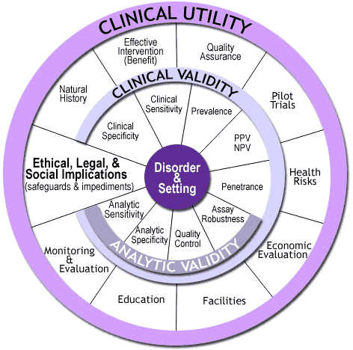
Ethical, Legal, and Social Implications of the Critical Congenital Heart Defect Screening Program
Emily Reddy, OTR
New England Genetics Collaborative (NEGC)
ELSI Results
The mission statement of the NEGC:
Both the NEGC and the LEND missions aim to improve health of children with special health care needs and improve overall systems of care for those children.
Stigmatization, Discrimination,
and Personal, Family and Social Issues
“The mission of the New England Genetics Collaborative (NEGC) is to promote and improve health and social well-being of those with inherited conditions through collaborations among public health professionals, private health professionals, educators, consumers and advocates in Maine, New Hampshire, Vermont, Massachusetts, Rhode Island and Connecticut. The NEGC is a partnership between the University of New Hampshire Institute on Disability, the Institute for Health Policy and Practice and Dartmouth Hitchcock Medical Center”
History of discrimination against individuals with genetic conditions
Question of informed consent and autonomy for child and family
Psychological impact on family
Societal impacts include:
  Effectiveness of test
  Appropriate use of test
  Financial and social barriers
Critical Congenital Heart Defect (CCHD)
Screening Program Description
ELSI Questions
Consent, Ownership and Reporting of Data
CCHD was added to list of recommended screenings in 2011
Collaborative project conducted in five New England States
NEGC aimed to develop processes to effectively screen for CCHD
CCHD is done through pulse oximetry test
Hospitals involved in the program must have follow up actions for failed pulse oximetry tests
I was responsible for answering the ELSI questions, which will ultimately be added to the full ACCE review of the CCHD screening program. The ELSI questions are:
Question 42: What is known about stigmatization, discrimination, privacy/confidentiality and personal/family social issues?
Question 43: Are there legal issues regarding consent, ownership of data and/or samples, patents, licensing, proprietary testing, obligation to disclose, or reporting requirements?
Question 44: What safeguards have been described and are these safeguards in place and effective?
Screening is done for every newborn without parental consent
Data is collected by public health agencies
Parents would prefer that they be notified every time their child’s data is used for research purposes
Physicians must disclose screening results to parents
Physician and hospital could be liable if screening is not performed or if appropriate follow up actions are not taken
CCHD Program Evaluation
Leadership
Safeguards
The NEGC is conducting an ACCE Review, which includes 44 questions addressing four main criteria:
  Analytic validity
  Clinical validity
  Clinical utility
  Ethical Legal and Social Implications (ELSI)
Through this Leadership In Action placement, I learned that it is vital that we assess the impacts of both the good and potentially harmful effects that programs have on people. Through our actions as leaders, it is crucial that we remain ethical, and do no harm to the people affected by our programs.
Through this project, I gained a deeper understanding of program evaluation. I learned the importance of communication when collaborating on portions of a larger project.
Genetic Information Non-discrimination Act (2008)
  Protects individuals from being excluded from health care or employment
Health Information Portability and Accountability Act
Hospitals involved in program have outlines of appropriate implementation of screening

