Slide 1

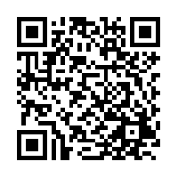
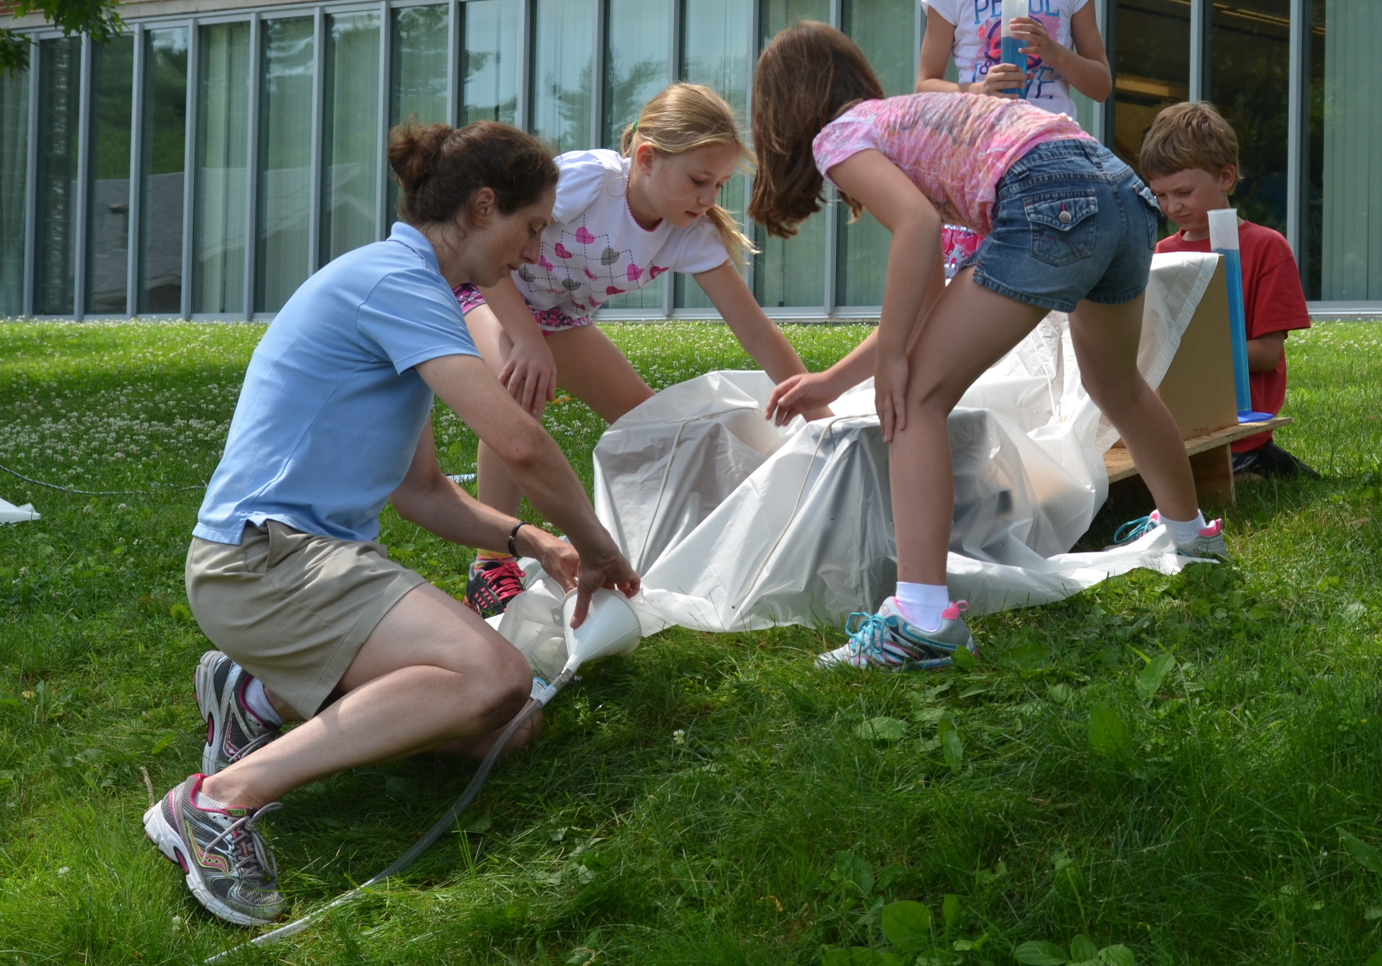
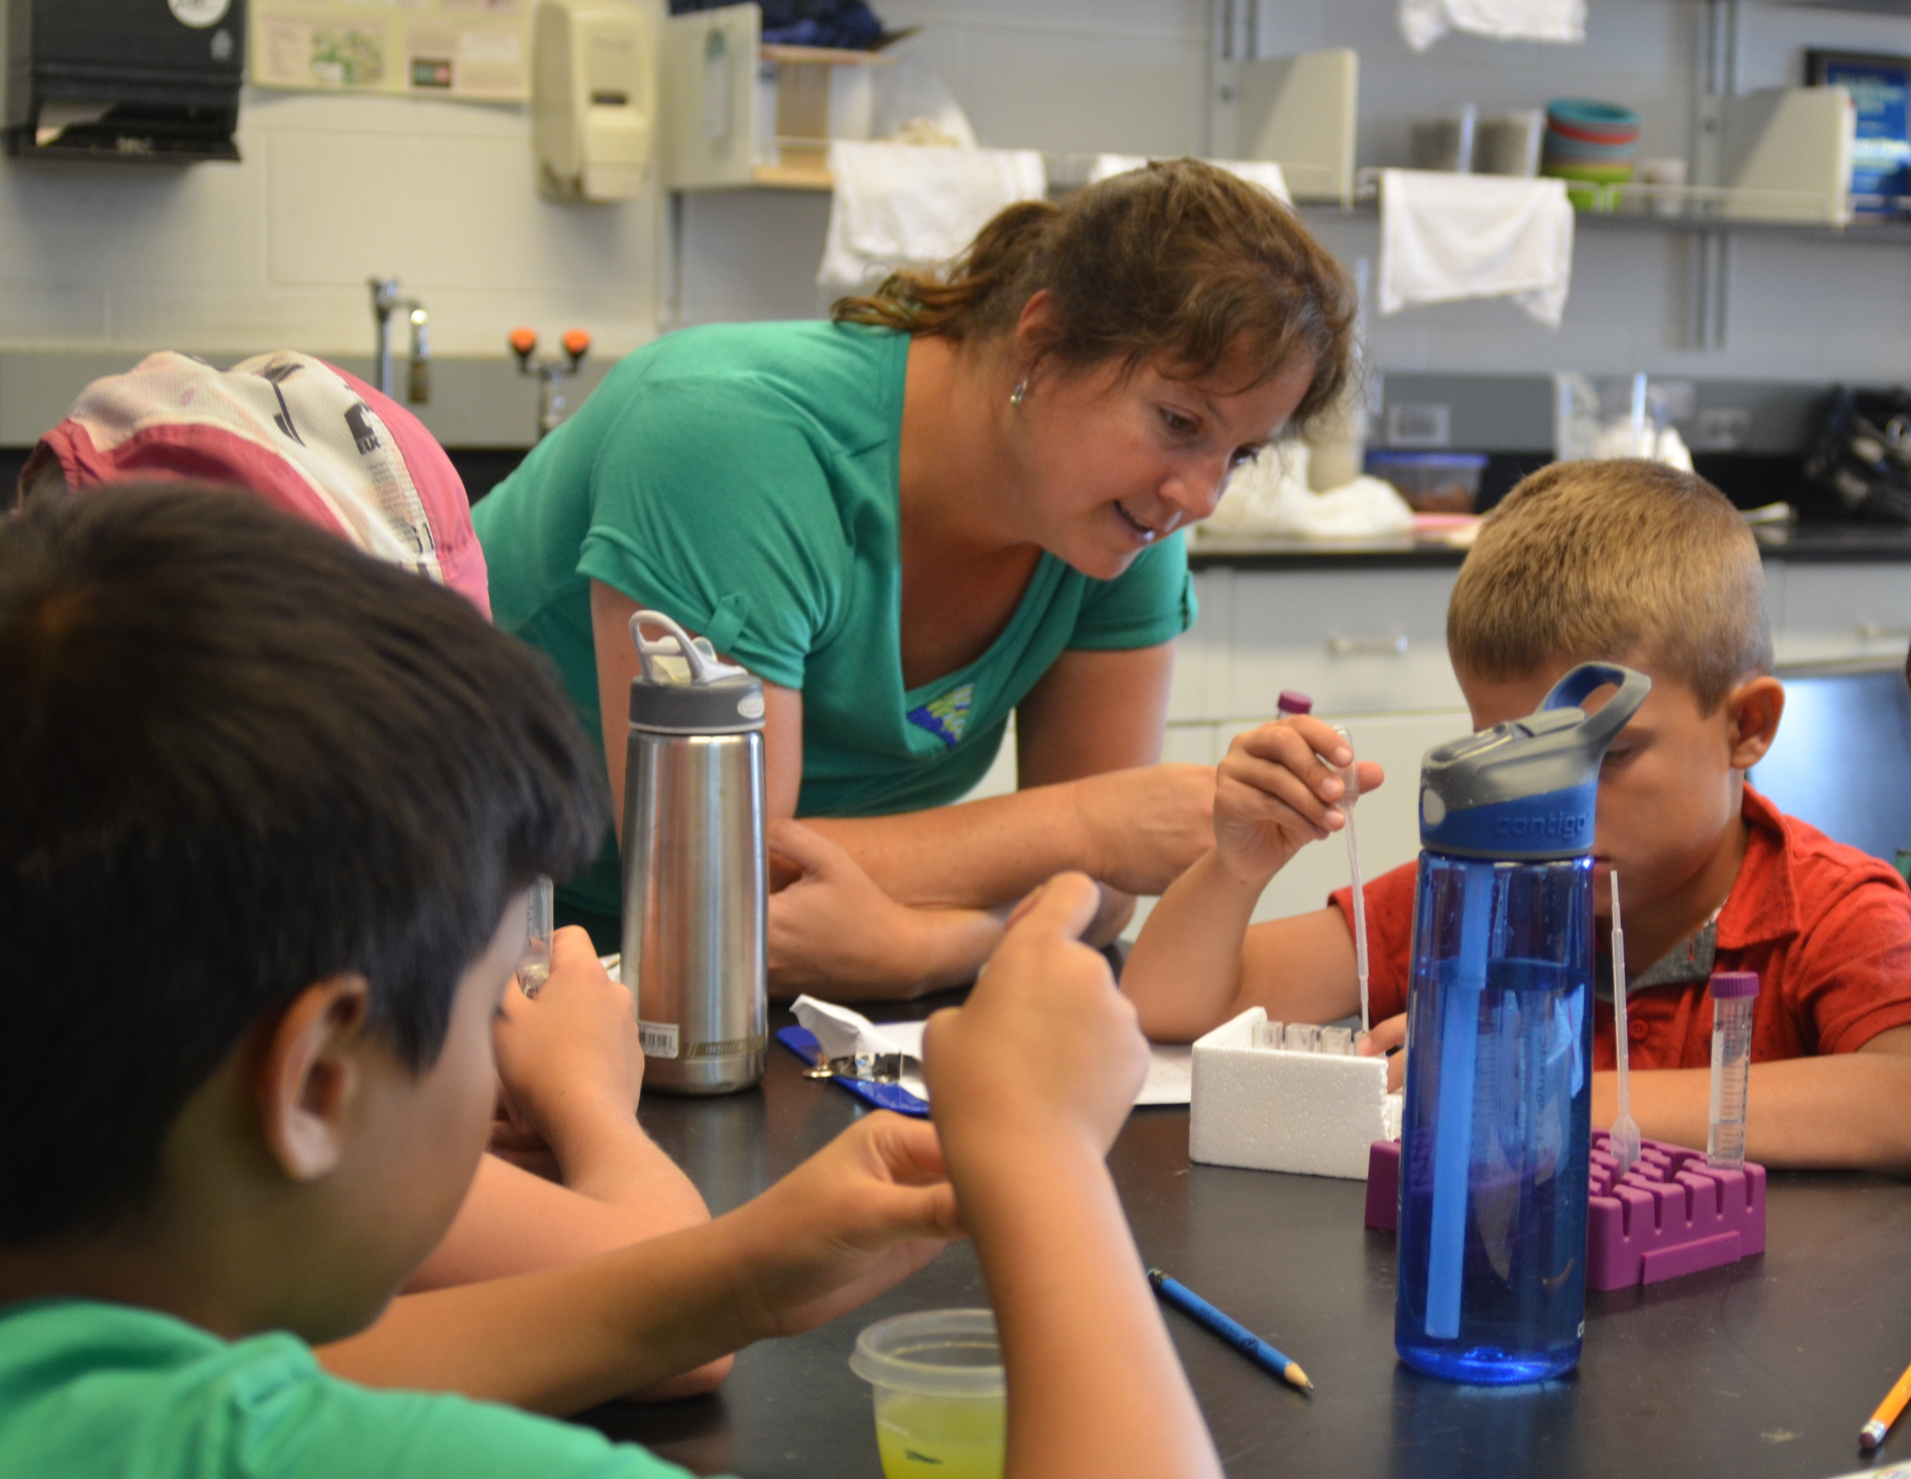
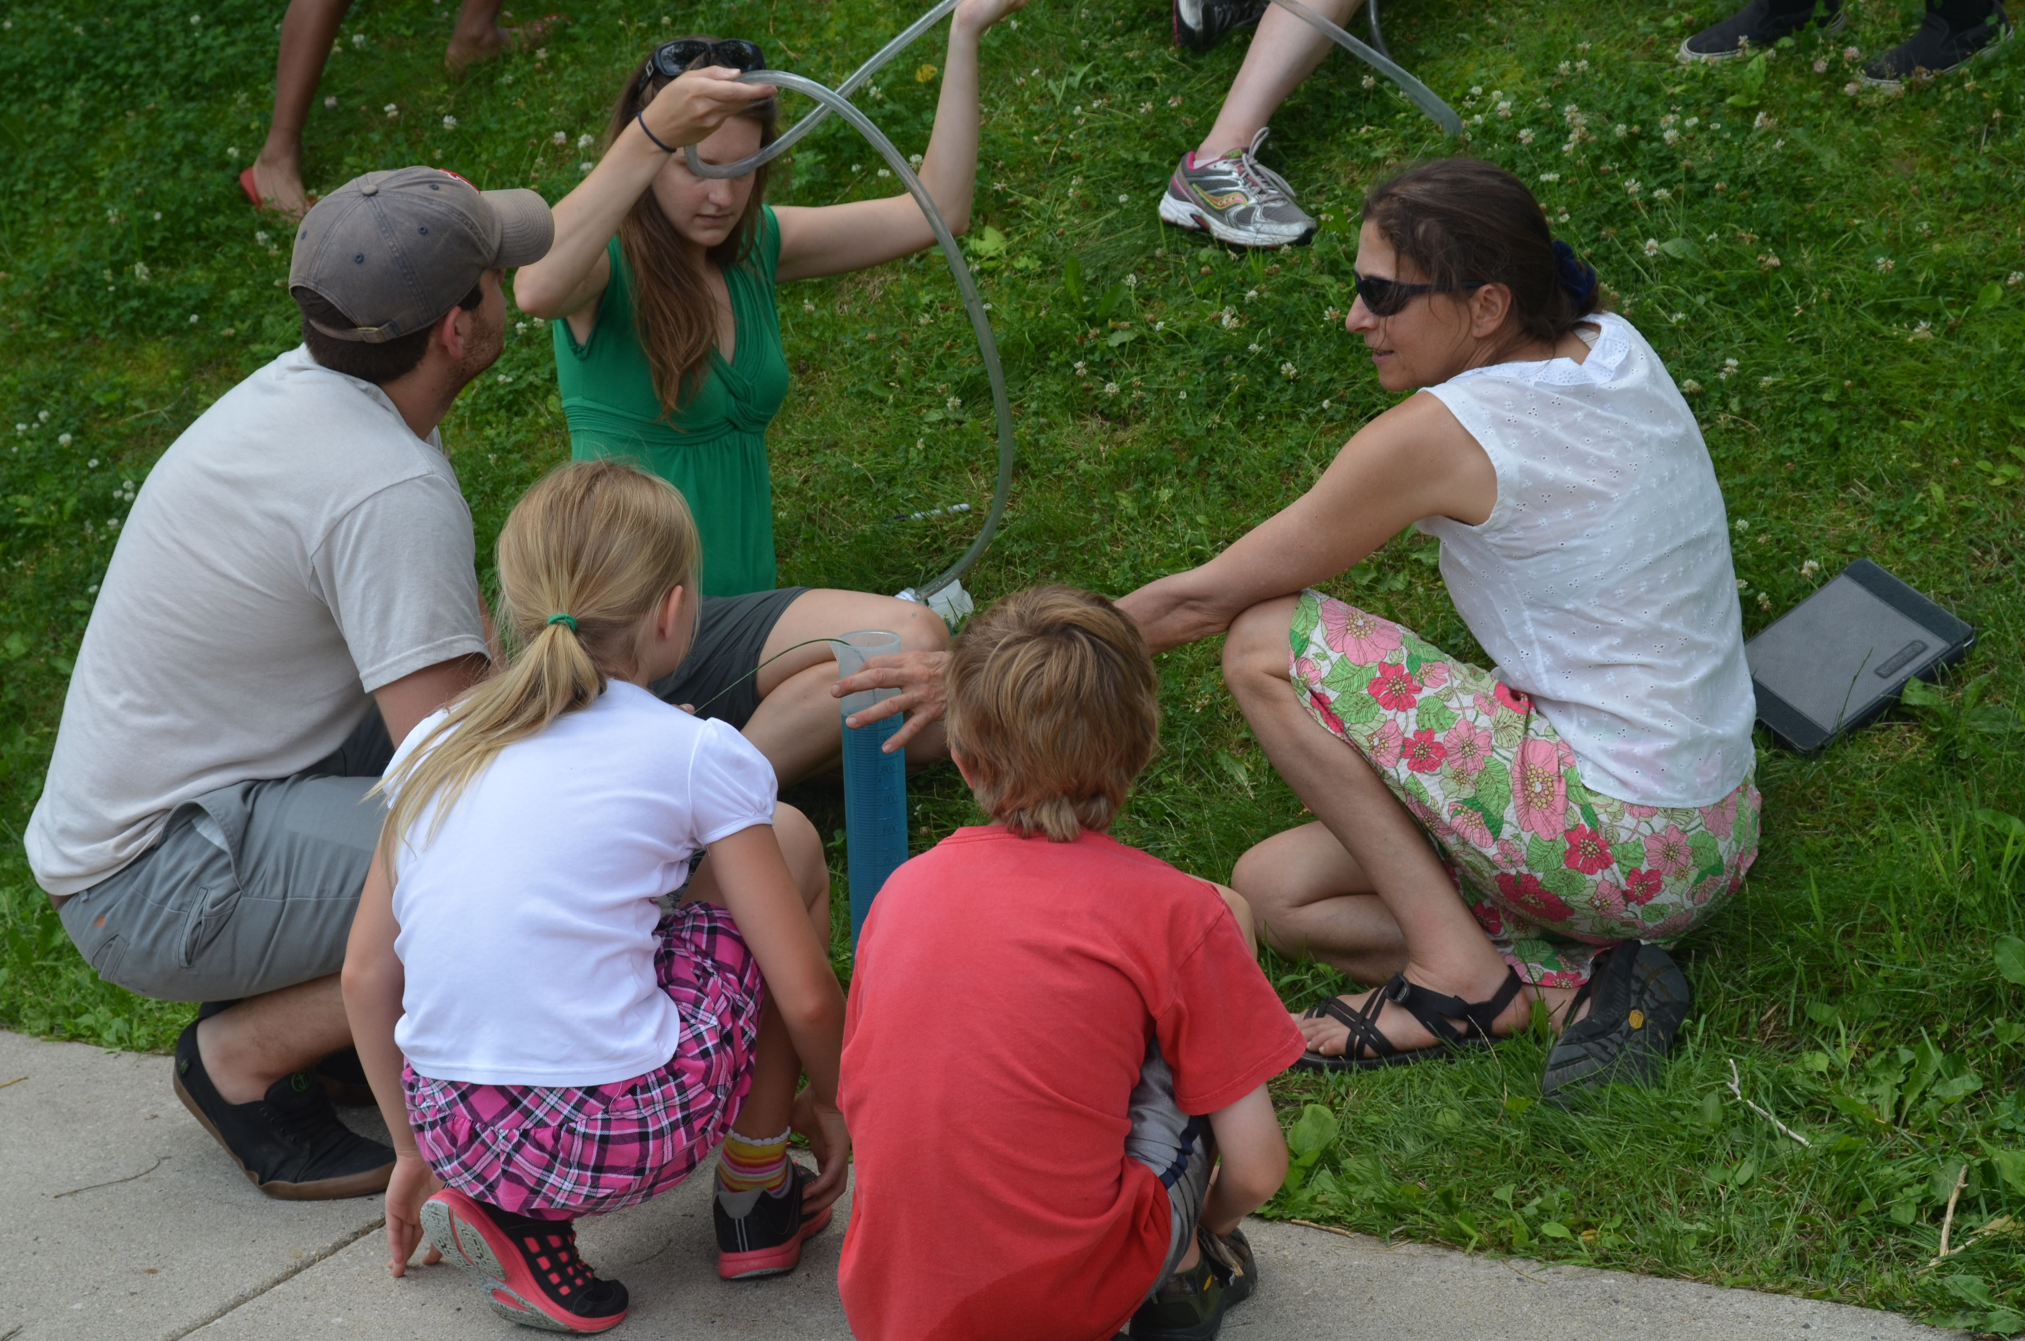
STEM TEACHERS COLLABORATIVE
Mission of the STEM TC
What is the STEM TC?
Coordinate and enhance capacity to strengthen STEM pathways through an interdisciplinary effort across the University
Identify priority areas to extend the impact of exemplary STEM educators to more youth in the region
Increase K-12 educators’ expertise in STEM fields
Educator Web Portal
Professional development and credit-bearing courses
Research-based and promising practices
Community of Practice
Focused on enhancing K-12 STEM education
Peer collaborations
Annual STEM Educators Summit with
Keynote speaker
Workshops
Panel discussions
Networking opportunities
Join the STEM TC today
To register for a free membership visit:
http://leitzelcenter.unh.edu/STEM-Teachers-Collaborative
For more information on the UNH STEM TC, email: STEM.teachers.collaborative@unh.edu

